Slide 1
UNIT 8: TOURISM
LESSON 2: A CLOSER LOOK 1
TEACHER: NGUYEN THU HANG

Slide 2
VOCABULARY

Slide 3
expedition /ˌekspəˈdɪʃn/ (n) an organized journey with a particular purpose, especially to find out about a place that is not well known
excursion/ɪkˈskɜːʃn/ (n) a short journey made for pleasure, especially one that has been organized for a group of people.
chuyến thám hiểm
chuyến tham quan

Slide 4
1. Match each word/phrase with a definition.
trip travel expedition
resort tour tour guide
1. A journey, usually for pleasure, to visit different places:
2. A place where a lot of people go on holiday:
3. The act or activity of moving from one place to another:
4. A person who shows tourists around:
5. A short journey to a place, especially one for pleasure:
6. An organised journey to a place that is not easy to reach:
tour
resort
travel
tour guide
trip
tour guide
expedition

Slide 5
2. Fill each blank with a word from the list. There are two extra words.
visit travel environment holiday book
guides pleased excursion reasonable trip
Would you like to explore an exciting location? Do you want to (1)__________ to a beautiful, relaxing beach, and help to save the environment? If the answer is yes, then you should (2)_____ your holiday with EcoTours! At EcoTours, we help you enjoy your holiday and learn more about the places you (3)_______ . In addition, EcoTours gives one dollar of the cost of your trip to help protect the local (4)_________ . Call us today to talk with one of our experienced tour (5)_____ . We’ll help you choose and plan a stimulating (6)______ that is right for you! Our holidays are definitely not boring. Don’t worry about the cost. Our prices are very (7)_________ . Call right now at (048) 555-6788. You’ll be (8) _________ with your EcoTours vacation.
travel
book
visit
environment
guides
holiday
reasonable
pleased

Slide 6
Compound Nouns

Slide 7
Compound noun (Danh từ ghép) có thể được thành lập bởi sự kết hợp giữa:
noun | + | noun | bus stop | Is this the bus stop for the number 12 bus?
 |  |  | fire-fly | In the tropics you can see fire-flies at night.
 |  |  | football | Shall we play football today?
adjective | + | noun | full moon | I always feel crazy at full moon.
 |  |  | blackboard | Clean the blackboard please.
 |  |  | software | I can’t install this software on my PC.
verb(-ing) | + | noun | breakfast | We always eat breakfast at 8am.
 |  |  | washing machine | Put the clothes in the red washing machine.
 |  |  | swimming pool | What a beautiful swimming pool!
noun | + | verb(-ing) | sunrise | I like to get up at sunrise.
 |  |  | haircut | You need a haircut.
 |  |  | train-spotting | His hobby is train-spotting.
verb | + | preposition | check-out | Please remember that check-out is at 12 noon.
noun | + | prepositional phrase | mother-in-law | My mother-in-law lives with us.
preposition | + | noun | underworld | Do you think the police accept money from the underworld?
noun | + | adjective | truckful | We need 10 truckfuls of bricks.

Slide 8
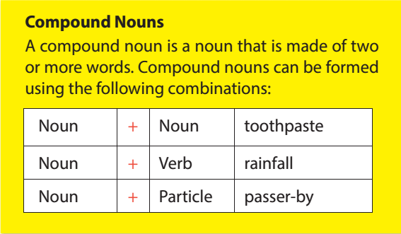
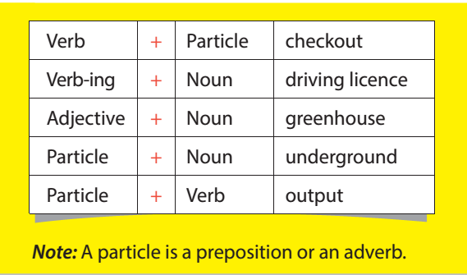

Slide 9
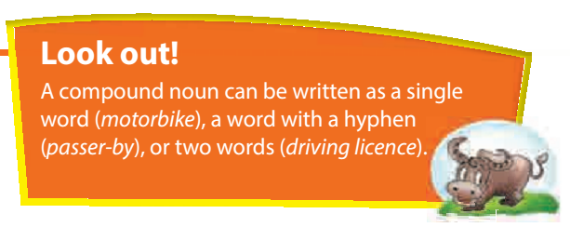

Slide 10
3. Use the words below to complete the compound nouns that match the definitions.
1. A feeling of tiredness and confusion about time after a long plane journey: jet______
2. A disadvantage or problem that makes something a less attractive idea: draw________
3. A short stay somewhere between two parts of a journey: stop_____
4. A popular time of the year for holidays: peak______
5. The place where you go first when you arrive at an airport, to show your ticket: check_____
6. A place at the side of a road marked with a sign, where buses stop: bus______
lag
back
over
season
-in
stop

Slide 11
4. Complete the sentences using the compound nouns below.
checkout
1. The_________ time is 12 noon at this hotel.
2. Let’s make sure that we stay at a hotel with a _____________.
3. There was a ________ with our tickets – we were charged for one-way tickets and not a round trip.
4. The motorway was blocked because there had been a _________.
5. After __________ , please remain seated until the aircraft comes to a standstill outside the terminal building.
6. At the hotel, you can choose between bed and breakfast, and __________ .
swimming pool
mix-up
pile-up
touchdown
full board

Slide 12
PRONUNCIATION

Slide 13
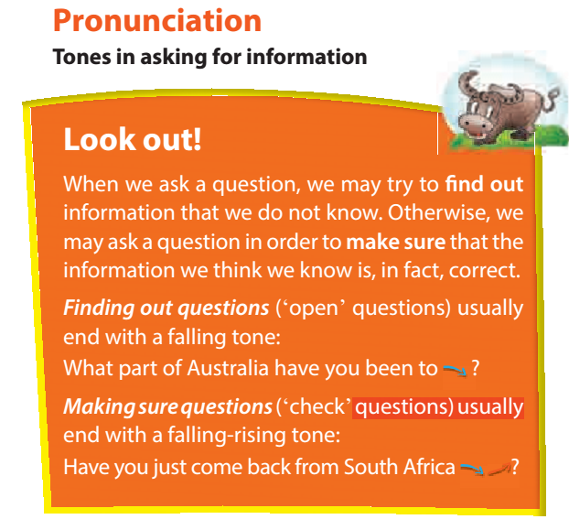

Slide 14
5. Listen and repeat the following mini-talks, paying attention to the tone in the questions.
1. A: Where would you like to go sightseeing?
B: I’d like to go to Australia most of all.
2. A: What do you think of the newly discovered cave?
B: Oh, fantastic.
3. A: Have you been sightseeing all day?
B: Yeah. We’ve been to the old pagoda, the orchid garden, and the open-air market.
4. A: Is Egypt a famous tourist attraction?
B: Yes. Millions of people go there every year.

Slide 15
6. Mark the questions with falling or falling- rising arrows, and practise the conversation with a partner. Then listen to check your pronunciation.
Martin: What's the matter, Janet? ↓
Janet: I'm looking for my passport. It seems to be lost. ↓ ↑
Martin: Have you already searched your purse?
Janet: Not yet. Oh, where are my glasses?
Martin: They may be in your plastic bag. Where is it? ↓
Janet: Oh, no, it's not here. Have I dropped it on the plane? ↓ ↑
Martin: Oh my God.
Janet: What should I do now? ↓
Martin: Let's report it to the customs officer.

Slide 16
REMEMBER WHAT HAVE YOU LEARNT TODAY!

Slide 17
HOME WORK
Learn by heart the new words/ compound nouns
Do exercise B3,4 in WB

