Slide 1
Unit 7:
Recipes and eating habits
Lesson 3: A closer look 2
TEACHER: NGUYEN THU HANG

Slide 2
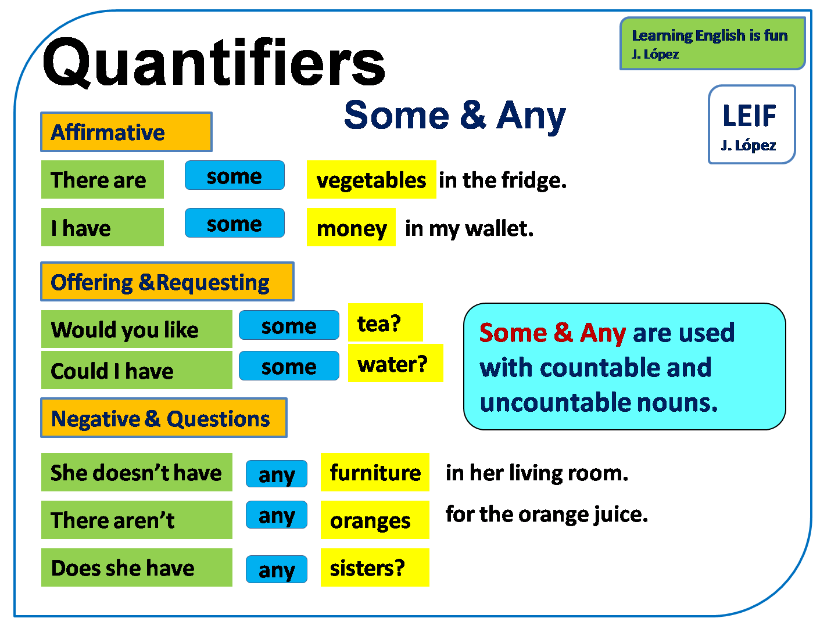

Slide 3
GRAMMAR

Slide 4
1. Fill each blank with a, an, some, or any.
Tom: Nina, you're drinking (1) a cola for breakfast?
Nina: Yes, (2) a glass of Coke and (3) some crisps. That's my favourite.
Tom: Don't you know that is a very bad way to start your day?
Nina: Why is it bad?
Tom: Breakfast is the first meal of the day, so it's very important to eat nutritious things.
Nina: Such as?
Tom: If you can't cook (4) some/any food yourself, have(5) a bowl of cereal and (6) some milk. Then eat (7) an apple.
Nina: But there isn't (8) any milk in the fridge.
Tom: Go out and buy (9) some .

Slide 5
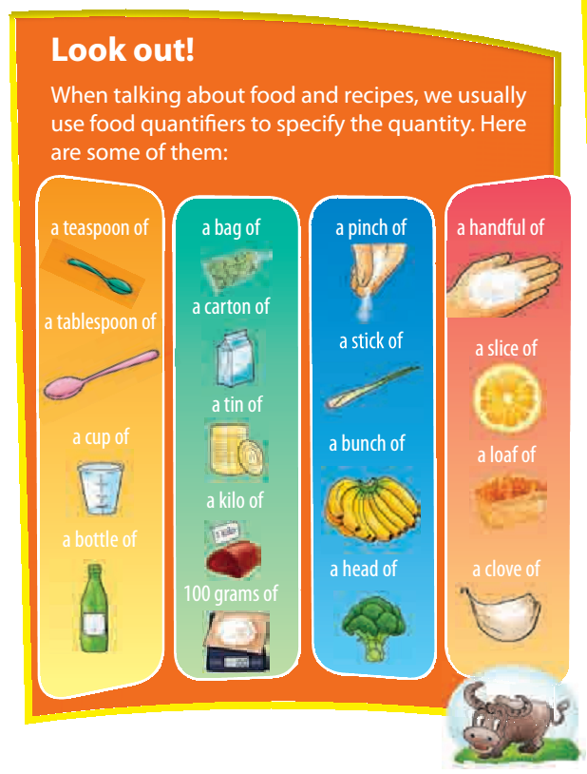

Slide 6
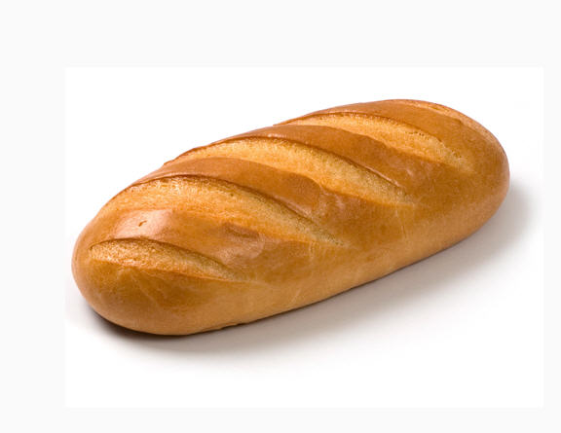
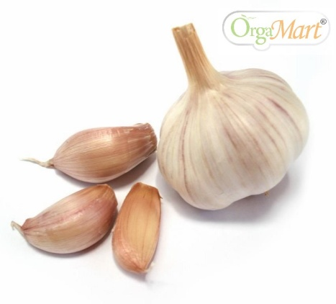
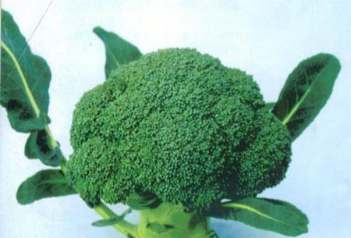
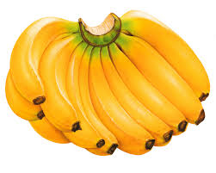
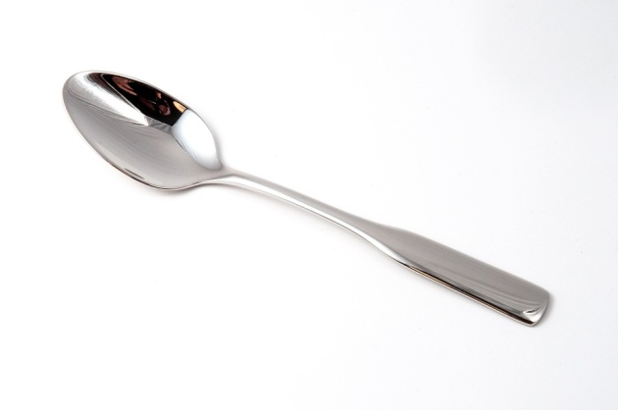

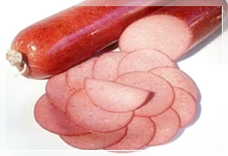
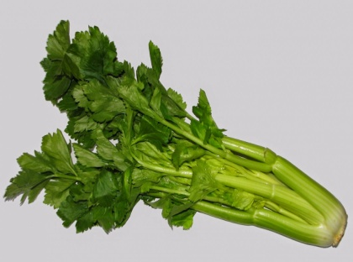
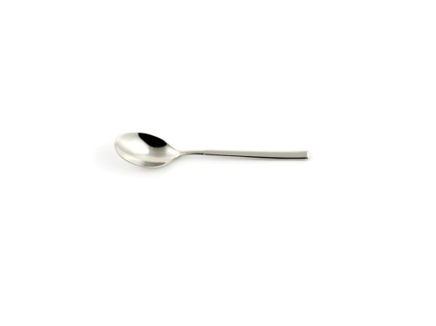
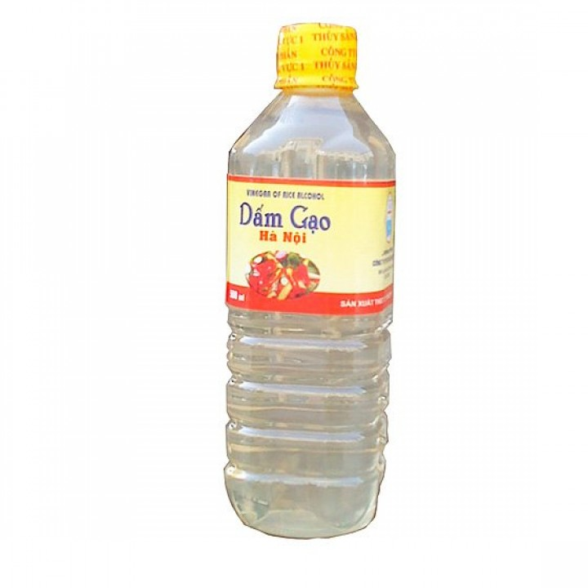
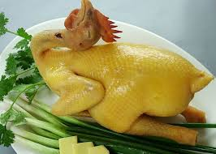
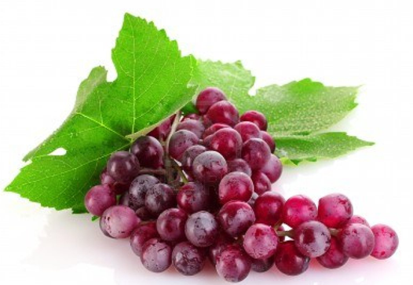
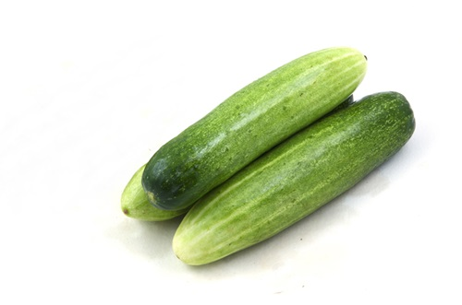
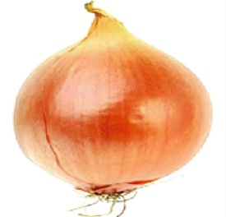

Slide 7
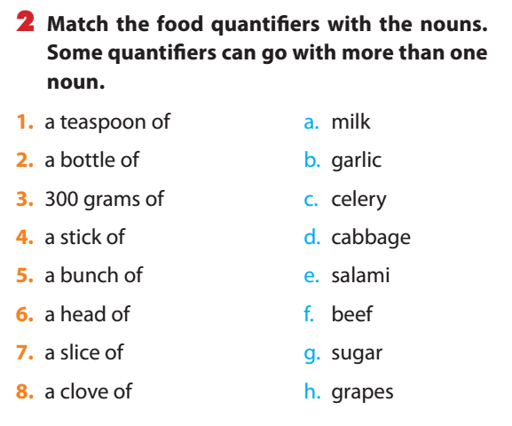

Slide 9
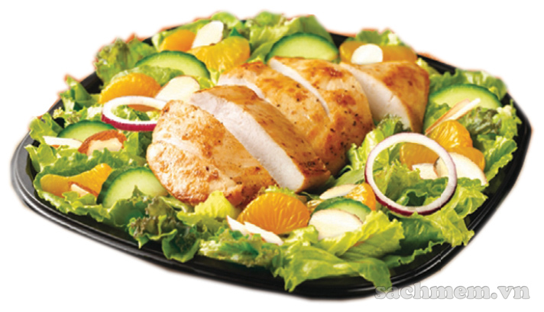
3a. Read the instructions to make a chicken salad. Fill each blank with a word/phrase in the box.
Chicken Salad
Boil (1) _________of lean chicken. While the chicken is cooking, wash two cucumbers, chop them in half and slice them. Then peel (2) _____ onion and slice it. Mix the sliced cucumber and onion in a bowl. Add two (3)__________ of vinegar, a (4) _________ of salt and a (5) _________ of sugar into the bowl and mix well. Leave the mixture to marinate for 10 minutes. Now slice the cooked chicken and combine it with the mixture in the bowl. Before eating, add (6)_______ pepper.
200 grams
an
tablespoons
teaspoons
teaspoon
some

Slide 10
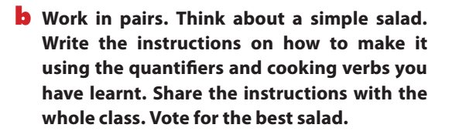
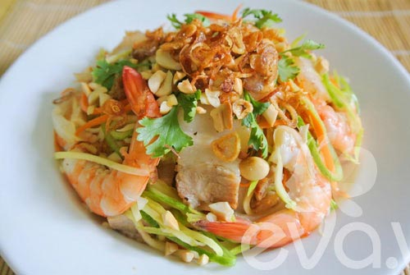

Slide 11
Preparing and cooking verbs:
- Wash
- Chop/ slice
- Boil
- Peel
- Mix/ combine
- Add

Slide 12
Modal verbs in conditional sentences type 1
Eg: I can help you to make chicken salad if you like.
If + S + V(s/es)…, S + will/can/must/should/may… +V

Slide 13
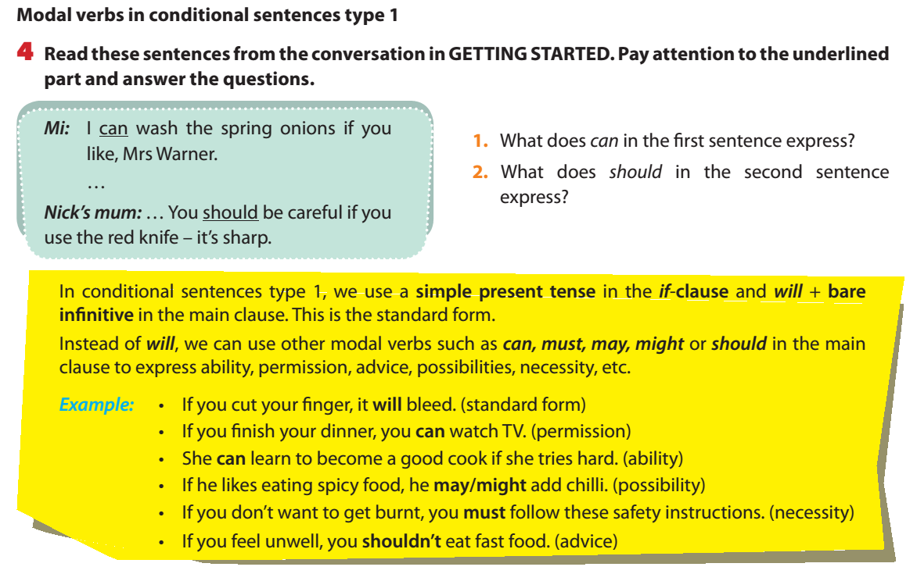
1. ability
2. advice
If + S + V , S + can/must + V (infinitive)
(present simple) may/might/should

Slide 14
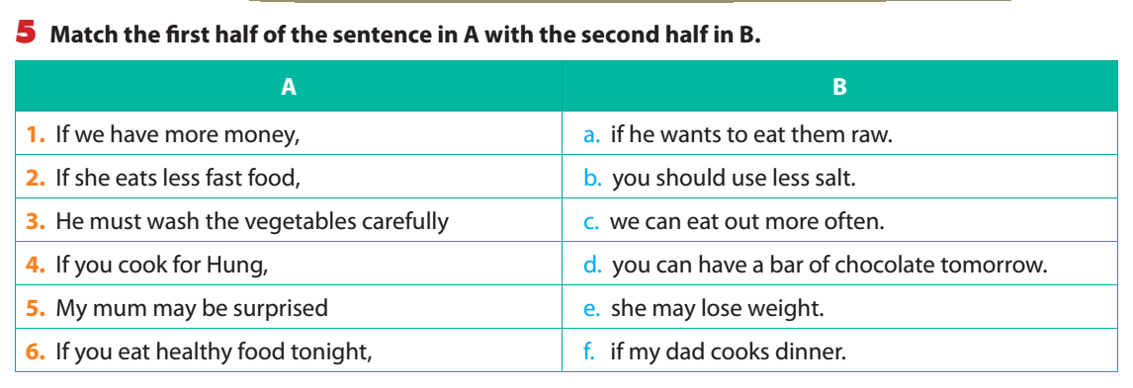

Slide 15
6. What will you say in these situations? Use suitable modal verbs with conditional sentences type 1.
1. Your father likes salty food, but you think it is necessary to reduce the amount of salt in his food. Otherwise, his health will suffer. You share your opinion with him.
→ .
2. Your brother is a good eater. He’s able to eat three bowls of rice when he’s hungry. You tell this to your friend.
→ .
3. You want to take a cooking class. Your mum agrees but asks you to choose a class at the weekend. Here is what she says to you.
→ .
4. Your friend offers you a slice of pork, but you see that it is undercooked. You refuse because it is possible that you will have a stomachache. You tell this to her.
→ .
5. Your sister is making a cake. You advise her to whisk the eggs for 10 minutes so that the cake is lighter
If you want to have good health, you must reduce the amount of salt in your food.
If my brother is hungry, he can eat three bowls of rice.
You can take a cooking class if it is at the weekend.
If I eat this undercooked pork, I may have a stomachache.
→ .You should whisk the eggs for 10 minutes if you want a lighter cake.

Slide 16
REMEMBER WHAT HAVE YOU LEARNT TODAY!
QUANTIFIERS
MODAL VERBS IN CONDITIONAL SENTENCES- TYPE 1

Slide 17
HOME WORK
Learn grammar by heart.
Do exercise C in WB.
- Prepare : Communication.

Slide 18
GOOD BYE!

