Slide 1



Unit 7: Recipes and eating habits
Lesson 2: A closer look 1
TEACHER: NGUYEN THU HANG

Slide 2

VOCABULARY

Slide 3

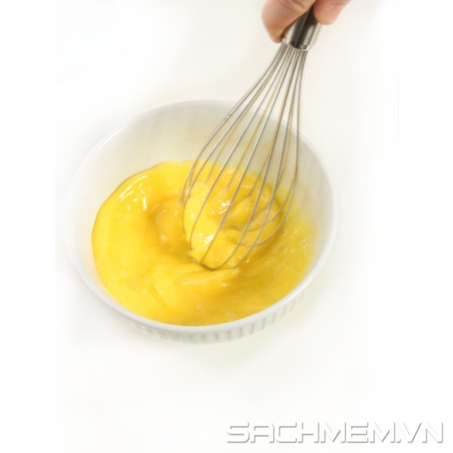
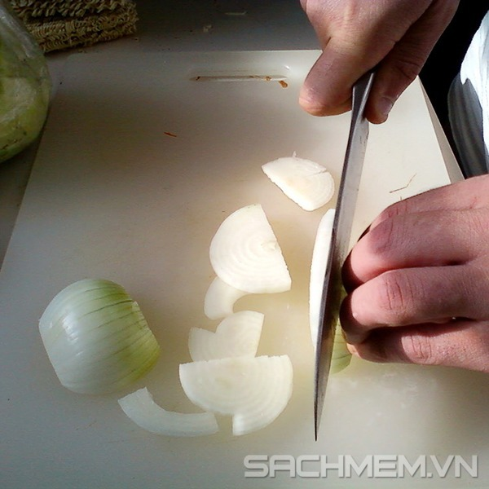
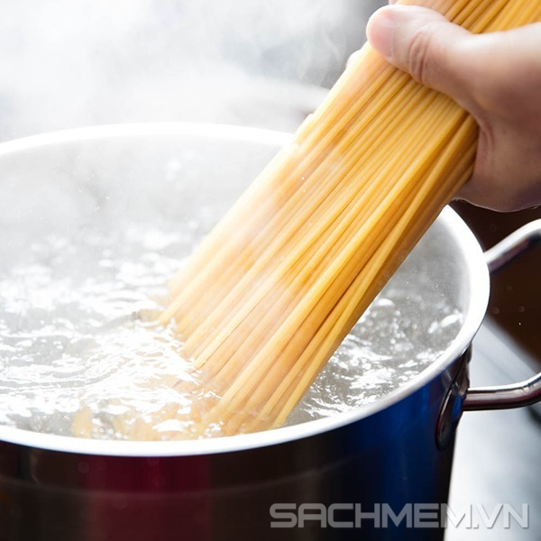
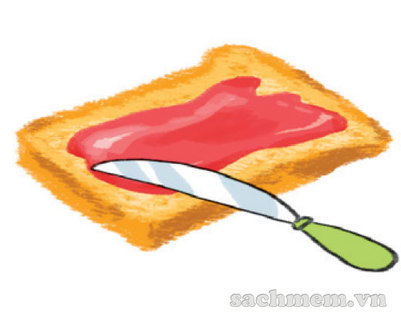
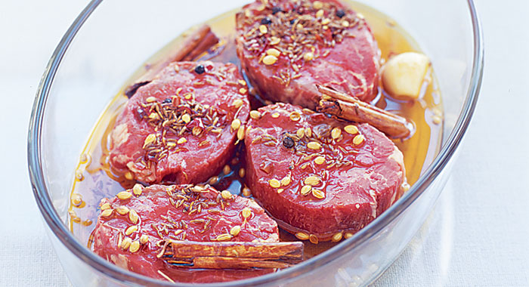
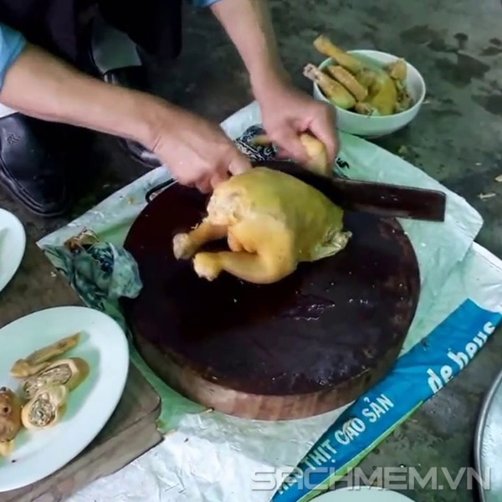
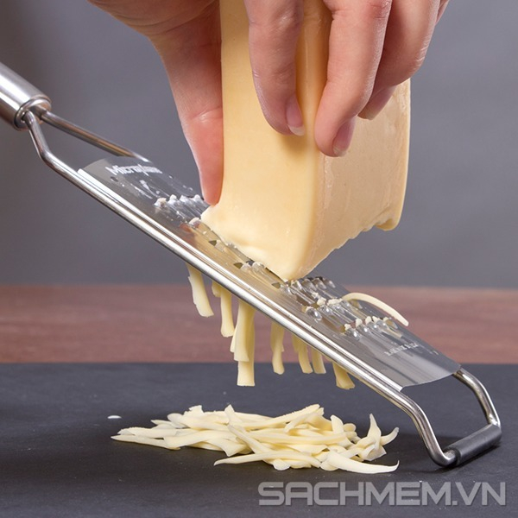

Vocabulary:
chop /tʃɒp/ (v)
chặt
dip /dɪp/ (v)
nhúng
grate /ɡreɪt/ (v)
nạo
marinate /ˈmærɪneɪt/ (V)
ướp
spread /spred/ (v)
phết
sprinkle /ˈsprɪŋkl/ (v)
rắc
slice /slaɪs/ (v)
cắt lát
whisk /wɪsk/ (v)
đánh (trứng…)

Slide 4
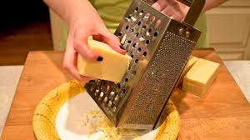
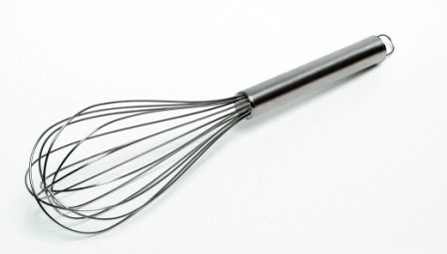


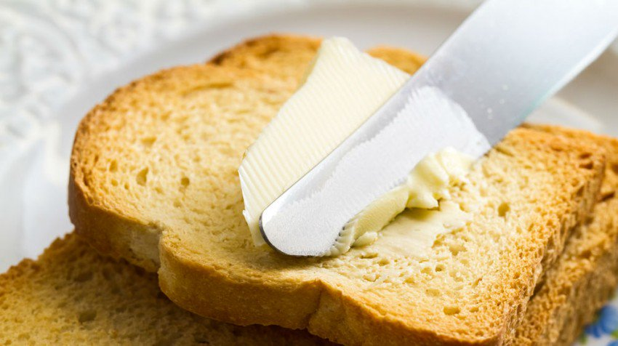
1. Write a food preparation verb from the box under each picture.
chop
slice
spread
dip
grate
whisk
sprinkle
marinate
whisk
A………………
B………………
C………………
D……………
E………………..
F………………
G………………
H…………….

Slide 5

2. Complete the sentences with the correct form of the verbs in 1 .
1. Don’t ____the cucumber into chunks. ___ thinly.
2. My mother usually ______ some cheese and _________ it over the pasta.
3. ______ the chicken in white wine for one hour
before roasting.
4. To make this cake successfully, you should ______
the eggs lightly.
5. ______ the prawns into the batter.
6. Can you ______ the butter on this slice
of bread or for me?
chop
Slice
grates
sprinkles
Marinate
whisk
Dip
spread

Slide 6

3. Match each cooking verb in A with its definition in B.
A | B
1. stir-fry | a. place food over boiling water so that it cooks in the steam.
2. deep-fry | b. cook something be keeping it almost at boiling point.
3. roast | c. cook food under or over a very strong heat.
4. grill | d. cook something slowly in liquid in a closed dish.
5. bake | e. cook cakes or bread in an oven.
6. steam | f. fry food in oil that covers it completely.
7. stew | g. cook thin strips of vegetables or meat quickly by stirring them in very hot oil
8. simmer | h. cook meat, or vegetables without liquid in an oven or over a fire.

Slide 7

3. Match each cooking verb in A with its definition in B.
A | B
1. stir-fry | g. cook thin strips of vegetables or meat quickly by stirring them in very hot oil
2. deep-fry | f. fry food in oil that covers it completely.
3. roast | h. cook meat, or vegetables without liquid in an oven or over a fire.
4. grill | c. cook food under or over a very strong heat.
5. bake | e. cook cakes or bread in an oven.
6. steam | a. place food over boiling water so that it cooks in the steam.
7. stew | d. cook something slowly in liquid in a closed dish.
8. simmer | b. cook something be keeping it almost at boiling point.

Slide 8

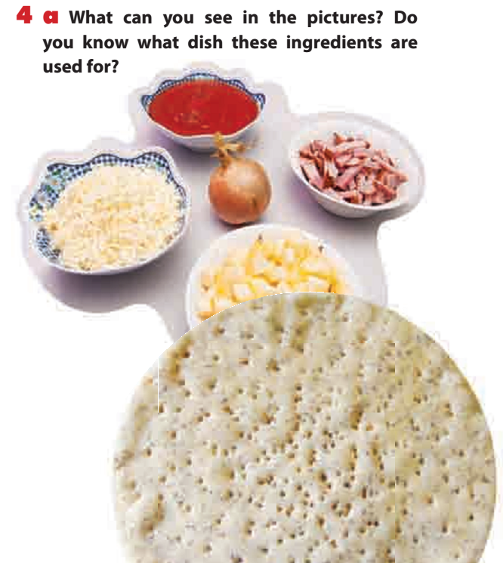
tomato sauce
bacon
onion
cheese
apple
pizza base
Pizza

Slide 9
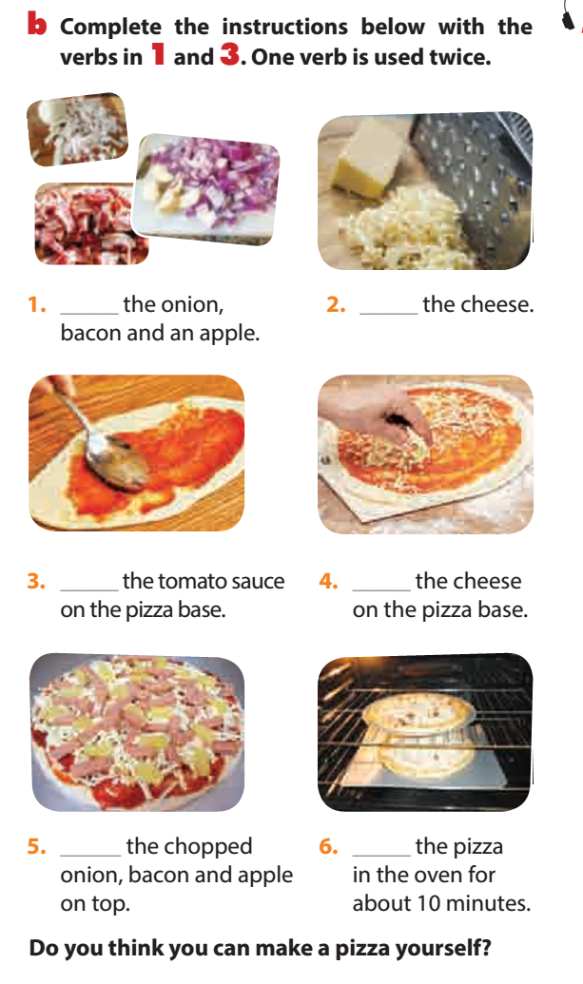

Do you think you can make a pizza yourself?
Chop
Grate
Spread
Sprinkle
Spread
Bake

Slide 10


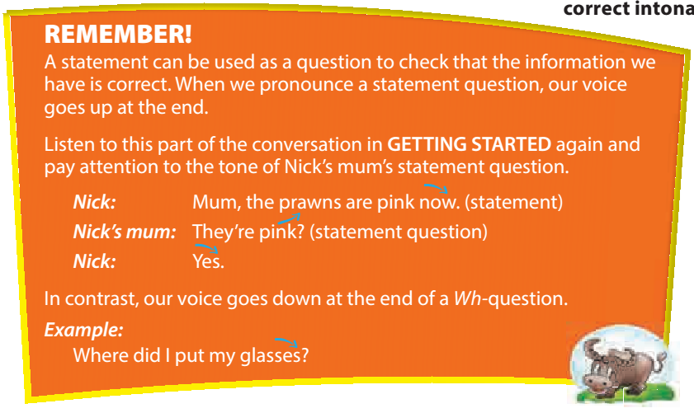


Slide 11
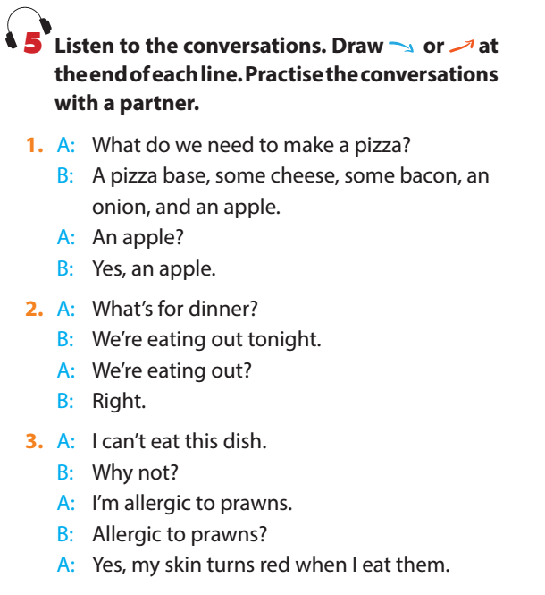
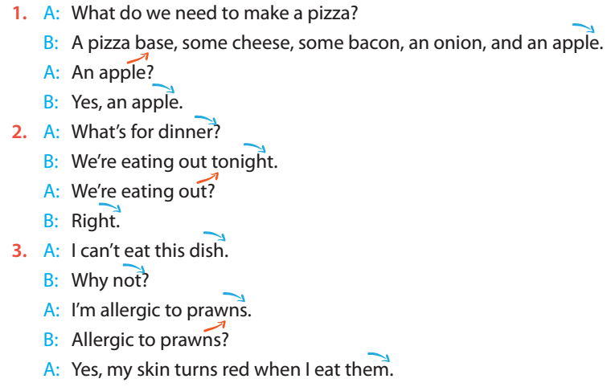


Slide 12
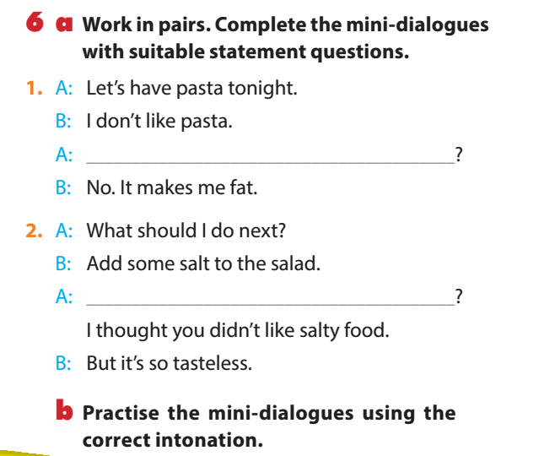

You don’t like pasta?
Don’t like pasta?
Add some salt?

Slide 13

REMEMBER WHAT HAVE YOU LEARNT TODAY!
COOKING VERBS
TONES IN STATEMENTS USED AS QUESTION

Slide 14

HOME WORK
Learn the vocabulary.
Do exercise B in WB.
- Prepare : A closer look 2.

