Slide 1
G
O
O
D
A
F
T
E
R
N
O
O
N
Welcome to our class !

Slide 2

UNIT 4:
Our Customs And Tradition
ENGLISH8
A CLOSER LOOK 1

Slide 3

Wednesday , Octorber 29th, 2015
UNIT 4 :
Our Customs And Tradition
Period 28: Lesson 2:
:
A closer look 1

Slide 4
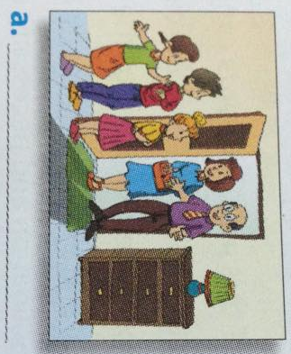
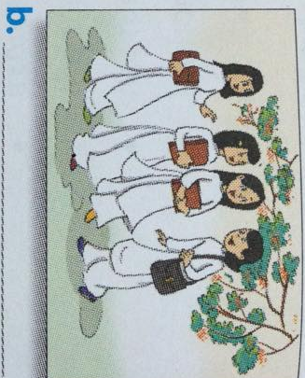
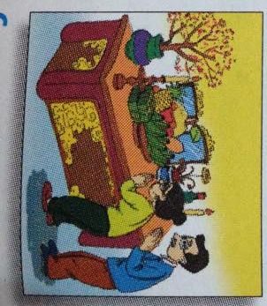
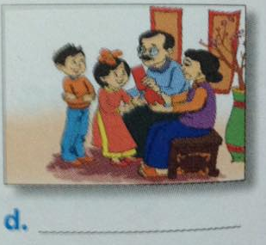
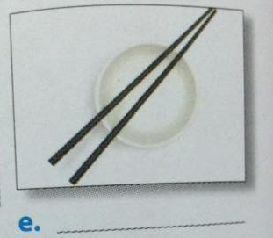
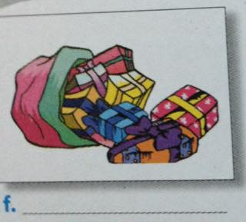
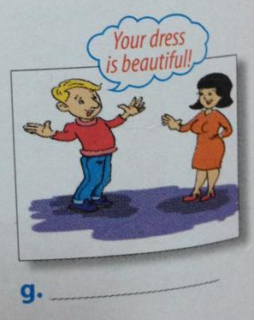
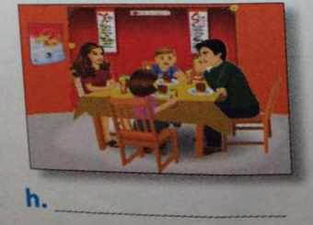
Smiling to accept a compliment
Match the pictures with the customs and traditions in the box.
Worshipping ancestors
Wrapping gifts in colourful paper
Having lunch together on the second day of Tet
Placing the chopsticks on top of the rice bowl when finishing a meals
Children in the family standing in a row to greet guests
Children in the family standing in a row to greet guests
Wearing ao dai on special ocassions
Wearing ao dai on special ocassions
Giving children lucky money at Tet
Giving children lucky money at Tet
Worshipping ancestors
Placing the chopsticks on top of the rice bowl when finishing a meals
Having lunch together on the second day of Tet
Wrapping gifts in colourful paper
Smiling to accept a compliment

Slide 5
Revision:
Custom
A custom is something accepted.
Tradition
A tradition is something special and is passed down through the generations.

Slide 6
Friday , Octorber 30th, 2015
UNIT 4 :
Our Customs And Tradition
Period 28:
Lesson 2:
A closer look 1
I. Vocabulary:
1/ Christian:
someone who believes in and follows the teachings of Jesus Christ
: người theo Thien Chua giáo
2/ sponge cake:
a soft cake made with eggs, sugar and flour but no fat
: bánh xốp
3/ fire crackers:
a firework that makes a loud noise when it explodes
: pháo hoa de bắn
4/ filmstrip:
đoạn trích trong phim
5/ offspring:
con cháu
6/ shaking stranger’s hands
bắt/ lắc tay người lạ

Slide 7
1. Match the frist halves of the sentences (A) with the second halves (B)
A | B
1/ Although they are not Christian, | a/The first person to step into your house in the new year should be a man
2/ It’s the custom | b/Making sponge cakes for the Mid- Autumn Festival instead of mooncakes
3/ According to tradition, | c/The tradition of living with their parents.
4/ Many young people do not follow | d/In that country for women to get married in white
5/ They broke with tradition by | e/The family has the custom of giving presents at Christmas
6/There is a tradition, | f/Morning exercise at 5 a.m
7/ In my family there is a custom of doing | g/Girls should wear ao dai on the first day of school

Slide 8
2. Read the full sentences in 1 again and complete the expressions below.
custom
It’s the ……………. for somebody to do something
There’s a …………… that + clause
……………… to tradition, + clause
Follow the …………… of doing something
Break ……… tradition by doing something
Have the custom ……. doing something
There is a custom of………… something
tradition
According
tradition
with
of
doing

Slide 9
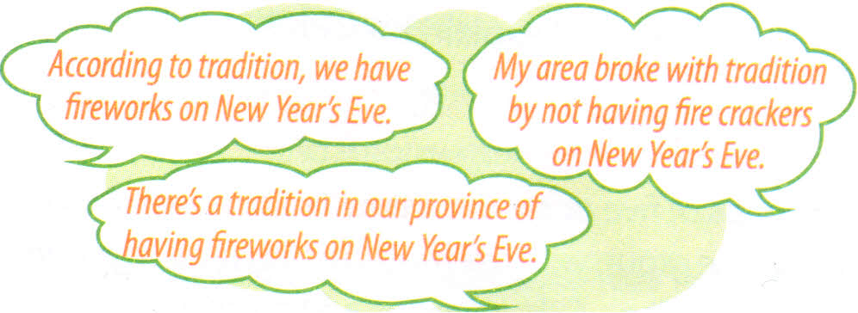
3. Read the following customs and traditions. Make sentences to say if you have these in your province or area, using any of the expressions in 2. Remember to change the verb tense if necessary.
having fiveworks on New Year’s Eve.
waiting until the guests finish eating before leaving the dinner table.
touching children’s heads
decorating the house on special occasions
women shaking stranger’s hands
1/ We have the custom of waiting until the guests finish eating before leaving the dinner table.
2/ The custom in my coutry that we often decorate the house on special occasions
3/ According to tradition, women shouldn’t shake stranger’s hands.

Slide 10
4/ Now complete the following sentences with your own ideas.
It’s the custom in my coutry that…
We broke with tradition by…..
There’s a tradition in my family that…..
We have the custom of….
According to tradition,…..
Work in groups of 4 to do this activity.
Write your answers on posters, then stick them on the board.

Slide 11
Monday , Octorber 26th, 2015
UNIT 4 :
Our Customs And Tradition
Period 28:
Lesson 2:
A closer look 1
I. Vocabulary:
1/ Christian:
someone who believes in and follows the teachings of Jesus Christ
: người theo Thien Chua giáo
2/ sponge cake:
a soft cake made with eggs, sugar and flour but no fat
: bánh xốp
3/ fire crackers:
a firework that makes a loud noise when it explodes.
: pháo hoa de bắn
4/ filmstrip:
đoạn trích trong phim
5/ offspring:
con cháu
6/ shaking stranger’s hands
bắt/ lắc tay người lạ
II. Pronunciation:
/spr/: spring, offspring…
/str/ : street, straw….

Slide 12
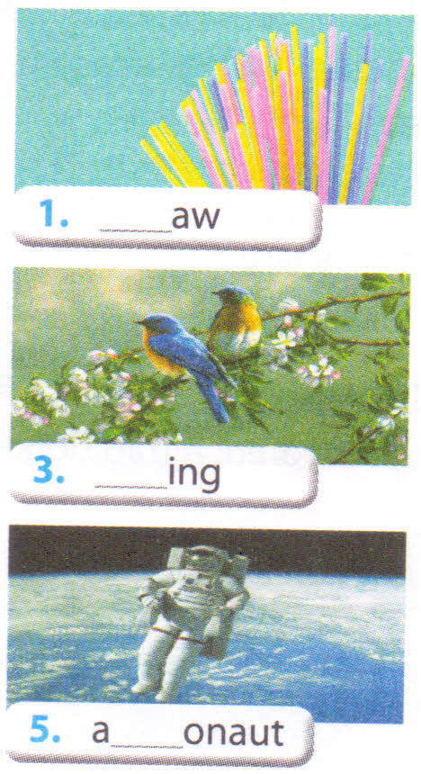
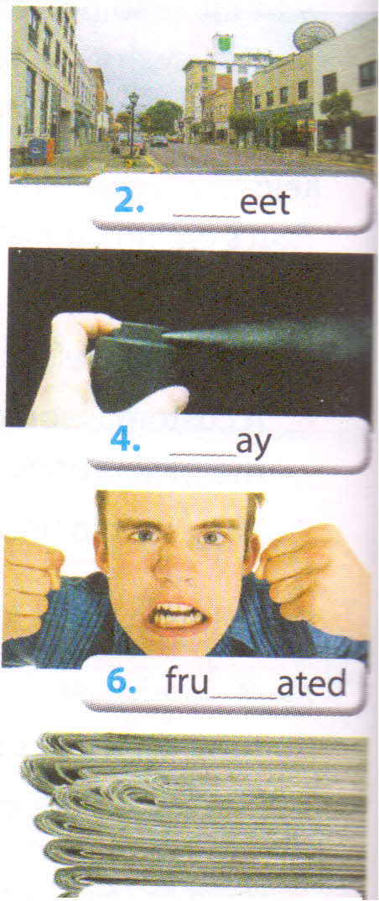
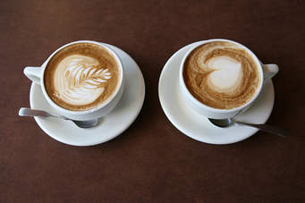
1/ Complete the words under the pictures wit spr or str. Then listen and repeat.
str
str
spr
spr
['æstrənɔ:t]
str
[frʌs'treitid]
str
spr
7. e ___ esso.
[es'presou]
spr
8. new __ int .

Slide 13
2/ Listen and circle the words with /spr/ and underline the word with /str/. Then say the sentence.
In my family, all the traditions of our ancestors are strictly followed.
The custom of saying hello to strangers has speard through our community.
In our district, it’s the custom for resident to sweep the streets on Saturday mornings.
That filmstrip really highlighted our customs and traditions.
Parents usually want their offspring to follow the family traditions

Slide 14

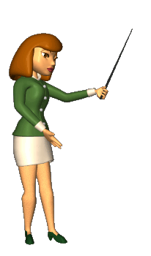
Homework
- Learn by heart the new words
- Practice 2 sounds: /spr/ and /str/,
- Do the exercise A1, A2, B2 page 28,29(workbook)

Slide 15
GOODBYE

