Slide 1


Unit 12 : Robots
Lesson 2
A closer look 1

Slide 2

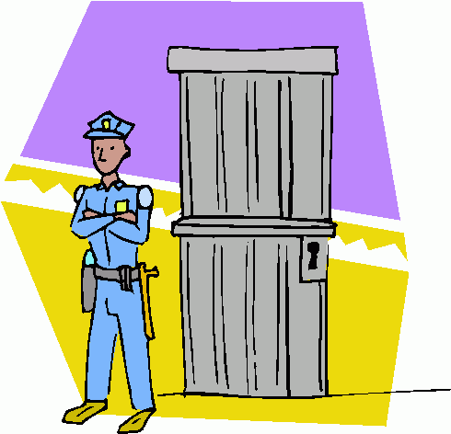

VOCABULARY
to recognize: nhận ra
to guard
to do sums

Slide 3

VOCABULARY
Task 4 Match the verbs in A with the nouns in B
A
Recognize
Make
Understand
Lift
Guard
B
Coffee
What someone says
Our faces
The house
Heavy things
1. c 2. a 3. b 4. e 5. d

Slide 4
Activity 2:Add another word/ phrase for each verb
Verb | Noun
Guard | the palace
Make
Understand
Lift
recognize
- tea
- what I say
- The table
- The box
- your mistakes
- Finger print

Slide 5

Grammar
Do
You
remember ?

Slide 6

Talk about present abilities

Slide 7
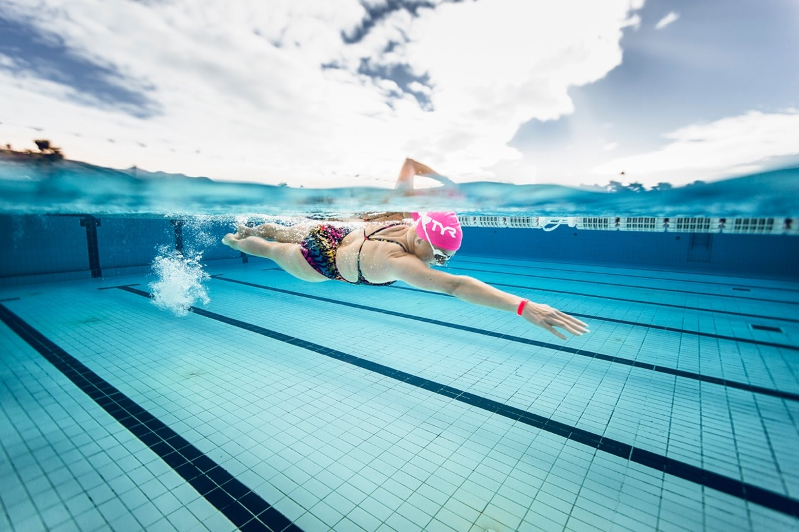
What about past abilities?
CAN → COULD
Eg : She could swim at the age of 7

Slide 8
STRUCTURE
Affirmative : (+) S + could + V
Negative : (-) S + could not/ couldn’t + V
Interrogative : (?) Could + S + V?
Short answers: Yes, … could. No, … couldn’t

Slide 9
Grammar Practice
Activity 3: Put the words in the correct order
1. could/ do sums/ Mary/ at the age of 7.
2. read and write/ you/ Could/ when you were 6?
3. could/ Robots/ lift heavy things/ some years ago.
4.move easily/ couldn’t/ Robots/ until recent years.
- Mary could do sums at the age of 7
- Could you read and write when you were 6 ?
- Robots could lift heavy things some years ago
- Robots couldn’t move easily until recent years

Slide 10
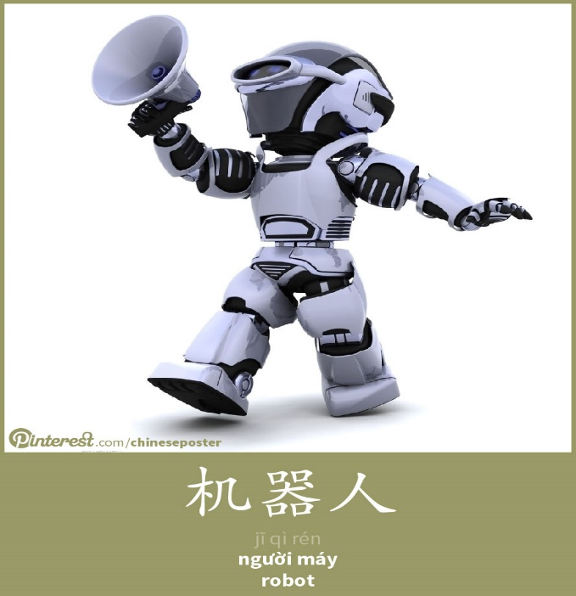
Grammar Practice
Activity 4 : What could Ongaku do 2 years ago?
Lift heavy things | ✓
Make coffee | ✗
Recognize our faces | ✗
Guard the house | ✗
Understand what we say | ✗
I am Ongaku
A: Could Ongaku lift heavy things 2 years ago?
B: Yes, it could.

Slide 11

SURVEY
3 things you could/ couldn’t do
at primary school

Slide 12
SURVEY
Name | Could | Couldn’t

Slide 13


Boy
house

Slide 14
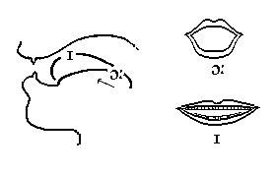
/ ɔɪ /
ntroduction

Slide 15
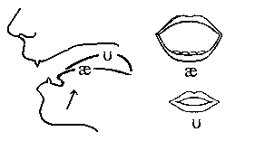
aʊ

Slide 16
TASK 1: Write the words you hear in the appropriate columns
/ ɔɪ / | /aʊ/

Slide 17
TASK 2: Listen and circle the words you hear
Did you put oil/ all in the salad?
I can see a car/ cow over there.
Ah/ Ouch! You’ve stepped on my toes.
She took a bar/ bow when she finished the song.
Did you put oil/ all in the salad?
I can see a car/ cow over there.
Ah/ Ouch! You’ve stepped on my toes.
She took a bar/ bow when she finished the song.

Slide 18
TASK 3: Listen and practice the chants
I’ve got a robot toy, a robot toy
He can jump up and down
He’s such a good boy, such a good boy
He’s the best boy in my house
I’ve got a robot toy, a robot toy
He can speak clear and loud
He’s got a sweet voice, got a sweet voice
He’s the best boy in my house

Slide 19

Homework:
Learn by heart all the new words.
Do exercises ( in workbook).

Slide 20
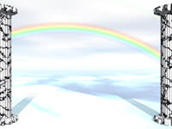







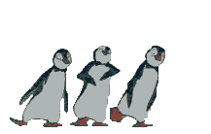

Thanks for your joining .

