Slide 1

Unit 7: Pollution Lesson 5:Skills 1

Slide 2
I. Vocabulary:
- sewage (n): nước thải sống, nước cống
- household (n): hộ gia đình
- pesticide (n): thuốc trừ sâu
- herbicide (n): thuốc diệt cỏ
- factor (n): nhân tố
- dramatic (adj): kịch tính, sâu sắc
- outbreak (n): sự phun ra, sự bùng phát
- cholera (n): bệnh tả
- untreated (adj): không xử lý

Slide 3
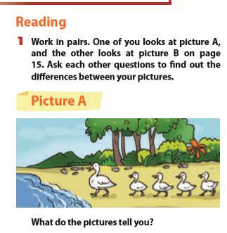
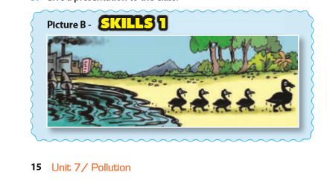
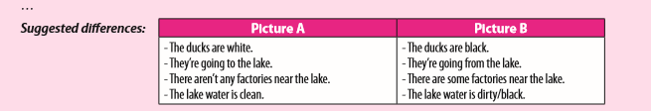
II. Reading:

Slide 4
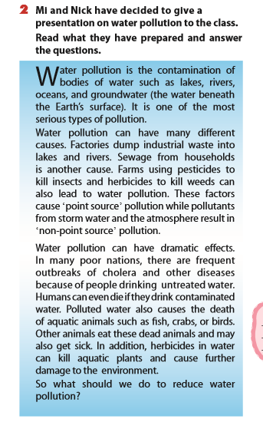

Slide 5
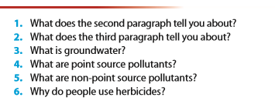
1. The second paragrah tells us about the causes of water pollution.
2. The third paragraph tells about the effects of water pollution.
3. It’s the water beneath the earth’s surface.
4. They are industrial waste, sewage, pesticides and herbicides.
5. They are pollutants from storm water and the atmostphere.
6. They use herbicides to kill weeds.

Slide 6
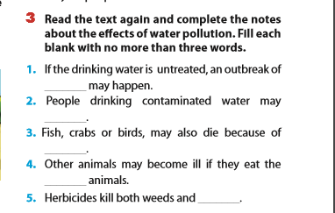
cholera
die
polluted water
dead
aquatic plants

Slide 7
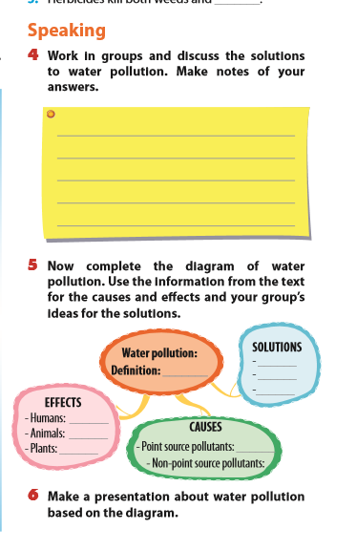
III.

Slide 8
IV. Homework:
Learn by heart the vocabulary.
Do the exercises D1,2- 7 (Workbook)
C2,3- 7 (Exercise notebook)
Prepare: Unit 7 (Skills 2)

