Slide 1
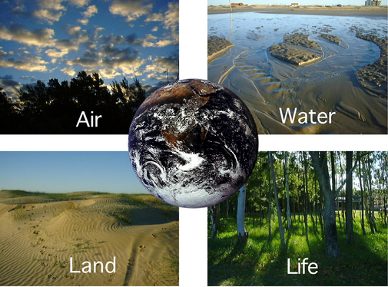
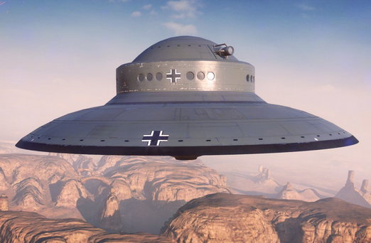
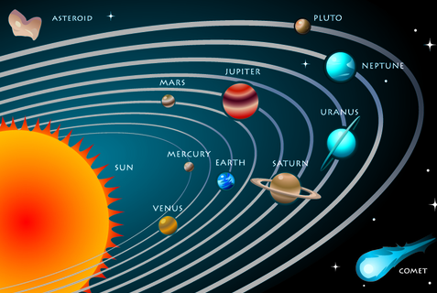
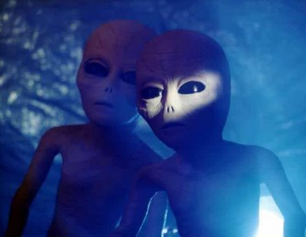
12
LIFE ON OTHER PLANETS
Unit
Lesson 1: GETTING STARTED
What could happen to earth?

Slide 2
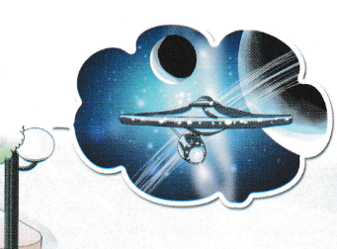
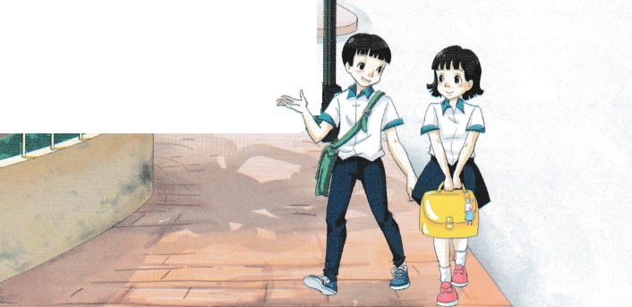
THIS UNIT IN CLUDES:
VOCABULARY
Life on Erath and other planets
PRONUCIATION
Stress in words ending in –ful and -less
GRAMMAR
May and might: review
Report speech: questions
COMMUNICATION
Predicting what other life forms might be like
Asking and answering questions about life on other planets.

Slide 3
Vocabulary
1.
trek
(n)
: hành trình
2.
captain
(n)
: thuyền trưởng
3.
crew
(n)
: thủy thủ đoàn
4.
terrorist
(n)
: kẻ khủng bố
5.
alien
(n)
: người ngoài hành tinh
6.
space buggy
(n)
: xe vũ trụ
7.
galaxy
(n)
: dải ngân hà
8.
solar system
(n)
: hệ mặt trời

Slide 4

1. Listen and read.
1. Where are Duong and Nhi?
2. What are they doing?
3. What might they be talking about?

Slide 5
a. Tick () true (T) or false (F).
T
F
1. Duong and Trang saw a boring film yesterday.
2. Nhi has seen Star Trek 2009.
3. Star Trek 2009 is a non-fiction film.
4. Nhi and Trang sometimes thinks about the future of the world.
5. Duong sounds sure about the future of the Earth.






Slide 6
b. Answer the questions.
1. Who is the captain of the spaceship?
→ James Kirk is the captain of the spaceship.
2. Where did the crew go in Star Trek 2009?
→They went to Nibiru planet.
3. When does the story in Star Trek Into Darkness happen?
→ It happens in 2259.
4. What do you think is the Enterprise?
→ It’s the name of the spaceship that the crew travel on.
5. What does John Harrison want to do?
→ He wants to destroy Earth.

Slide 7
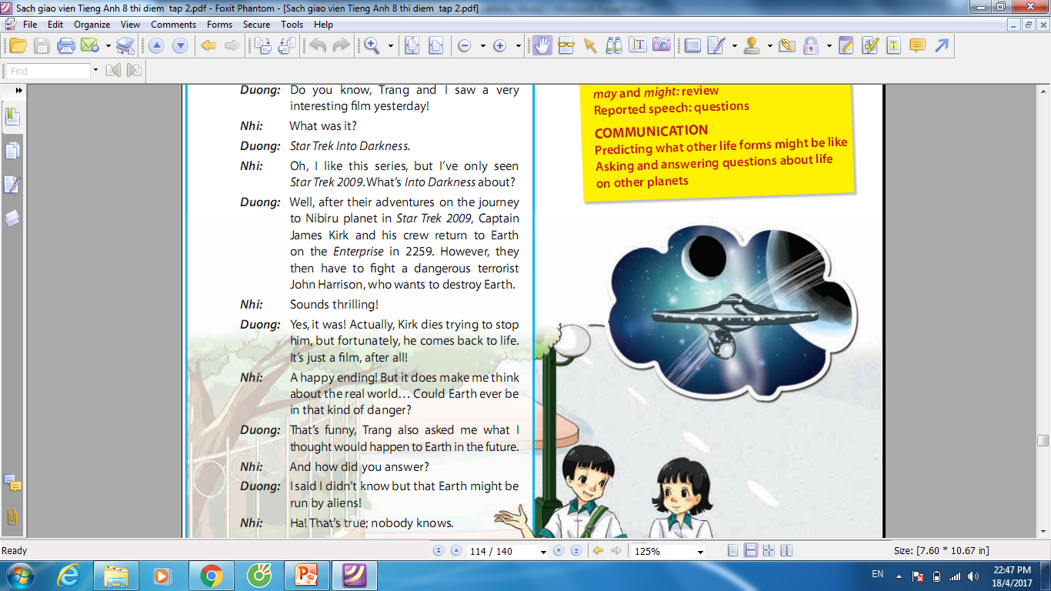
c. Can you find the sentences in reported speech in the conversation?
Underline them.

Slide 8
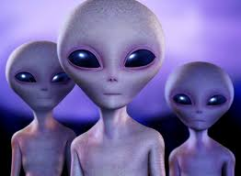
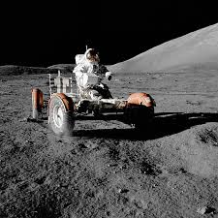
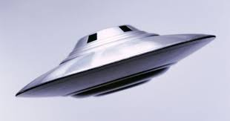
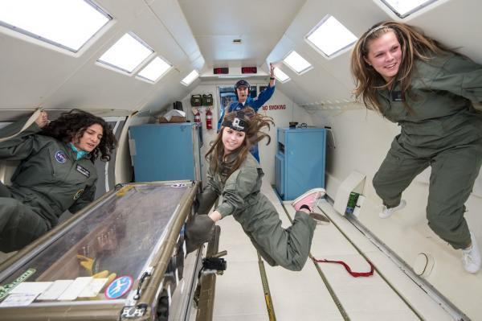
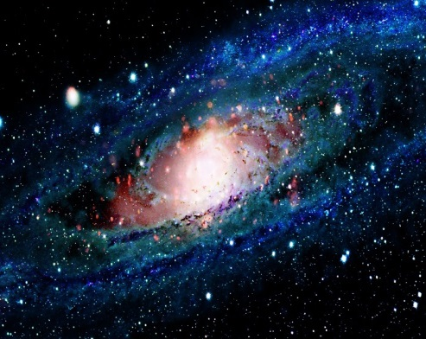
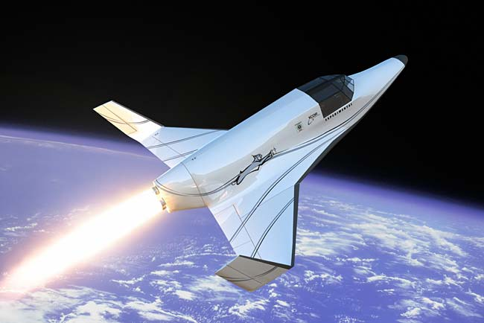
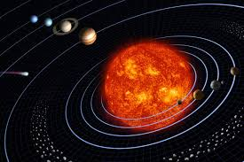
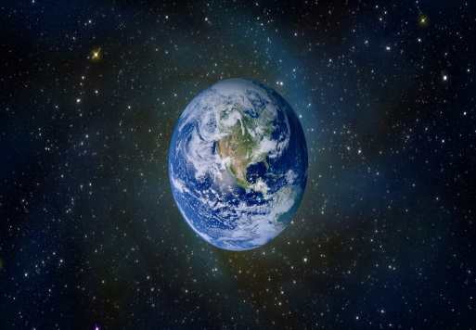
2. Label the picture. Then listen and repeat.
aliens space buggy galaxy planet weightless solar system spaceship UFO
1
2
3
4
aliens
space buggy
UFO
weightless
5
6
7
8
galaxy
spaceship
solar system
planet

Slide 9
3. Use the words/ phrases in 2 to fill the blanks.
aliens
1. The __________ were green and they had huge head and big eyes.
2. The aliens came out of a _________, which looked like a disk.
3. A __________ is a vehicle used for travelling on the surface of the
moon.
4. A moon moves around a __________ and a __________ move around a
star
5. In a __________ environment, everything floats uncontrollably.
6. There are eight planets that moves round the Sun in our __________
7. We don’t know how many solar systems there are in each __________
8. Vostok 1 is a name of the __________ in which Yuri Gagarin flew into
outer space.
UFO
space buggy
planet
planet
weightless
solar system
galaxy
spaceship

Slide 10
4 GAME: WHAT AND WHERE
2
solar system
1
3
aliens
UFO
7
galaxy
4
planet
6
spaceship
5
weightless
8
space buggy

Slide 11

HOMEWORK
* Learn by heart vocabulary.
* Speak with your friends
* Prepare lesson 2: A closer look 1.

