Slide 1
Unit 1: Local environment
TEACHER: NGUYEN THU HANG

Slide 2
01
WARM UP

Slide 3
PREVIEW: PHRASAL VERB
https://www.liveworksheets.com/c?a=s&s=English&t=p33bt2p79o3&mn=t&sr=n&ms=uz&l=vm&i=czxofo&r=js&db=4&f=dzduznun&cd=ph00fz5h34j0zlyvkgmjejqp9ngnxglxlxg

Slide 4
VOCABULARY

Slide 5
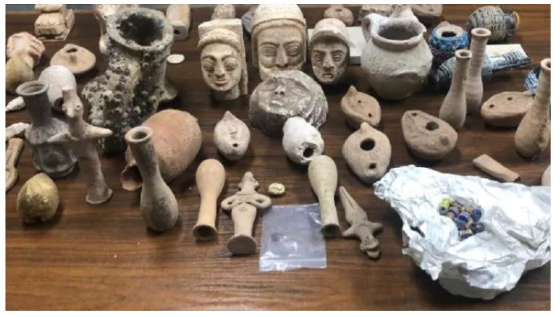
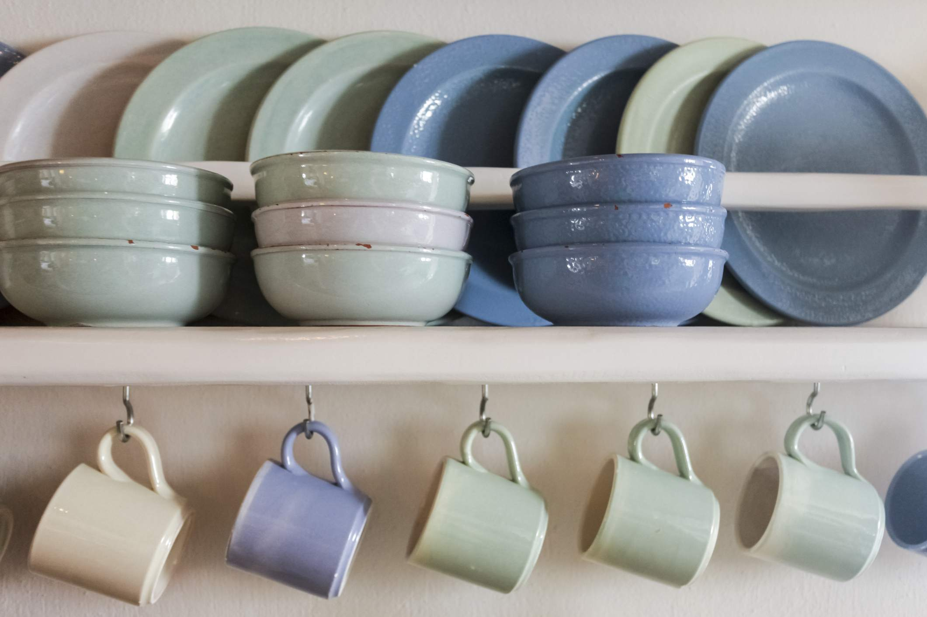
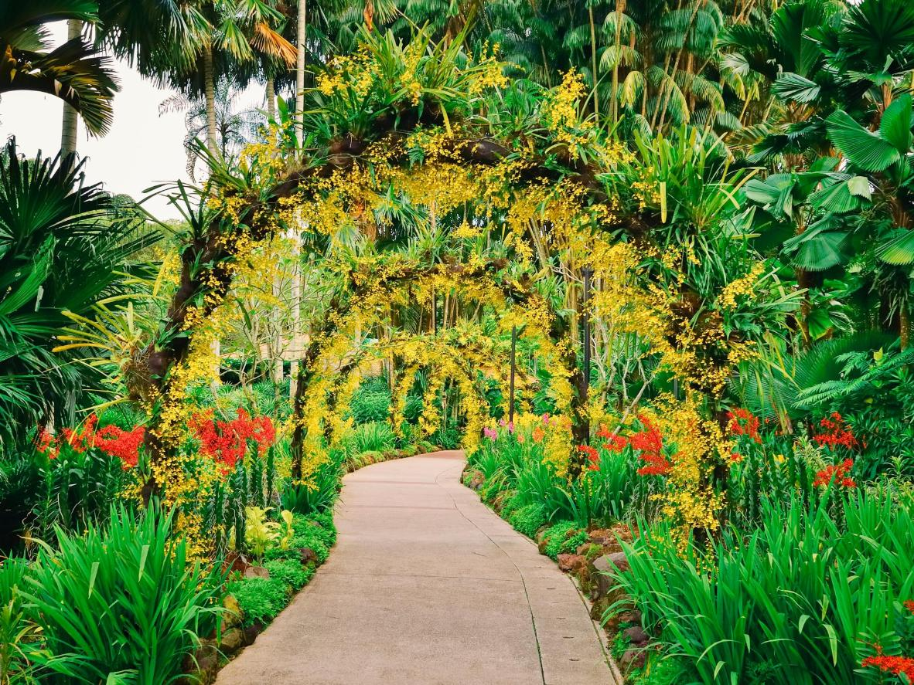
Vocabulary:
•
-Botanical Garden /bəˌtænɪkl ˈɡɑːdn/ (n): Vườn Bách thảo
-artefact/ˈɑːtɪfækt/ (n): đồ tạo tác
-explore /ɪkˈsplɔː(r)/ (v): khám phá
-fascinate /ˈfæsɪneɪt/(v): mê hoặc, quyến rũ
-ceramic /səˈræmɪk/ (n): đồ gốm
•
•
•
•

Slide 6
LISTENING

Slide 7

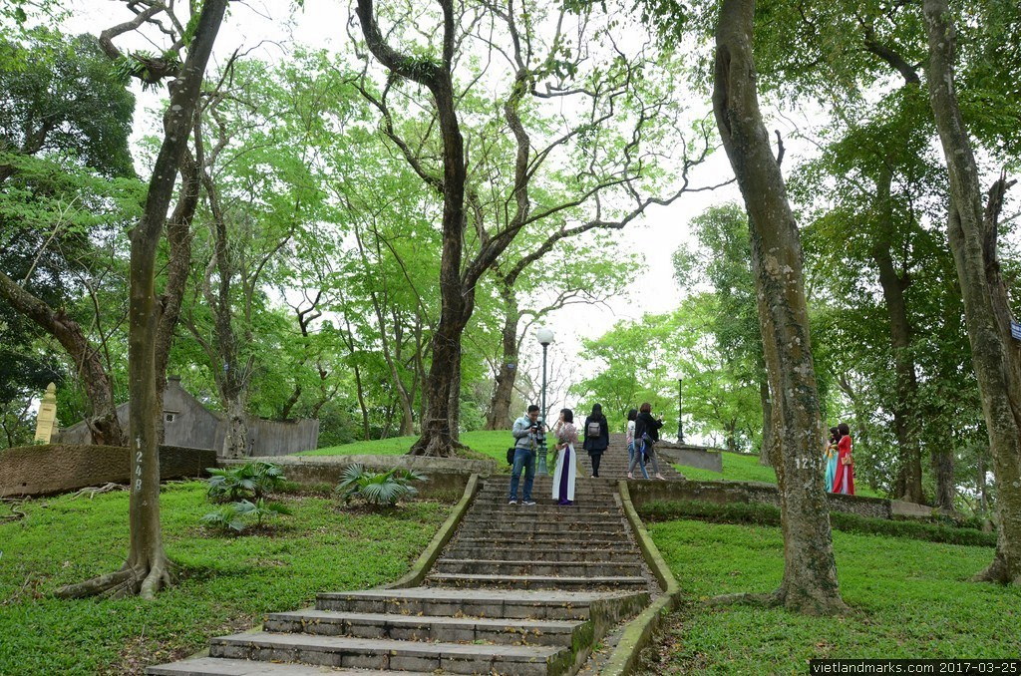
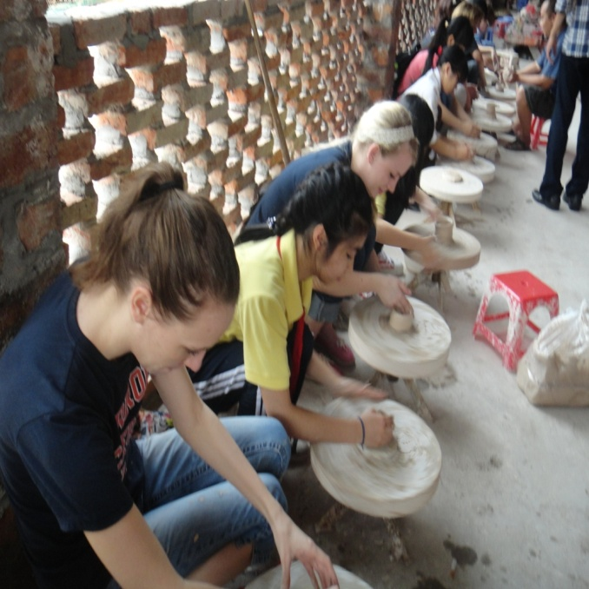
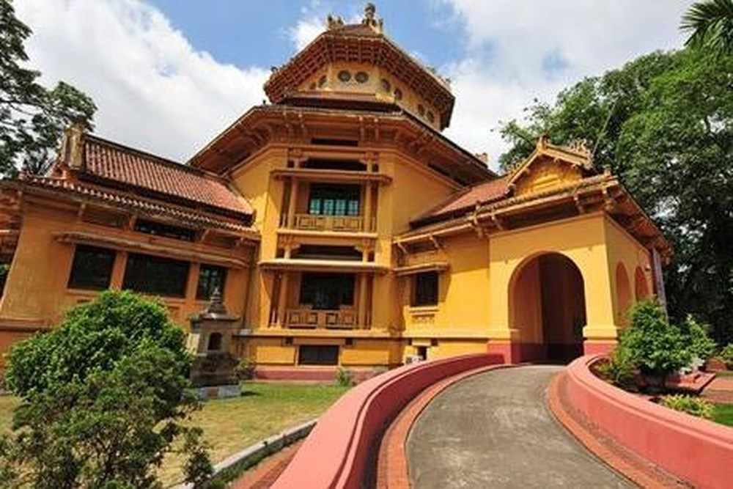
Listening
4Teen radio is asking different students about their places of interest.
1. Describe what you see in each picture. Do you know what places they are?
A
B
C
Ha Noi Botanical Garden
Bat Trang pottery village
Viet Nam National Museum of History
Listen and check your answers.

Slide 8
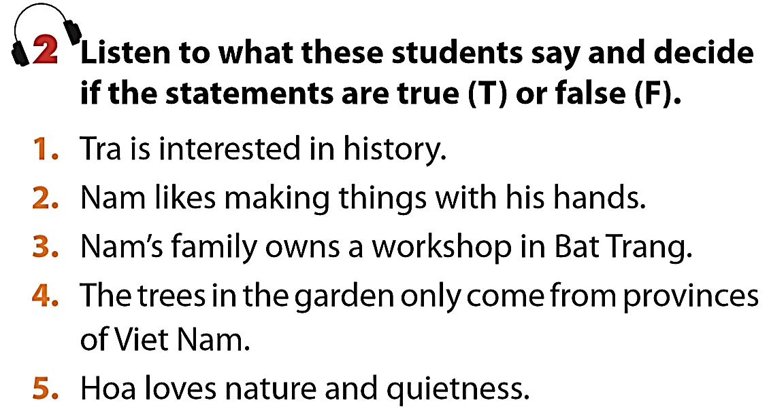
My friend’s relatives live there and they own a workshop.
I’m fascinated by traditional handicrafts.
I love history
T
T
F
It’s a nice place for those who love nature and quietness.
There are lots of trees from different countries
F
T

Slide 9



3. Listen again and complete the table. Use no more than three words for each blank.
Student | Place of interest | Activities
Tra | Viet Nam National Museum of History | - Seeing various (1)__________ - Looking round and (2)_______ __________________________
Nam | Bat Trang pottery village | - Learning to (3)_____________ and (4)____________________
Hoa | Ha Noi Botanical Garden | - Climbing up (5)____________ - Reading (6)_______________ - Feeding (7)_______________ - (8)________________ people
There’s an extensive collection of artefacts tracing Viet Nam’s history.
artefacts
so you can spend time looking round and exploring Vietnamese culture
Every time I go there, they teach me how to make things such as pots, vases, or bowls. I’m learning to paint on ceramics now.
After that I go down and feed the pigeons.
Sometimes I just sit on the bench, watching people dancing or playing sports
I usually climb up the hill and read books at the top
exploring Vietnamese culture
make things
paint on ceramics
the hill
books
pigeons
watching

Slide 10
WRITING

Slide 11
Writing
4. If a visitor has s day to spend in your hometown/city, where will you advise him/her to go? What can they do there? Work in pairs, discuss and take notes of your ideas.
Places | Activities
Place 1: ……………………… | …………………………………………………
Place 2: ……………………… | …………………………………………………
Place 3: ……………………… | …………………………………………………

Slide 12
Place of interest | Activities
Viet Nam National Museum of History | - Seeing various artefacts - Looking round and exploring Vietnamese culture
Bat Trang pottery village | - Learning to make things and paint on ceramics
Ha Noi Botanical Garden | - Climbing up the hill - Reading books - Feeding pigeons - Watching people playing sports

Slide 13
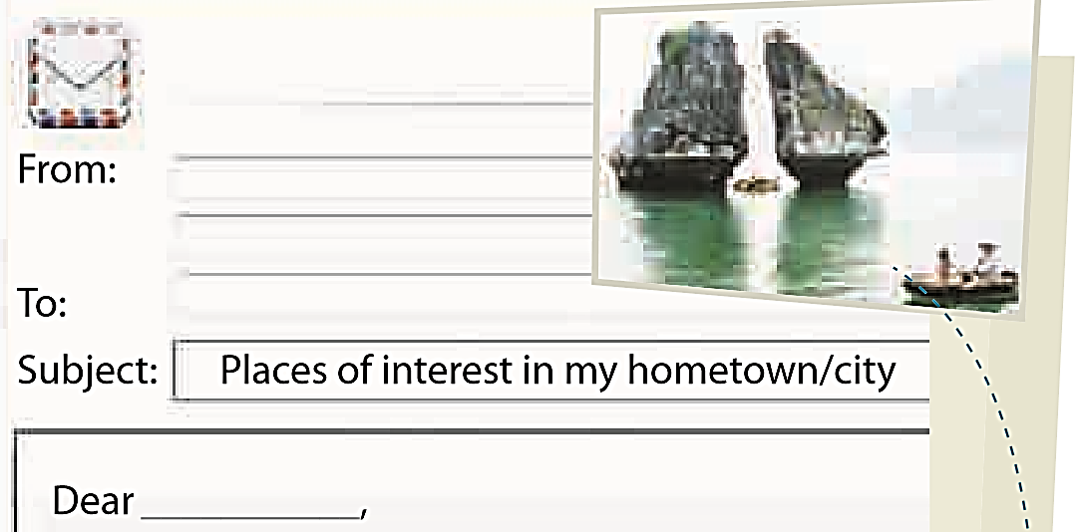

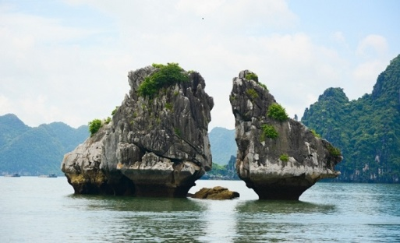
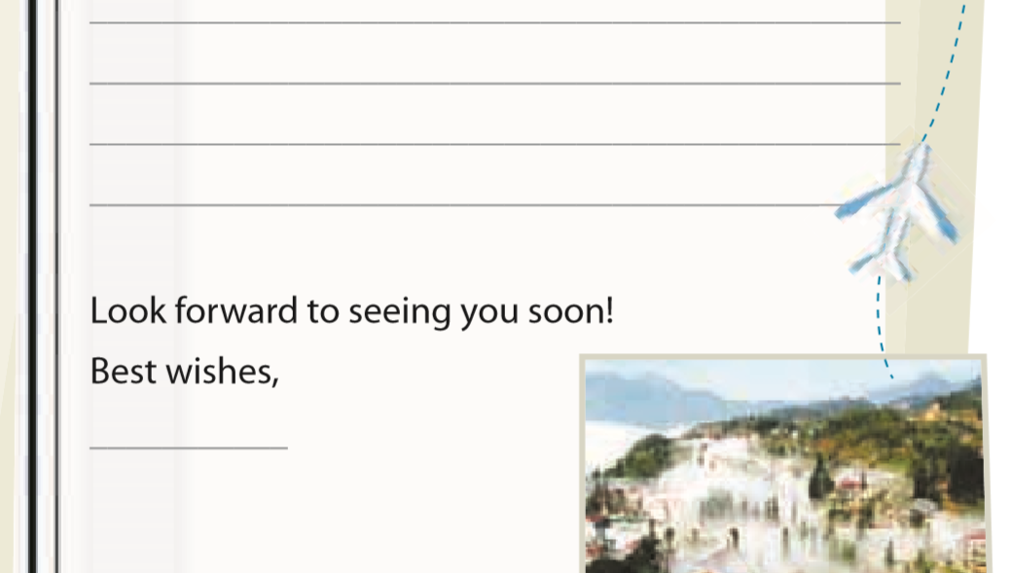
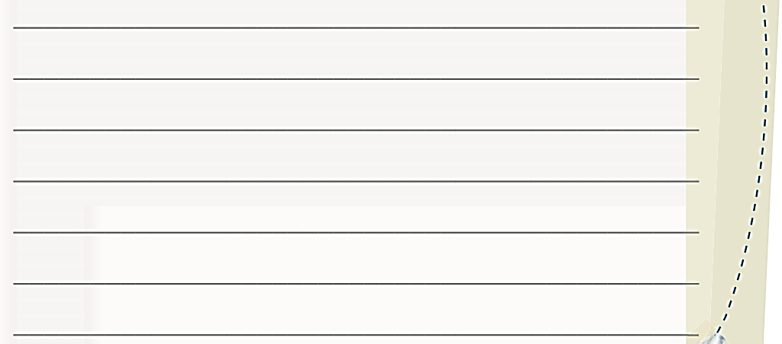
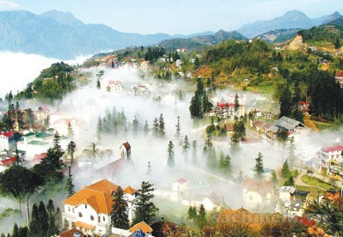
5. Imagine that your Australia pen friend is coming to Viet Nam and will spend a day in your hometown/city. He/She has asked for your advice on the places of interest they should go to and the thing they can do there.
Write an email to give him/her some
information.

Slide 14
vinh@gmail.com
From: ……………………………………
To: ……………………………………
Subject: ……………………………………
Dear…………………,
Look forward to seeing you soon!
Best wishes,
…………………
tony@fastmail.com
Tony
It’s great to know that you are coming to Viet Nam. What a pity you can only spend one day in Ha Noi.
There are many interesting places in Viet Nam, but I think within one day you should be able to visit three places. The first place I suggest is Viet Nam National Museum of History. You can see various artefacts there. The second place is Bat Trang pottery village. If you go there, you can learn to make things and paint on ceramics. Finally, you can visit Ha Noi Botanical Garden. There you can climb up the hill, read books and feed the pigeons.
Tell me when you’re come, so I can show you around these places.
Vinh

Slide 15
REMEMBER
WHAT HAVE YOU LEARNT TODAY!

Slide 16
HOME WORK
-Practice writing more.
-Learn vocabulary by heart.
-Prepare: LOOKING BACK

Slide 17
THANKS FOR LISTENING

