Slide 1

UNIT 1
HOME

Slide 2
LESSON 3

Slide 3
WARM UP
GAME : SENTENCE CHAIN
The game starts with “ My house has a ….”
STUDENT: “My house has a balcony and a pool….”
THAT STUDENT POINTS AT ANOTHER PERSON. THAT PERSON WILL HAVE TO SAY: “My house ………………” and go on.

Slide 4
PRONUNCIATION

Slide 5
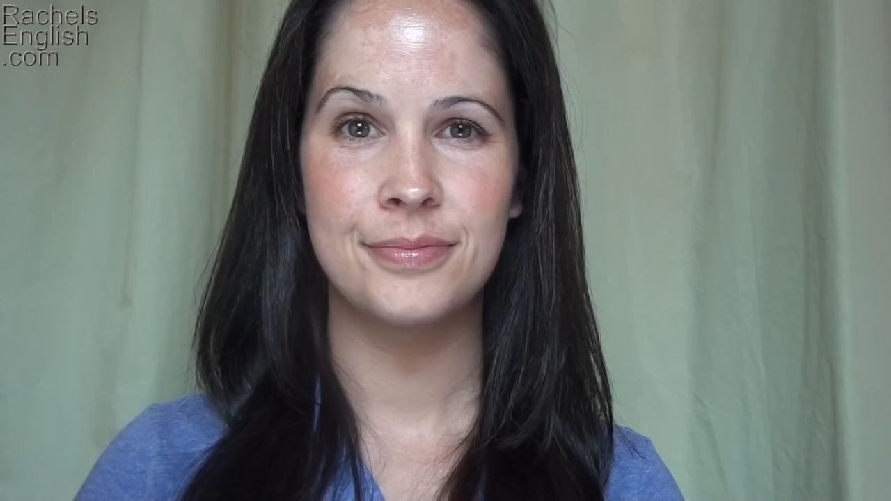
pronunciation
QUESTION
INTONATION

Slide 6



1
PRONUNCIATION
Intonation for yes/no question goes up.
Ngữ điệu với câu hỏi “ Yes, No” được lên giọng ở cuối câu.
Listen and practice the sentences.
1. Do you live in an apartment?
2. Does your house have a pool?
3. Does your house have a yard?

Slide 7
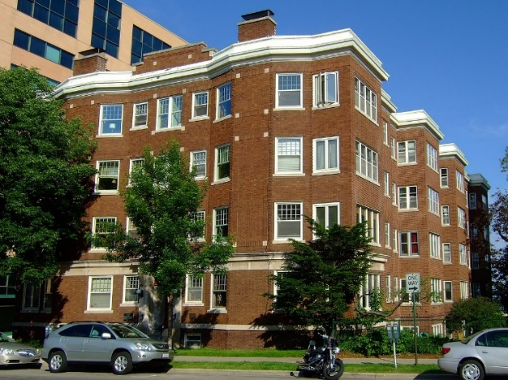
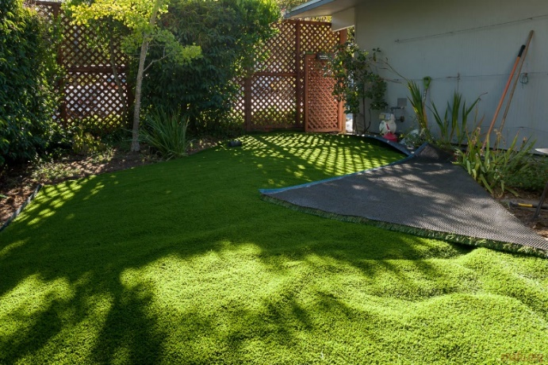
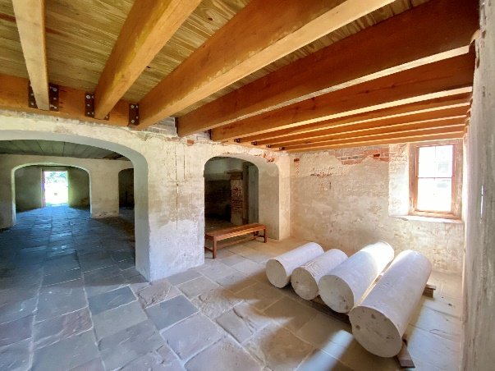
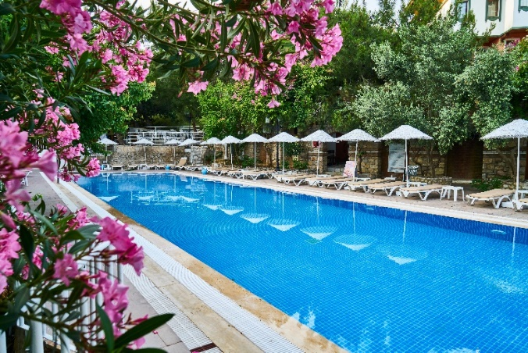


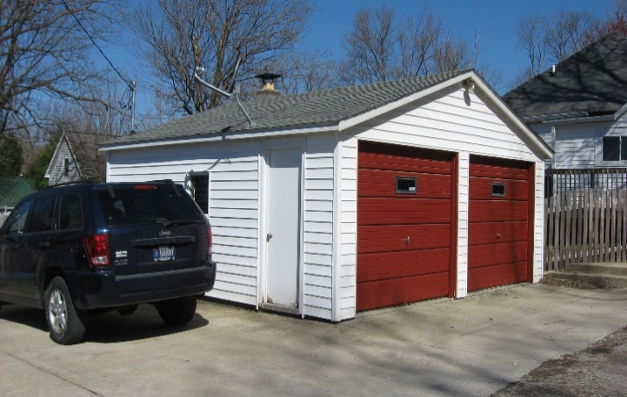

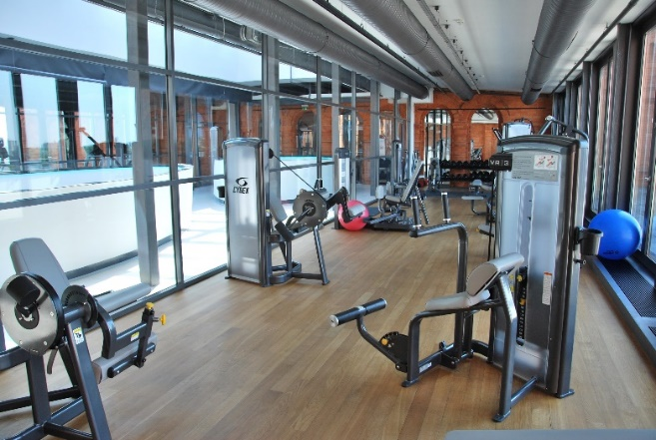
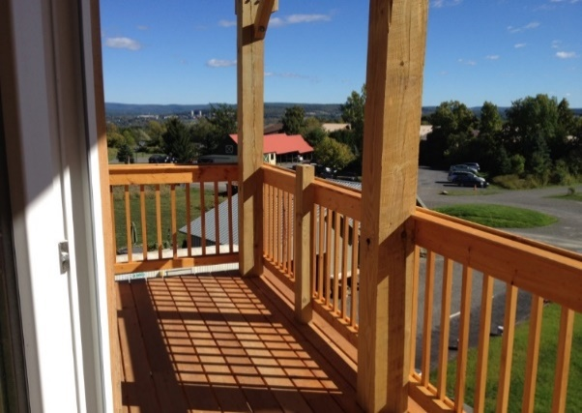
PRACTICE
Ask your partner the questions below. Pay attention to the intonation.
1
2
3
4
5
6
7
8
Sample : Do you live in an apartment? Yes, I do, No, I don’t
Does your house have a yard? Yes, it does/ No, it doesn’t

Slide 8
SPEAKING

Slide 9


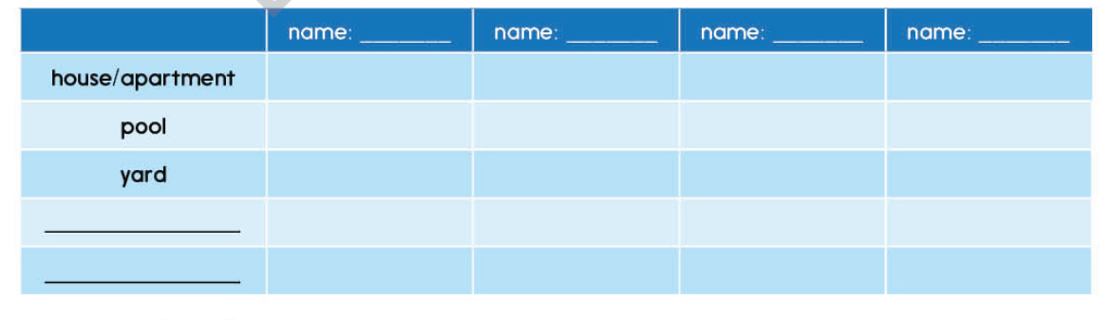
CLASS SURVEY
Speaking tips
Add two more words in the table and then walk around the class
and complete the survey about your classmate’s houses.
Excuse me! Can I ask you some questions?

Slide 10
WRAP - UP
Listen to each student talking about their house then decide whether the sentences are True or False.
 | Sentences | T | F
1. | Chris lives in a big apartment in the city.
2. | Wendy’s house has three bedrooms and a garden.
3. | Gary lives in a small house near the city.
4. | Rose lives in a small apartment. It has one bedroom.
5 | Rose hates her small apartment.
T
F
F
T
F

Slide 11
homework
Practice asking about what houses
Practice speaking /i/ sound
Prepare: Lesson 3 – Grammar (page 12)

Slide 12

THANKS FOR LISTENING

