Slide 1
UNIT 9 RECIPE AND EATING HABITS
LESSON 3 – A CLOSER LOOK 2

Slide 2
Quantifiers: review
e.g. There’s a boy leaning on the fence.
a
an
Indefinite article
E.g: There are some glasses on the table.
There's some butter in the fridge
some
the affirmative with plural countable nouns or uncountable nouns
E.g: Is there any flour left?
There aren't any strawberries in the fridge..
any
in questions and negations

Slide 3
Ex1: Fill each blank with a, an, some, or any.
a
Tom: Nina, you're drinking (1) _____________ cola for breakfast?
Nina: Yes, (2) ______ glass of Coke and (3) _____________ crisps. That's my favourite.
Tom: Don't you know that is a very bad way to start your day?
Nina: Why is it bad?
Tom: Breakfast is the first meal of the day, so it's very important to eat nutritious things.
Nina: Such as?
Tom: If you can't cook (4) _____________ food yourself, have (5) _____________ bowl of cereal and (6) _____________ milk. Then eat (7) _____________ apple.
Nina: But there isn't (8) _____________ milk in the fridge.
Tom: Go out and buy (9) _____________ .
a
some
any
a
some
an
any
some

Slide 4
Charade
3 teams.
Choose 1 representative → Guess the word → Write it on the board
The other members → Describe
Notes:
Matching activity – Give the set of pics and set of verbs. Match and stick the final on the board.

Slide 5
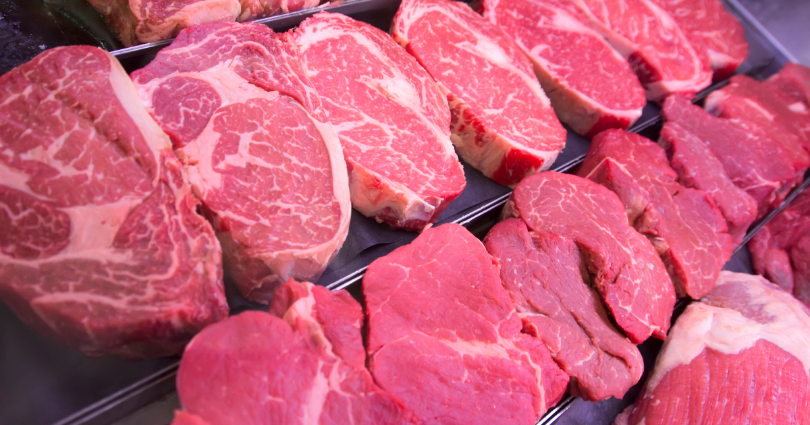
Milk
Sugar
Beef
Celery

Slide 6
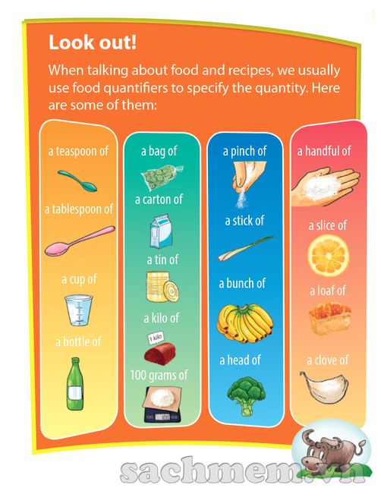
milk, beef, sugar, celery
→ Uncountable noun
a box of milk
→ Countable noun
100 grams of
beef
A teaspoon of
sugar
A stick of
celery
Notes:
We make the milk countable by adding Quantifier: a box of

Slide 7
Work in pairs. Match the food quantifiers with the nouns. Some quantifiers can go with more than one noun.
1. a teaspoon of |  | milk
2. a bottle of |  | b. garlic
3. 300 grams of |  | c. celery
4. a stick of |  | d. cabbage
5. a bunch of |  | e. salami
6. a head of |  | f. beef
7. a slice of |  | g. sugar
8. a clove of |  | h. grapes
a
g
a
f
g
c
h
b
d
e
f
b

Slide 8
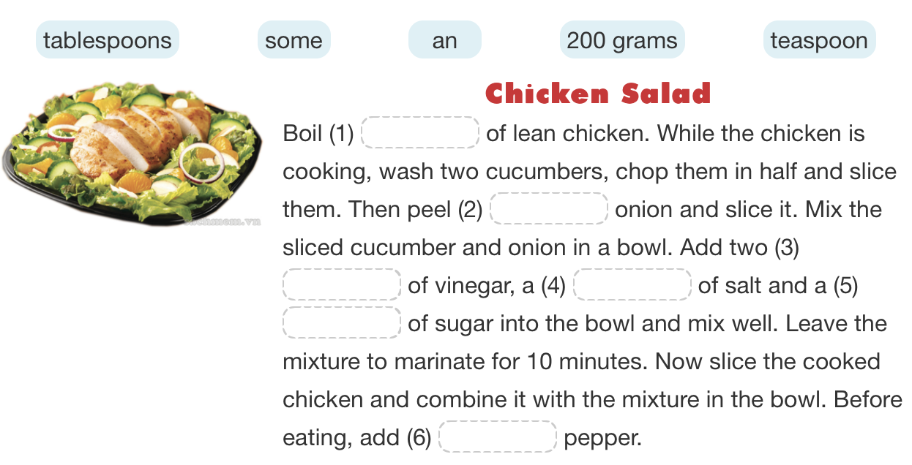
Ex 3. Read and fill each blank with a word/phrase in the box.
200 grams
an
tablespoons
teaspoon
teaspoon
some
Notes:
Homework

Slide 9
If you cut your finger, it will bleed.
→ Conditional type 1 – standard form
What does can in the first sentence express?
What does should in the second sentence express?
Mi: I can wash the spring onions if you like, Mrs Warner.
Nick's mum: ... You should be careful if you use the red knife - it's sharp.
(ability)
(advice)
Notes:
What grammar is this in example 1.

Slide 10
• If you finish your dinner, you can watch TV.
• She can learn to become a good cook if she tries hard.
• If he likes eating spicy food, he may/might add chilli.
• If you don't want to get burnt, you must follow these safety instructions.
• If you feel unwell, you shouldn't eat fast food.
(permission)
(ability)
(possibility)
(necessity)
(advice)

Slide 11
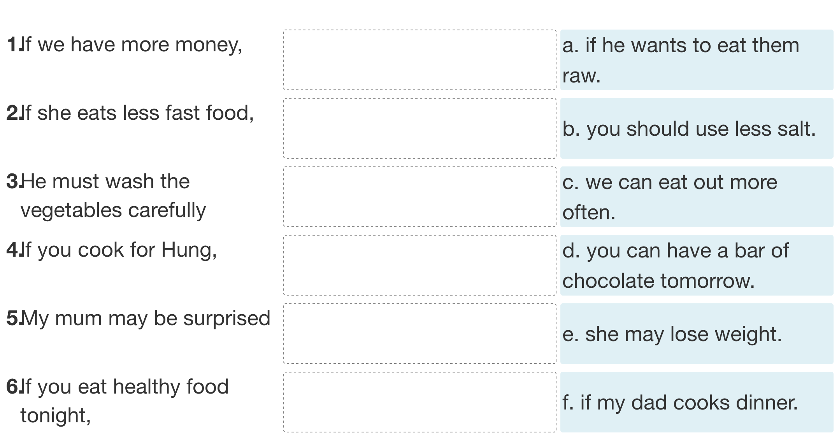
Ex 5. Work individually. Match the first half of the sentence in A with the second half in B.

Slide 12
Ex6. What will you say in these situations?
Your friend, Mai, is not good at cooking, but she wants to study abroad. You think learning to cook is a good idea because she can cook for herself when she's away from home. Give her some advice.
Your friend, Mai, is not good at cooking, but she wants to study abroad. You think learning to cook is a good idea because she can cook for herself when she's away from home. Give her some advice.
→ If you want to study abroad, you should learn to cook

Slide 13
1.Your father likes salty food, but you think it is necessary to reduce the amount of salt in his food. Otherwise, his health will suffer. You share your opinion with him.
2.Your brother is a good eater. He's able to eat three bowls of rice when he's hungry. You tell this to your friend.
3.You want to take a cooking class. Your mum agrees but asks you to choose a class at the weekend. Here is what she says to you.
→ If you want to have good health, you must reduce the amount of salt in your food
→ If my brother is hungry, he can eat three bowls of rice
→ You can take a cooking class if it is at the weekend.

Slide 14
4.Your friend offers you a slice of pork, but you see that it is undercooked. You refuse because it is possible that you will have a stomachache. You tell this to her.
5.Your sister is making a cake. You advise her to whisk the eggs for 10 minutes so that the cake is lighter
→ If I eat this undercooked pork, I may have a stomachache.
→ You should whisk the eggs for 10 minutes if you want a lighter cake.

Slide 15
Money, time, homework,
Luggage, furniture,

