Slide 1
WELCOME TO OUR CLASS

Slide 2

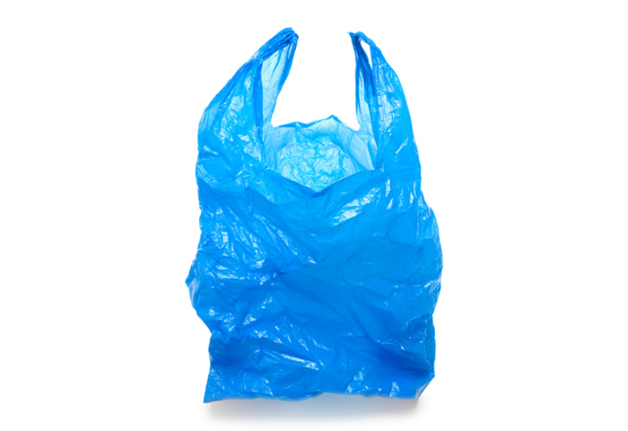
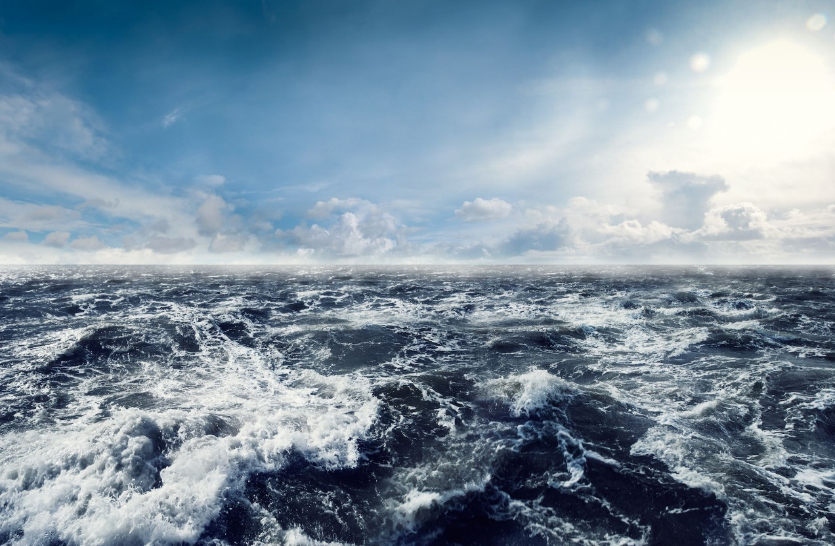
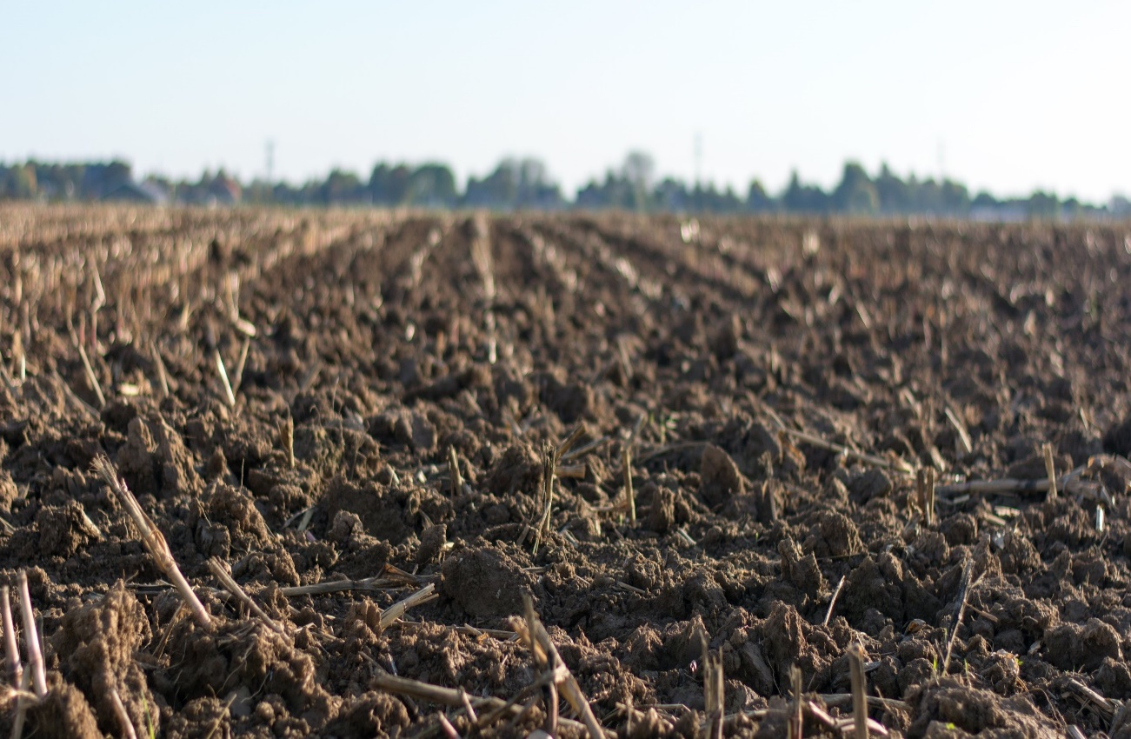
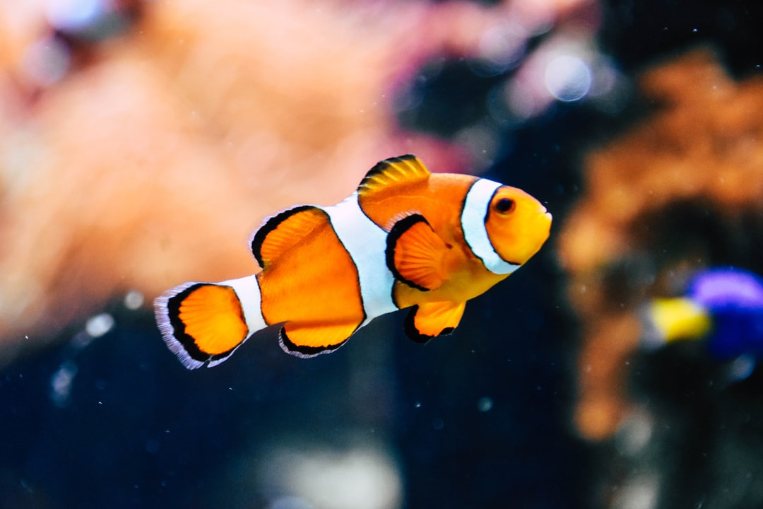
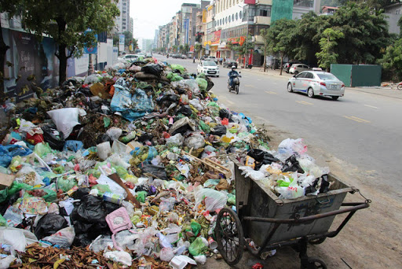
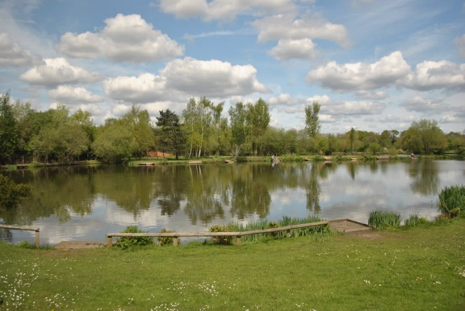
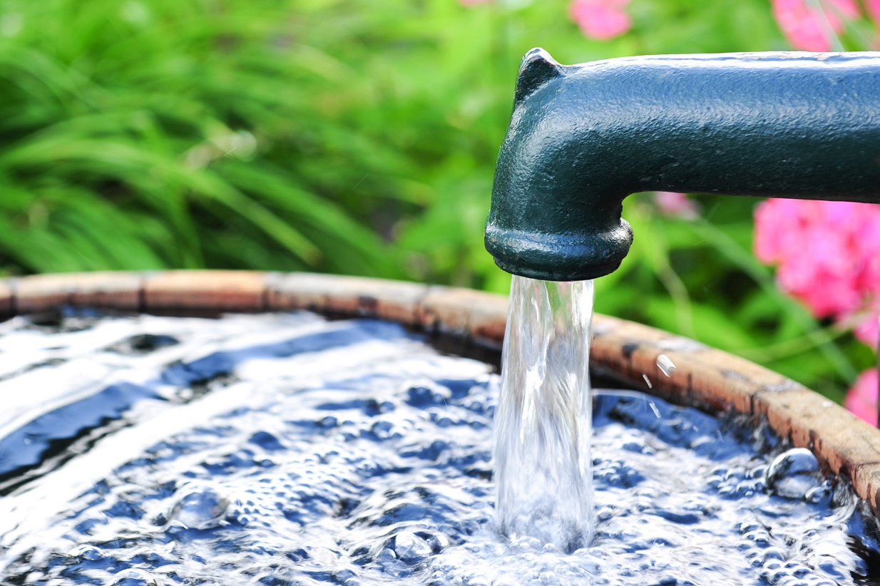
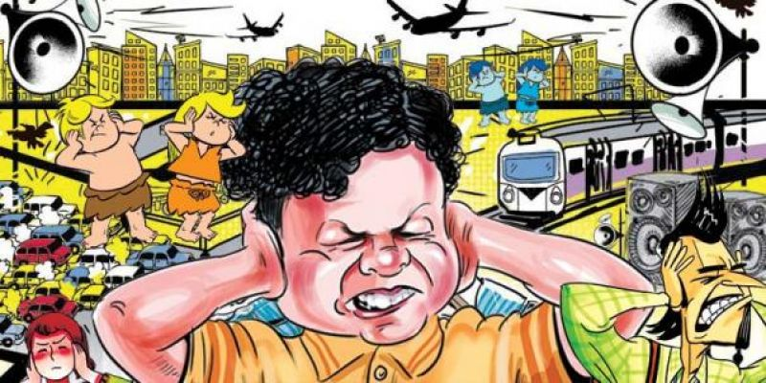
P
L
A
S
T
I
C
P
1
O
2
O
C
E
A
N
L
H
T
3
L
I
G
What is it?
What is it?
What is it?
4
L
K
L
A
E
5
U
R
U
B
B
I
S
H
6
W
A
T
E
R
T
7
F
I
I
S
H
What is it?
8
What kind of bag is it?
What is it?
What is it?
O
S
O
I
L
The…….is so annoying
It’s a …….. bulb.
9
N
N
O
I
S
E

Slide 3
UNIT 7 : POLLUTION
LESSON 1 : GETTING STARTED

Slide 4
KINDS OF POLLUTION

Slide 5
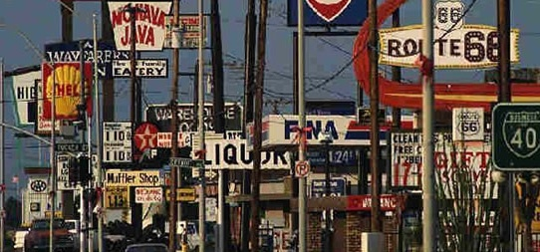
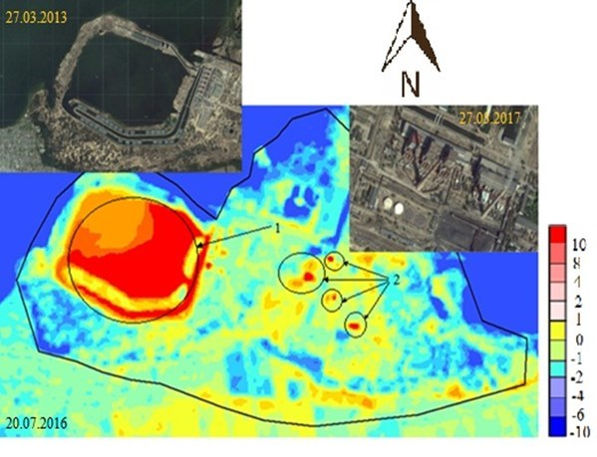
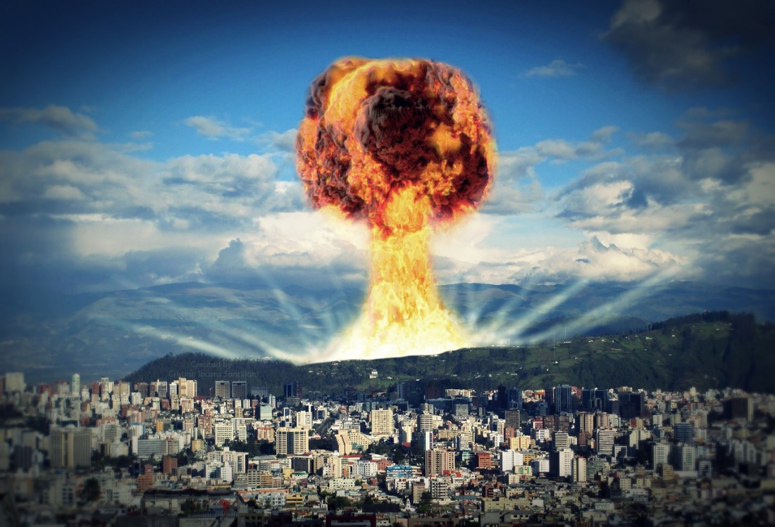
I. NEW WORDS
thermal pollution
/ˈθɜːməl pəˈluːʃən/
: ô nhiễm nhiệt
radioactive pollution
/ˌreɪdiəʊˈæktɪv pəˈluːʃən/
: ô nhiễm phóng xạ
visual pollution
/ˈvɪʒuəl pəˈluːʃən/
: ô nhiễm tầm nhìn

Slide 6


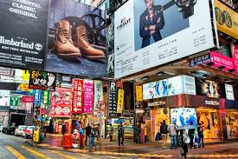
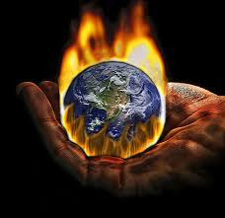
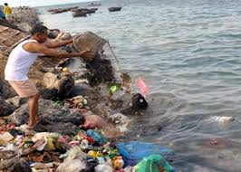
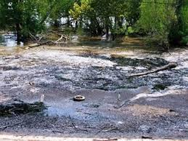
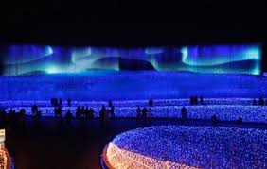
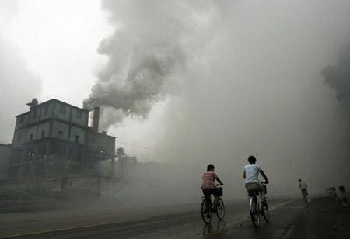
Matching
water pollution land/ soil pollution air pollution noise pollution thermal pollution light pollution radioactive pollution visual pollution
b. noise
pollution
c. visual
pollution
d. thermal
pollution
a. radioactive
pollution
e. water
pollution
f. land/ soil
pollution
g. light
pollution
h. air
pollution

Slide 7
Complete the sentences with the types of pollution.
1. When ……………............. happens, the water temperature in streams, rivers, lakes, or oceans changes.
2. ……………………. occurs when the atmosphere contains gases, dust, or fumes in harmful amounts.
3. When radiation goes into the land, air or water, it is called ………………………
4. Too much use of electric lights in cities may cause …………..
5. ………………….. is the contamination of lakes, rivers, oceans, or groundwater, usually by human activities.
6. ………………………… happens when human activities destroy the Earth’s surface.
7. …………..…… occurs because there are too many loud sounds in the environment.
8. The sight of too many telephone poles, advertising billboards, overhead power lines, or shop signs may case ……………………
thermal pollution
Air pollution
radioactive pollution
light pollution
Water pollution
Land/ Soil pollution
Noise pollution
visual pollution

Slide 8
PREDICTION
T | F | NI
1. The water in the lake has been polluted by a ship.
2. Water pollution in the lake has made the fish die.
3. Aquatic plants may also die because of the polluted water.
4. Nick wouldn’t sneeze so much if the air was clean.
5.Nick and Mi will give a talk about water and air pollution.

Slide 9


Slide 10
CHECK PREDICTION
T | F | NI
1. The water in the lake has been polluted by a ship.
2. Water pollution in the lake has made the fish die.
3. Aquatic plants may also die because of the polluted water.
4. Nick wouldn’t sneeze so much if the air was clean.
5.Nick and Mi will give a talk about water and air pollution.
√
√
√
√
√

Slide 11
01:00
00:59
00:58
00:57
00:56
00:55
00:54
00:53
00:52
00:51
00:50
00:49
00:48
00:47
00:46
00:45
00:44
00:43
00:42
00:41
00:40
00:39
00:38
00:37
00:36
00:35
00:34
00:33
00:32
00:31
00:30
00:29
00:28
00:27
00:26
00:25
00:24
00:23
00:22
00:21
00:20
00:19
00:18
00:17
00:16
00:15
00:14
00:13
00:12
00:11
00:10
00:09
00:08
00:07
00:06
00:05
00:04
00:03
00:02
00:01
00:00
Find a word / phrase that means :
dead
1. no longer alive
L10
2. growing or living in, on, or near water
aquatic
L16
3. throwing away something you do not want, especially in a place with is not allowed
dump
L10
4. A substance that can make people or animals ill or kill them if they eat or drink it
poison
L15
5. Made unclear or unsafe to use
L13
polluted
6. To think of an idea, or a plan
to come up with
L22

Slide 12


Slide 13
Answer the questions.
1. Where are Nick and Mi ?
2. What does the water in the lake look like ?
3. Why is Mi surprised when they get closer to the lake?
4. What is the factory dumping into the lake?
5. Why is Nick sneezing so much ?
01:30
01:29
01:28
01:27
01:26
01:25
01:24
01:23
01:22
01:21
01:20
01:19
01:18
01:17
01:16
01:15
01:14
01:13
01:12
01:11
01:10
01:09
01:08
01:07
01:06
01:05
01:04
01:03
01:02
01:01
01:00
00:59
00:58
00:57
00:56
00:55
00:54
00:53
00:52
00:51
00:50
00:49
00:48
00:47
00:46
00:45
00:44
00:43
00:42
00:41
00:40
00:39
00:38
00:37
00:36
00:35
00:34
00:33
00:32
00:31
00:30
00:29
00:28
00:27
00:26
00:25
00:24
00:23
00:22
00:21
00:20
00:19
00:18
00:17
00:16
00:15
00:14
00:13
00:12
00:11
00:10
00:09
00:08
00:07
00:06
00:05
00:04
00:03
00:02
00:01
00:00
STOP

Slide 14





LUCKY SPIN
30
20
1
2
3
40
10
50
80
4
5
60
70
SPIN

Slide 15






1.Where are Nick and Mi?
They are in Mi's home
village
B. They are in Nick's home
village
C. They are in the city
D. They are in a sea village
BACK

Slide 16

2.What does the water in the lake look like?
A.It's almost blue
B.It's almost black
C.It's almost pink
D.It's almost yellow
BACK

Slide 17
3.Why is Mi surprised when they get closer to the lake?
A.Because the lake is beautiful.
B. Because she hasn’t seen this lake before.
C.Because she sees the fish are dead.
D. Because she wants to swim.
BACK

Slide 18
4.What is the factory dumping into the lake?
A. It's dumping water into the lake
B. It's dumping poison into the lake
C. It's dumping food into
the lake
D. It's dumping plastic bags into the lake
BACK

Slide 19
5.Why is Nick sneezing so much?
A. Because the river is not clean.
B. Because the water is not clean.
C. Because the factory is not clean.
D. Because the air is not clean.
BACK

Slide 20
Answer the questions
1. Where are Nick and Mi ?
→ They are in Mi’s home village.
2. What does the water in the lake look like ?
→ It's almost black .
3. Why is Mi surprised when they get closer to the lake?
→ Because she sees the fish dead.
4. What is the factory dumping into the lake?
→ It's dumping poison into the lake
5. Why is Nick sneezing so much ?
→ Because the air is not clean.

Slide 21
Work in groups. Which types of pollution in 3 does your neighbourhood face? Rank them in order of seriousness. Give reasons for your group’s order.
→ It’s air pollution, noise pollution and visual pollution.
→ Air pollution does harm to your health. Noise pollution can make you stressed. Visual pollution is not good for sight around.
01:30
01:29
01:28
01:27
01:26
01:25
01:24
01:23
01:22
01:21
01:20
01:19
01:18
01:17
01:16
01:15
01:14
01:13
01:12
01:11
01:10
01:09
01:08
01:07
01:06
01:05
01:04
01:03
01:02
01:01
01:00
00:59
00:58
00:57
00:56
00:55
00:54
00:53
00:52
00:51
00:50
00:49
00:48
00:47
00:46
00:45
00:44
00:43
00:42
00:41
00:40
00:39
00:38
00:37
00:36
00:35
00:34
00:33
00:32
00:31
00:30
00:29
00:28
00:27
00:26
00:25
00:24
00:23
00:22
00:21
00:20
00:19
00:18
00:17
00:16
00:15
00:14
00:13
00:12
00:11
00:10
00:09
00:08
00:07
00:06
00:05
00:04
00:03
00:02
00:01
00:00
STOP

Slide 22

CONSOLIDATION

Slide 23
HOME WORK
- Learn the new words by heart.​
- Practice the dialogue again.​
- Do exercises B1,2,3 in workbook (page 4).​
- Prepare for Unit 7: A closer look 1. (new words, grammar)​

