Slide 1

WELCOME TO MY CLASS

Slide 2

* WARM UP
Choose the best answer.

Slide 3




WARM UP
1. They usually ( take) _________ a lot of beautiful photos.
A
TAKES
WHAT A PITY !
B
TAKE
PERFECT
C
TOOK
SORRY !
D
WILL TAKE
SORRY !

Slide 4
WARM UP
2. _______ you still (play) _________ badminton next year?
WHAT A PITY !
A
DO / PLAY
SORRY !
B
ARE / PLAYING
C
WHAT / PLAY
SORRY !
D
WILL / PLAY
PERFECT

Slide 5
WARM UP
3. What _____ Nam (go) _____ to the zoo at the moment?
WHAT A PITY !
SORRY !
SORRY !
PERFECT
A
IS / GOING
B
WILL / GO
C
DOES / GO
d
HAS / GONE

Slide 6
WARM UP
4. We (study) ________ English since 2012.
SORRY !
SORRY !
PERFECT
WHAT A PITY !
A
STUDIED
B
HAVE STUDIED
C
HAS STUDY
D
STUDY

Slide 7
WARM UP
5. I think we (get) ________ a lot of good marks in this semester.
WHAT A PITY !
SORRY !
SORRY !
PERFECT
a
GET
B
HAVE GOT
c
WILL GET
d
ARE GETING

Slide 8
UNIT ONE
MY HOBBIES
A CLOSER LOOK 2

Slide 9
I. GRAMMAR
THE PRESENT SIMPLE TENSE
THE FUTURE SIMPLE

Slide 10
II. PRACTICE
1. Complete the sentences. (Ex. 1/ p.9)
loves
Ngoc ( love) ……….….. the cartoon, but she says she
( not/continue) ………..…………….......this hobby in the future.
2. They usually ( take) ……………… a lot of beautiful photos.
3. What ……......your brother ( do) ………….. in his free time?
4. I think ten years from now more people ( enjoy) ……….………………….... gardening.
5. .………… you (do) ……………... morning exercises every day?
6. …………you still ( play) ………..….. badminton next year?
won’t continue
take
does do
will enjoy
Do do
Will play

Slide 11
2. Read the table and complete his report using the present simple. (Ex. 2/ p.9)
Name Activity | Boys |  |  | Girls
 | Nam | Son | Binh | Ly | Hue
Watching TV | everyday | everyday | everyday | everyday | everyday
Swimming |  |  |  | X 3 per week | X 3 per week
Playing badminton | everyday | everyday |  | X 4 per week | everyday
Nick’s report
I ask some classmates about their hobbies and I got some interesting results. Everybody ( 1. like) ………….… watching TV, and they (2. watch) ….…………….. it everyday. The three boys Nam, Son, Binh ( 3 not love) ……………..…… swimming, but the two girls, Ly and Hue (4. go) ……………swimming three times a week. Most of them (5. enjoy) ………..……… playing badminton. Nam, Son and Hue (6. play) ……………… badminton everyday and Ly (7. play) …….………….… the sports four times a week. Only Binh (8. not like) ………................…. badminton, he never (9. play) …………….…. it.
likes
watch
don’t love
go
enjoy
play
plays
doesn’t like
plays

Slide 12
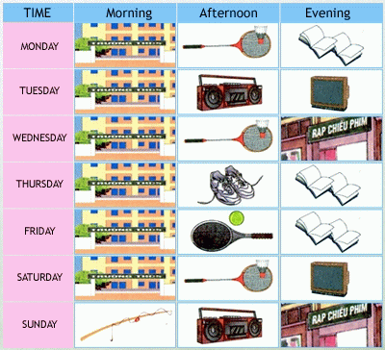
3. Work in groups. Ask and answer about the frequency they do these activities. (Ex. 3/ p. 10)
A: How often do you go to school?
B: I usually go to school / I go to school everyday.

Slide 13
III. LOOK OUT
Verbs of liking + V - ing
We often use the – ing form after verbs of liking and not liking. These verbs are like, love, enjoy, hate, dislike ……..
Example:
I like going to the cinema.
She hates cleaning the floors.

Slide 14
1. Complete the sentences, using the – ing form of the verbs in the box. (Ex. 4/ p. 10)
riding
My Dad enjoys ……………….. his bike to work.
My Mum doesn’t like ……………….... films on TV, She loves …………………………..to the cinema.
I like ………………..… to my friends in my free time.
My younger brother loves……………..…… monopoly with me every evening.
They hates ……………..….. noodles .They prefer rice.
Does your grandma enjoy……………………………?
walk
watching
watch
going
talk
talking
go
playing
play
eating
ride
walking
eat

Slide 15
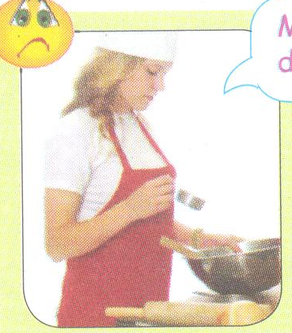
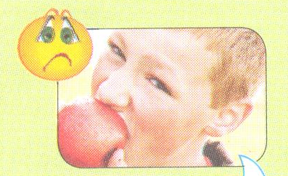
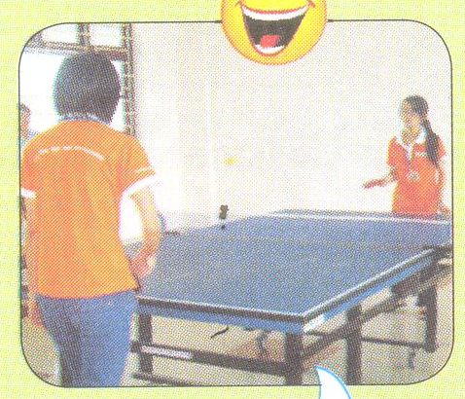
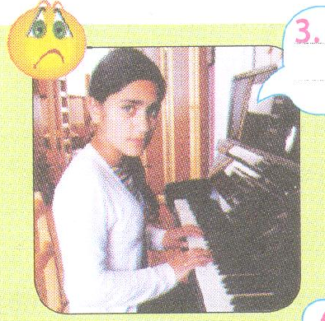
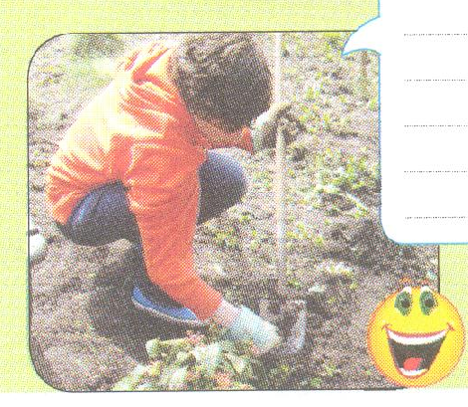
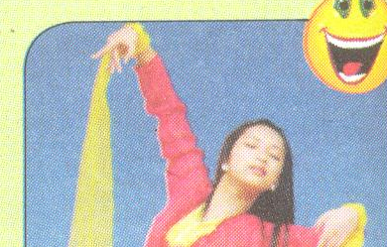
2. Look at the pictures and write sentences. Use the suitable verbs of liking or not liking and the – ing form. (Ex. 5/p.10)

Slide 16

10
6
20
1
4
19
Lose turn
20
2
5
15
3
11
6
30
10
lucky
No mark
lucky
No mark
No mark
9
5
Double points
Double points
Double points
13
Notes:
16

Slide 17
2. Look at the pictures and write sentences. Use the suitable verbs of liking or not liking and the – ing form. (Ex. 5/p.10)
My cousin, Vy, doesn’t like cooking.

Slide 18
2. Look at the pictures and write sentences. Use the suitable verbs of liking or not liking and the – ing form. (Ex. 5/p.10)
He doesn’t like eating apples.

Slide 19
2. Look at the pictures and write sentences. Use the suitable verbs of liking or not liking and the – ing form. (Ex. 5/p.10)
They love playing table tennis.

Slide 20
2. Look at the pictures and write sentences. Use the suitable verbs of liking or not liking and the – ing form. (Ex. 5/p.10)
She hates playing the piano.

Slide 21
2. Look at the pictures and write sentences. Use the suitable verbs of liking or not liking and the – ing form. (Ex. 5/p.10)
He enjoys gardening.

Slide 22
2. Look at the pictures and write sentences. Use the suitable verbs of liking or not liking and the – ing form. (Ex. 5/p.10)
She likes dancing.

Slide 23
3. What does each member in your family like or not like doing? Write the answers. (Ex. 6/p.10)
1. My father likes …………………………..
2. My father hates …………………………..
3. My mother enjoys ……………………….
4. My mother doesn’t like …………………..
5. My brother / sister loves …………………
6. My brother / sister doesn’t like ………...

Slide 24
IV. At home
Learn new words and the structures.
Practise the exercises again.
Do exercises B2 – B6 (page 5, 6/ workbook).
Prepare COMMUNICATION.

Slide 25
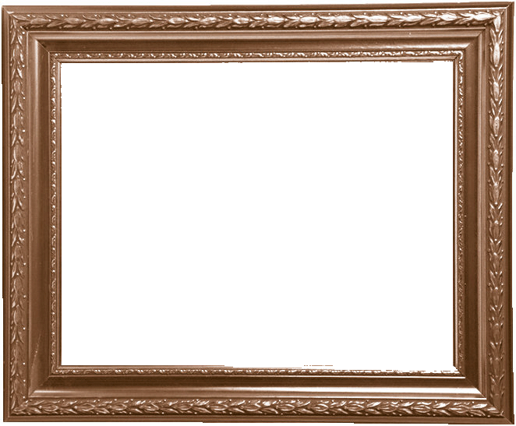



Notes:
25

Slide 26



The bye bye
song
Notes:
26

