Slide 1

Teacher: Doan Le
Long Bien Secondary School
Unit 10: COMMUNICATION
LESSON 1: GETTING STARTED
School year: 2020 - 2021

Slide 2
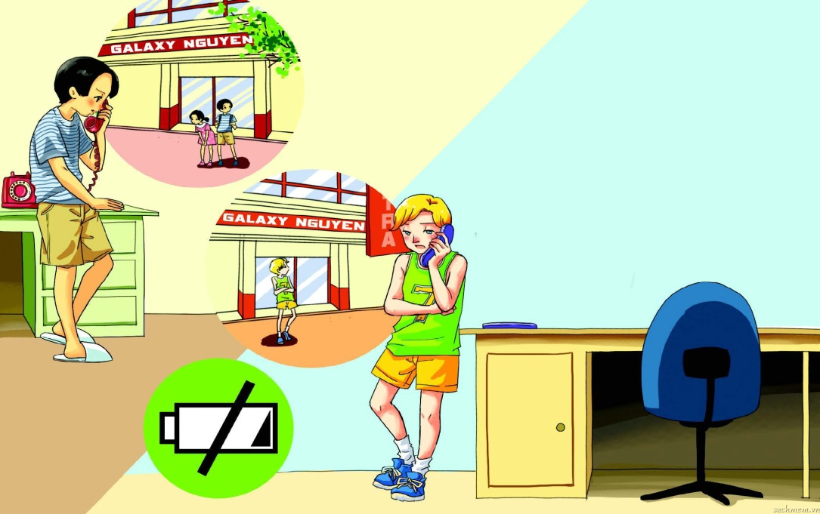
UNIT 10 COMMUNICATION
Lesson 1: Getting started

Slide 3

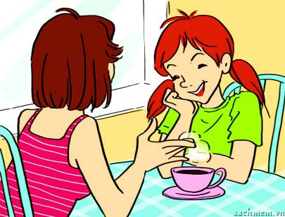


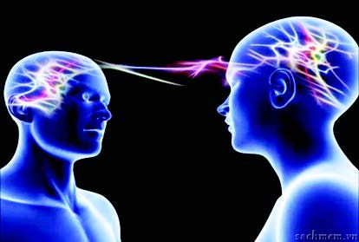
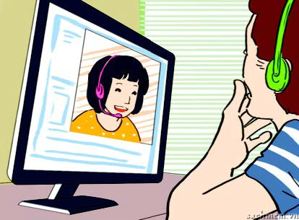
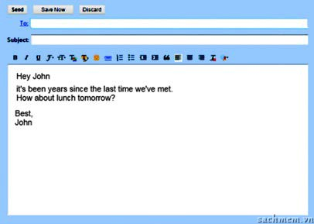
COMMUNICATION CHANNEL?
How do people communicate with others?

Slide 4

1. Listen and read.
Phuc: Hi Nick. What happened today? We were waiting for ages and you never showed up!
Nick: Hi Phuc. Well I wanted to ask you the same question.
Phuc: Why? We planned to meet outside the cinema, didn’t we? We waited and then Mai decided to go in without you. She didn’t want to miss the start of Frozen you know. Did you oversleep or something?
Nick: No, I was there on time, and it was me who waited for you two.
Phuc: Are you kidding? We didn’t see you there. We tried to call you but couldn’t get through.
Nick: I couldn’t call you either. My battery was flat.
Phuc: Never mind. We can try again. How about this Sunday afternoon at 2.30 p.m.? There’s Superman 3.
Nick: Great..., but I’ll be having my Vietnamese class then. Let’s go for the 4.15 p.m. show. I’ll need to take the bus to Nguyen Du Street and it’s quite far.
Phuc: But it’s not Galaxy Nguyen Du! We’ll be seeing it at Galaxy Nguyen Trai... Wait... Which cinema did you go to today?
Nick: Oh no, I went to Galaxy Nguyen Du. I wish my mobile phone had a better battery!

Slide 5
Find words or phrases in the conversation that mean:
1. to wait for a very long time
Wait for ages
2. to arrive
Show up
3. to succeed in talking to someone on the phone
Get through
4. “My battery had no electrical power left.”
‘‘My battery was flat.’’
5. “Are you making a joke?”
“Are you kidding?”
6. “Let’s do that again.”
“We can try again.”

Slide 6
b. Decide if the statement are true (T) or false (F).
1.Phuc, Mai and Nick wanted to see a film today at Galaxy cinema.
2.Only Mai and Phuc watched the film.
3.Nick was asleep at home at that time.
4.Mai and Phuc could not reach Nick on the phone.
5.Nick went to the wrong Galaxy cinema.
6.Nick will not be able to go to the cinema at 2.30 p.m. this Sunday because he will be having a class.
T
T
F
Nick was waiting outside the cinema but it’s wrong
T
T
T
T

Slide 7
c. Answer the questions
1. Why couldn’t Phuc, Mai and Nick see the film together as was their plan?
2. What was the problem?
3. Was it only because of Nick’s mobile phone?

Slide 8
c. Answer the questions
1. Why couldn’t Phuc, Mai and Nick see the film together as was their plan?
They couldn’t see the film together because Nick went to the wrong cinema.
2. What was the problem?
They didn’t communicate clearly the name and address of the cinema beforehand. Then they were not able to contact each other because the battery of Nick’s mobile phone was flat.
3. Was it only because of Nick’s mobile phone?
No, it wasn’t. + Nick went to the wrong cinema.
+ Then they were not able to contact each other because the battery of Nick’s mobile phone was flat.

Slide 9
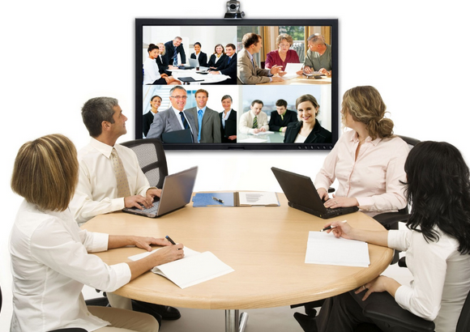
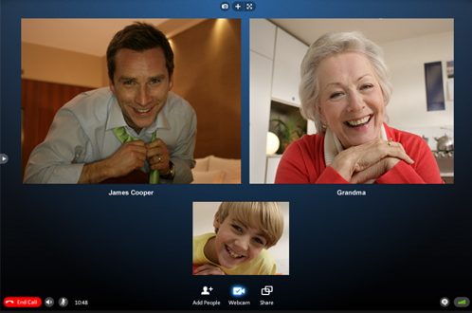


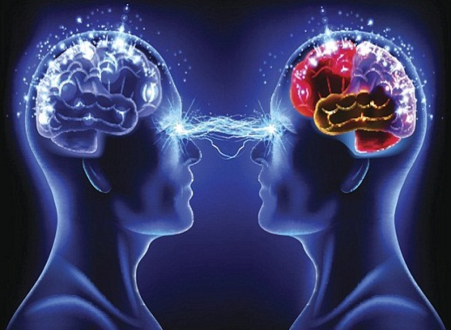

2. Match the words /phrases with the photos about way of communication. Then listen to check your answers.
Using social media emailing meeting face to face (F2F)
video chatting having a video conference
using telepathy sending letters ( snail mail )
1.
2.
3.
having a video conference
Emailing
Video chatting
4.
5.
6.
7.
Meeting face-to-face (F2F)
Using social media
Using telepathy
Sending letters (snail mail)

Slide 10
3.Fill the gaps with the correct form of the words /phrases from the box in 2
Using social media emailing meeting face to face (F2F)
video chatting having a video conference
using telepathy sending letters ( snail mail )
Using social media
1.........................................including Facebook , YouTube etc. as a means of communication has become very popular among young people.
2.Our group has worked on line the whole time ! Now let's ...............................!
meet face to face
emailing
3.If you want to write to a friend in another country, .....................is a faster and cheaper way than ....................................................
sending letters ( snail mail)
Using telepathy
4.................................. is a way to communicate instantly by thought.
5.In the future, maybe voice calls will disappear. We will use .......................... to talk to and see a friend at the same time.
video chatting
have a video conference
6. We should .............................. ................this week. Kate will be able to join us from Hong Kong , and perhaps Tim from England too.

Slide 11
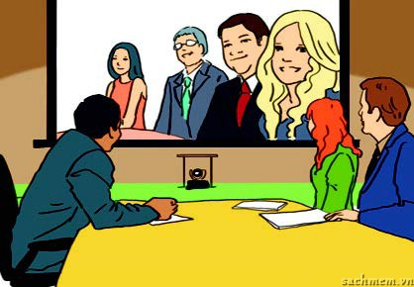
REMEMBER
COMMUNICATION CHANNEL?

Slide 12
Homework
Learn by heart the new words.
Speak with your friends about ways of communication
Prepare a closer look 1

Slide 13
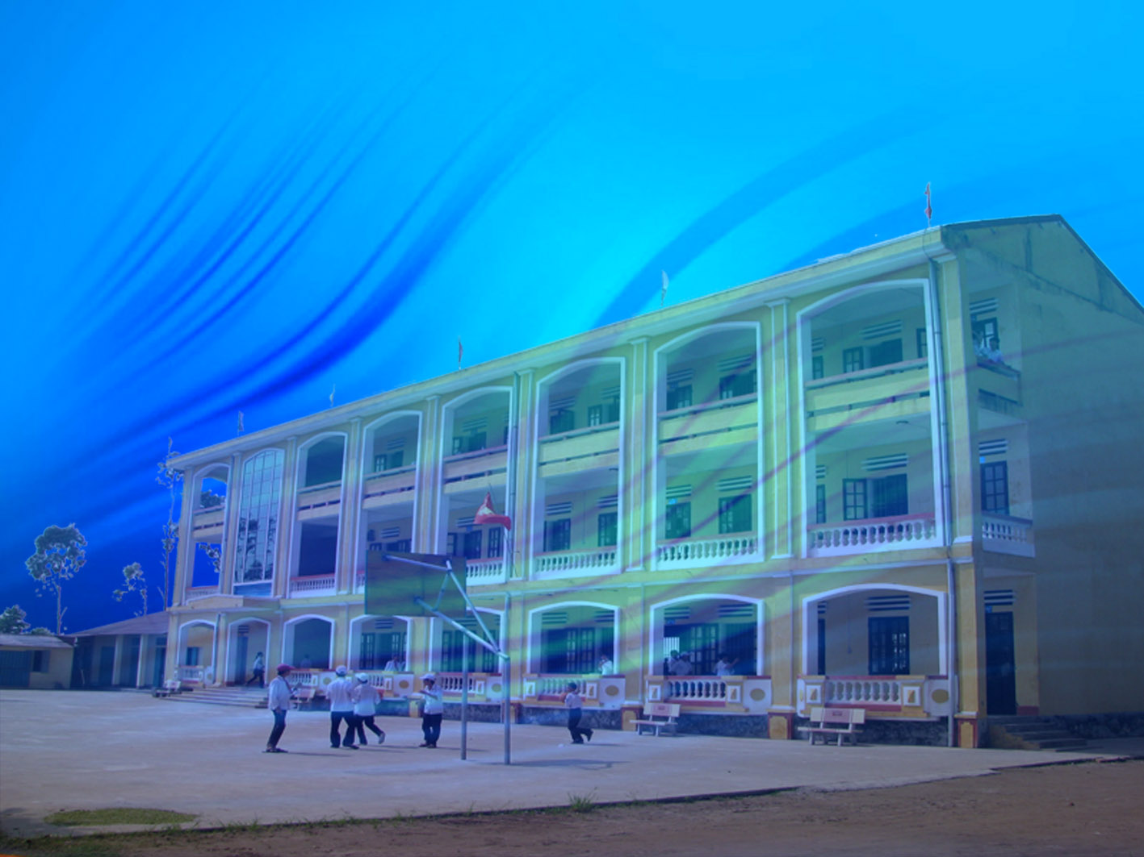






Thanks for your attendance
Goodbye

