Slide 1



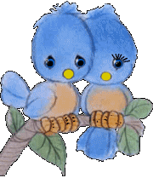
Dong Hai Secondary School
WELCOME TO OUR CLASS TODAY
Subject: English 8

Slide 2
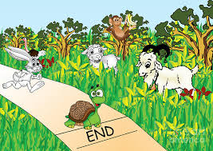

Monday, December 9th , 2019
Unit 6: FOLK TALES
Period 46: A closer look 2(p.61, 62)

Slide 3
Monday, December 9th, 2019 Unit 6: FOLK TALES Period 46: A closer look 2(P. 61, 62)
Grammar:
Past continuous:
1a. Read part of the conversation from GETTING STARTED. Pay attention to the underlined part.
Duong: I phoned you around 9 p.m last night, but no reply.
Nick: Oh, I was doing some Internet research on Vietnamese legends for my project.

Slide 4
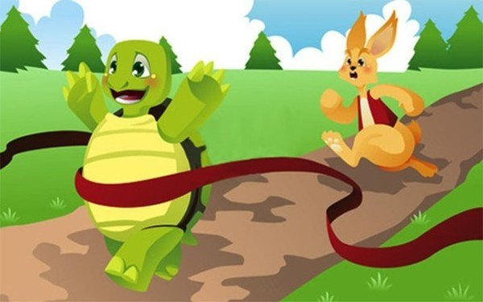

Ex2: At 3p.m yesterday the tortoise was running ahead of the hare.
1b. When do we use the past continuous ?
Ex1: Yesterday I (see) a hare and a tortoise.
saw
V₂
Form: S + was/ were + Ving
Past continuous (quá khứ tiếp diễn)
Usage: We use the past continuous to describe an action that was in progress at a stated time in the past. (diễn tả 1 hành động diễn ra tại 1 thời điểm xác định trong quá khứ)

Slide 5
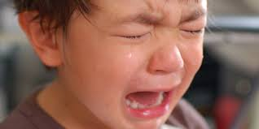

a fairy appeared
- When the boy was crying, ,
- A fairy appeared
while the boy was crying
S + was/ were + Ving , S + V_{2/ed}
(quá khứ tiếp diễn)
(quá khứ đơn)
(hành động đang diễn ra
trong quá khứ)
(hành động xen vào)
(when / while )

Slide 6
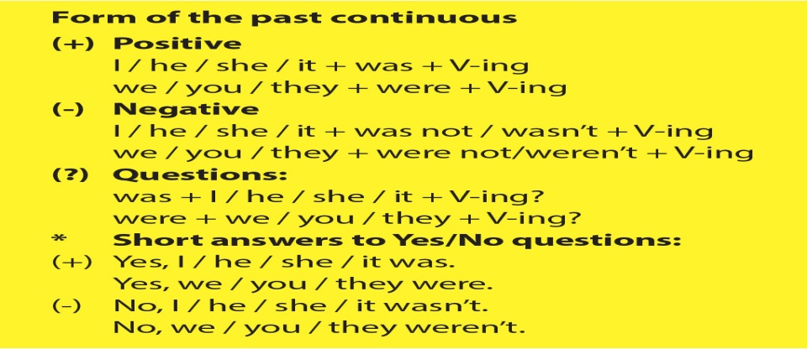
(quá khứ tiếp diễn)

Slide 7
DẤU HIỆU NHẬN BIẾT
at + giờ + thời gian trong quá khứ (at 12 o’clock last night,…)
- at this time + thời gian trong quá khứ. (at this time two weeks ago, …)
- at that moment
+ Trong câu có “when/while” khi diễn tả một hành động đang xảy ra và một hành động khác xen vào.

Slide 8
2. Complete the following sentences by putting the verbs in brackets in the correct form:
was wearing
1. When the prince saw Cinderella at the party, she (wear) …………... a beautiful gown.
2. What (you/ do) …………….…….this time yesterday?
3. When Jack (go) …………….. to the market, he met a magician.
4. While the hare was sleeping, the tortoise (run) ……… to the finish as fast as he could.
5. When the princess returned, the prince (not wait) …………………
for her.
were you doing
was going
ran
wasn’t waiting

Slide 9
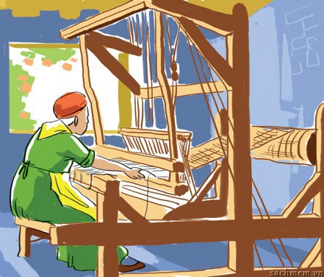
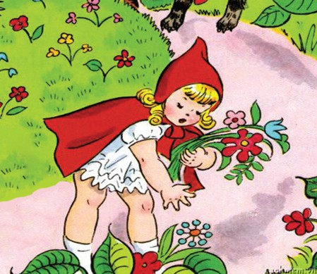
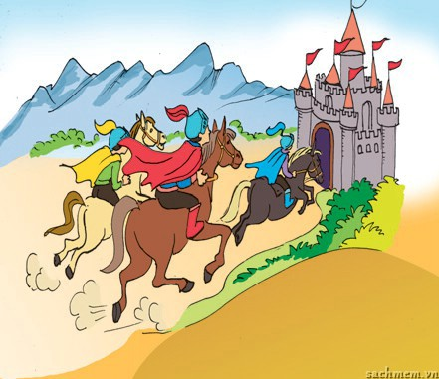
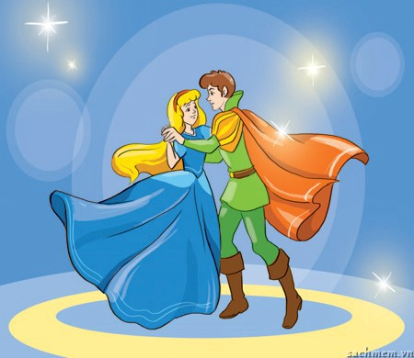
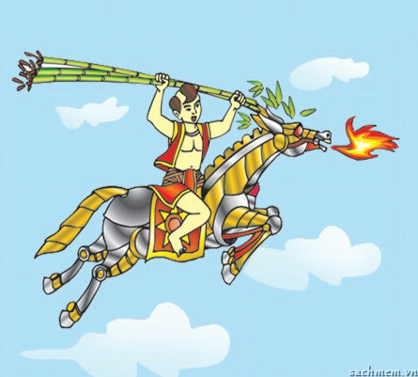
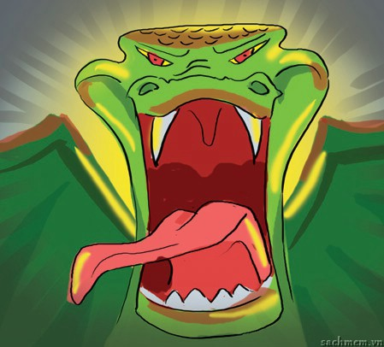
3a. Use the past continuous and the the suggested words to
write sentences to describe what was happening in each picture.
1.servant/ spin/ in the woods
2.girl/ pick flowers/ by the side of the road
3. knights/ ride horses/ to the castle
1.The servant was spinning in the woods.
2. The girl was picking flowers by the side of the road
3. The knights were riding horses to the castle
4. Cinderella was dancing with the prince
5. Saint Giong was flying to heaven.
6. The ogre was roaring with anger.
4.Cinderella/ dance/ with the prince
5.Saint Giong/ fly/ to heaven.
6.ogre/ roar/ with anger

Slide 10
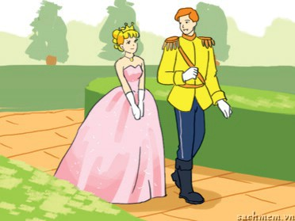
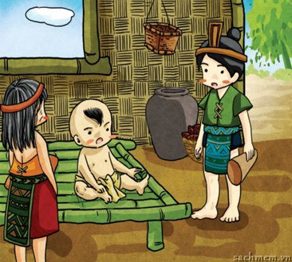
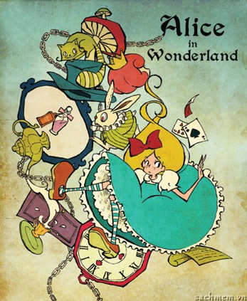
4. Write the correct form of each verb, using the past continuous or the past simple.
S + was/ were + Ving , S + V_{2/ed}
(when / while )
1.The prince (walk) …………..... along the road when he met a princess, so he (stop) ……….. and (have) ……….a chat with her.
2. When Saint Giong (lie) …………..on the bed, he (hear) ……….…..an announcement that the emperor(need) …..........brave men to protect his land.
3.Alice was walking alone in the woods when she suddenly (hear) …………. footsteps behind her. Someone (follow) …........
her. She was frightened and she (start) ………….to run.
was walking
was lying
heard
heard
stopped
needed
was following
had
started

Slide 11
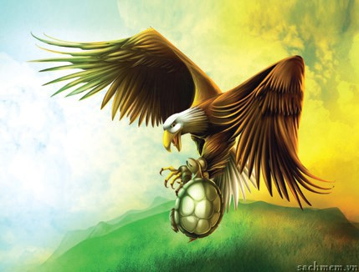
5. a. Read the fable and put the verbs in brackets into the past simple or the past continuous.
b. What is the moral of the fable?
 Be happy with what you have/ you are.
It was a nice day. The sun (1. shine) …………… and a tortoise(2.sleep)
………………. in the sun. He opened his eyes and saw that an eagle was flying in the sky. “I want to fly like that!” the tortoise said. The eagle heard him and agreed to help. The eagle picked up the tortoise, and off they (3. go) …………... When they (4. fly) …………………….very high in the sky, the eagle (5. open) …………. his claws for the tortoise to fly. But the poor tortoise (6. fall) ……………all the way down to earth.
was shining
was sleeping
went
was flying
opened
fell

Slide 12
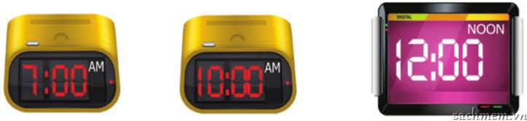
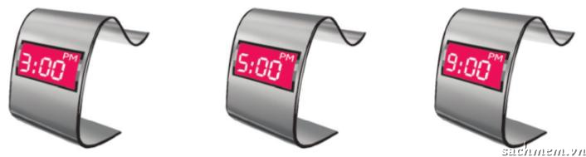
Monday, December 9th , 2019 Unit 6: FOLK TALES Period 46: A closer look 2(P. 61, 62)
I. Grammar:
Past continuous:
Form: S + WAS/ WERE + V-ing.
II. Practice:
Guess what YOUR partner was doing last Sunday at these times
III. Game:
Example:
A: Were you having breakfast at 7 a.m. last Sunday?
B: Yes, I was./ No, I wasn’t.
Example:
I think Minh was having breakfast at 7 a.m. last Sunday.

Slide 13


1
2
3
4
5
6
1. We (have) ………. dinner when he came.
A: having
B: had
C:were having
D: have
TRỢ GIÚP
Notes:
Nội dung game show “Ai là triệu phú”

Slide 14
1
2
3
4
5
6
2. What (you/do) ………. from 3p.m to 6 p.m yesterday?
A: did you do
B: are you doing
C: do you do
D: were you doing
TRỢ GIÚP
Notes:
Nội dung game show “Ai là triệu phú”

Slide 15
1
2
3
4
5
6
3. When I (come) …. home, my mother was cooking dinner.
A: came
B: coming
C: come
D: comes
TRỢ GIÚP
Notes:
Nội dung game show “Ai là triệu phú”

Slide 16
1
2
3
4
5
6
4. He (plant) ….. trees in the garden at 4 pm yesterday.
A: is planting
B: plant
C: was planting
D: planted
TRỢ GIÚP
Notes:
Nội dung game show “Ai là triệu phú”

Slide 17
1
2
3
4
5
6
5. Last night, I (watch) …. TV with my brother.
A: watching
B: watched
C: watches
D: was watching
TRỢ GIÚP
Notes:
Nội dung game show “Ai là triệu phú”

Slide 18
1
2
3
4
5
6
6. At this time last year, I (attend) …… an English course
A: attend
B: attended
C: was attending
D: were attending
TRỢ GIÚP
Notes:
Nội dung game show “Ai là triệu phú”

Slide 19
Special round
7. They (dance) …. merrily when Cinderella suddenly (leave) … the party.
A: danced - left
B: were dancing - left
C: danced - leaving
D: is dancing - left
TRỢ GIÚP
Notes:
Nội dung game show “Ai là triệu phú”

Slide 20
Special round
8. Mrs Lan (do)…. the gardening at 5p.m yesterday ?
A: is doing
B: was doing
C: Is Mrs Lan doing
D: Was Mrs Lan doing
TRỢ GIÚP
Notes:
Nội dung game show “Ai là triệu phú”

Slide 21
Unit 6: FOLK TALES Period 46: A closer look 2 (P. 61, 62)
I. Grammar:
Past continuous:
Form: S + WAS/ WERE + V-ing.
II. Practice:
III. Game:
IV. Homework:
Study the grammar.
- Do exercise B4, B5, B6 (p.44, 45) (Workbook).
- Prepare : Unit 6: Lesson 4: Communication.

