Slide 1



Slide 2
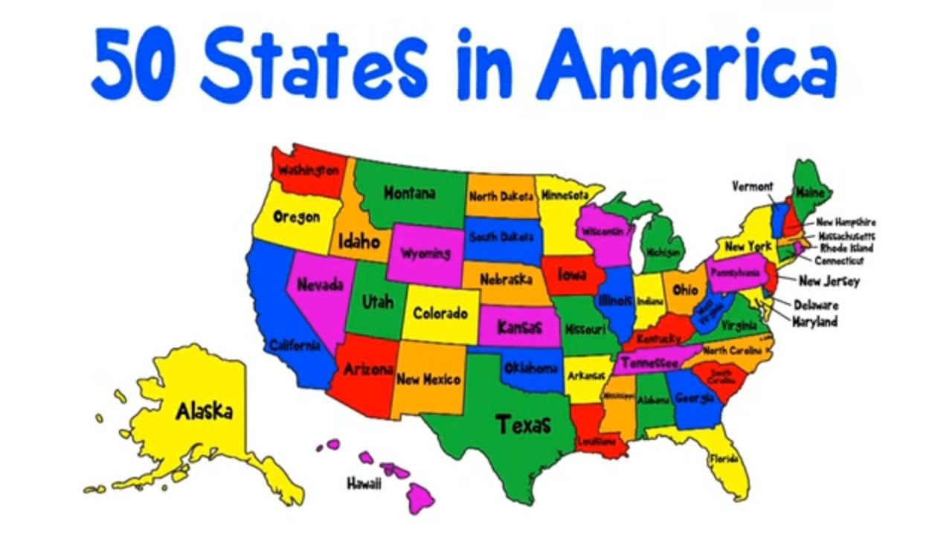
Guessing game
Which country is it?
The USA

Slide 3
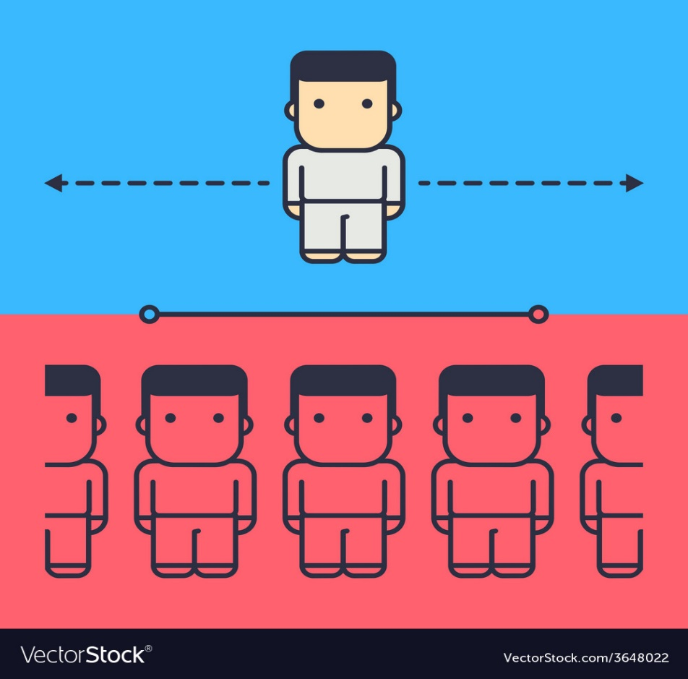
Guessing game
Which country is it?
It has the smallest population.
New Zealand

Slide 4
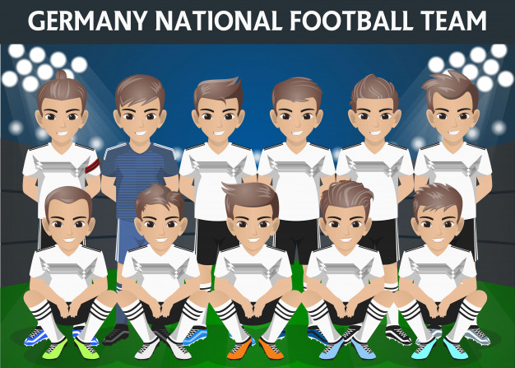
Guessing game
Which country is it?
It has the most famous football clubs in the world.
The United Kingdom

Slide 5
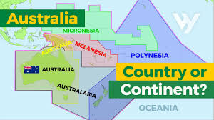
Guessing game
Which country is it?
It is both country and continent
Australia

Slide 6
UNIT 8. ENGLISH SPEAKING COUNTRIES
Period 65. Lesson 4. Communication

Slide 7
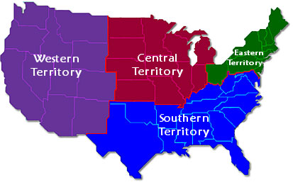
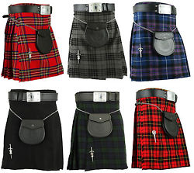
I. New words:
1, territory (n)
/ˈterɪtəri/ : lãnh thổ
2, kilt (n)
/kɪlt/ : váy caro của đàn ông Xcốt-len

Slide 8
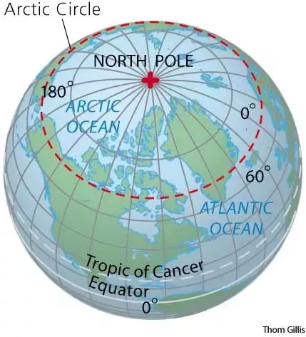
I. New words:
3, North Pole (n)
: Bắc Cực
4, Arctic Circle (n)
/ˈɑ:ktɪk/ : vòng Bắc Cực

Slide 9
Fill in the blanks
Territory Kilt North Pole Arctic Circle
1________
Territory
is a land that is under control of a particular country.
2________
North Pole
is the point on the surface of the Earth that is furthest north.
3________
Arctic Circle
is the line of latitude 66° 33′ North
4________
Kilt
is the skirt traditionally worn by Scottish men and boys

Slide 10
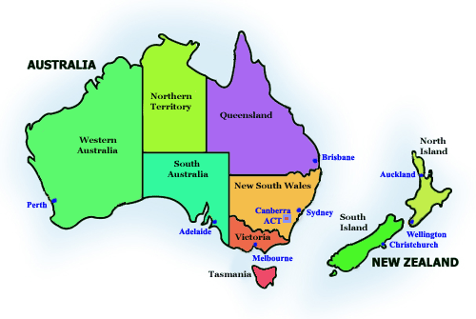
II. Quiz time
Question 1
______ are both surrounded by the sea.
A. The UK and the USA
B. Canada and New Zealand
C. Australia and New Zealand
D. The USA and Australia
Notes:
Key: 1C

Slide 11
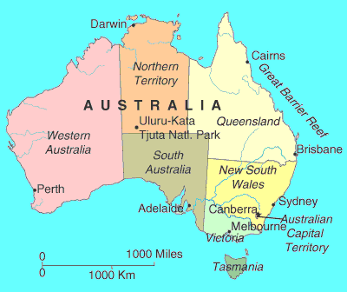
II. Quiz time
Question 2
Of these countries, _____ is the youngest.
A. Australia
B. Canada
C. The USA
D. The United Kingdom
Notes:
Key: 1C

Slide 12
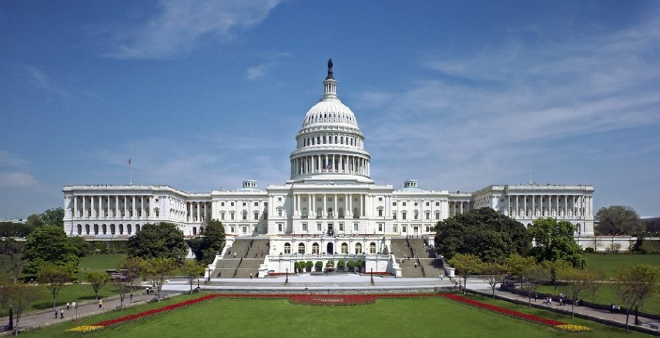
II. Quiz time
Question 3
The capital of New Zealand is _______.
A. Canberra
B. Washington D.C
C. Wellington
D. Ottawa
Notes:
Key: 1C

Slide 13
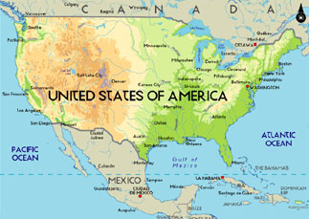
II. Quiz time
Question 4
____is the most diverse in geography and climate.
A. Canada
B. The USA
C. The United Kingdom
D. New Zealand
Notes:
Key: 1C

Slide 14
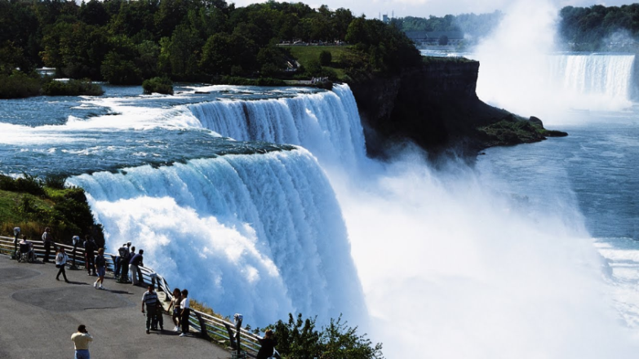
II. Quiz time
Question 5
Niagara Falls is a spectacular waterfall in __.
A. Wales
B. Canada
C. England
D. Australia
Notes:
Key: 1C

Slide 15
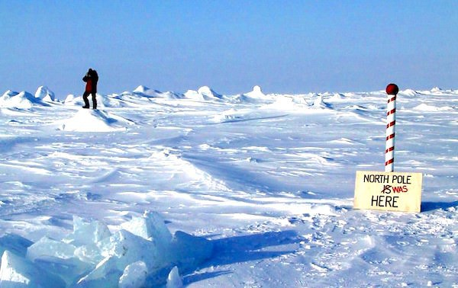
II. Quiz time
Question 6
__________ is closest to the North Pole.
A. America
B. Canada
C. New Zealand
D. Australia
Notes:
Key: 1C

Slide 16
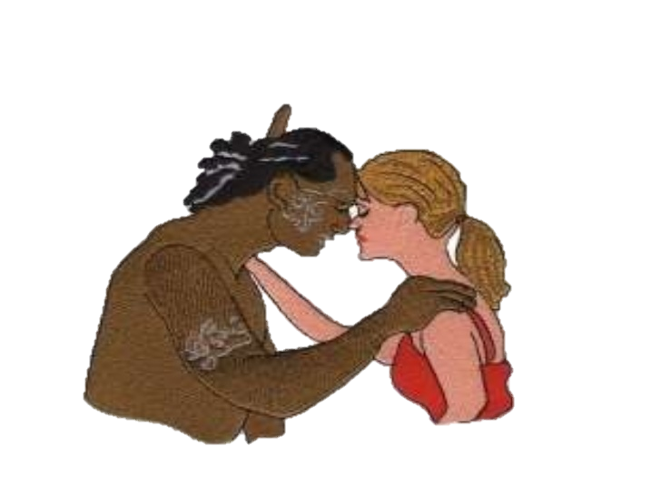
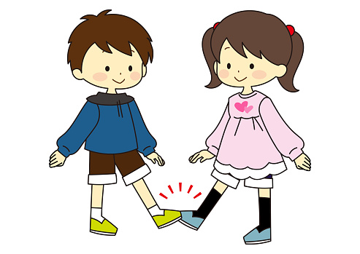
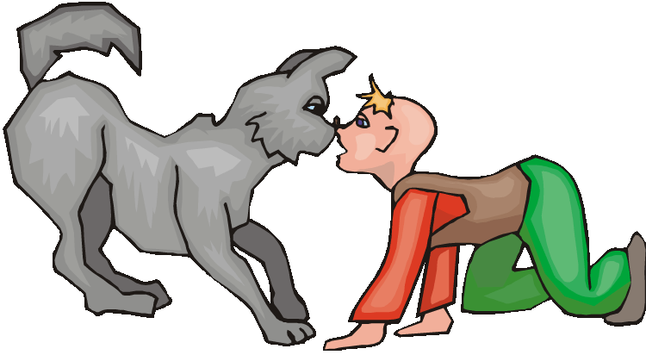
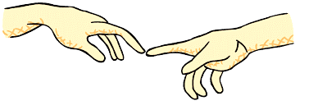
II. Quiz time
Question 7
Of these countries, _____ is the youngest.
A. Touching toes
B. Touching forehead
C. Touching noses
D. Touching hands
Notes:
Key: 1C

Slide 17
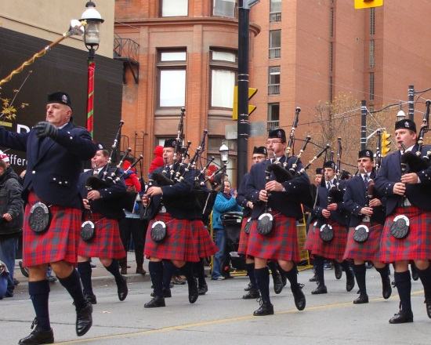
II. Quiz time
Question 8
A kilt is the traditional garment for ____.
A. Scottish men
B. The Maori in New Zealand
C. The Americans
D. The Aborigines in Australia
Notes:
Key: 1C

Slide 18
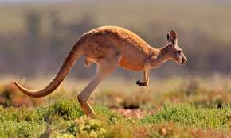
II. Quiz time
Question 9
This animal, the __ , is a symbol of Australia.
A. kangaroo
B. koala
C. rabbit
D. emu
Notes:
Key: 1C

Slide 19
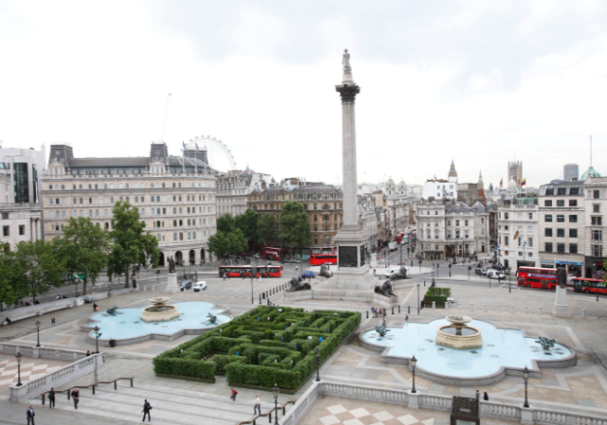
II. Quiz time
Question 10
_______ is in London.
A. Trafalga Square
B. Times Square
C. Sky Tower
D. Ayers Rock
Notes:
Key: 1C

Slide 20
III. Practice
HOW MUCH DO YOU KNOW ABOUT A COUNTRY?
Step 1. Choose an English speaking country.
Step 2. Write down on notebook 3 sentences about that country.
Step 3. Describe the country.

Slide 21
IV. Homework
1. Make a sentence for each new words
2. Write a paragraph (10-12 sentences) about one of your favorite English speaking countries.
3. Prepare for Skills 1.

