Slide 1
Unit 3
What day is it today ?
Lesson 1

Slide 2
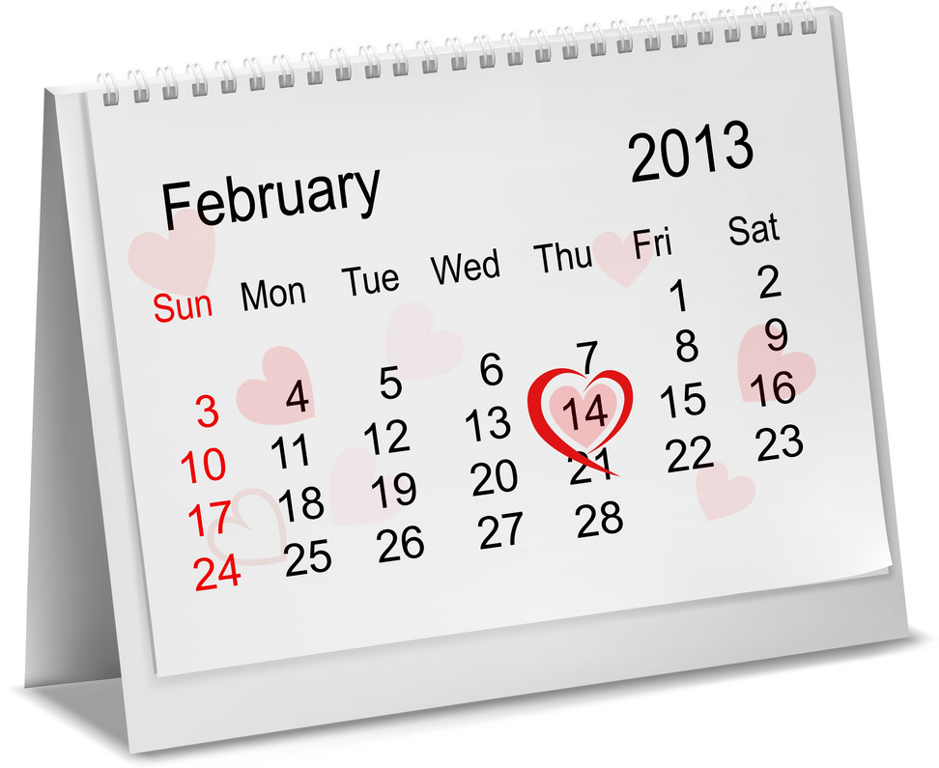
Calendar
Year
Month
Day
Week
Date

Slide 3
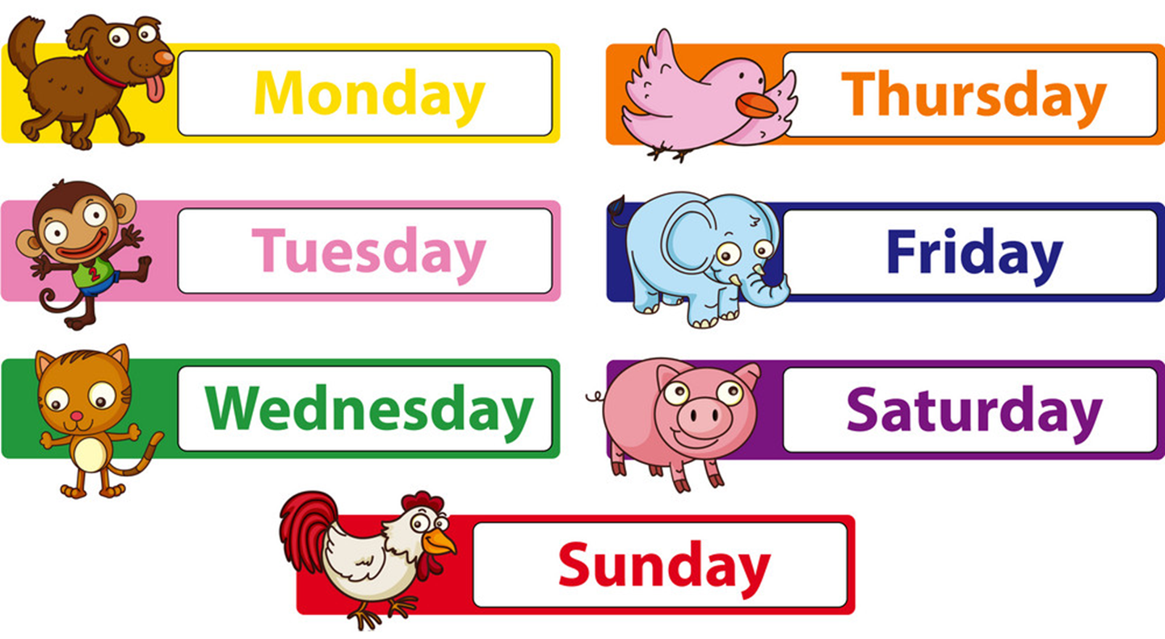
Days of a week

Slide 4
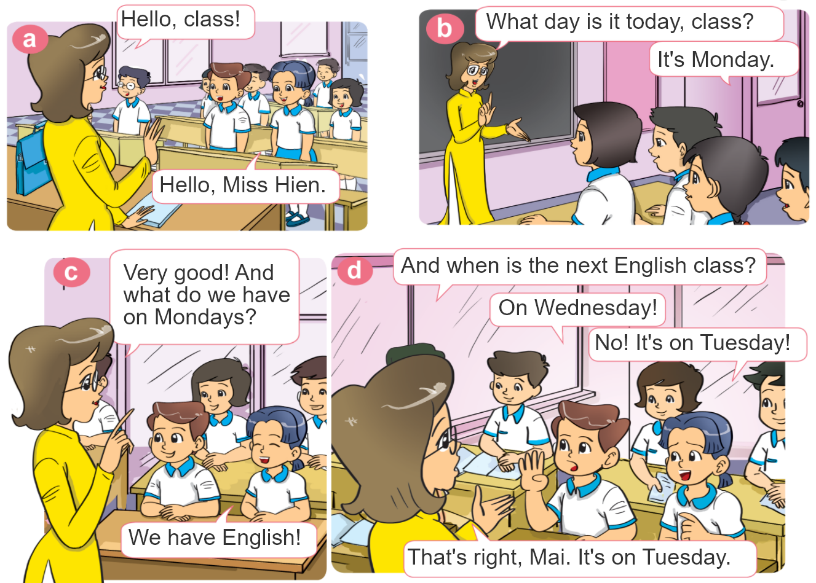

1. Look, listen and repeat.

Slide 5
Structures
Cách hỏi và trả lời hôm nay là thứ mấy:
What day is it today?
(Hôm nay là thứ mấy?)
It’s _______.
+ day
(Thứ _______)

Slide 6

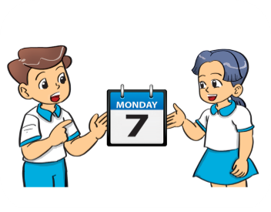

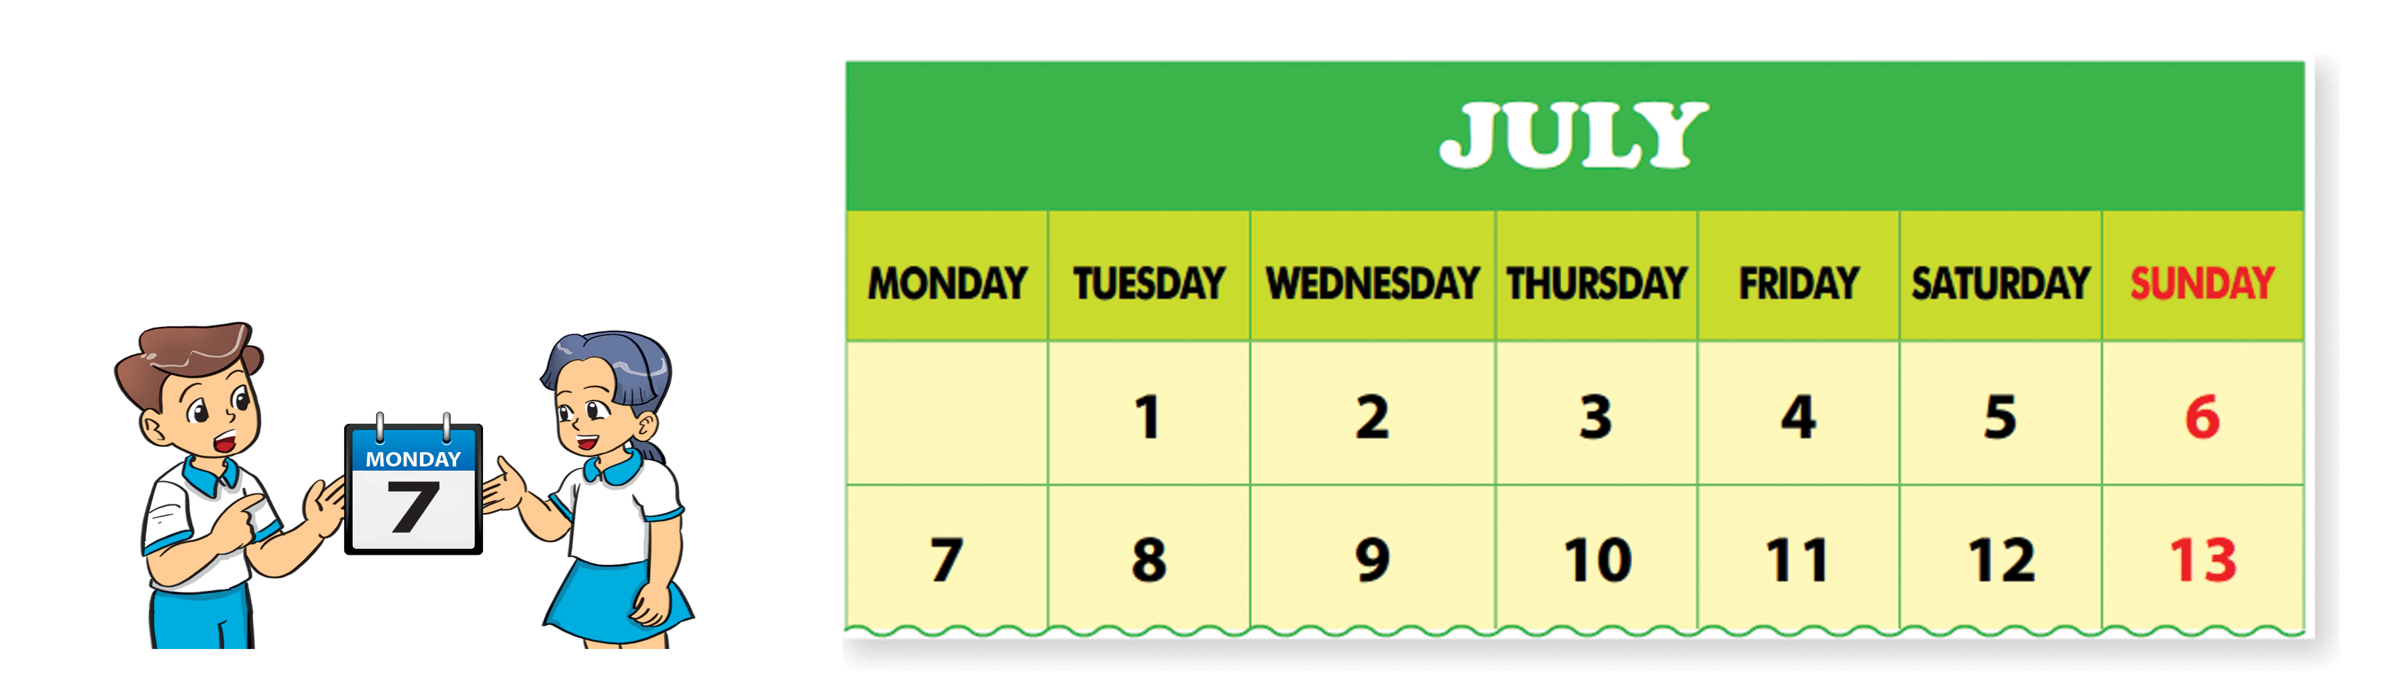
2. Point and say.
What day is it today?
It’s ___________.

Slide 7
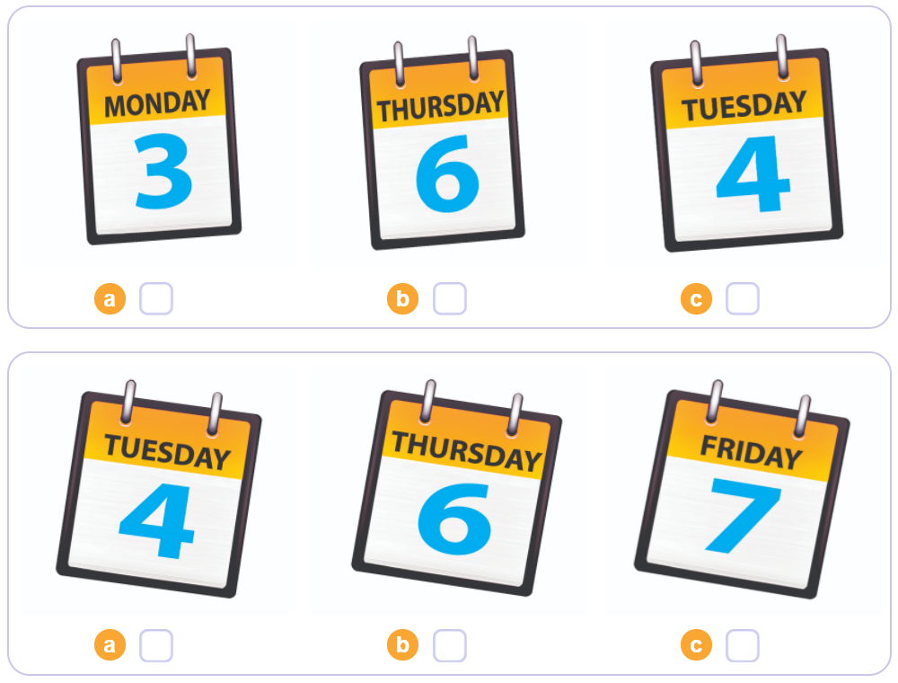

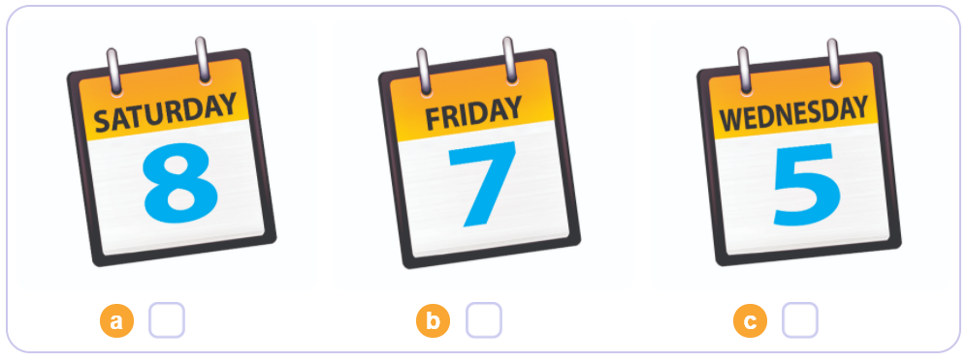
3. Listen and tick.
1
2
3

Slide 8
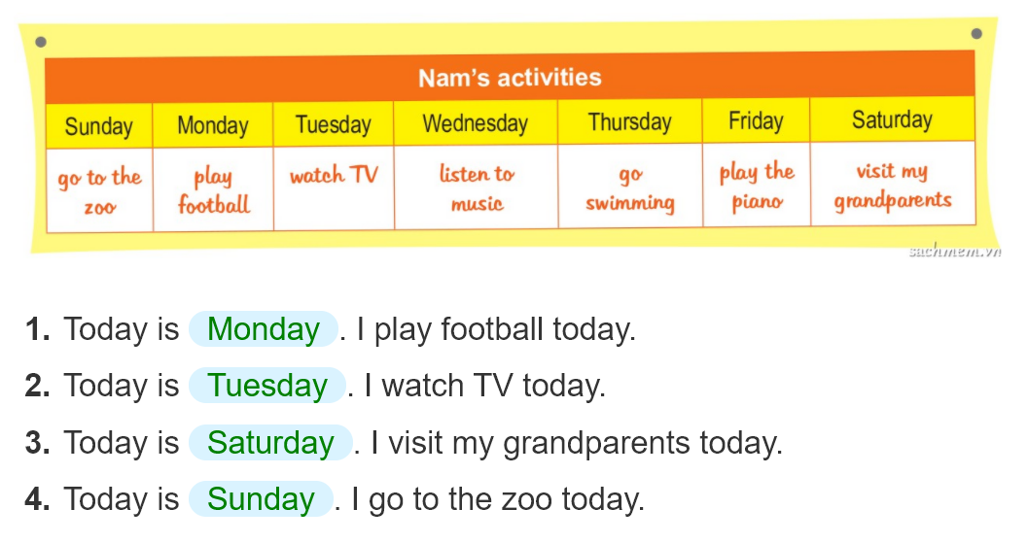
4. Look and write.
_______.
_______.
_______.
______.

Slide 9
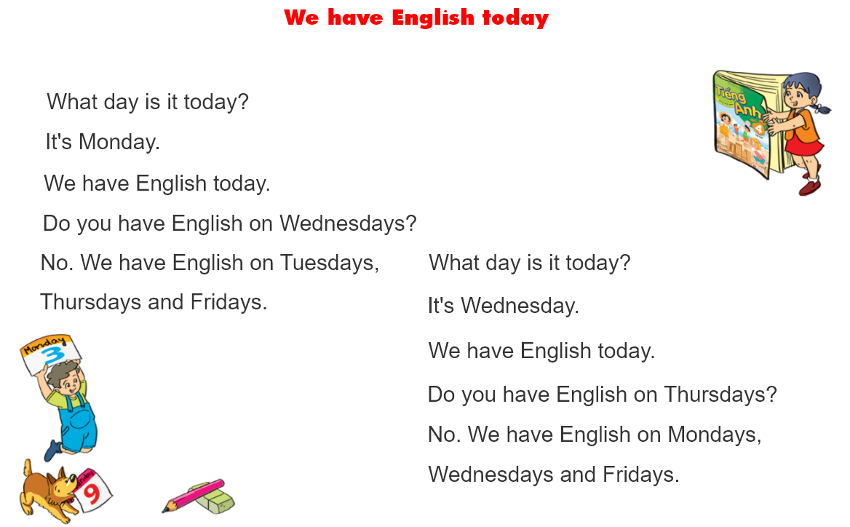

5. Let’s sing

Slide 10
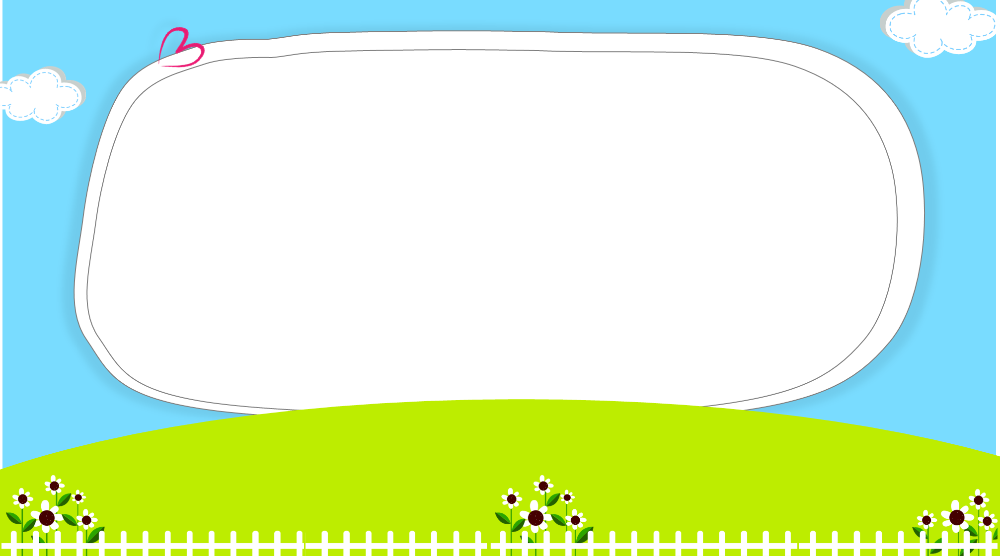


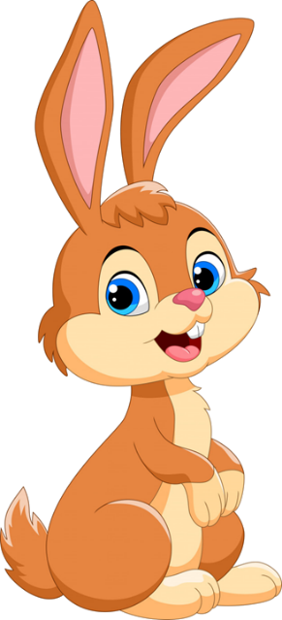
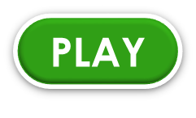
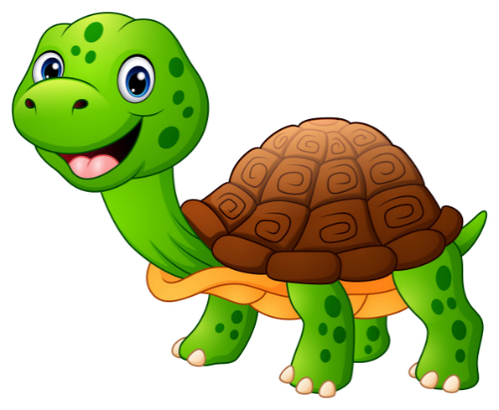
Click hình chú Thỏ hoặc chú Rùa khi chọn đáp án.

Slide 11


What day is it today?
It’s Saturday.
It’s eight.

Slide 12

What day is it today?
It’s Friday.
It’s six.

Slide 13
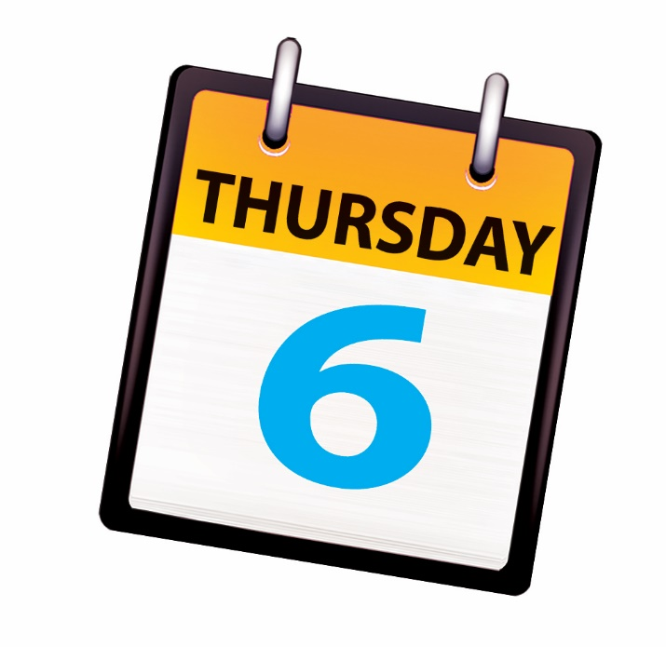
What day is it today?
It’s Thursty.
It’s Thursday.

Slide 14


What day is it today?
It’s Tuesday.
It’s four.

Slide 15
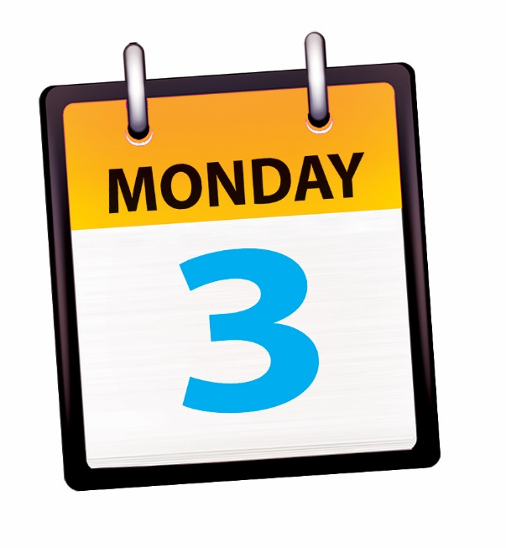
It’s Monday.
What day
is it tomorrow?
What day
is it today?

