Slide 1

Unit 15
When is
Children's Day?
Lesson 3

Slide 2
LET’S PLAY
PLAY

Slide 3
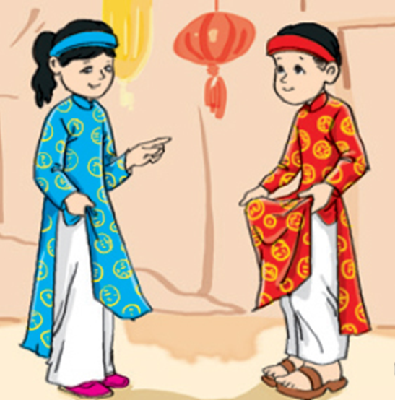
Children wear new ____ at Tet.
A. clothes
B. books
C. School bag
D. house
Next

Slide 4
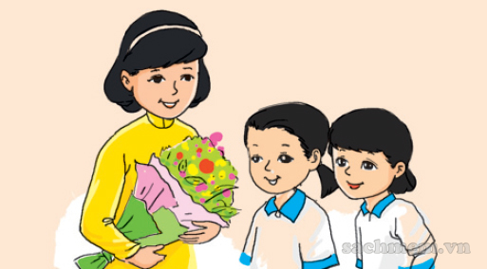
We give our teachers beautiful _______ on Teachers' Day.
A. books
B. clothes
C. Banh Chung
D. Flowers
Next

Slide 5
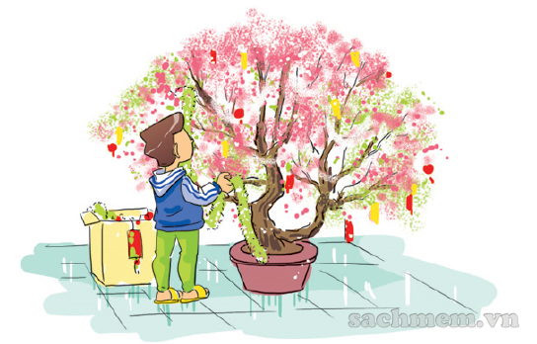
decorate
A. the class
B. the school
C. the house
D. the tree
Next

Slide 6
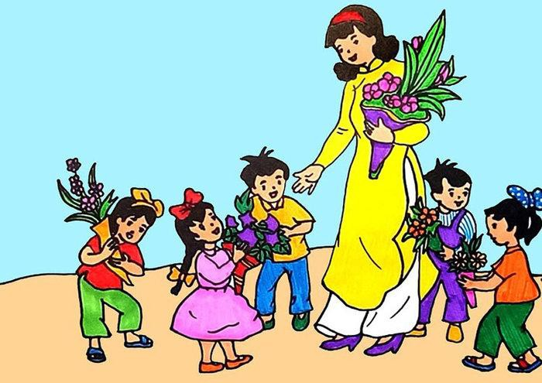
When is Teachers' Day?
A. We have a party.
B. It's on the twentieth of November.
C. I'm playing football.
D. We make Banh Chung
Next

Slide 7
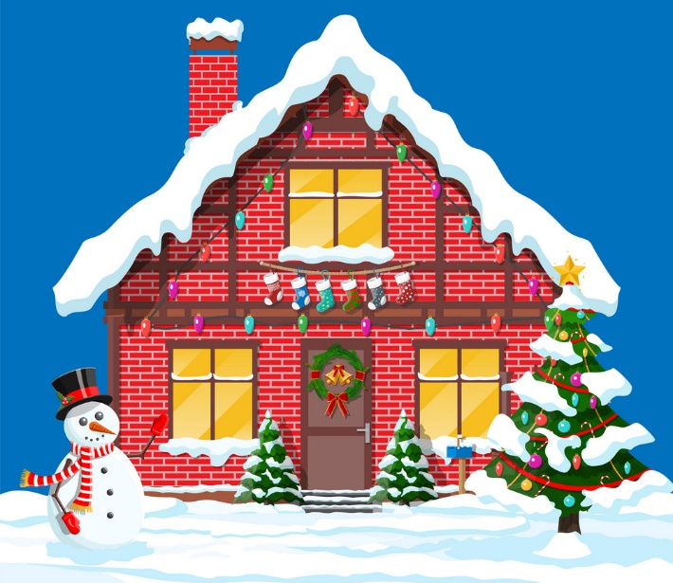
A: ______ is Christmas?
B: It's on the twenty-fifth of December.
A. Where
B. When
C. What
D. We
Next

Slide 8

What do you do on ______?
A. Children’s Day
B. Teachers’ Day
C. Women’s Day
D. Fathers’ Day
Next

Slide 9
WELL DONE!

Slide 10
PRONOUNCIATION

Slide 11

1. Listen and repeat
cl | clothes | She wears new clothes at Tet.
 | close | Close the door, please.
fl | flowers | My mother buys lots of flowers for Tet.
 | floor | I clean the floor in the afternoon.

Slide 12
2
3
4
2. Listen and write.
1. We give our teachers lots of ________ on Teachers' Day.
2. ________ the door, please.
3. The _________ are beautiful.
4. She's cleaning the _______ now.
flower
Close
clothes
floor

Slide 13
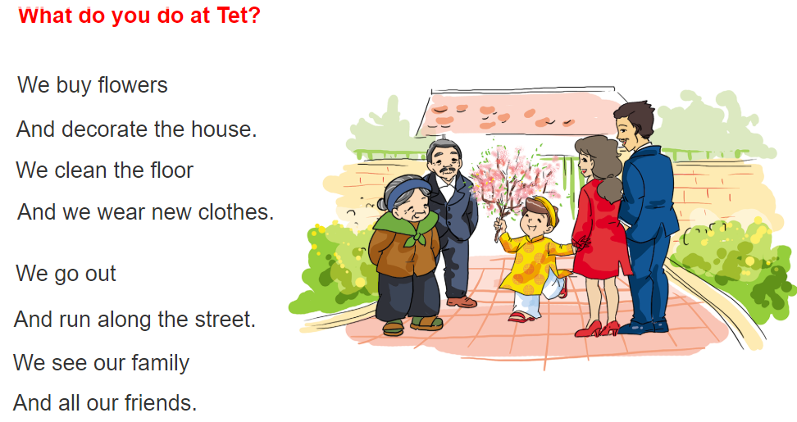

3. Let's chant

Slide 14
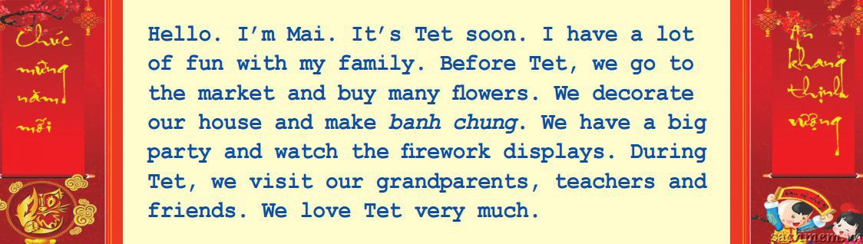
4. Read and write
1. It's ________ soon.
2. Mai's family go to the market and buy many ________.
3. They decorate ____________ and make ____________.
4. They watch _____________________.
5. They visit _________________, ________ and _______.
Tet
flowers
their house
banh chung
the firework displays
their grandparents
teachers
friends

Slide 15
5. Write about your Tet
Before Tet, I ________________.
During Tet, I ________________.

Slide 16
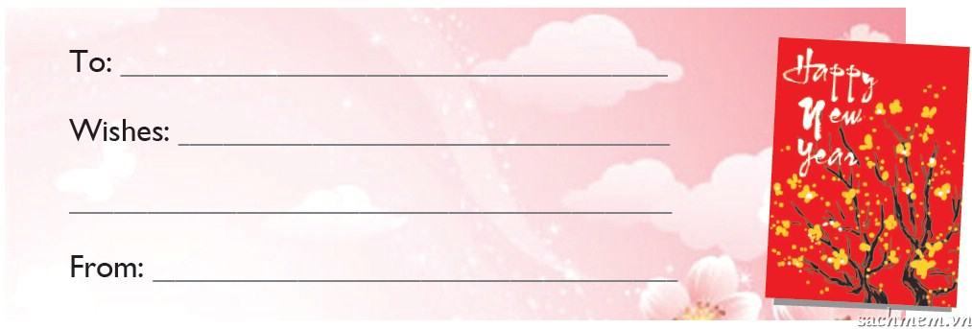
6. Project
Make a greeting card for Tet.
Then write wishes to your friend.

