Slide 1
Unit 16
Do you have any pets?
Lesson 1

Slide 2
VOCABULARY

Slide 3
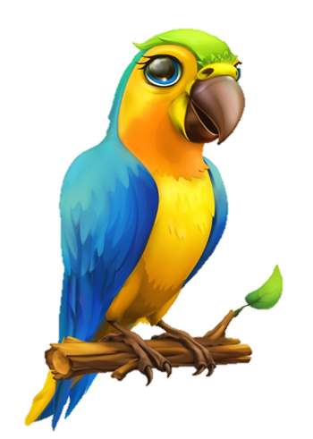
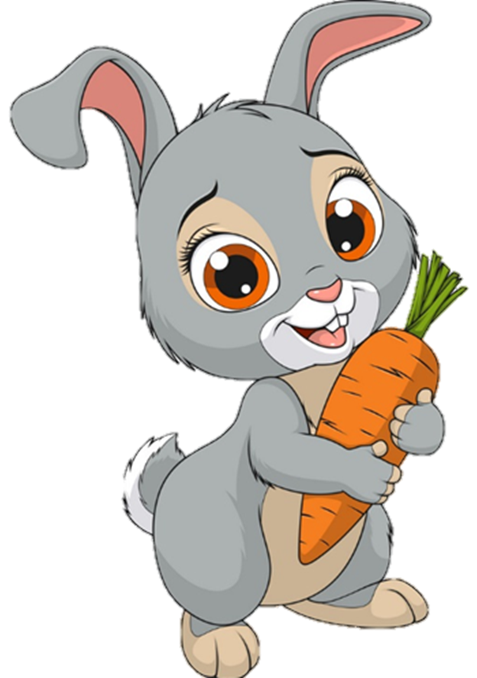


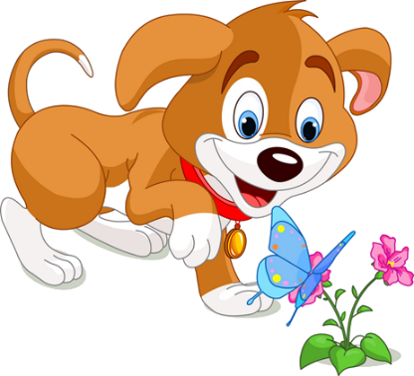
Vocabulary
pet
/pet/

Slide 4
Vocabulary
parrot
/ˈpærət/

Slide 5
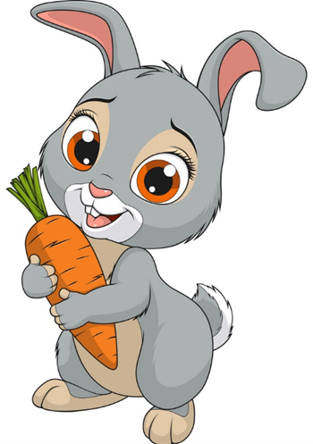
Vocabulary
rabbit
/ˈræbɪt/

Slide 6

Vocabulary
goldfish
/ˈɡəʊldfɪʃ/

Slide 7

Vocabulary
cage
/keɪdʒ/

Slide 8

Vocabulary
tank
/tæŋk/

Slide 9




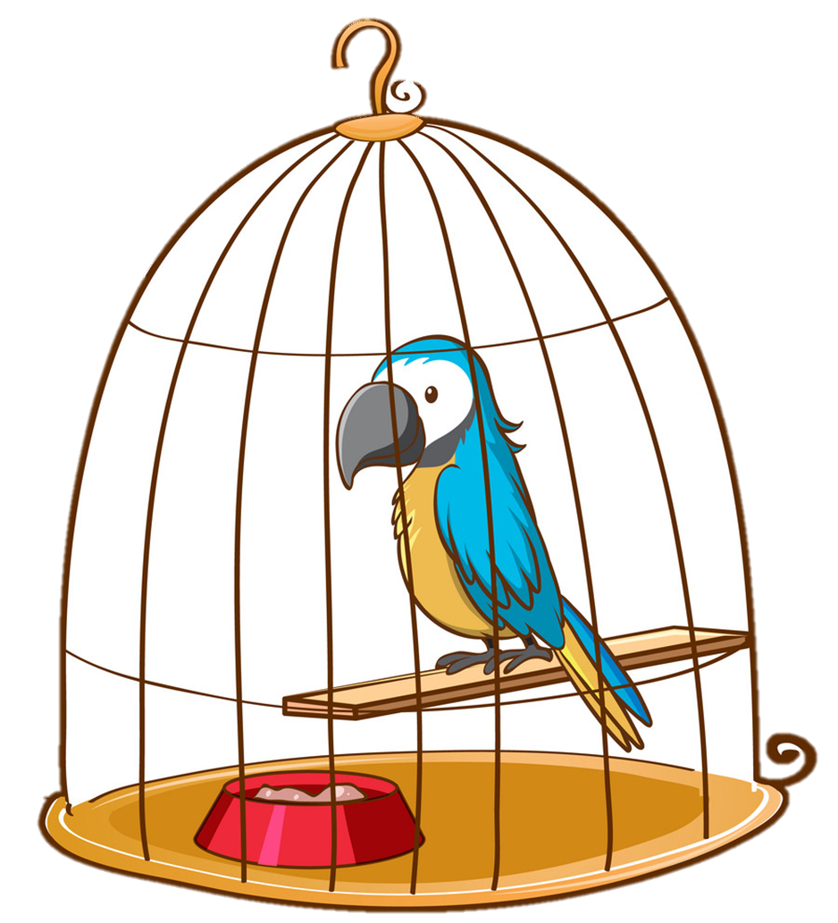
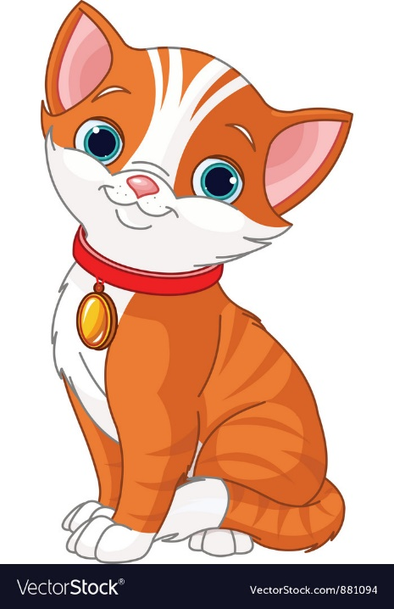
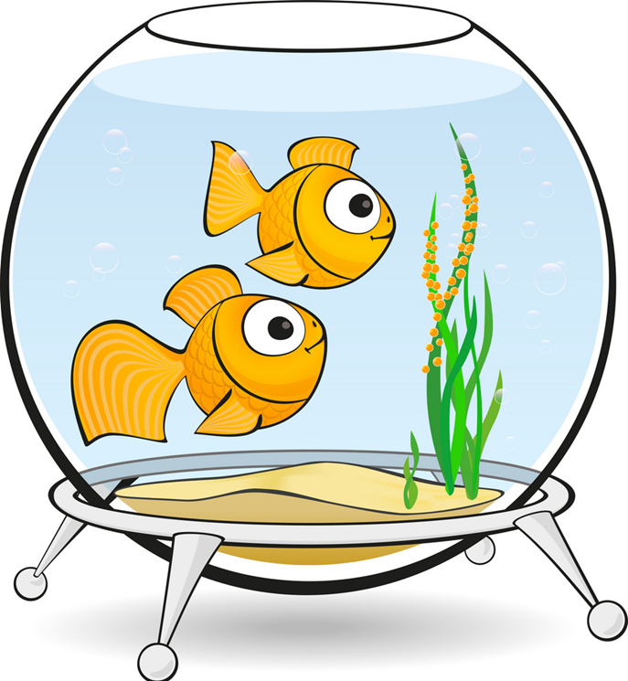
Vocabulary
1
2
3
parrot
rabbit
goldfish
4
5
6
tank
cage
pets

Slide 10






Find the best picture
Next
parrot

Slide 11
Find the best picture
Next
goldfish

Slide 12
Find the best picture
Next
cage

Slide 13
Find the best picture
Next
rabbit

Slide 14
Find the best picture
Next
pet

Slide 15
Find the best picture
Next
tank

Slide 16

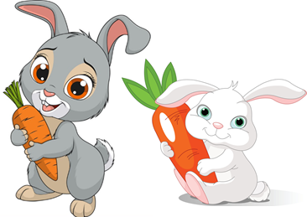
Vocabulary
parrot
parrots
a goldfish
goldfish
a
a rabbit
rabbits
a pet
pets

Slide 17
GRAMMAR

Slide 18

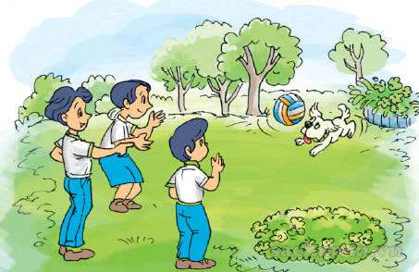
1. Look, listen and repeat
That's my dog.
Wow! He's cute!
Wow! He's cute!

Slide 19
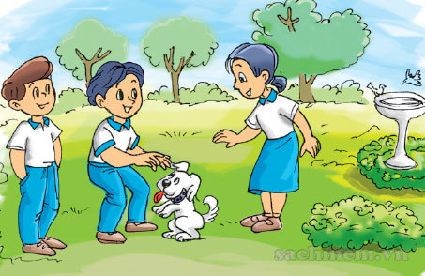

1. Look, listen and repeat
Do you have any pets?
Yes, I do. I have two dogs.

Slide 20
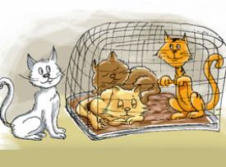
2. Point and say
cats
Do you have any __________?
Yes, I do.

Slide 21
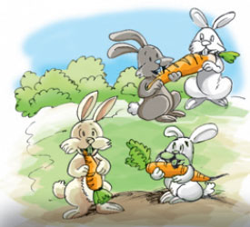
2. Point and say
rabbits
Do you have any __________?
Yes, I do.

Slide 22
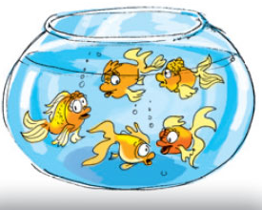
2. Point and say
goldfish
Do you have any __________?
No, I don’t.

Slide 23
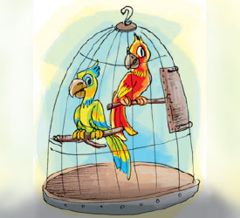
2. Point and say
parrots
Do you have any __________?
No, I don’t.

Slide 24


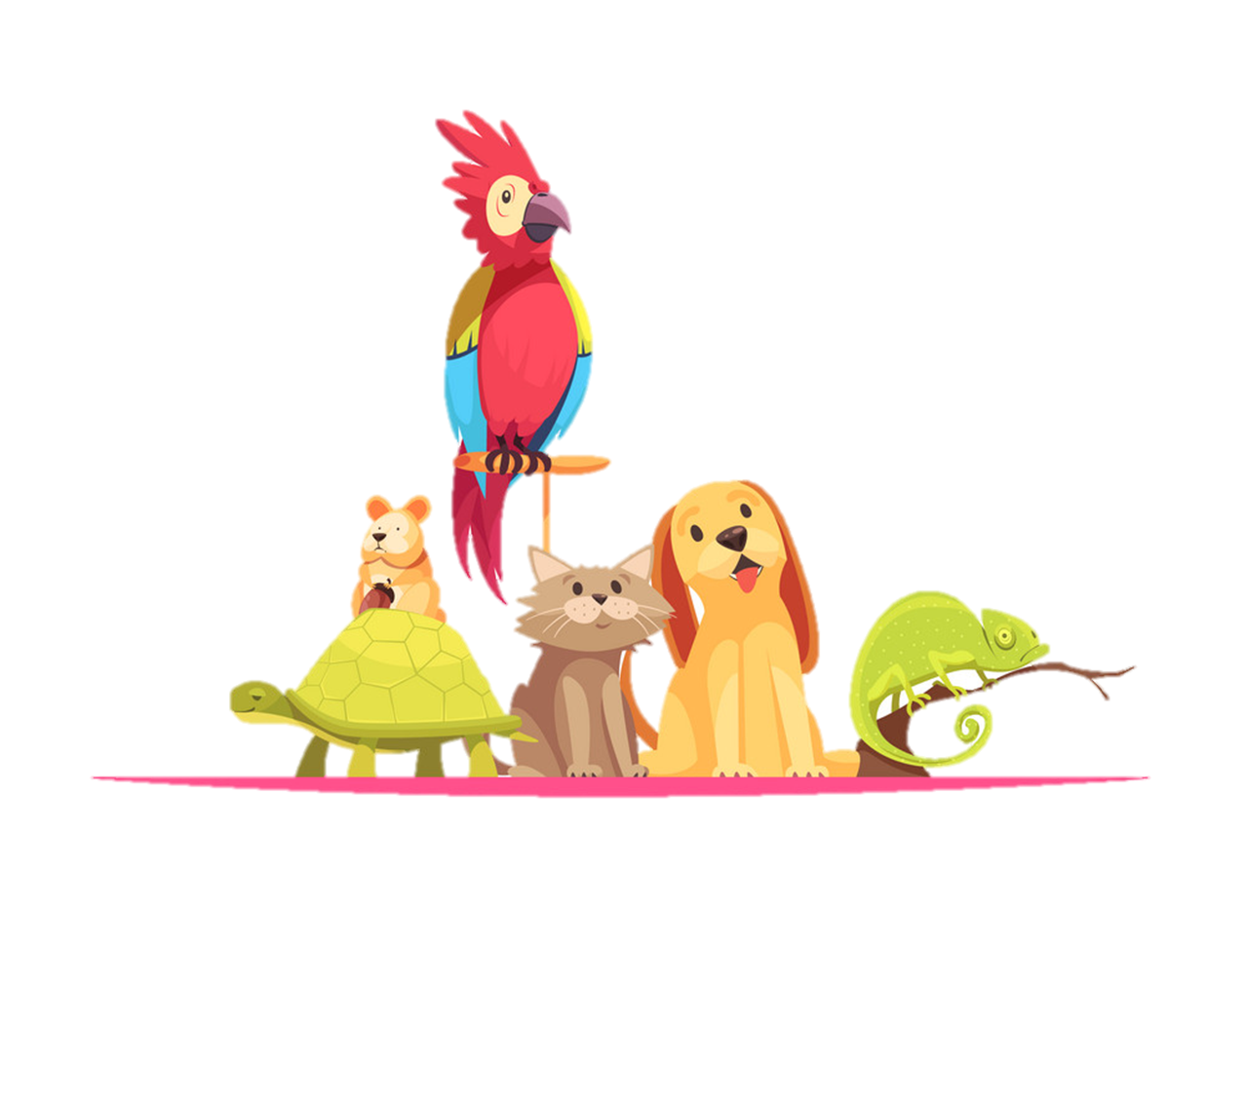

Model sentence
Yes, I do.
Do you have any _______?
No, I don’t.
pets
goldfish
parrots
rabbits
cats

Slide 25
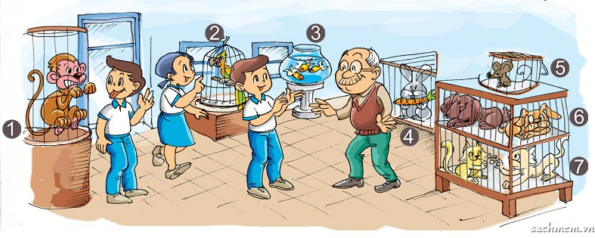
3. Let's talk
Yes, I do.
Do you have any _______?
No, I don’t.

Slide 26
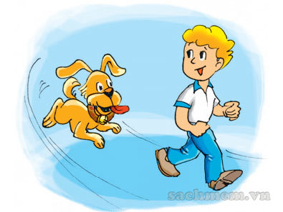
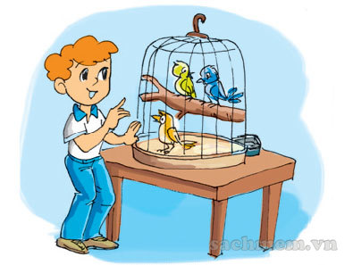
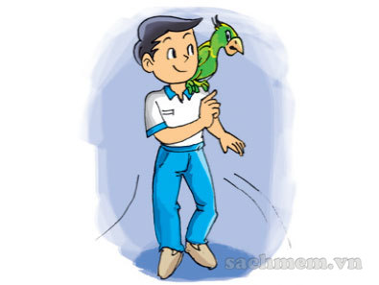
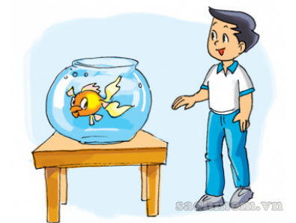
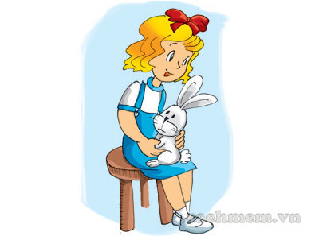
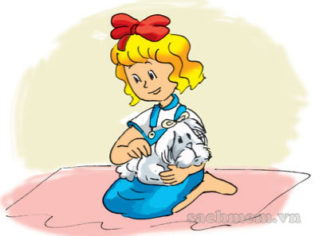
4. Listen and tick
a
b
1.
a
b
2.
a
b
3.
3
2

Slide 27
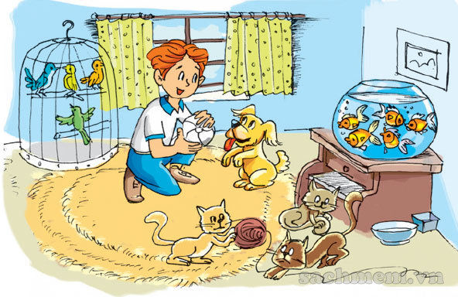
5. Look and write
I have a lot of pets. I have one (1) dog and three (2) cats. I have four (3) birds in the cage and five (4) goldfish in the fish tank. Do you have a pet?
_______
______
______
____________

Slide 28
6. Let's write
What pets do you have?
I have _____________________.
2. Where are your pets?
It’s _____________________.
They’re ___________________.

Slide 29



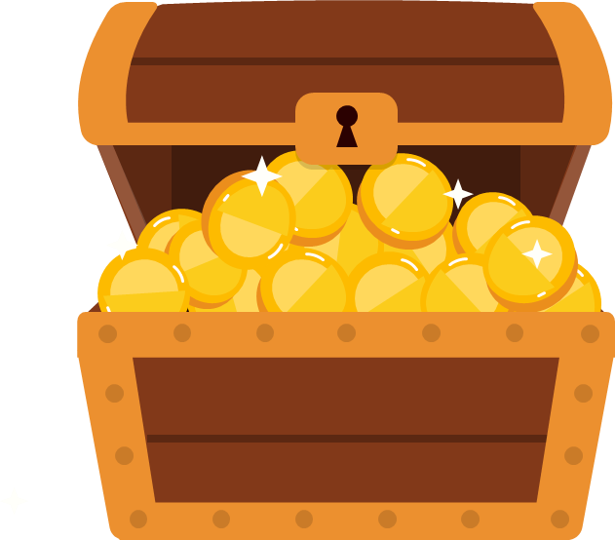

Play

Slide 30


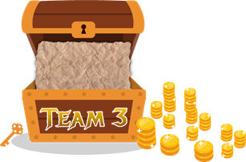



1
2
3
4
5
6
7
8
1
2
3
4
5
6
7
8
1
2
3
4
5
6
7
0
8
1
0
2
3
4
5
6
7
8
0
Exit

Slide 31

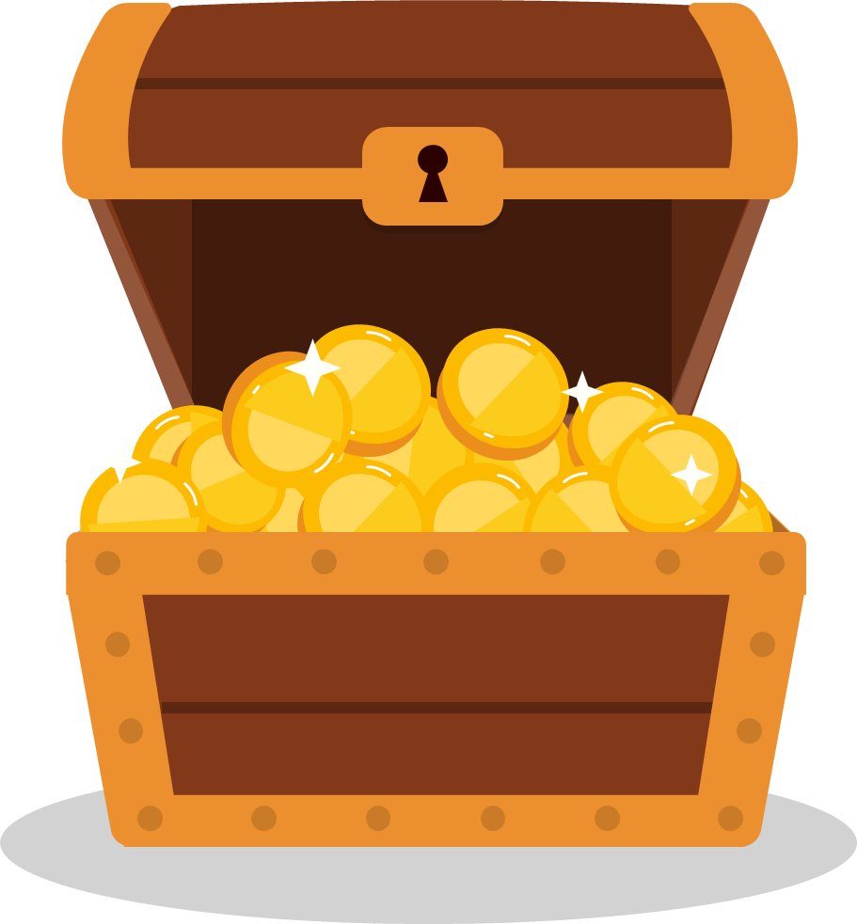


A
parrots
Do you have any ______?
B
parrot
Yes, I do.
C
a parrot
Back

Slide 32
A
a pet
Do you have any ______?
B
pets
Yes, I do.
C
pet
Back

Slide 33
A
goldfishs
Do you have any ______?
B
a goldfish
No, I don’t.
C
goldfish
Back

Slide 34

Yes, I do.
XEM ĐÁP ÁN
Do you have any birds?
Back

Slide 35
A
I do
Do you have any rabbits?
B
I don’t
No, _________.
C
I am not
Back

Slide 36
A
I am
Do you have any dogs?
B
I don’t
Yes, ________.
C
I do
Back

Slide 37
A
any
Do you have _____ goldfish?
B
some
No, I don’t.
C
an
Back

Slide 38

No, I don’t.
XEM ĐÁP ÁN
Do you have any rabbits?
Back

