Slide 1
Unit 7
How do you
leArn English
Lesson 3

Slide 2
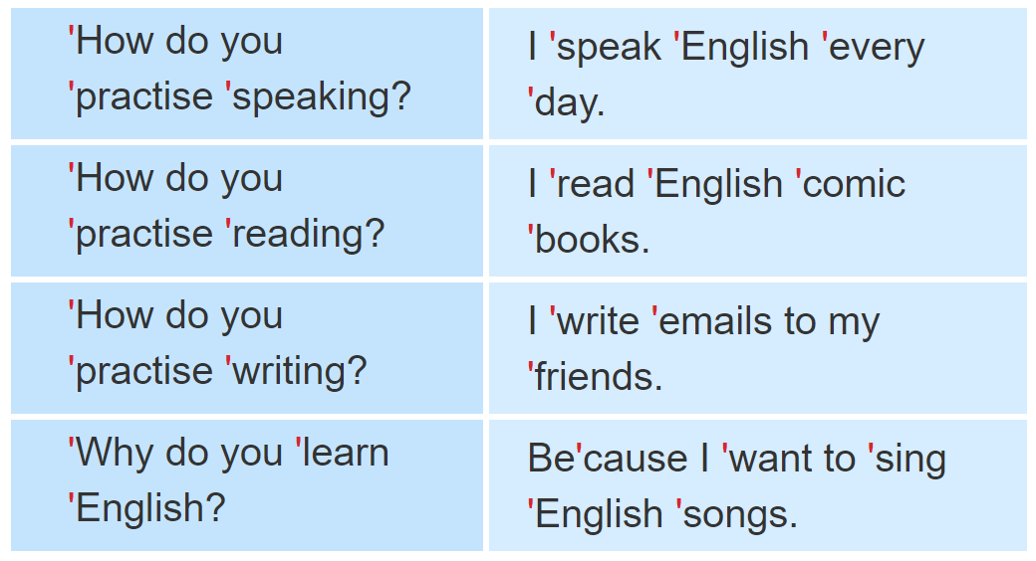

1. Listen and repeat.

Slide 3
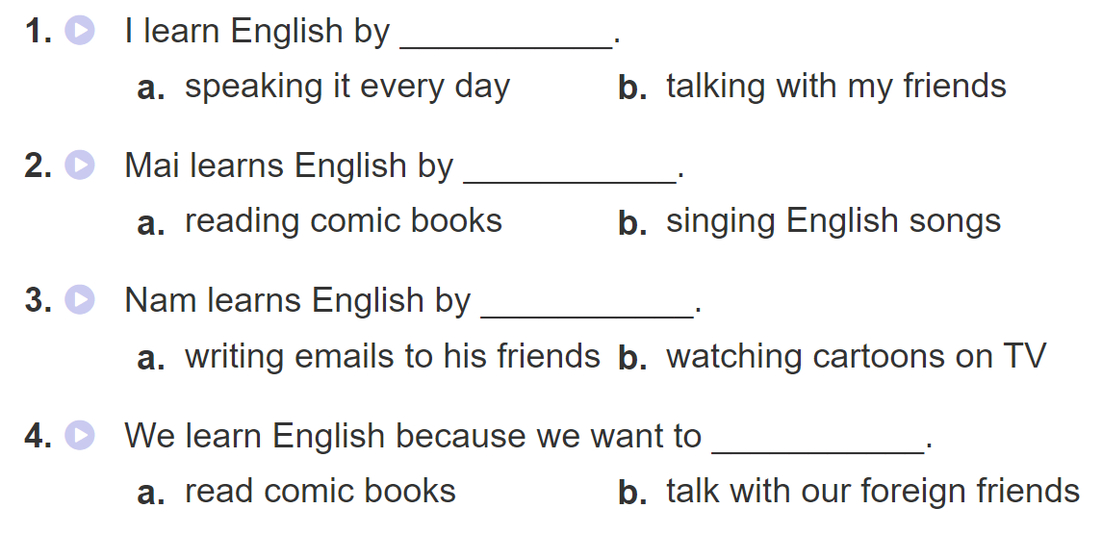

2. Listen and tick. Then write and say aloud

Slide 4
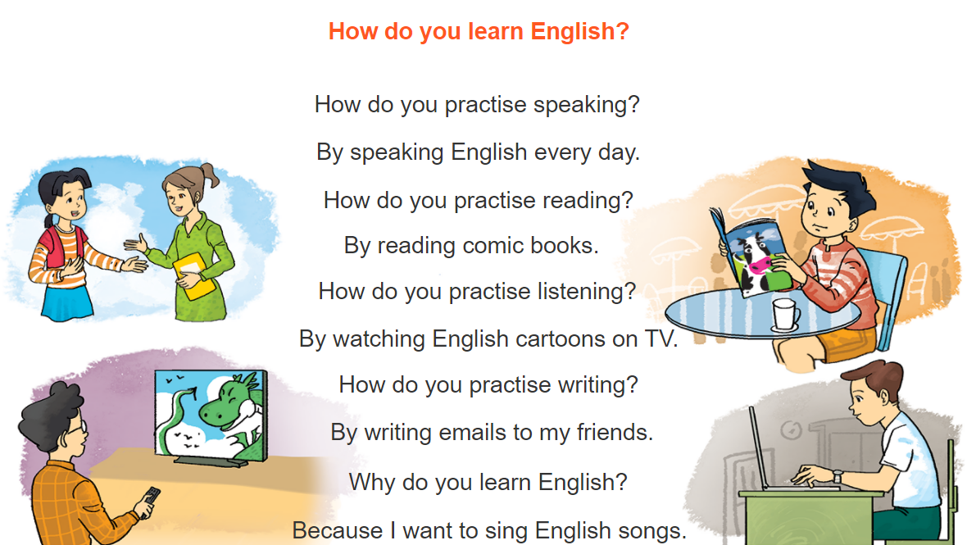
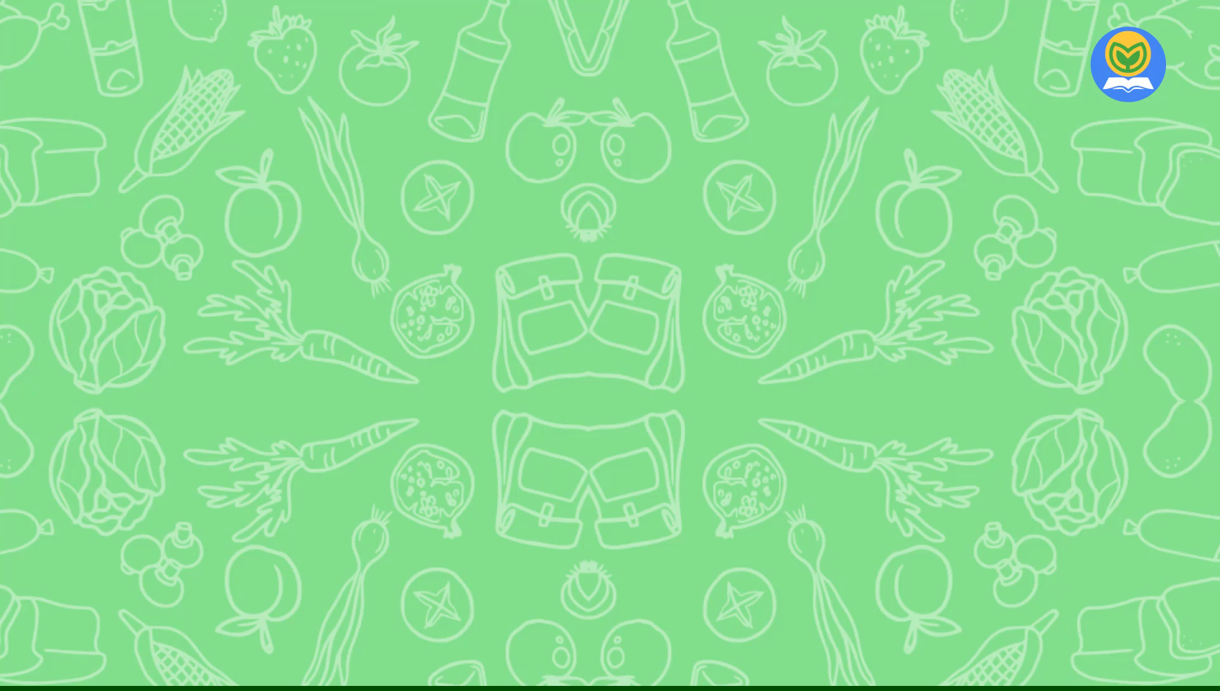

3. Let’s chant

Slide 5

4. Read and tick True (T) or False (F)
My name is Mai. I love reading English comic books. When I see a new word, I try to guess its meaning. I write the word in my notebook and say it a few times. I often stick new words on my bedroom walls and practise reading them aloud. I learn to speak English by talking with my foreign friends in my free time. My friend Akiko is good at English. She usually practises listening by watching cartoons on TV. She learns to write by writing emails to me every day. We are happy because we can understand each other. English is necessary for communication.

Slide 6
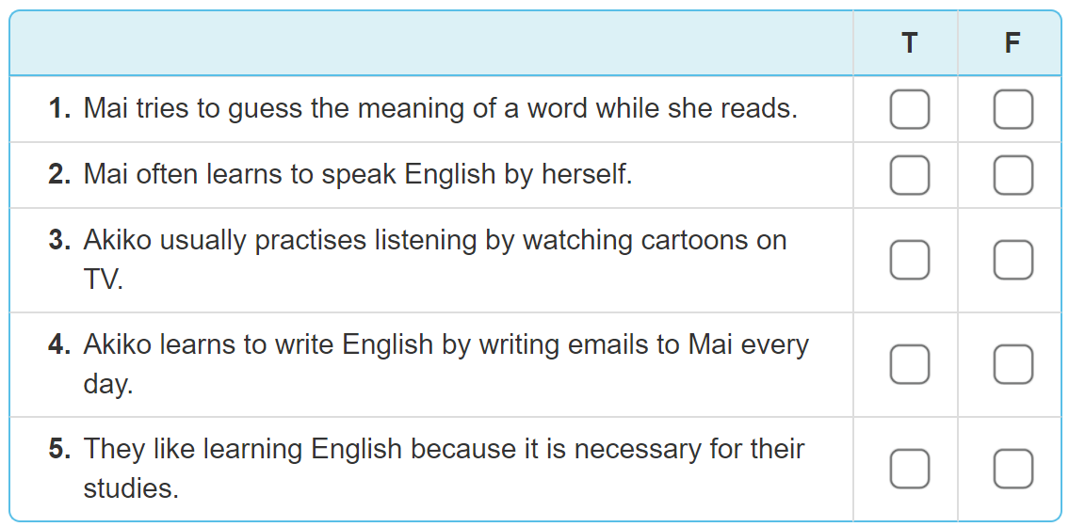
4. Read and tick True (T) or False (F)
✔
✔
✔
✔
✔

Slide 7
5. Write about how your friend learns English.
My friend is _______________.
He/She learns to read English by _______________.
He/She learns vocabulary by _______________.
He/She learns English because_______________.

Slide 8

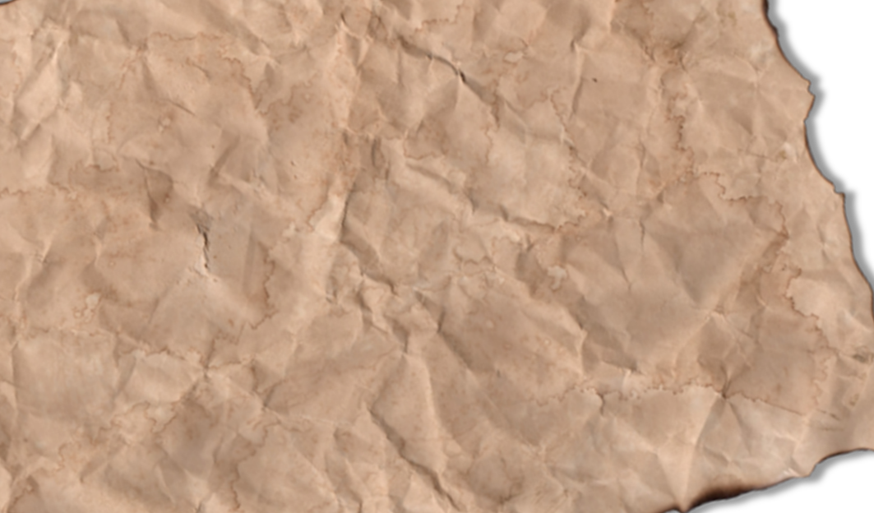

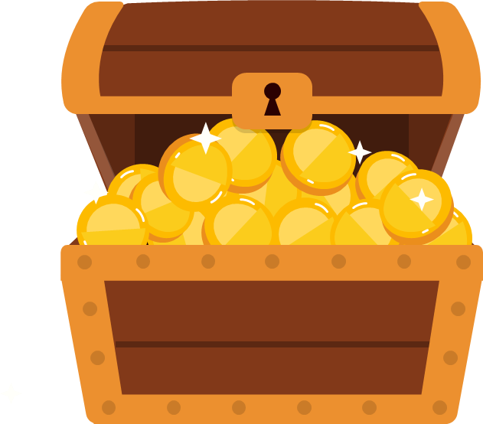
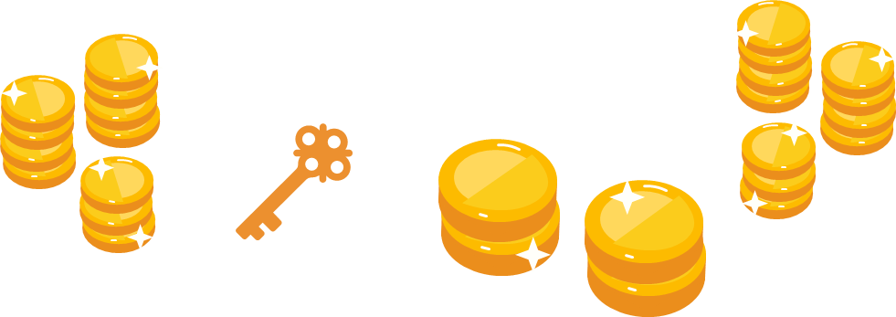
Play

Slide 9
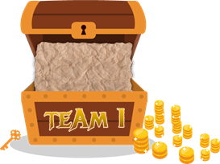

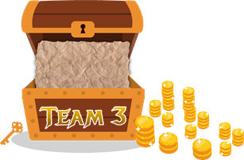

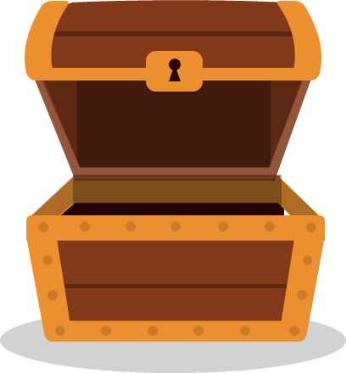
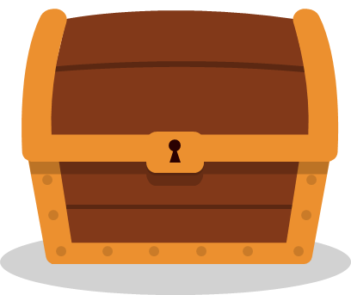
1
2
3
4
5
6
7
8
1
2
3
4
5
6
7
8
1
2
3
4
5
6
7
0
8
1
0
2
3
4
5
6
7
8
0
Exit

Slide 10
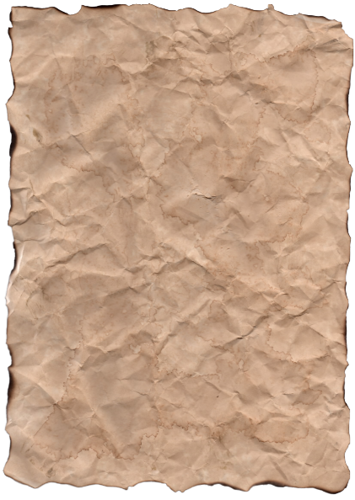
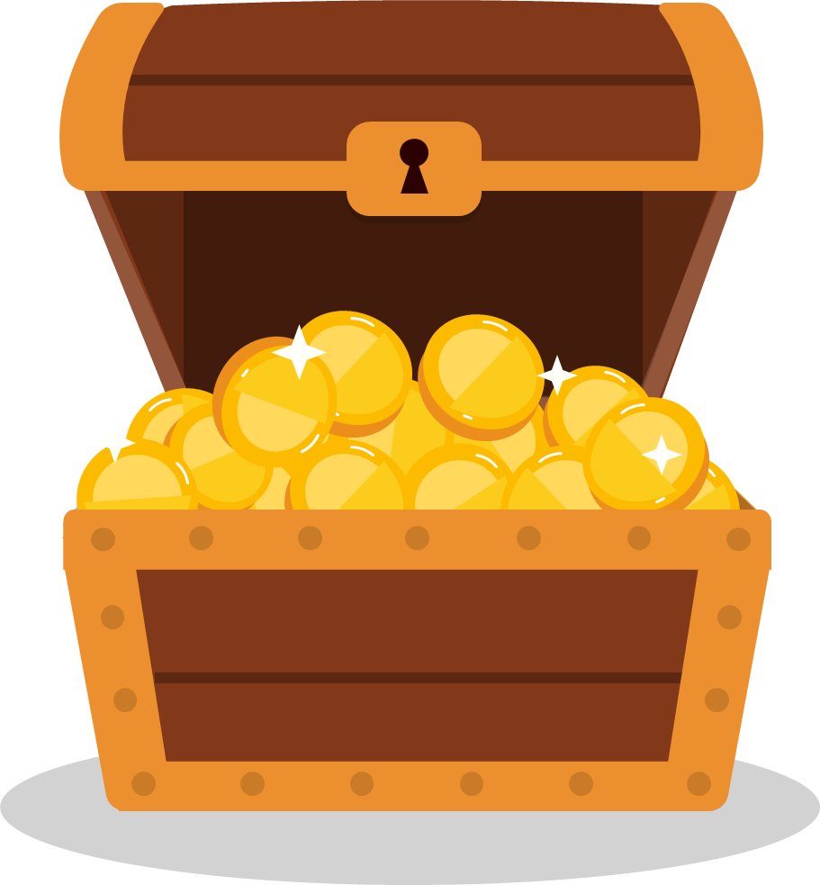
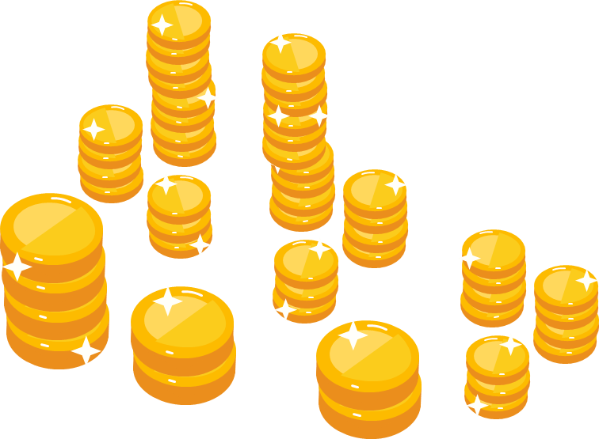
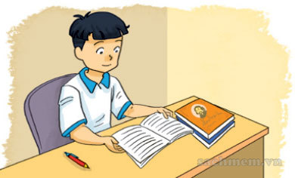
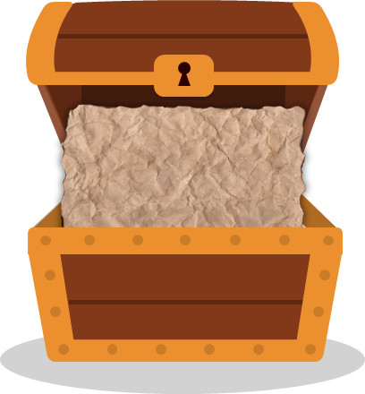
reading
XEM ĐÁP ÁN
How do you practise
______ English?
Back

Slide 11
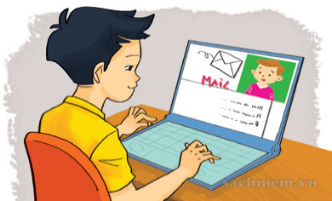
writting
XEM ĐÁP ÁN
How do you practise
______ English?
Back

Slide 12
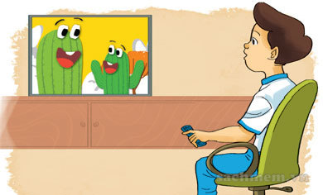
listening
XEM ĐÁP ÁN
How do you practise
______ English?
Back

Slide 13
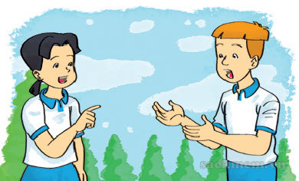
speaking
XEM ĐÁP ÁN
How do you practise
______ English?
Back

Slide 14
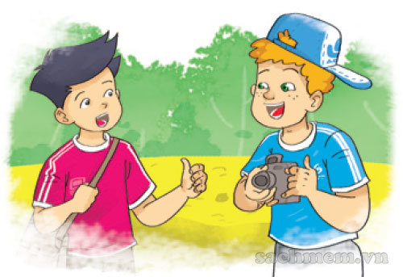
Because I want to
XEM ĐÁP ÁN
Why do you learn English?
________ talk with
my foreign friends
Back

Slide 15
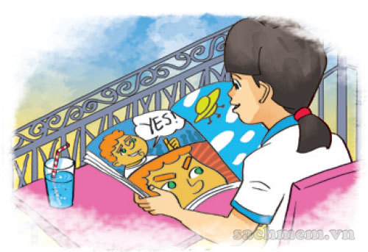
read
XEM ĐÁP ÁN
Why do you learn English?
Because I want to _____
the comic books.
Back

Slide 16
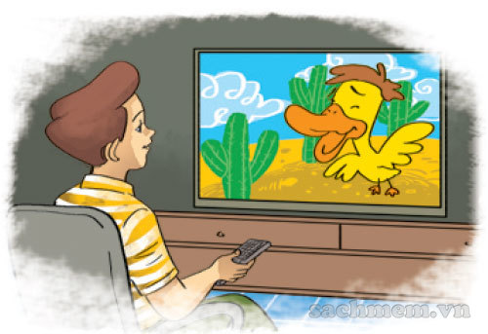
watch
XEM ĐÁP ÁN
Why do you learn English?
Because I want to _____
English cartoons on TV.
Back

Slide 17
sing
XEM ĐÁP ÁN
How do you learn English?
I _____ English songs.
Back

