Slide 1
Unit 6
HOW MANY LESSONS
DO YOU HAVE TODAY?
Lesson 2

Slide 2
VOCABULARY

Slide 3
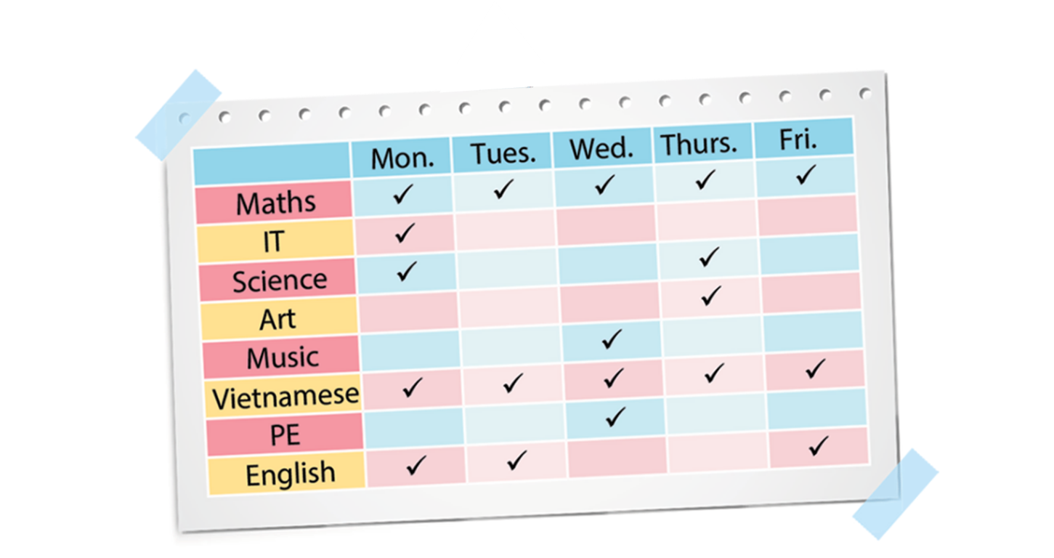

A. Vocabulary
(Adv)
every school day
Once
a week
Three times
a week
Twice
a week
✔
✔
✔
Four times a week

Slide 4
GRAMMAR

Slide 5
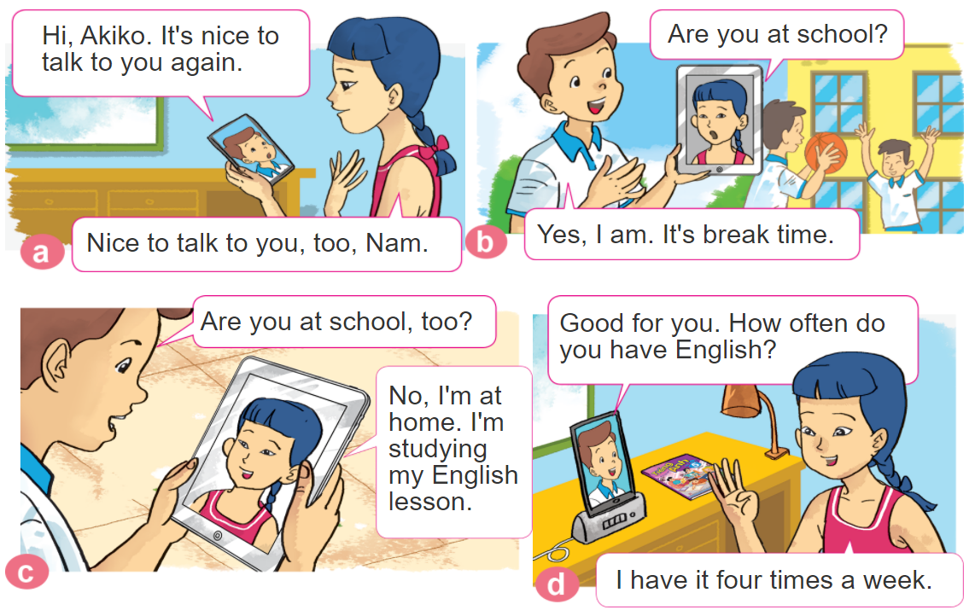
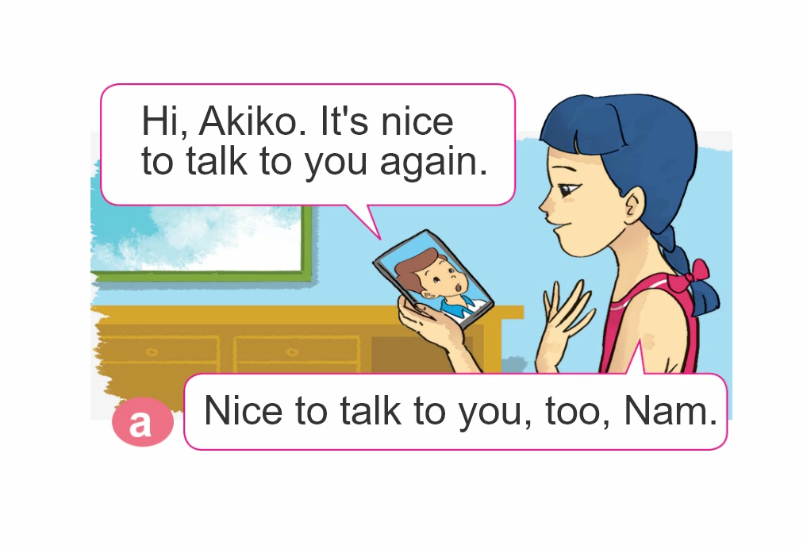

1. Look, listen and repeat.

Slide 6

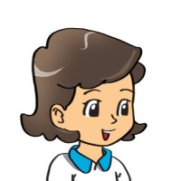




2. Point and say
How often do you have______?
I have it _________.
Maths
every
school day
Music
once a week
Science
twice a week
Vietnamese
four times a week

Slide 7

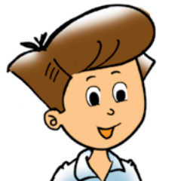



3. Let’s talk
How many lessons do you have today?
I have______.
I have it ______.
How often do you have _________?
+ adv
+ môn học
(Tớ học nó ________)
(Bạn học môn _______
thường xuyên như thế nào?)

Slide 8

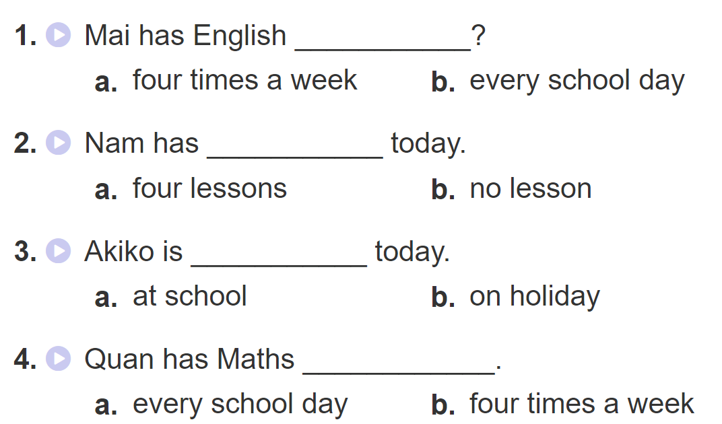
4. Listen and circle a or b

Slide 9
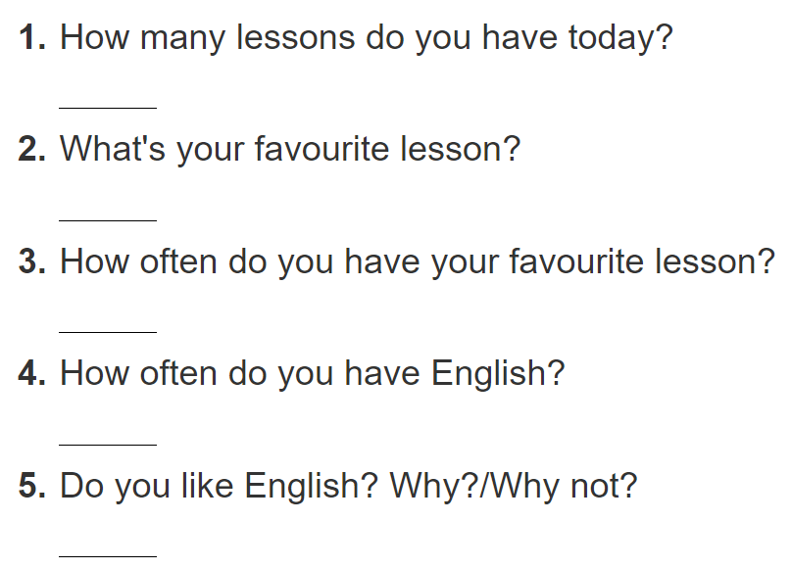
5. Write about you
I have ________________________.
My favourite lesson is ____________.
I have it ______________________.
I have it _______________________.
Yes, I do/ No, I don’t. Beacause ____.

Slide 10
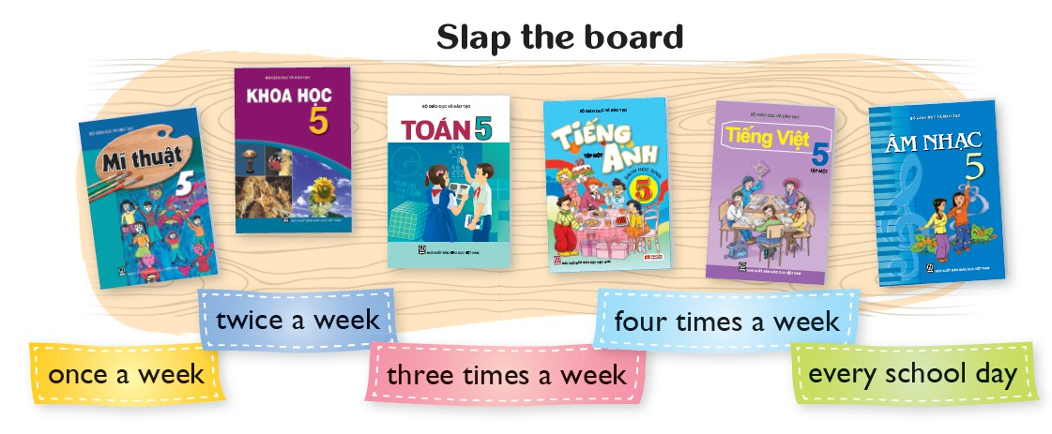
6. Let’s play

Slide 11












Ms Huyền Phạm
0936.082.789
Ms Huyền Phạm
0936.082.789
Ms Huyền Phạm
0936.082.789
Ms Huyền Phạm - 0936.082.789 – YOUTUBE: MsPham. Facebook: Dạy và học cùng công nghệ.
Ms Huyền Phạm
0936.082.789
Notes:
Ms Huyền Phạm - 0936.082.789 – YOUTUBE: MsPham. Facebook: Dạy và học cùng công nghệ.

Slide 12
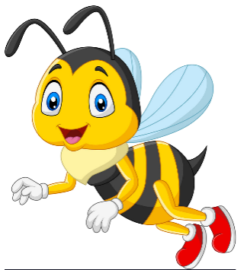





How often do you have IT?
Next
I have it
everyday.
I have it twice
a week.
I have it
once a week.
I have it
one a week.
Notes:
Ms Huyền Phạm - 0936.082.789 – YOUTUBE: MsPham. Facebook: Dạy và học cùng công nghệ.

Slide 13
How often do you have Maths?
Next
I have it
once a week.
I have it everyday.
I have it everyday.
I have it everyday.
Notes:
Ms Huyền Phạm - 0936.082.789 – YOUTUBE: MsPham. Facebook: Dạy và học cùng công nghệ.

Slide 14
How often do you have English?
Next
I have it
once a week.
I have it
twice a week.
I have it three times a week.
I have it
everyday.
Notes:
Ms Huyền Phạm - 0936.082.789 – YOUTUBE: MsPham. Facebook: Dạy và học cùng công nghệ.

Slide 15
How often do you have Science?
Next
I have it
twice a week.
I have it
once a week.
I have it three times a week.
I have it
everyday.
Notes:
Ms Huyền Phạm - 0936.082.789 – YOUTUBE: MsPham. Facebook: Dạy và học cùng công nghệ.

Slide 16
How often do you have Music?
Next
I have it
once a week.
I have it
twice a week.
I have it three times a week.
I have it
everyday.
Notes:
Ms Huyền Phạm - 0936.082.789 – YOUTUBE: MsPham. Facebook: Dạy và học cùng công nghệ.

Slide 17
How often do you have Art?
Next
I have it
twice a week.
I have it
once a week.
I have it
everyday.
I have it three times a week.
Notes:
Ms Huyền Phạm - 0936.082.789 – YOUTUBE: MsPham. Facebook: Dạy và học cùng công nghệ.

Slide 18
How often do you have Vietnamese?
Next
I have it
once a week.
I have it three times a week.
I have it
twice a week.
I have it
everyday.
Notes:
Ms Huyền Phạm - 0936.082.789 – YOUTUBE: MsPham. Facebook: Dạy và học cùng công nghệ.

Slide 19
How often do you have PE?
Next
I have it three times a week.
I have it
once a week.
I have it
everyday.
I have it
twice a week.
Notes:
Ms Huyền Phạm - 0936.082.789 – YOUTUBE: MsPham. Facebook: Dạy và học cùng công nghệ.

Slide 20








Notes:
Ms Huyền Phạm - 0936.082.789 – YOUTUBE: MsPham. Facebook: Dạy và học cùng công nghệ.

