Slide 1

Unit 3: School
Lesson 2.3
SB p. 43
WB p. 31 (D)
Notes:
By the end of this lesson, students will be able to ask what subjects people like.

Slide 2

WARM UP

Slide 3

It’s time to learn …

Slide 4

Structures
Do you like math?
Yes, I do./No, I don’t.

Slide 5

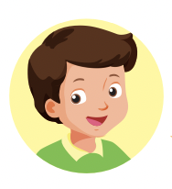

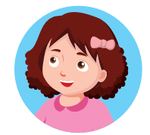
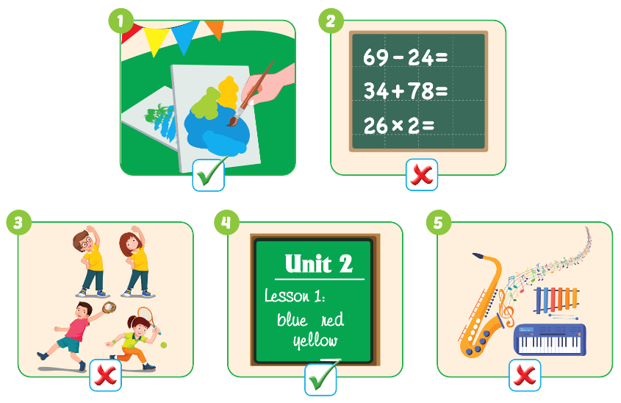

Slide 6
Let’s play!

Slide 7


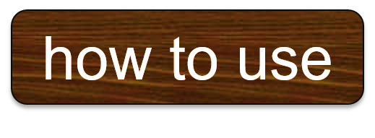
Do you like………….?
- …….................

Slide 8
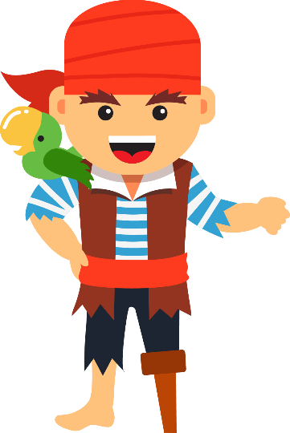
NEXT
Help me please!

Slide 9


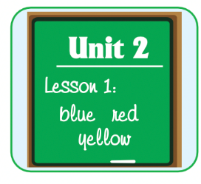


1
NEXT
Do you like English?
Do you like………….?
- …….................
ANSWER
No, I don’t.

Slide 10

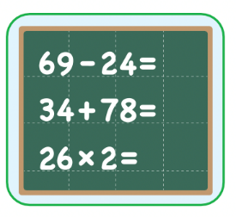

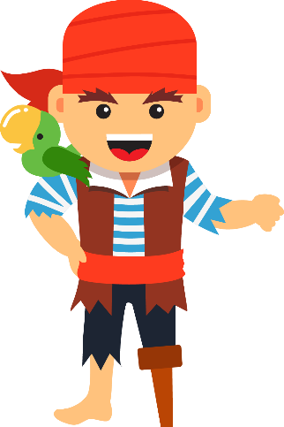
1
NEXT
2
Do you like math?
Do you like………….?
- …….................
ANSWER
Yes, I do.

Slide 11

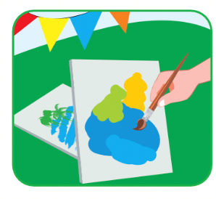
1
NEXT
2
3
Do you like art?
Do you like………….?
- …….................
ANSWER
Yes, I do.

Slide 12

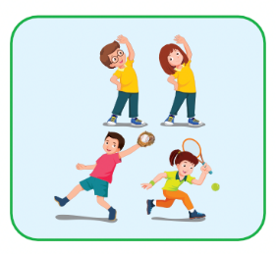
1
NEXT
2
3
Do you like P.E.?
4
Do you like………….?
- …….................
ANSWER
No, I don’t.

Slide 13

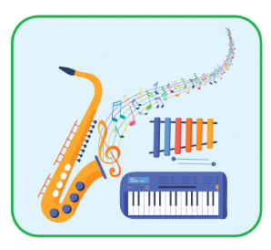
1
NEXT
2
3
Do you like music?
4
Do you like………….?
- …….................
5
ANSWER
Yes, I do.

Slide 14
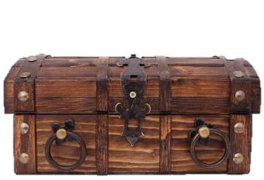
1
END
2
Hurray!
We found the treasure! THANK YOU!
3
4
5
ANSWER

Slide 15
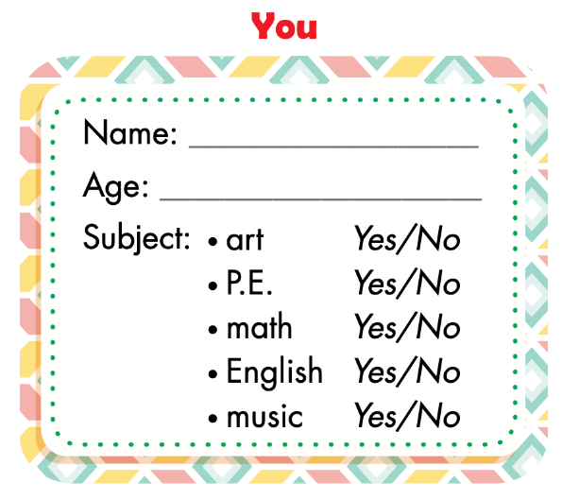
Fill in the form.
Notes:
Divide the class into groups of four.
Have Student A cover their eyes.
Have the other students put one of their own items on the
desk in a random order.
Have Student A open their eyes and try to guess.
Have other students respond.
Have students swap roles and repeat.

Slide 16
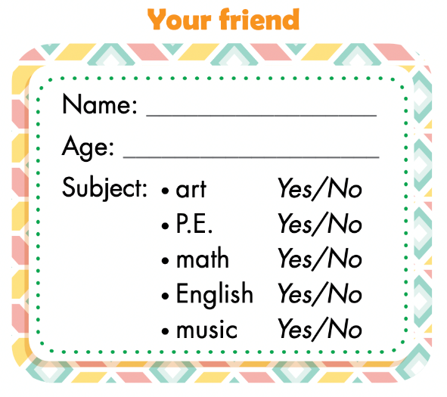
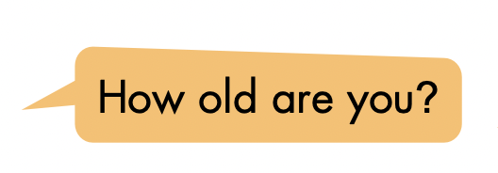
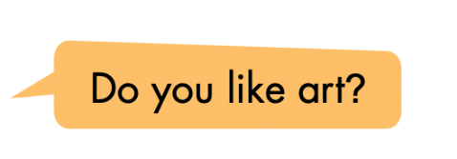
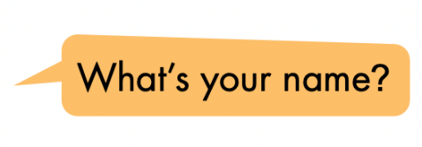
Ask, write, and circle.
Example:
Tam
8
I am 8.
Yes, I do.
I am Tam.

Slide 17

Pairwork

Slide 18
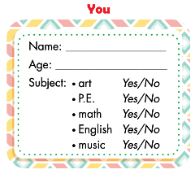
Groupwork: draw a bar graph.
Work in groups of 6
Take out YOU form and count
Fill in the form 1 (count students say YES)
Draw a bar graph
Notes:
134722862

Slide 19
subjects | Numbers of students
art
P.E.
math
English
music
6
1
3

