Slide 1

Unit 3: School
Lesson 2.2
SB p. 42
WB p. 31 (C)
Notes:
By the end of this lesson, students will be able to pronounce the sound /ɪ/ and ask what subjects people like.

Slide 2

WARM UP

Slide 3


School subjects

Slide 4
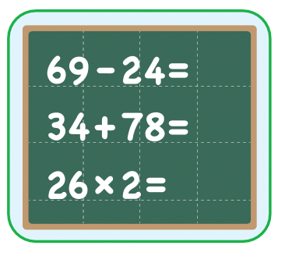


Do you like math ?
GREAT
Yes, I do.
math
No, I don’t.

Slide 5
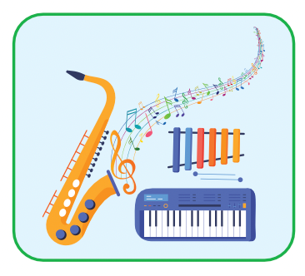


Do you like music?
GREAT
music
Yes, I do.
No, I don’t.

Slide 6
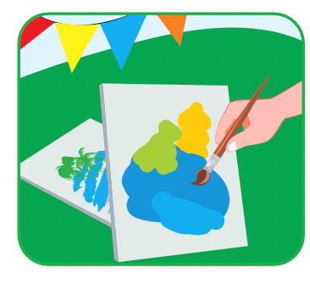
Do you like music ?
GREAT
math
Yes, I do.
No, I don’t.

Slide 7
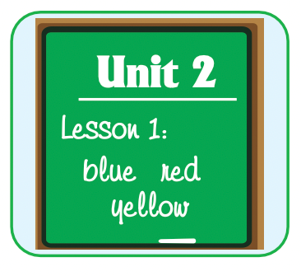


Yes, I do.
Do you like music?
GREAT
Do you like English?
Do you like art?

Slide 8
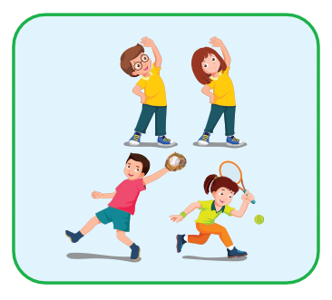

No, I don’t.
Do you like music?
GREAT
Do you like art?
Do you like P.E.?

Slide 9

It’s time to learn …

Slide 10

Phonics
/ɪ/

Slide 11


Click on the icon to hear the sound
Click on each word to hear the sound
English
physical
/ɪ/
/ɪ/

Slide 12
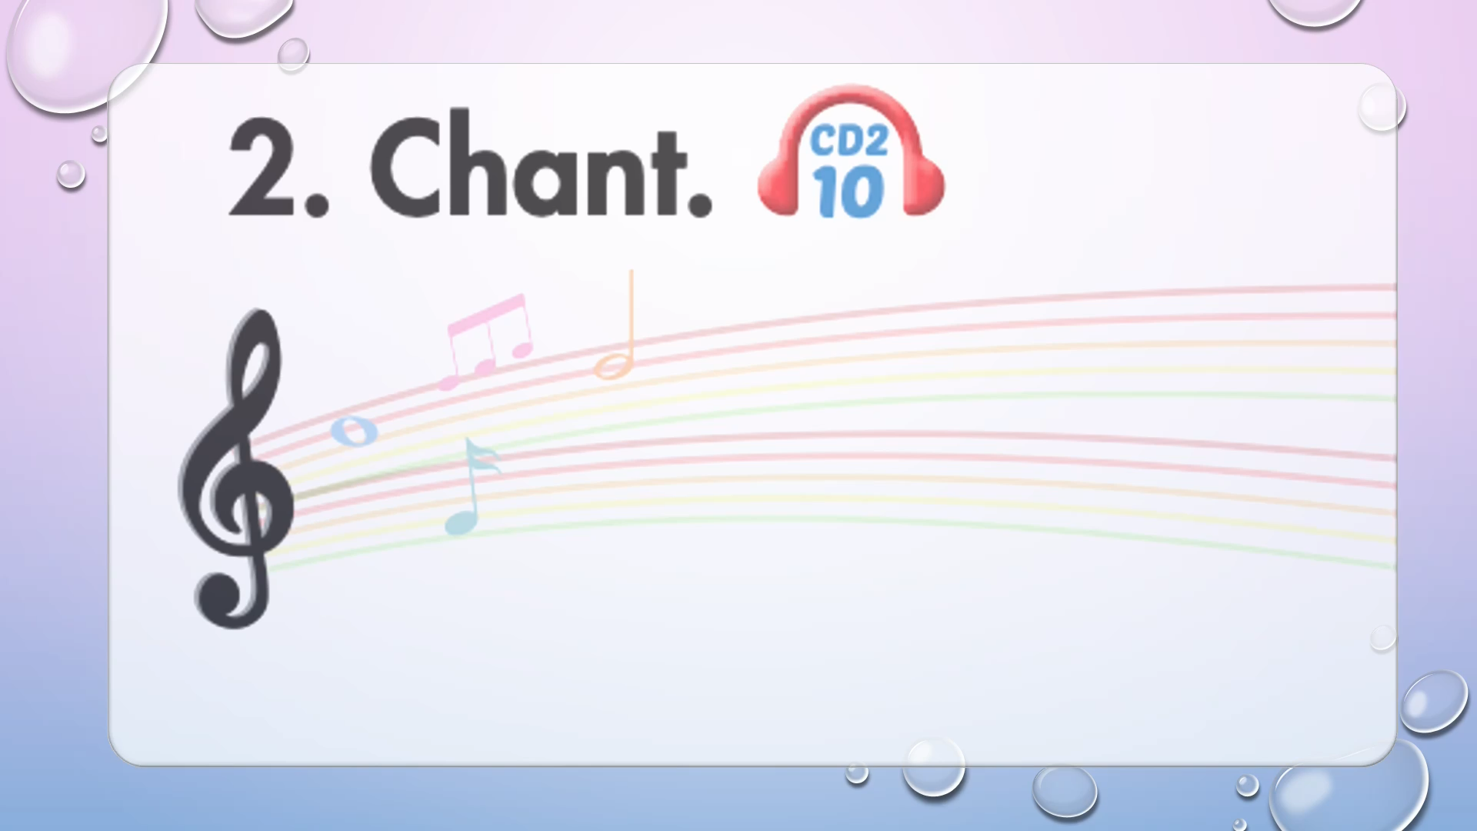

Slide 13
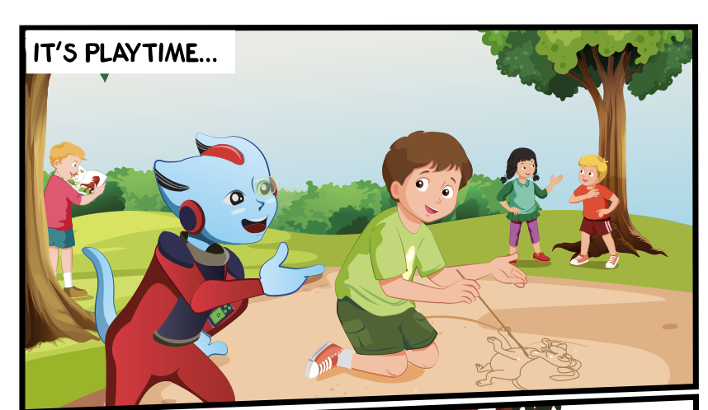
Look at the pictures and answer these questions.
Who can you see?
What are they doing?
Where are they?

Slide 14


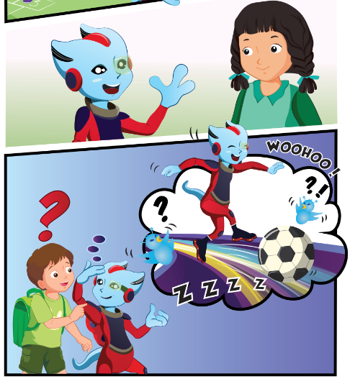
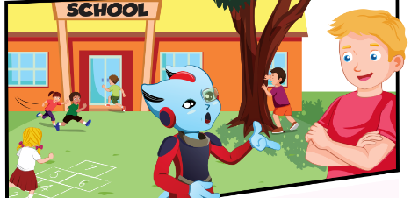
Click on the icon to hear the sound
3.
1.
4.
2.

Slide 15

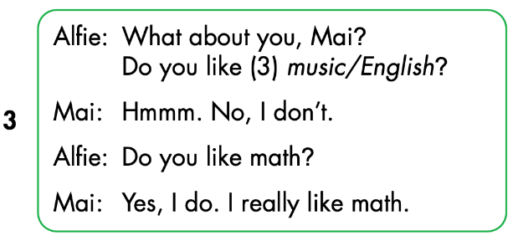
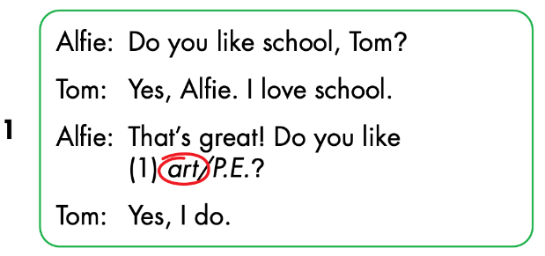
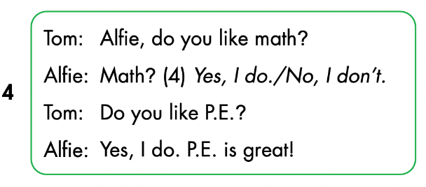
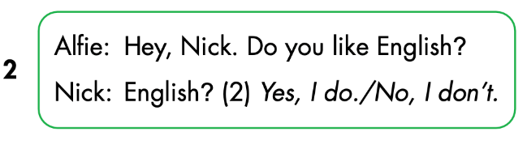
Click on the icon to hear the sound

Slide 16
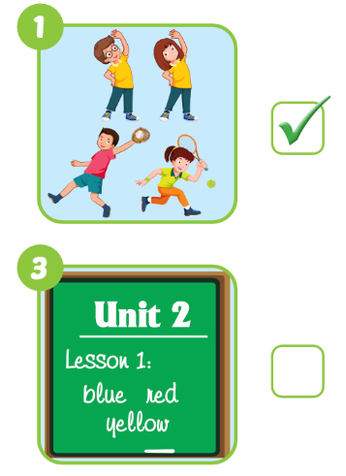
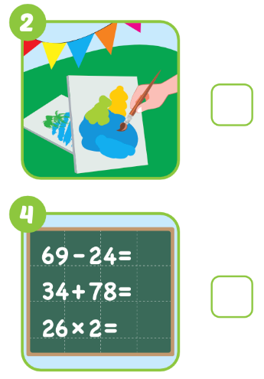

WB p. 31
Click on the icon to hear the sound

Slide 17
Interview game
Draw this table
Choose 3 school subjects to write
Names | Math | English | Art
Tam
✓
✓
✘
Move around to ask: Do you like…? And write in the table
Work in pairs and tell about your friends
Notes:
134722862

