Slide 1
Unit 5
What will you do this weekend?
Lesson 1

Slide 2
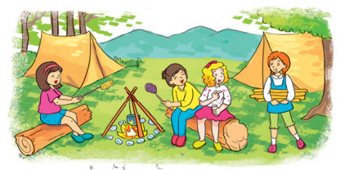
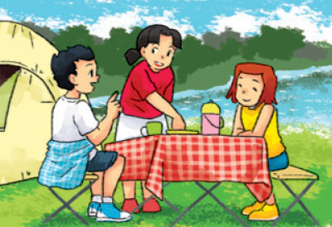
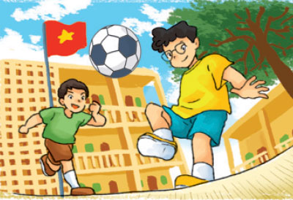
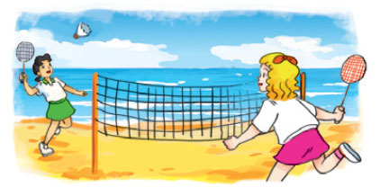
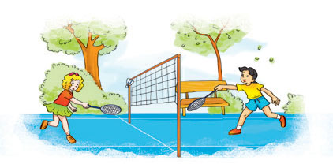
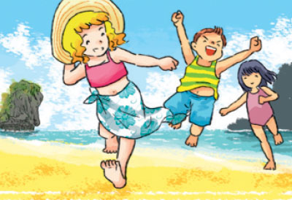
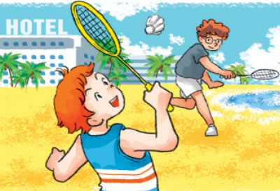
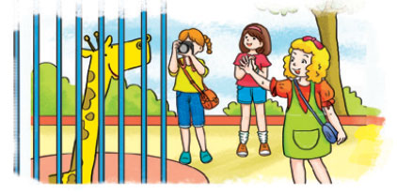
A. Vocabulary
in the mountains
in the countryside
at school
at the seaside
Ở trên núi
Ở nông thôn
Ở trường
Ở trên bờ biển
in the park
on the beach
by the sea
at the zoo
Ở công viên
Ở trên bãi biển
Ở gần biển
Ở sở thú

Slide 3
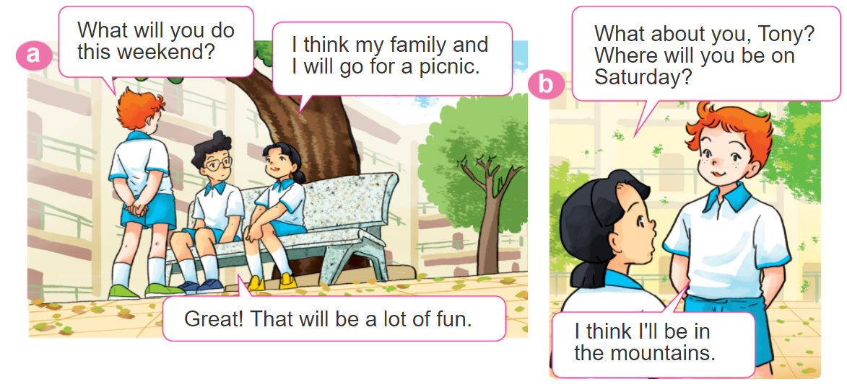

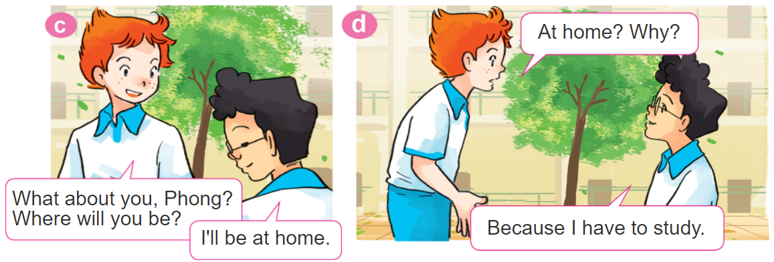
1. Look, listen and repeat

Slide 4
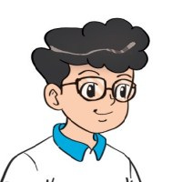
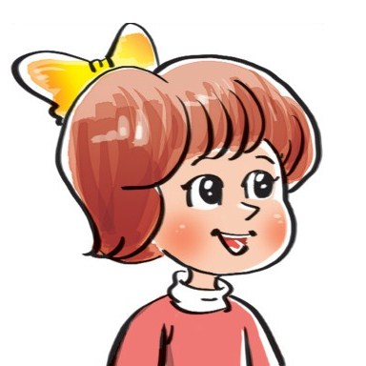
2. Point and say
Where will you be this weekend?
I think I'll be ____________.
in the
countryside
by the sea
on the beach
at school

Slide 5
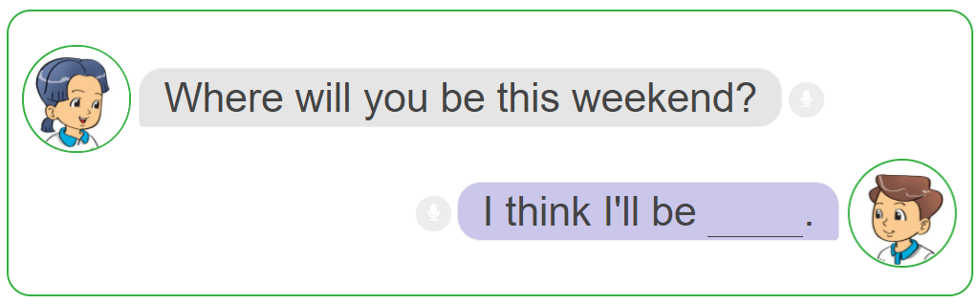
3. Let’s talk.

Slide 6
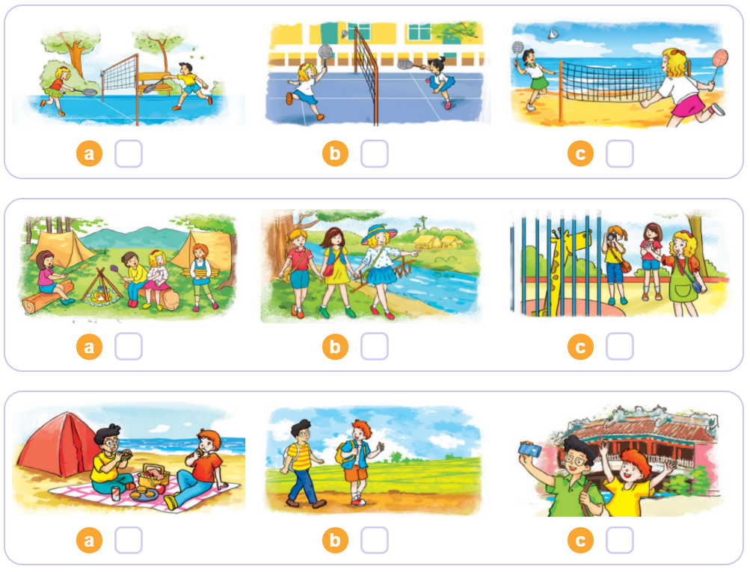

4. Listen and tick
1
2
3

Slide 7
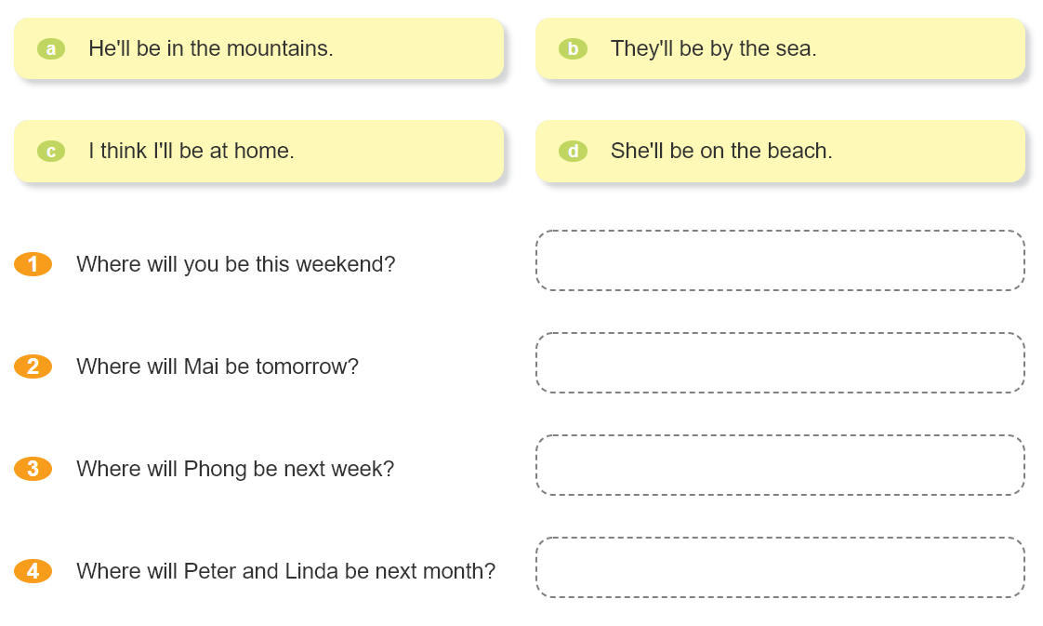

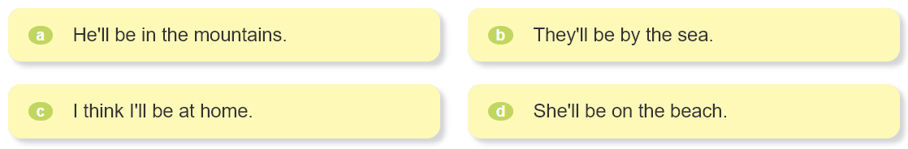
5. Read and match.

Slide 8
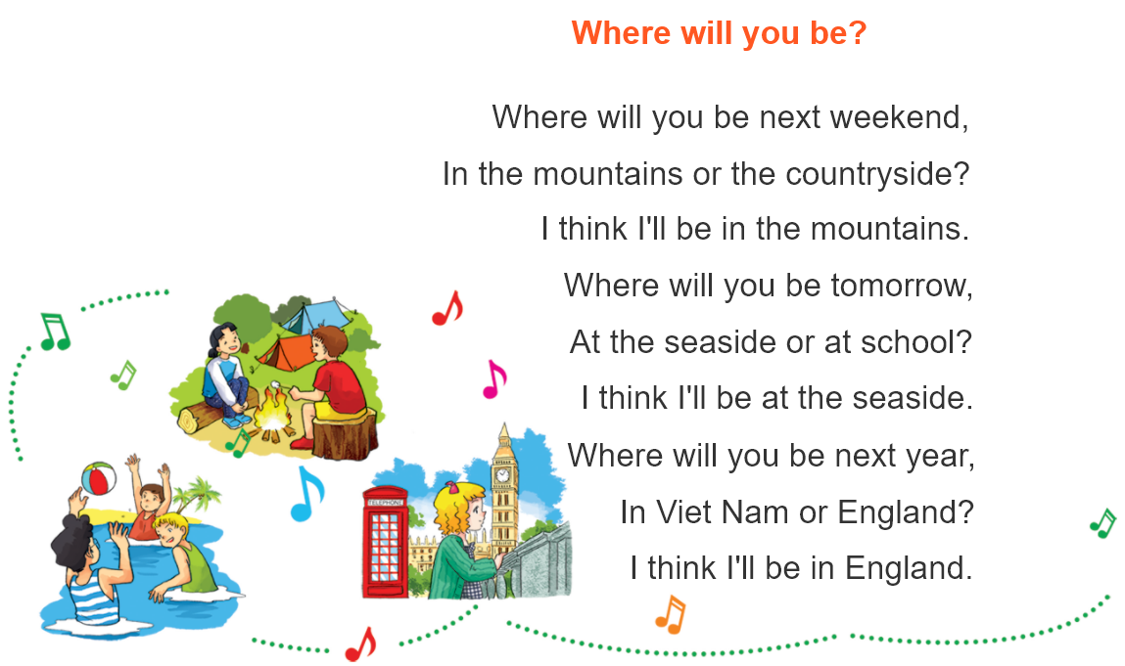

6. Let’s sing.

Slide 9
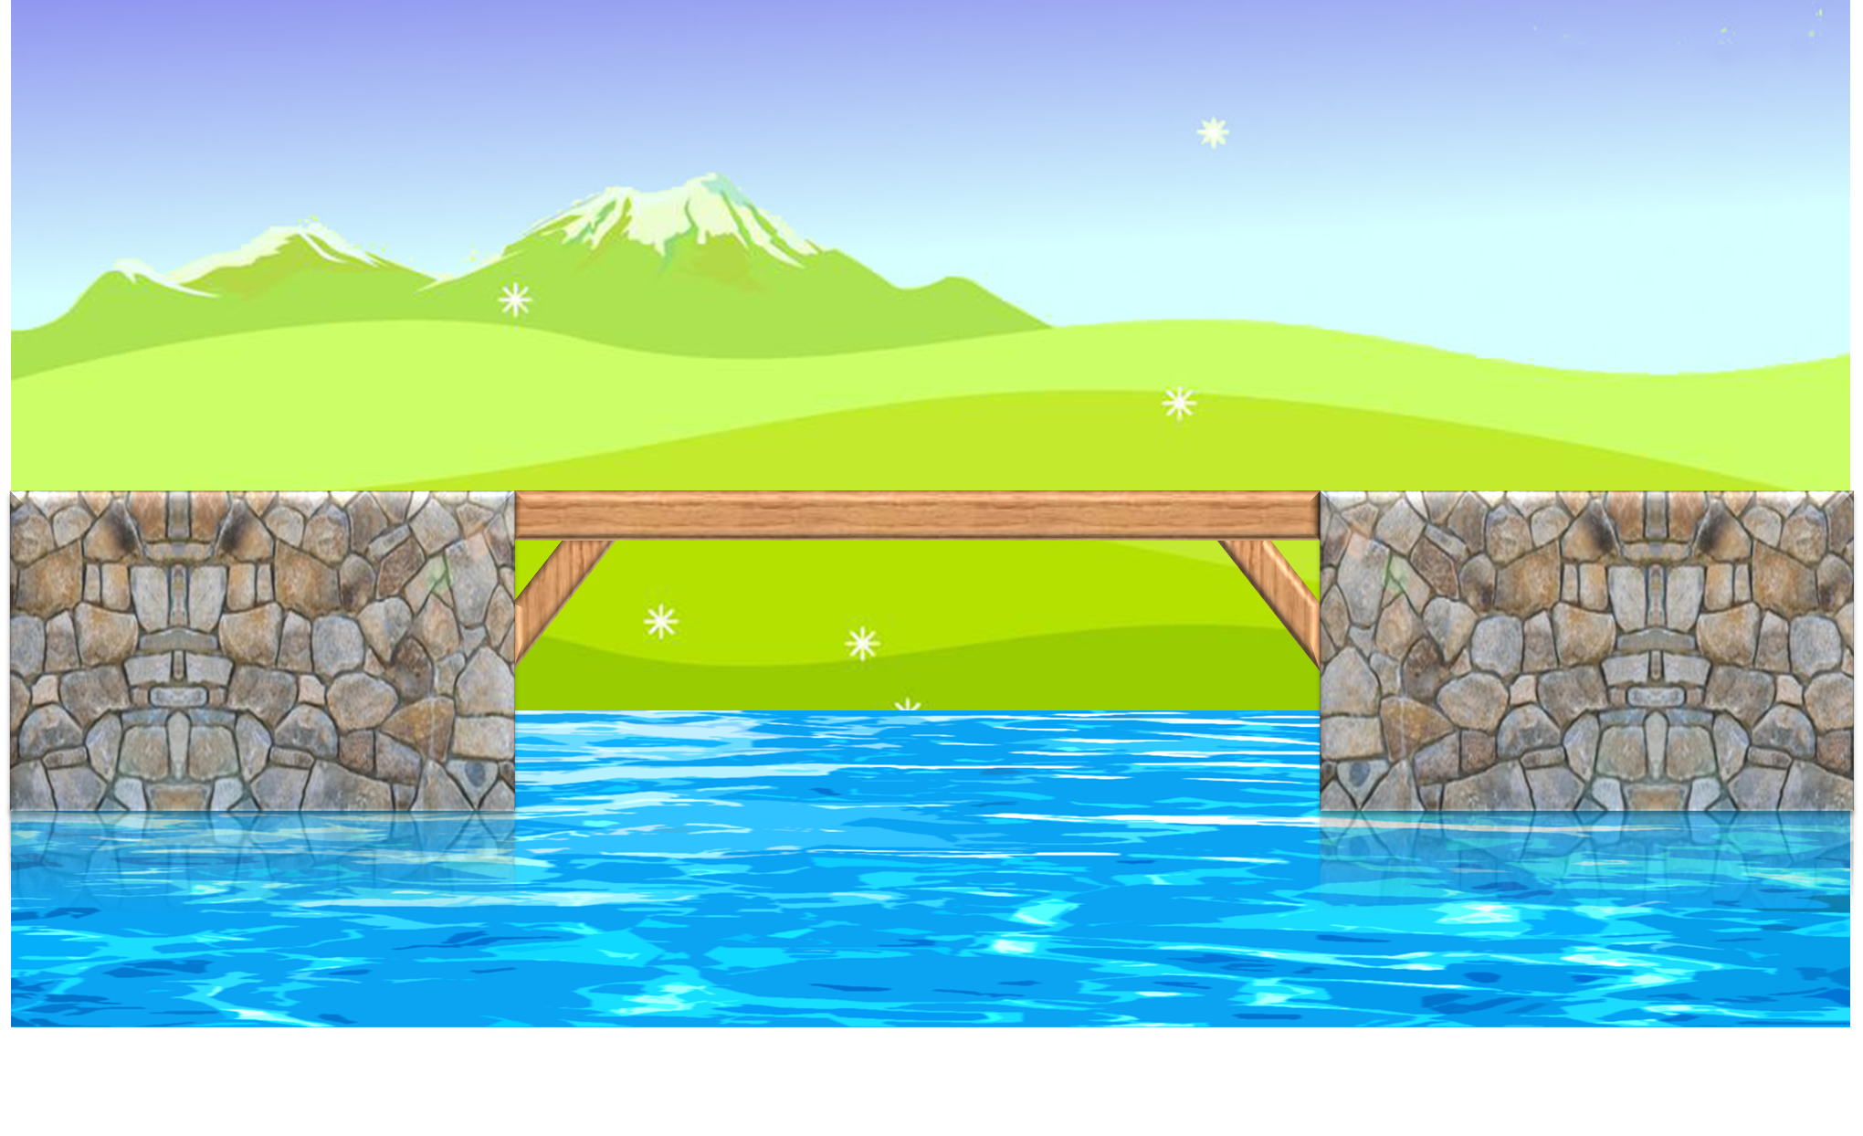
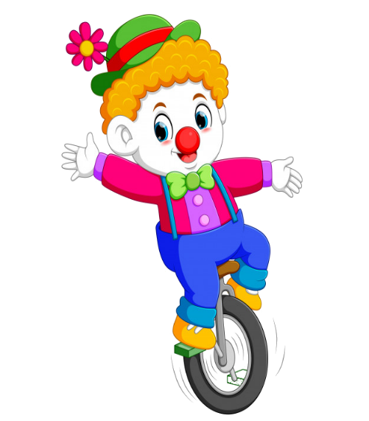



PLAY

Slide 10



Where will you be this weekend?
I think I'll be at the seaside.
I think I'll be at the zoo.
I think I'll be in the park.
I think I'll be at school.

Slide 11
Where will you be this weekend?
I think I'll be at the seaside.
I think I'll be on the beach.
I think I'll be at the zoo.
I think I'll be in the mountain.

Slide 12
Where will you be this weekend?
I think I'll be in the mountain.
I think I'll be at the zoo.
I think I'll be by the sea.
I think I'll be at the seaside.

Slide 13
Where will you be this weekend?
I think I'll be at the zoo.
I think I'll be in the mountain.
I think I'll be by the sea.
I think I'll be at school.

Slide 14
Where will you be this weekend?
I think I'll be in the countryside.
I think I'll be at the zoo.
I think I'll be in the park.
I think I'll be on the beach.

