Slide 1


English 3
Unit 1
Nice to see you again
Lesson 3
Teacher: Ms. Huyền Phạm

Slide 2
Review

Slide 3
















Trò chơi
HÁI TÁO
Notes:
Ms Huyền Phạm - 0936.082.789 – YOUTUBE: MsPham. Facebook: Dạy và học cùng công nghệ.

Slide 4

Nice to see you, too.
A
Good morning, class.
Good morning, Miss Hien.
B
Goodbye, Miss Hien.
C
Notes:
Ms Huyền Phạm - 0936.082.789 – YOUTUBE: MsPham. Facebook: Dạy và học cùng công nghệ.

Slide 5
I’m very well, thank you.
A
How are you, Mai?
Good night.
B
Nice to see you again.
C
Notes:
Ms Huyền Phạm - 0936.082.789 – YOUTUBE: MsPham. Facebook: Dạy và học cùng công nghệ.

Slide 6
Nice to see you again.
A
Goodbye, Miss Hien.
Good afternoon, class.
B
Bye, Hoa. See you tomorrow
C
Notes:
Ms Huyền Phạm - 0936.082.789 – YOUTUBE: MsPham. Facebook: Dạy và học cùng công nghệ.

Slide 7
Good night.
A
Nice to see you, too
Nice to see you again.
B
Goodbye.
C
Notes:
Ms Huyền Phạm - 0936.082.789 – YOUTUBE: MsPham. Facebook: Dạy và học cùng công nghệ.

Slide 8
Good evering.
A
Good night.
Goodmorning.
B
Good night.
C
Notes:
Ms Huyền Phạm - 0936.082.789 – YOUTUBE: MsPham. Facebook: Dạy và học cùng công nghệ.

Slide 9

Good ____.
afternoon
A
moring
B
night
C
Notes:
Ms Huyền Phạm - 0936.082.789 – YOUTUBE: MsPham. Facebook: Dạy và học cùng công nghệ.

Slide 10
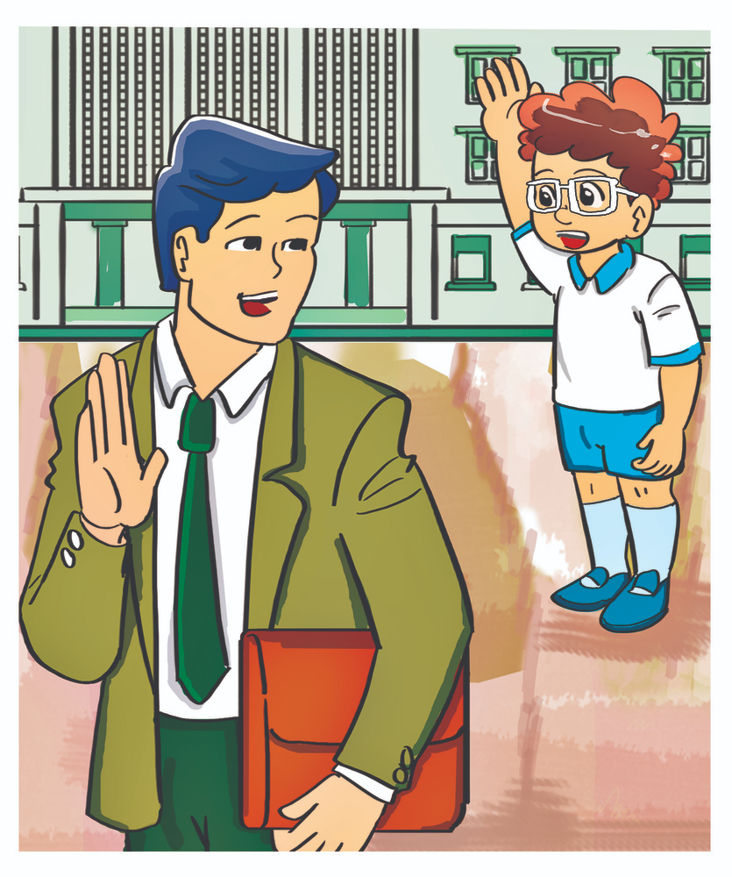
night
A
bye
B
evening
Good _____
C
Notes:
Ms Huyền Phạm - 0936.082.789 – YOUTUBE: MsPham. Facebook: Dạy và học cùng công nghệ.

Slide 11
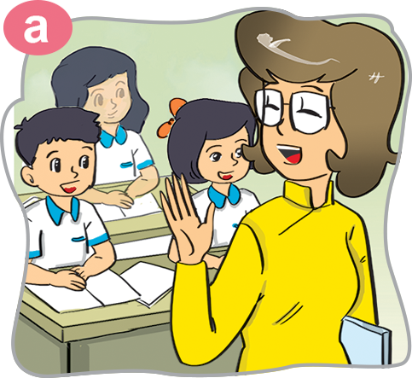
too
A
Nice
B
tomorrow.
See you _______.
C
Notes:
Ms Huyền Phạm - 0936.082.789 – YOUTUBE: MsPham. Facebook: Dạy và học cùng công nghệ.

Slide 12
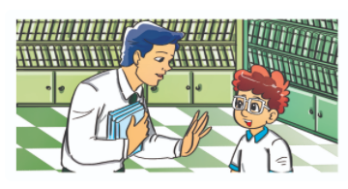
Nice
A
Nine
B
See
____ to meet you.
C
Notes:
Ms Huyền Phạm - 0936.082.789 – YOUTUBE: MsPham. Facebook: Dạy và học cùng công nghệ.

Slide 13
Phonics

Slide 14
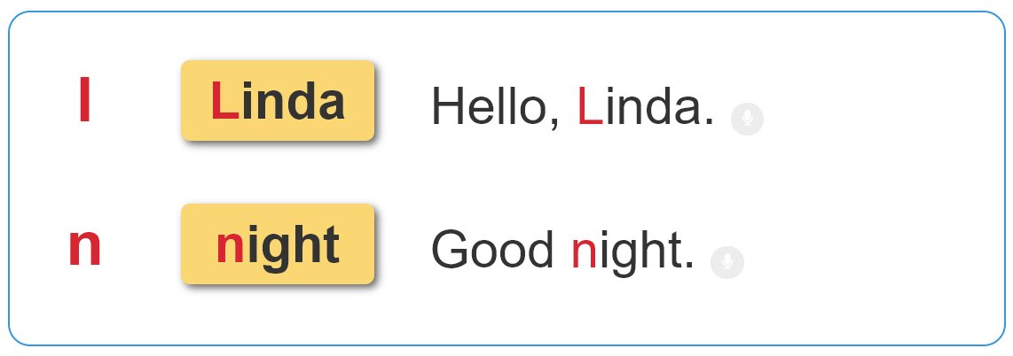

6. Listen and repeat

Slide 15
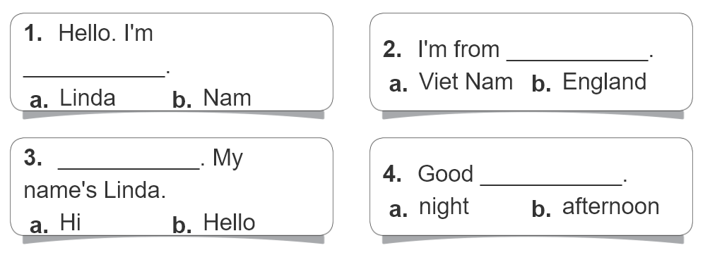
2. Listen and circle. Then write and say aloud.

Slide 16
Practise

Slide 17

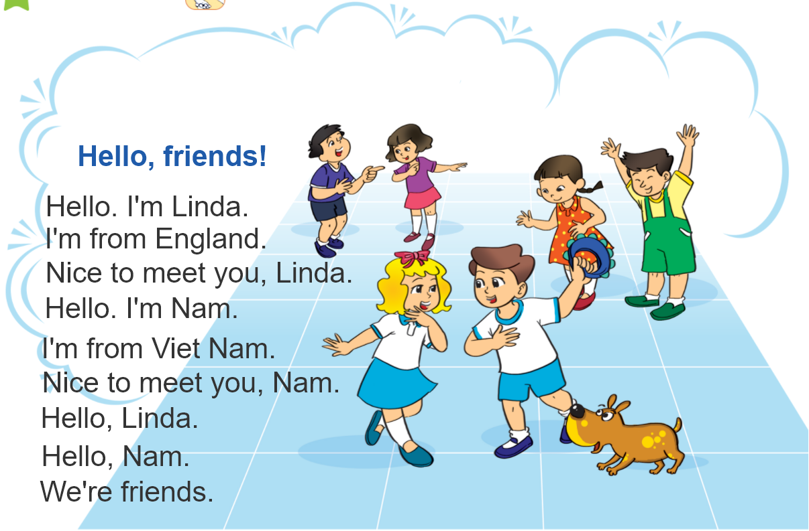

3. Let's chant

Slide 18
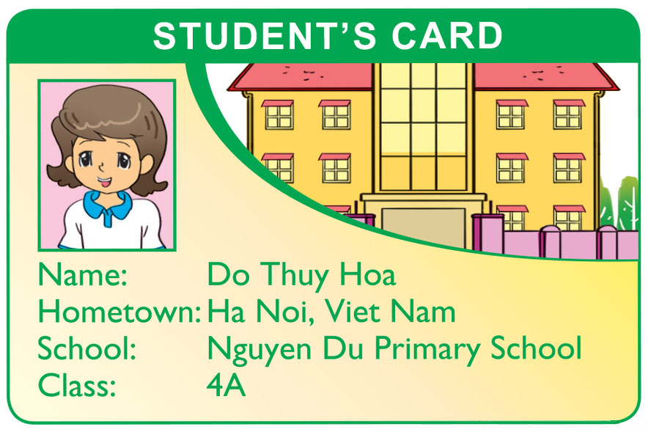
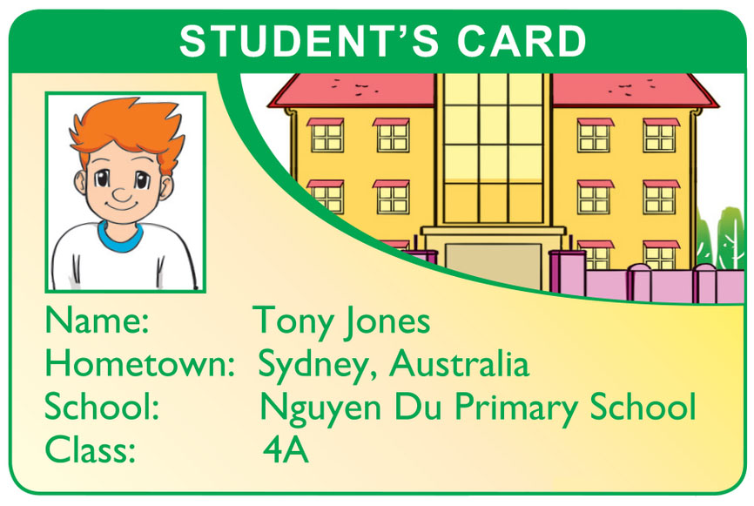
4. Read and answer.
What is the girl's name?
Her name is Do Thuy Hoa.
2. Where is she from?
She's from Ha Noi, Viet Nam.
3. What is the boy's name?
His name is Tony Jones.
4. Where is he from?
He's from Sydney, Australia.

Slide 19
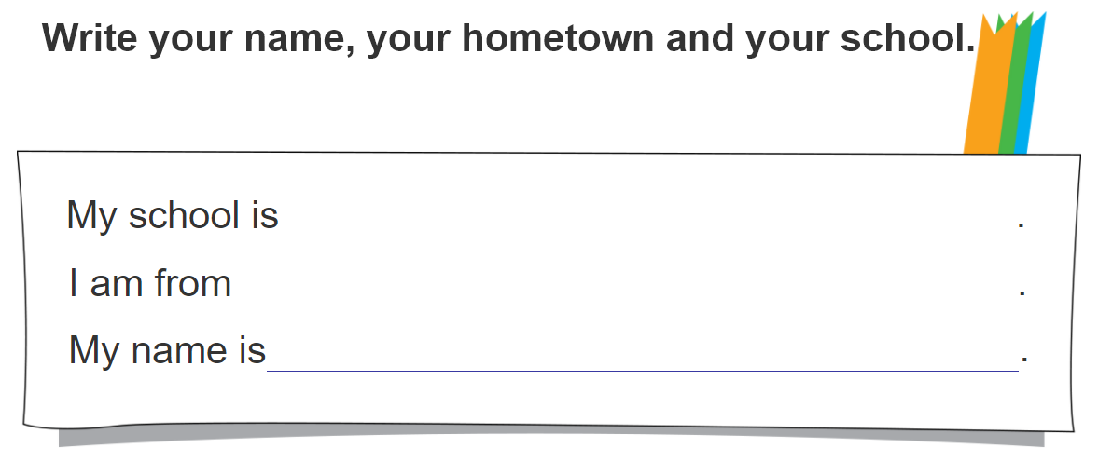
5. Write about you

Slide 20
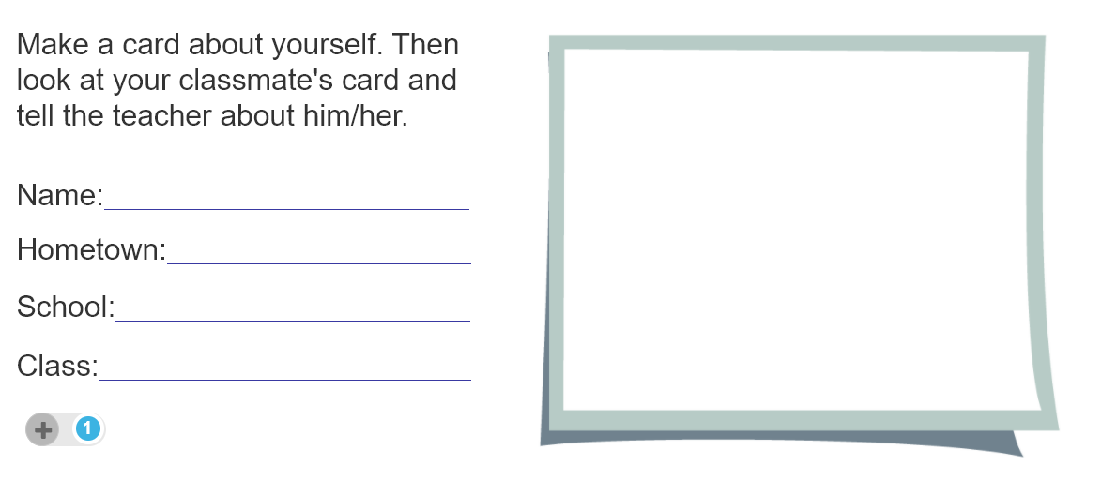
6. Project

