Slide 1


UNIT 18
What's your
phone number?
Lesson 2

Slide 2
VOCABULARY

Slide 3
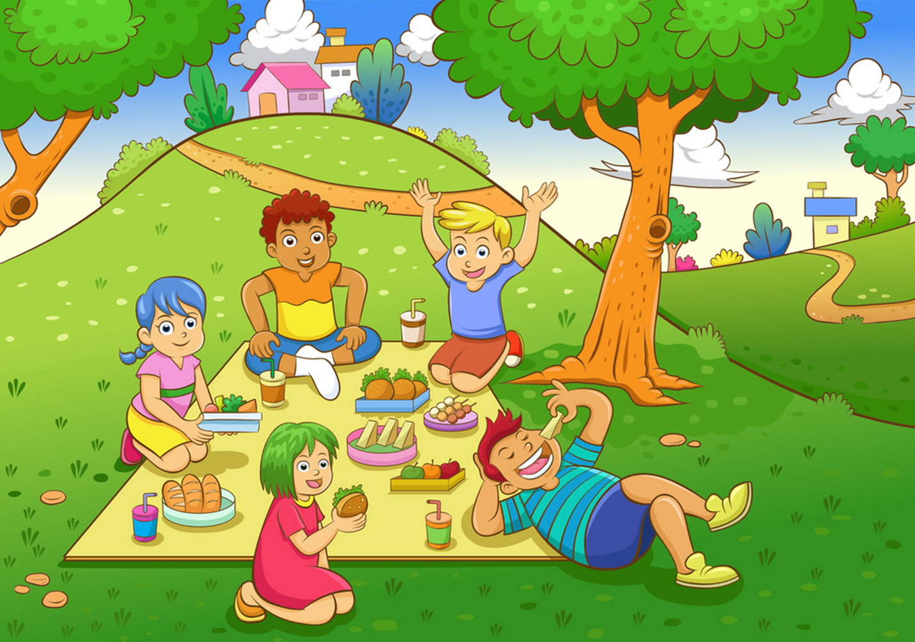
Vocabulary
Go a picnic
/ɡəʊ ə ˈpɪknɪk/

Slide 4
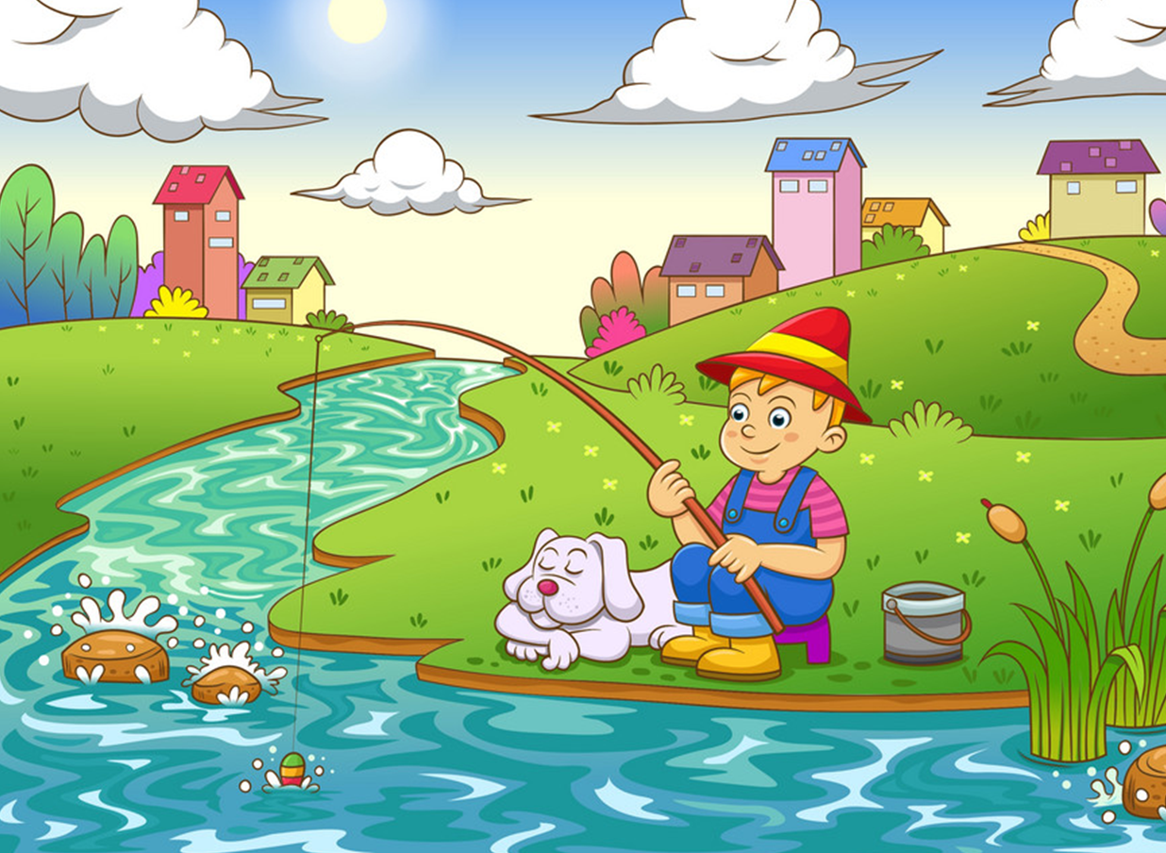
Vocabulary
Go fishing
/ɡəʊ ˈfɪʃɪŋ/

Slide 5
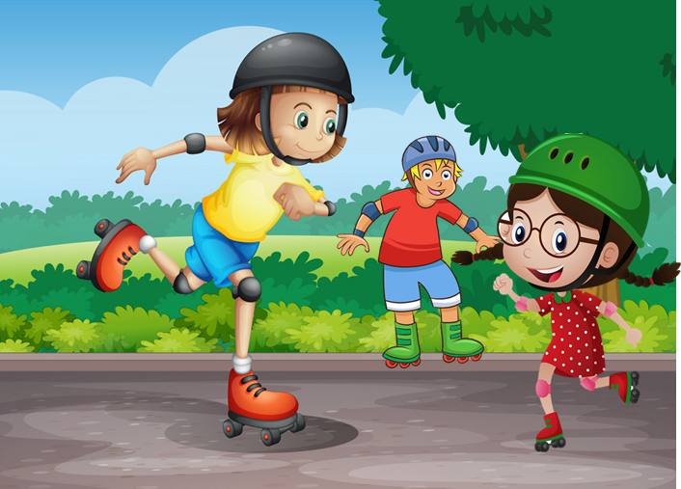
Vocabulary
Go skating
/ɡəʊ ˈskeɪtɪŋ/

Slide 6
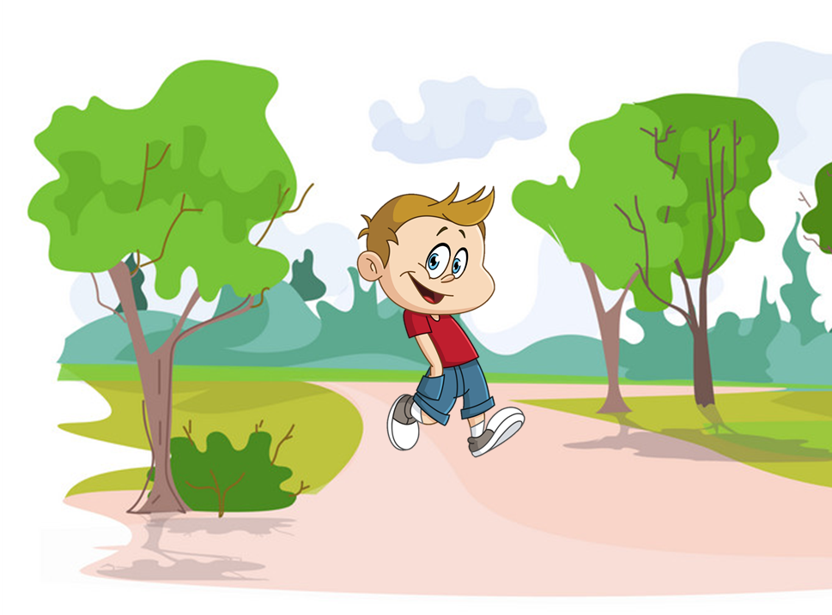
Vocabulary
Go for a walk
/ɡəʊ fɔːr ə wɔːk/

Slide 7
Vocabulary
Go for a walk
Go a picnic
Go skating
Go fishing

Slide 8
GRAMMAR

Slide 9
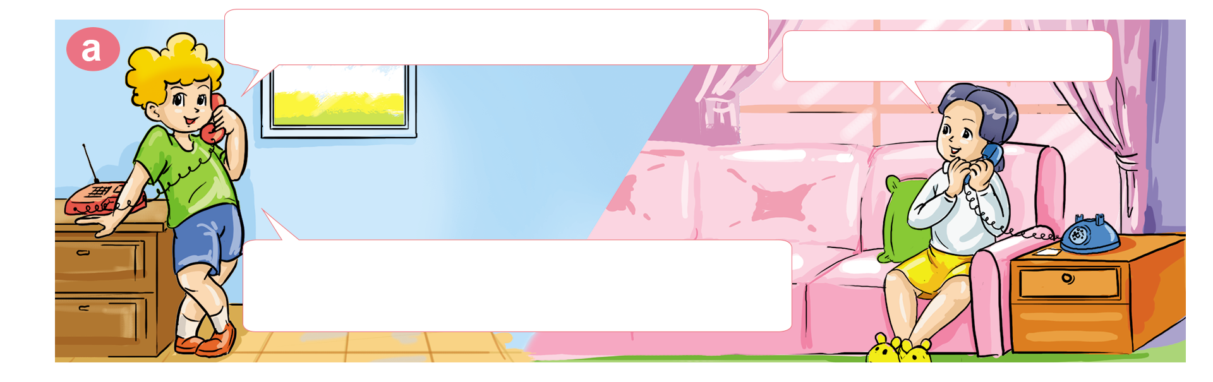
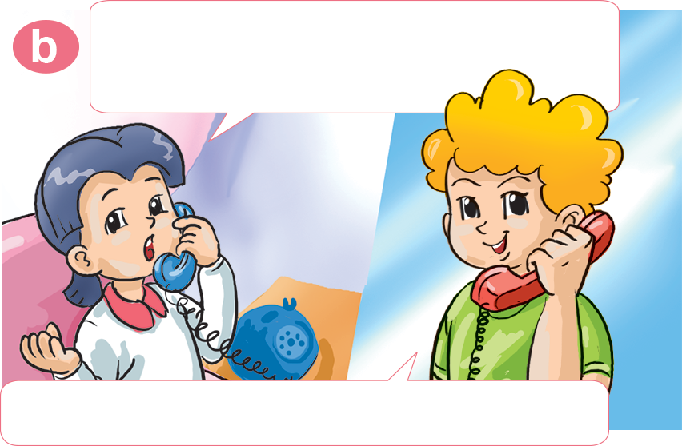
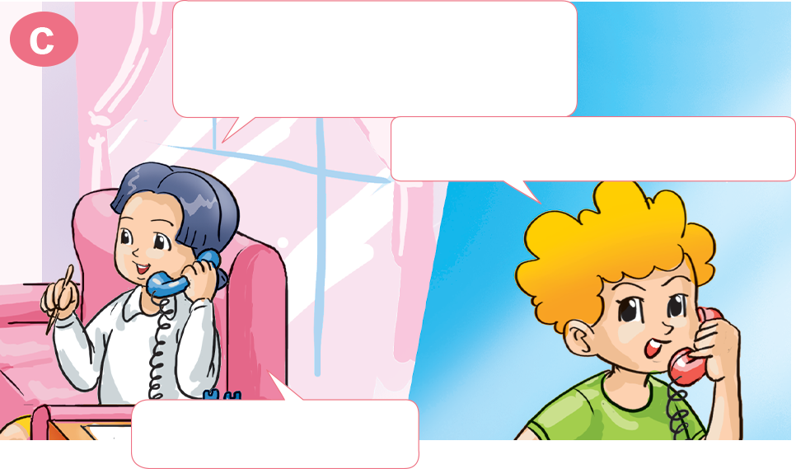
1. Look, listen and repeat
Hello. May I speak to Mai, please?
Speaking. Who is it?
It's Peter. We are free tomorrow. Would you like to go for a picnic?
Yes, I'd love to, but I have to ask my parents.
Sure. What's your phone number?
It's 0438 570 339.
OK. Then can you call me back?
OK. Thanks.

Slide 10

2. Point and say
Would you like to _______________?
go for a walk
I'd love to.

Slide 11
2. Point and say
Would you like to _______________?
go skating
I'd love to.

Slide 12
2. Point and say
Would you like to _______________?
go fishing
I'd love to.

Slide 13
2. Point and say
Would you like to _______________?
go for a picnic
I'd love to.

Slide 14

2. Point and say
Would you like to _______________?
go skating
Sorry, I can't.

Slide 15
2. Point and say
Would you like to _______________?
go for a walk
Sorry, I can't.

Slide 16
2. Point and say
Would you like to _______________?
go for a picnic
Sorry, I can't.

Slide 17
2. Point and say
Would you like to _______________?
go fishing
Sorry, I can't.

Slide 18

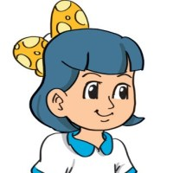
3. Let’s talk
What's your phone number?
Would you like to ____________ ?

Slide 19


4. Listen and circle
1. Mai wants to go for a ___________.
a. picnic b. walk
2. Phong wants to go ___________.
a. fishing b. skating
3. Linda's phone number is ___________.
a. 0999 291 196 b. 0999 291 195
4. Nam's phone number is ___________.
a. 0438 456 339 b. 0463 393 845

Slide 20
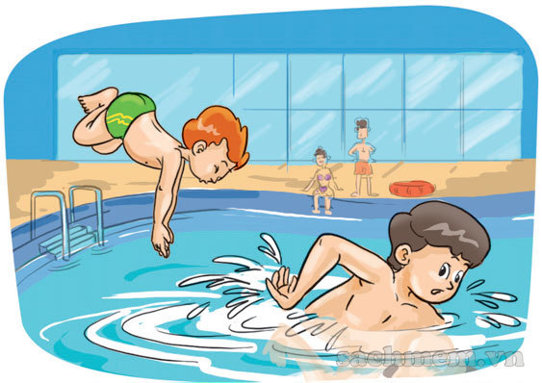
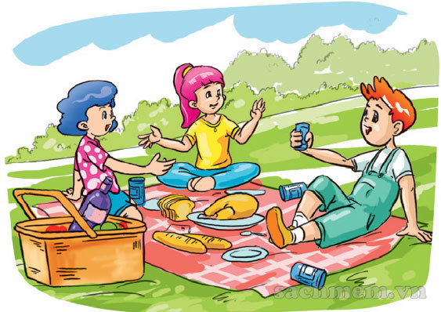
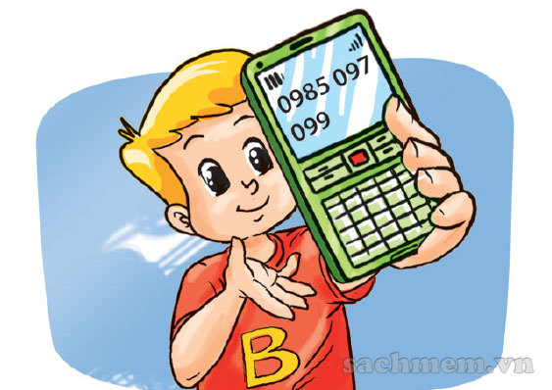
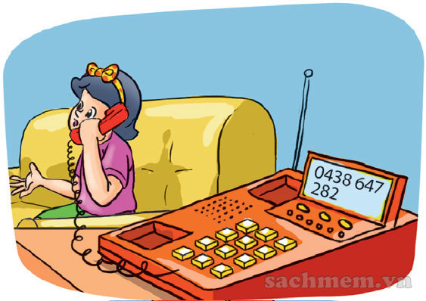
5. Look and write
1
A: Would you like _______________?
B: Sorry, I can't.
to go swimming
2
A: _____________________________?
B: I'd love to.
Would you like to go for a picnic
A: What's _______________________?
It's 0985 097 099
your phone number
3
4. A: Hello. _____________ Amy, please?
B: Speaking.
May I speak to
4

Slide 21
6. Let’s play

Slide 22





Play

Slide 23






1
2
3
4
5
6
7
8
1
2
3
4
5
6
7
8
1
2
3
4
5
6
7
0
8
1
0
2
3
4
5
6
7
8
0
Exit

Slide 24




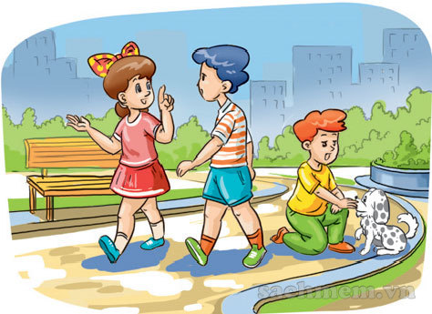
A
Yes, I’d love to
B
Yes, I do
Would you like to go for a walk?
C
Sorry, I can't.
Back

Slide 25
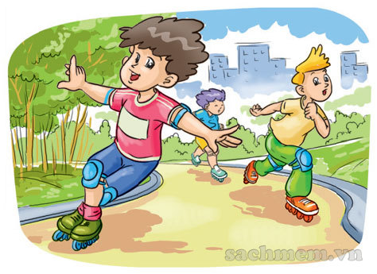
A
To go fishing
B
To go skating
Would you like _______________?
Yes, I’d love to.
C
To go swimming
Back

Slide 26
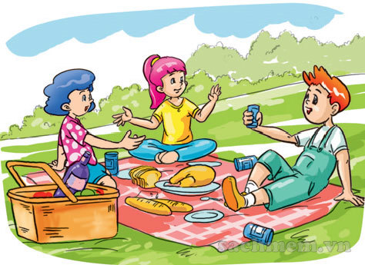
A
too
B
a
Would you like ___ go
for a walk?
Sorry, I can’t.
C
to
Back

Slide 27
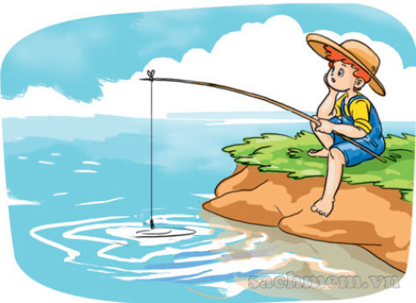
Sorry, I can’t.
XEM ĐÁP ÁN
Would you like to
go fishing?
Back

Slide 28
A
Do you like
B
Would you like
____________to
go swimming?
C
What do you like
Back

Slide 29
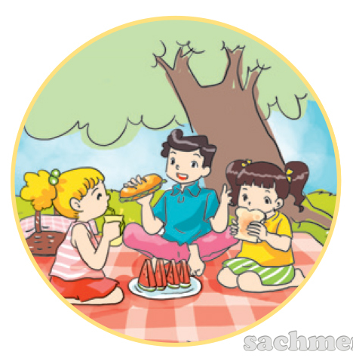
A
a picnic
B
for picnic
Would you like to
go ___________?
C
for a picnic
Back

Slide 30

A
No, I can’t.
B
Yes, I’d love to.
Would you like to
go skating?
C
No, I am not.
Back

Slide 31
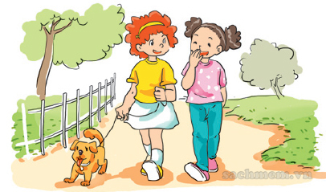
Yes, I’d love to.
XEM ĐÁP ÁN
Would you like to
go for a walk?
Back

Slide 32
3. Let’s talk
Hello. May I speak to ______, please?
Would you like to ____________ ?
What's your phone number?

Slide 33
THANK YOU!

