Slide 1


HOW DO YOU SPELL YOUR NAME?

Slide 2














LISTEN TO MUSIC

Slide 3

New words
Spell : đánh vần

Slide 4



My name’s Linda
What’s your name?
L-I-N-D-A
How do you spell your name?

Slide 5

Patterns:
How do you spell your name?
(Tên của bạn đánh vần như thế nào?)
L-I-N-D-A.
(L-I-N-D-A.)

Slide 6
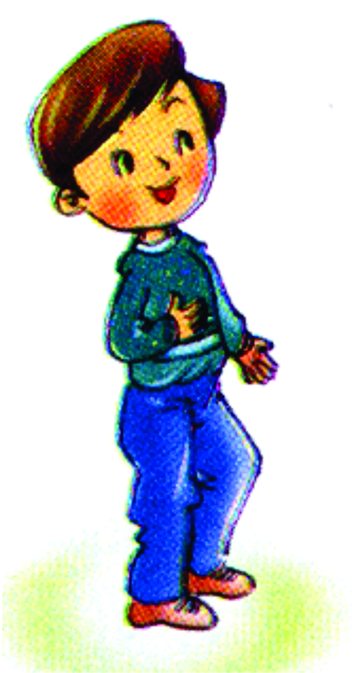
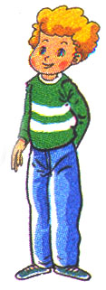
How do you spell your name?
___________.
L-I-N-D-A
Linda
Nam
Quan
Peter

Slide 7
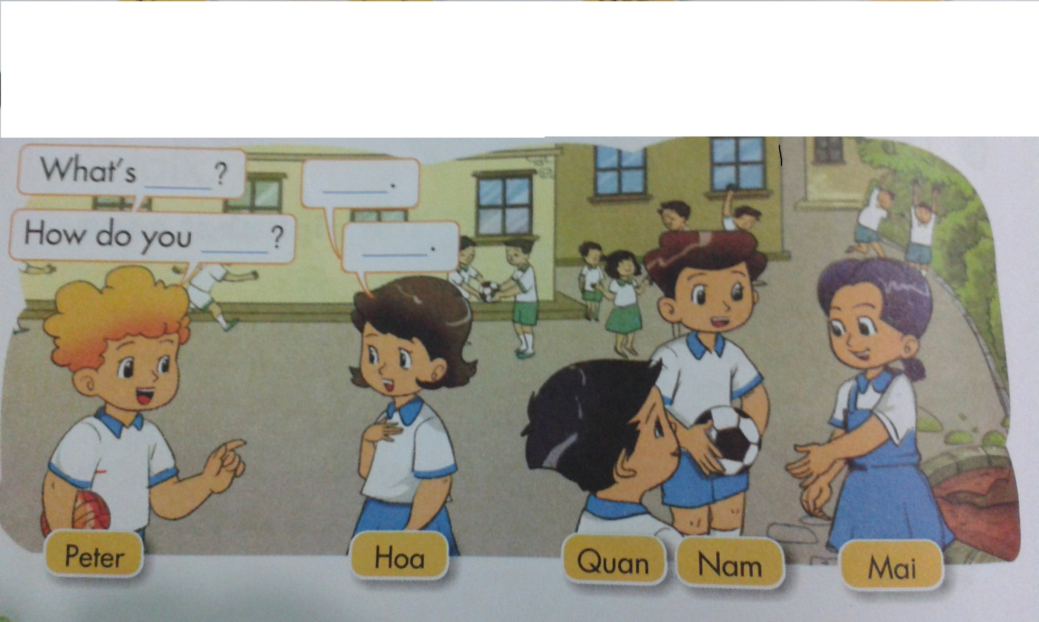
What’s _________?
___________.
How do you ___________?
___________.

Slide 8
PLAY GAME
Interview

Slide 9




Good bye!
See you!

