Slide 1
Unit 8
What are
you reading?
Lesson 2

Slide 2
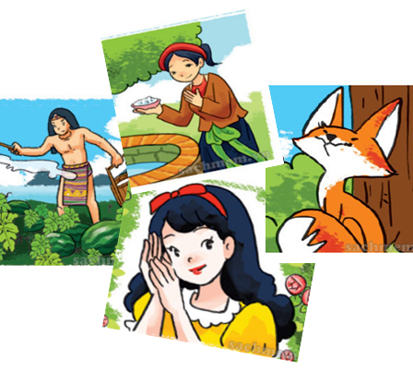
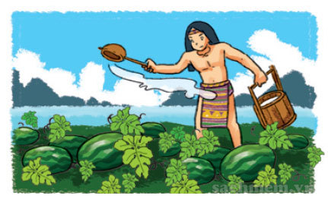
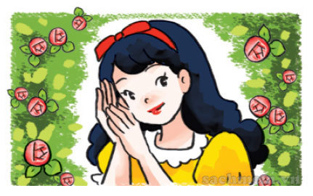
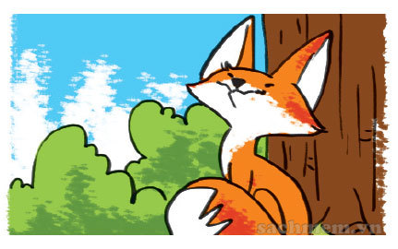
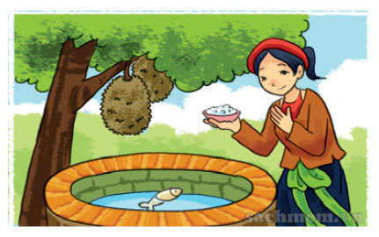
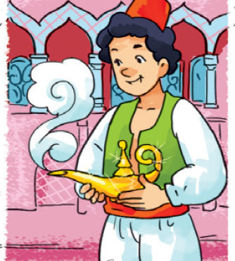
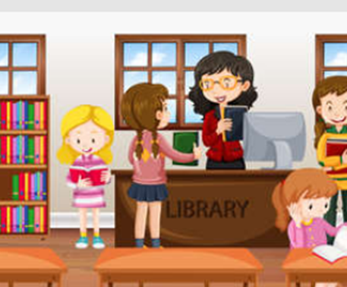

A. Vocabulary
main character
hard-working
kind
clever
/meɪnˈkærəktər/
/ˌhɑːrd ˈwɜːrkɪŋ/
/kaɪnd/
/ˈklevər/
Nhân vật chính
Chăm chỉ
Tốt bụng
Lanh lợi
gentle
generous
borrow
finish
/ˈdʒentl/
/ˈdʒenərəs/
/ˈbɔːrəʊ/
/ˈfɪnɪʃ/
Dịu dàng
Hào phóng
Mượn
Hoàn thành

Slide 3

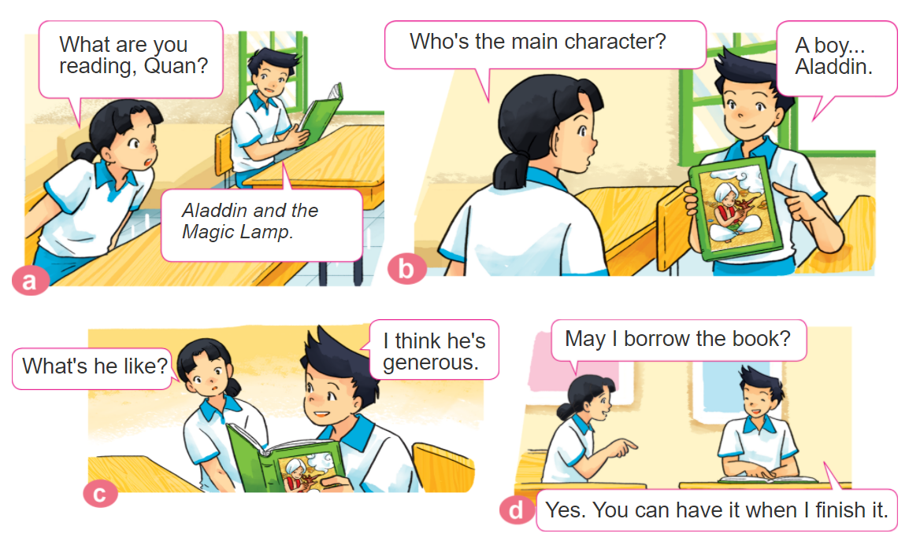
1. Look, listen and repeat.

Slide 4

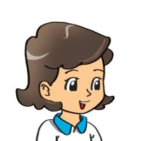
2. Point and say
What's ________ like?
He's/She's _________.
Tam
gentle
An Tiem
hard-working
Snow White
kind
The Fox
clever

Slide 5

B. Grammar
Hỏi và trả lời về tính cách của ai đó:
What's ___________ like?
+ Tên nhân vật
He/she’s _____.
+ adj

Slide 6

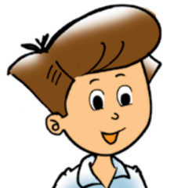


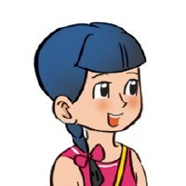
3. Let’s talk
Do you like fairy tales/comic books/short stories?
Yes, ___________.
No, ____________.
What book/story are you reading?
It’s ______.
What's the main character like?
He’s/ She’s ______.

Slide 7
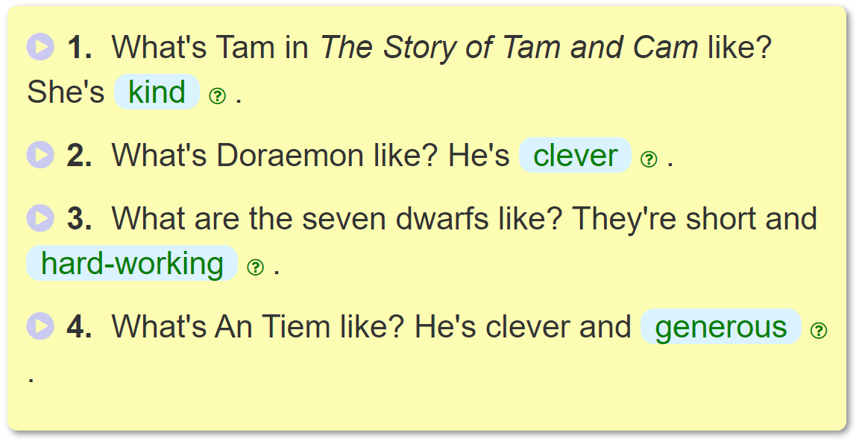
4. Listen and write one word in each blank.
_______
________
______________
___________

Slide 8
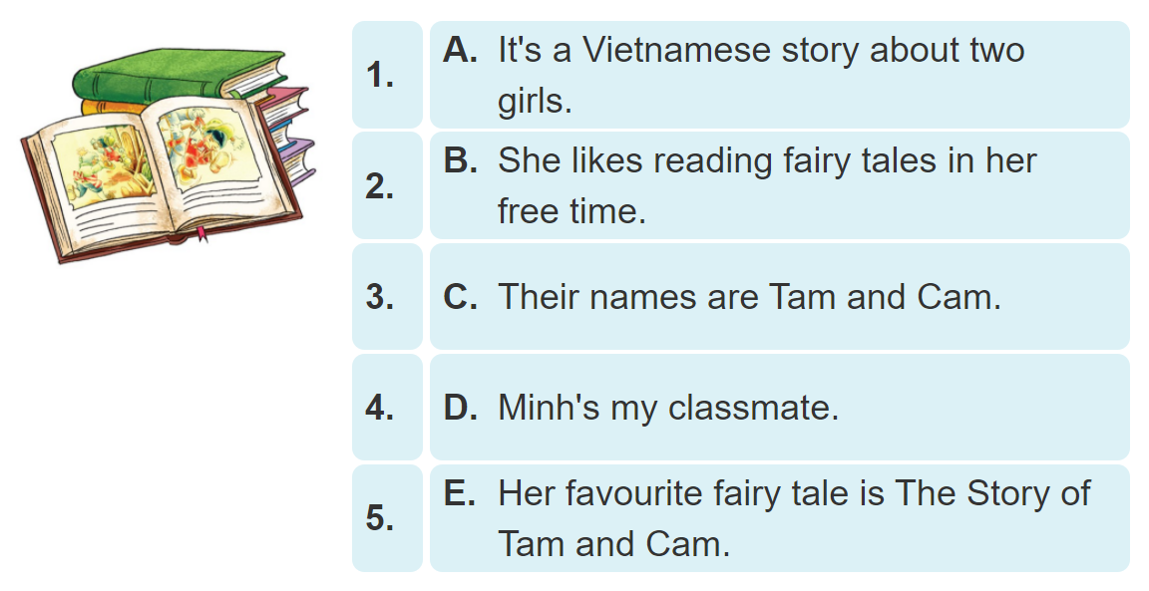
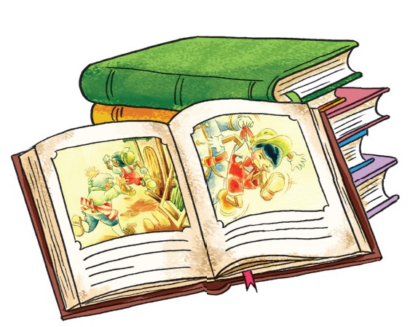
5. Number the sentences in the correct order.

