Slide 1

Unit 1: My friends
Lesson 1.2
Page 11

Slide 2
Objectives
By the end of this lesson, students will be able to practice listening skills and …
Vocabulary: Alphabet
Structure: What’s your name? – My names Alfie.
How do you spell “Alfie”? – A-L-F-I-E.
Phonics: spell, space

Slide 3

WARM UP

Slide 4

It’s time to learn …

Slide 5

Phonics
/sp/

Slide 6


spell
space
Act1. Read and say YES
or NO Listen and check.
spider
spring
strong
speak
spider
spring
surprise
spicy
sport
speak
sport
star
spoil
spicy
spoil
spa
spa
Notes:
(spider, strong, surprise, sport, spoil, spring, speak, spicy, star, spa) audios from Cambridge Dictionary
Click the picture to hear the sound the Aud 14
Click each word to hear the sound of each word
Act 1; click the words to hear the sounds

Slide 7

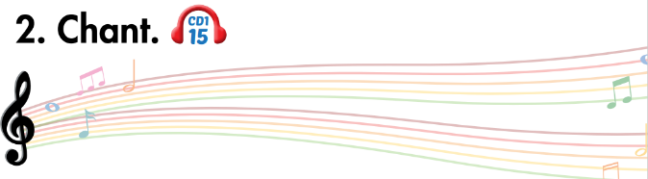
sp
spell
space

Slide 8

Listening

Slide 9


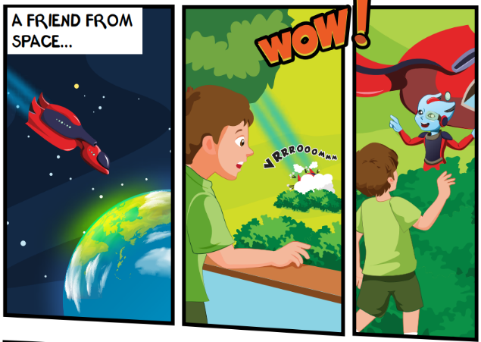
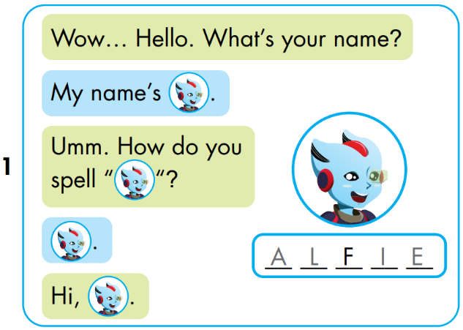


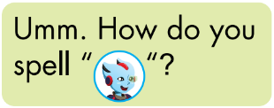


A
L
I
E
Notes:
Click the picture to hear the entire story
Click on the BIG PORTRAIT OF ALFIE to hear the CONVERSATION
Click on each sentence to hear the sound.
Click on THE SPACE (BACKGROUND) to reveal the answer.

Slide 10
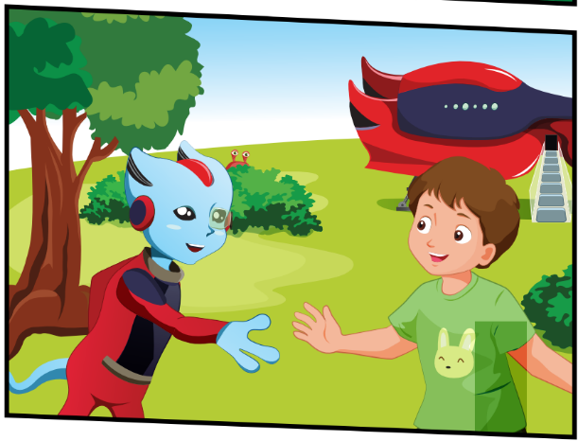
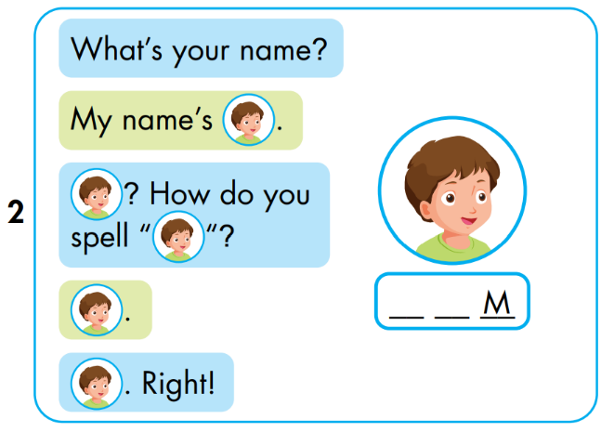


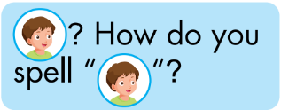


T
O
Notes:
Click the picture to hear the entire story
Click on the BIG PORTRAIT OF ALFIE to hear the CONVERSATION
Click on each sentence to hear the sound.
Click on THE SPACE (BACKGROUND) to reveal the answer.

Slide 11
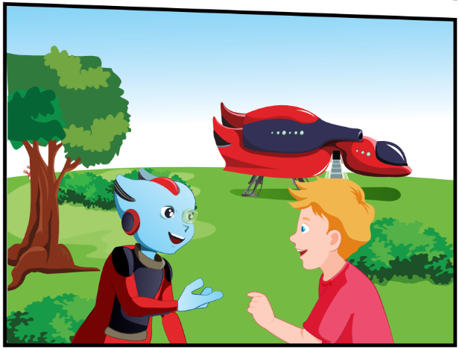
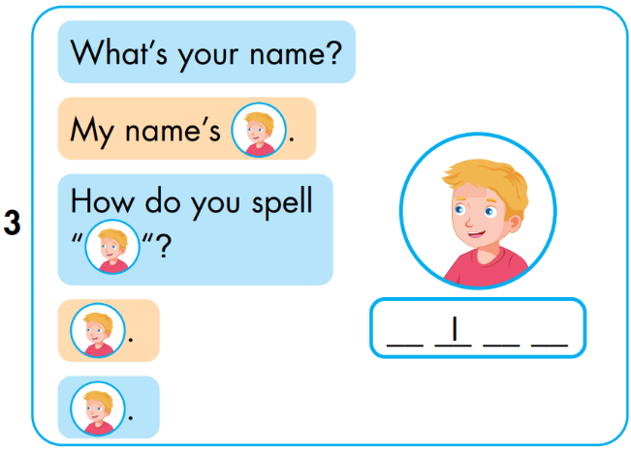


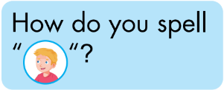


N
C
K
Notes:
Click the picture to hear the entire story
Click on the BIG PORTRAIT OF ALFIE to hear the CONVERSATION
Click on each sentence to hear the sound.
Click on THE SPACE (BACKGROUND) to reveal the answer.

Slide 12

Speaking

Slide 13
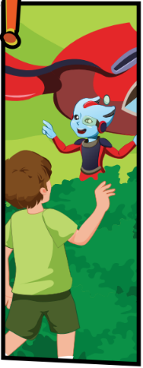
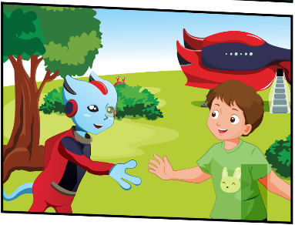




Notes:
- Lastly, students play roles and cover the story.

Slide 14

Practice

Slide 15

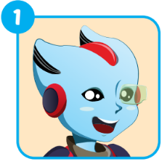
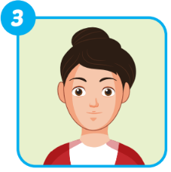
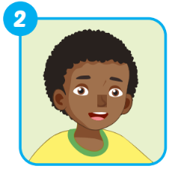
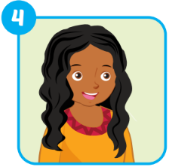
Extra 1 – WB p9
A _ _ _ _
ALFIE
_ _ _ _
MARY
_ _ _ _
HUGO
ELLA
_ _ _ _

Slide 16

Carry out a survey
No. | What’s your name? | How can your spell ...?
1. | My name’s Alfie. | A-L-F-I-E.
2. | ...
3. | ...
4. | ...
5. | ...

Slide 17

CONSOLIDATION

Slide 18
Lesson 3
Today’s lesson
Vocabularies
The Alphabet
Structures/ Sentence patterns
Tom: What’s your name?
Alfie: My name’s Alfie.
Tom: How can you spell “Alife”?
Alfie: A-L-F-I-E.
Phonics
“sp”, spell, space

Slide 19

Enjoy your day!

