Slide 1

Unit 1: My friends
Lesson 1.1
Page 10

Slide 2
Objectives
By the end of this lesson, students will be able to spell names.
Vocabulary: The Alphabet
Structure: How do you spell “Alfie”?
A-L-F-I-E.

Slide 3

WARM UP

Slide 4

It’s time to learn …

Slide 5

New words
The alphabet
A B C...

Slide 6

Presentation

Slide 7

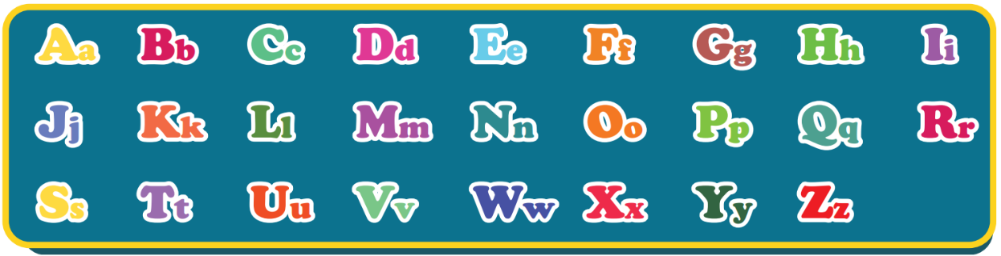
The Alphabet Song
Notes:
Click on the picture to listen to the Alphabet song.
For the first time, the arrow icon automatically appears in group of two-three letters along with the music.
For the second time, guider has to point every single letter for students.

Slide 8

Practice

Slide 9

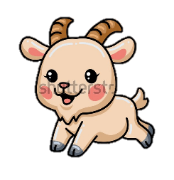

Act2. Look and write.
Aa
Bb
Cc
Dd
Ee
Ff
Gg
Cat
_all
_at
Ball
Apple
Dog
_lephant
Fish
_oat
_pple
_og
Elephant
_ish
Goat
Notes:
apple: 692424901
Ball: 535561051
Cat: 457791871
Dog: 399897679
Elephant: 1929090011
Fish: 643769101
Goat: 2008803551

Slide 10
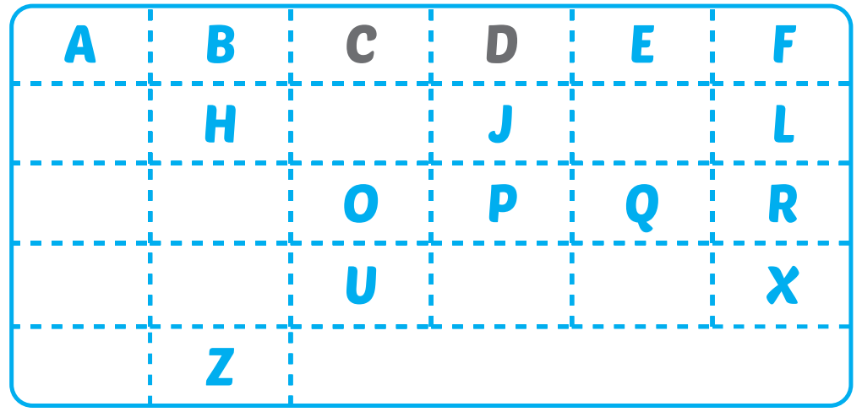
Extra-Act1 - WBp8. Write missing letters.
G
I
K
M
N
S
T
V
W
Y

Slide 11
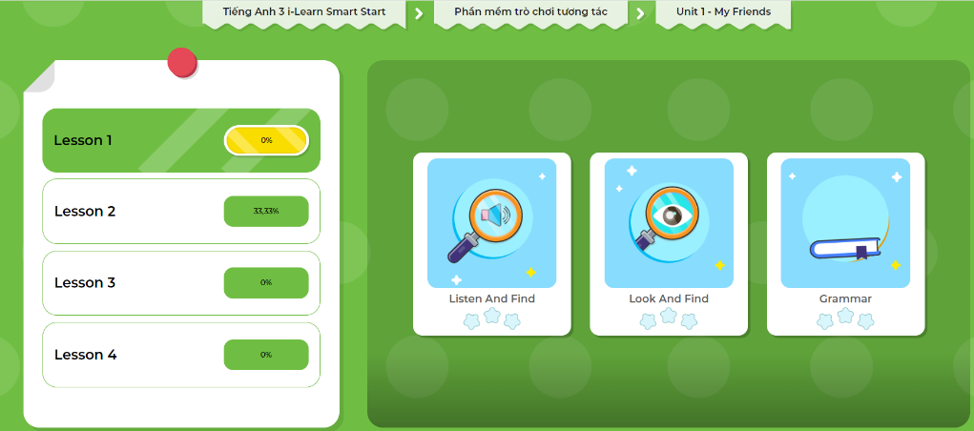
Extra-Act2. DHA app.
Click here to play the games

Slide 12

Structures
How do you spell “Alfie”?
A-L-F-I-E.

Slide 13
Presentation

Slide 14

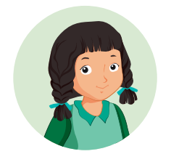
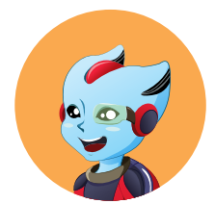
How do you spell “Alfie”?
A-L-F-I-E.
Mai
Alfie
Notes:
- Click on the WORDS to hear the SOUND

Slide 15
Practice

Slide 16
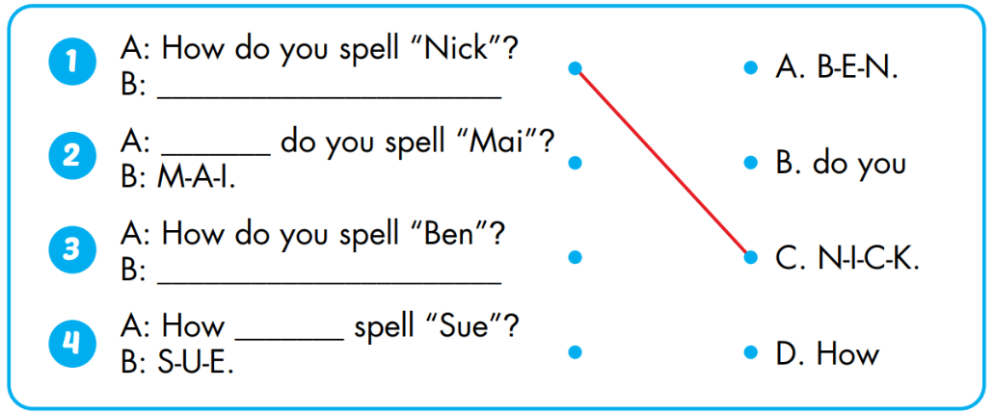
Act1. Look and match. Practice.

Slide 17
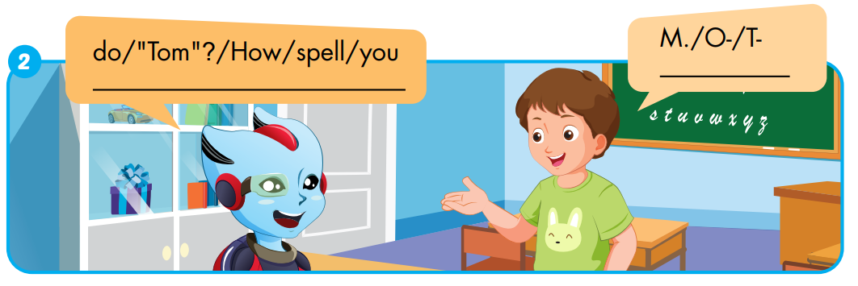
Extra-Act1 - WBp8. Unscramble and write.
T-
O-
M.
How
do
you
spell
“Tom”?

Slide 18
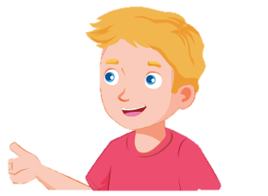
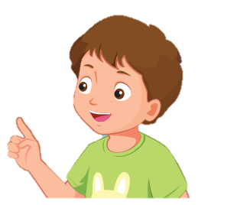
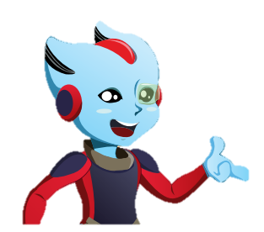


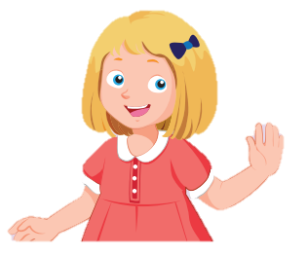
Act2. Spell names of yours and friends.
Hello.
My name’s Alfie.
A-L-F-I-E.
Nick
Tom
His name’s Nick.
N-I-C-K.
Her name’s Mai.
M-A-I.
Mai
Sue

Slide 19

WRAP-UP

Slide 20
Today’s lesson
Vocabularies
The Alphabet
Structures/ Sentence patterns
How do you spell “Alfie”?
A-L-F-I-E.

Slide 21
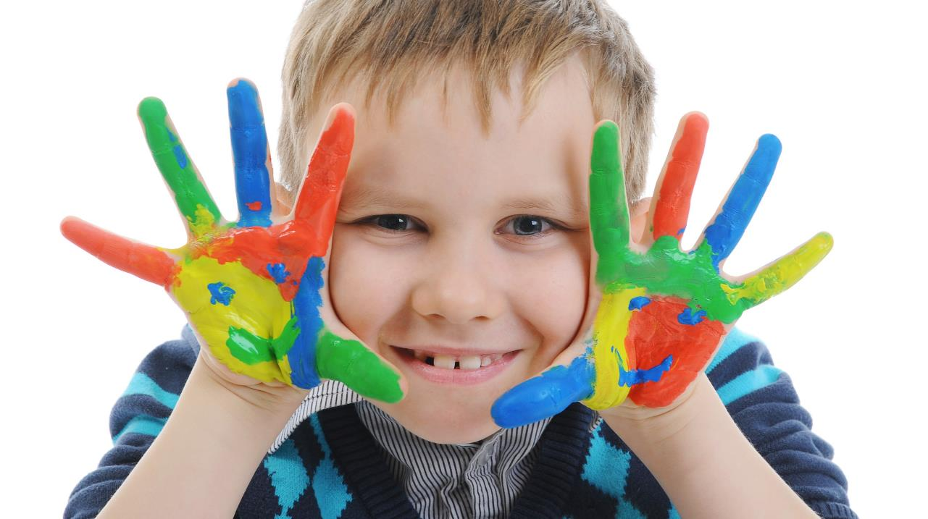
Enjoy your day!

