Slide 1

Unit 6: Clothes
Lesson 2.1
Page 85

Slide 2
Objectives
By the end of this lesson, students will be able to talk about what they are wearing.
Vocabulary: skirt, jacket, jeans, boots, T-shirt.
Structure: - What are you wearing?
- I’m wearing blue jeans/
I’m wearing a red jacket.

Slide 3

WARM UP

Slide 4
Unscramble the letters
dress
d
s
e
r
s
pants
t
p
n
s
a
shorts
h
o
r
s
t
s
socks
c
o
s
k
s
shirt
h
r
i
t
s

Slide 5
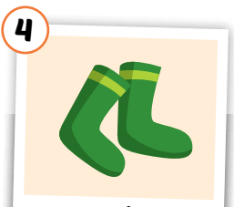
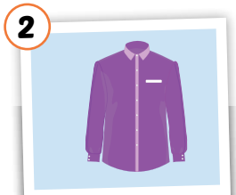
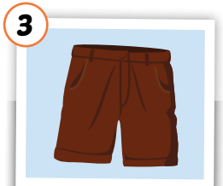
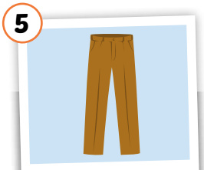
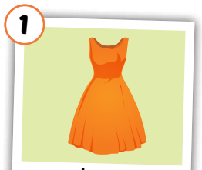

Slide 6
shirt

Slide 7
socks

Slide 8
pants

Slide 9
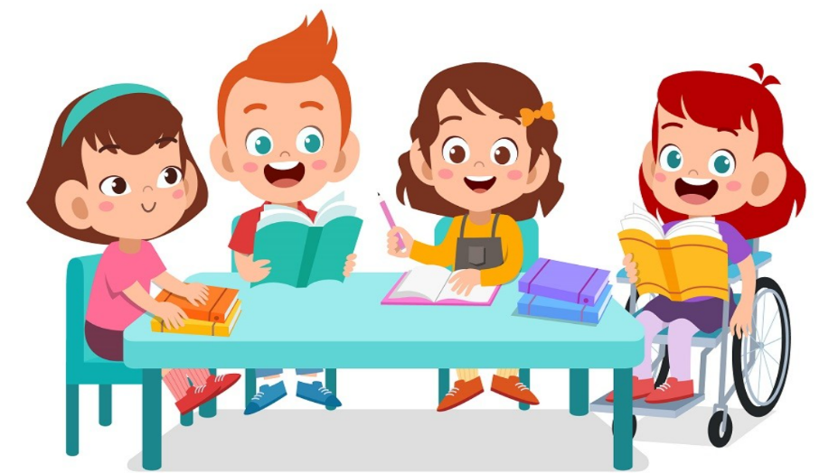
It’s time to learn …

Slide 10

Vocabulary

Slide 11

New words
skirt,
jacket,
jeans,
boots,
T-shirt.

Slide 12


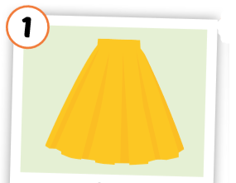
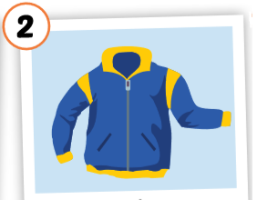
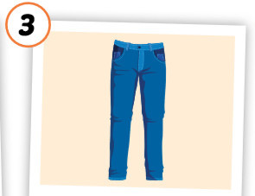
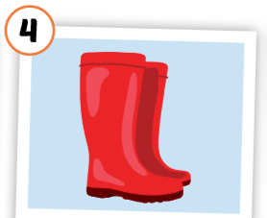
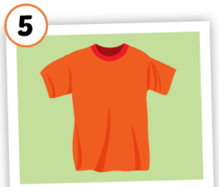
Click each English word to hear the sound.
skirt
jacket
jeans
boots
T-shirt
/skɜːrt/
váy
/ˈdʒækɪt/ áo khoác
/dʒiːnz/
quần jean, quần bò
/buːts/ đôi ủng
/ˈtiː ʃɜːrt/
áo thun
Notes:
GV giới thiệu từ vựng, CCQ

Slide 13
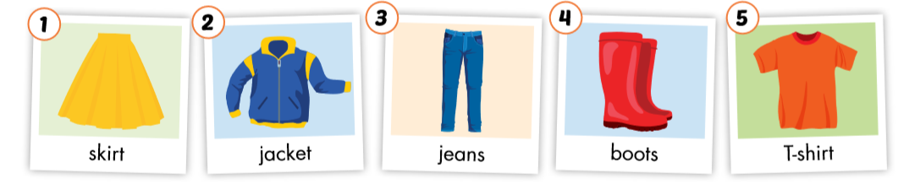

Slide 14
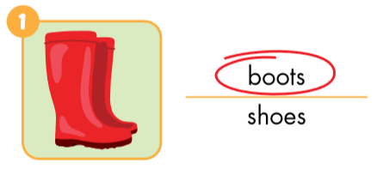
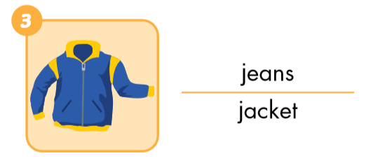
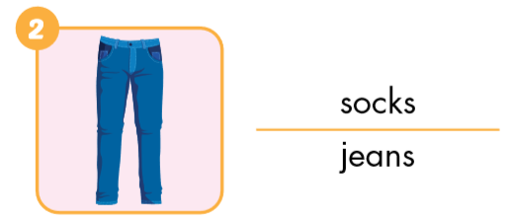
Look and circle.

Slide 15
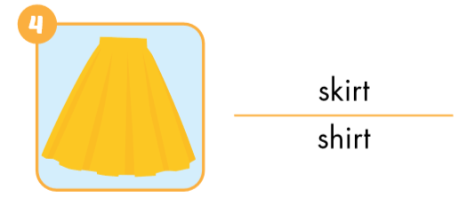
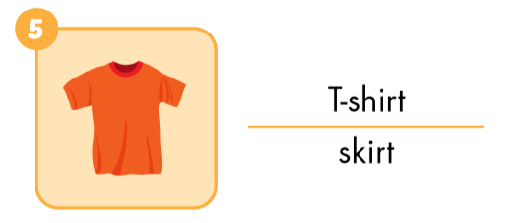
Look and circle.

Slide 16
Put the pictures in the right group.
yellow
blue
red
orange

Slide 17
Put the pictures in the right group.
1. a (pen)
2. some (pens)

Slide 18
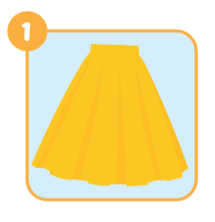
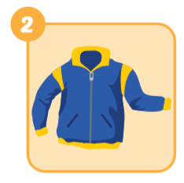
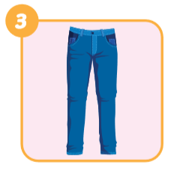
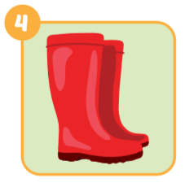
Look and write
skirt
jacket
jeans
boots

Slide 19
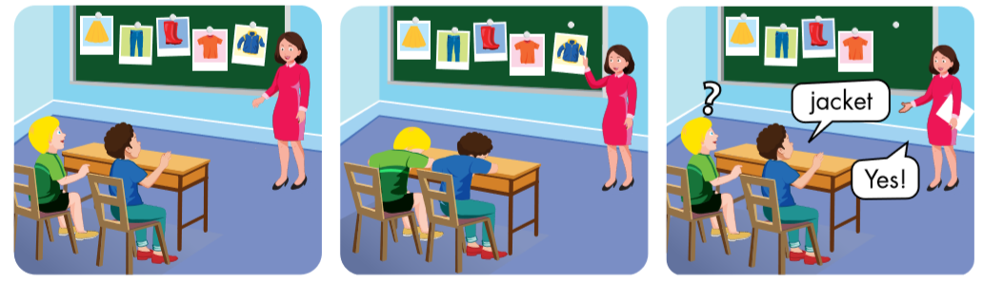

Slide 20


skirt
?

Slide 21

Yes.
jeans
No.

Slide 22

Practice

Slide 23

Structures
What are you wearing?
I’m wearing blue jeans.
What are you wearing?
I’m wearing a red jacket.

Slide 24

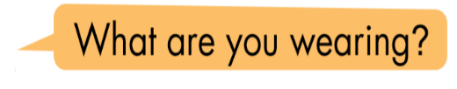

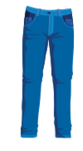

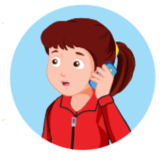
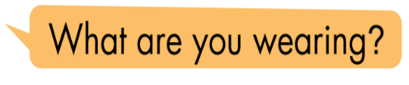

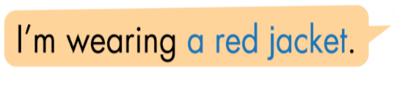
Click the earphone to hear the sound.

Slide 25


What are you wearing?
I’m wearing red boots.

Slide 26


What are you wearing?
I’m wearing a yellow skirt.

Slide 27


What are you wearing?
I’m wearing blue jeans.

Slide 28


What are you wearing?
I’m wearing a orange T-shirt.

Slide 29


What are you wearing?
I’m wearing a blue jacket.

Slide 30

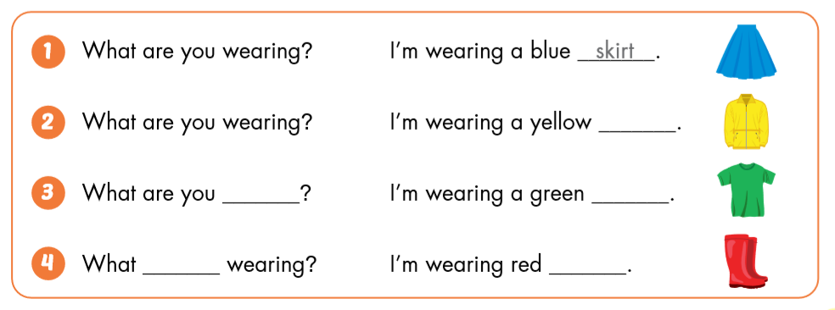
skirt.
jacket.
wearing?
T- shirt.
are you
wearing?
boots.

Slide 31

CONSOLIDATION

Slide 32





T-shirt
boots
jacket
jeans
skirt

Slide 33
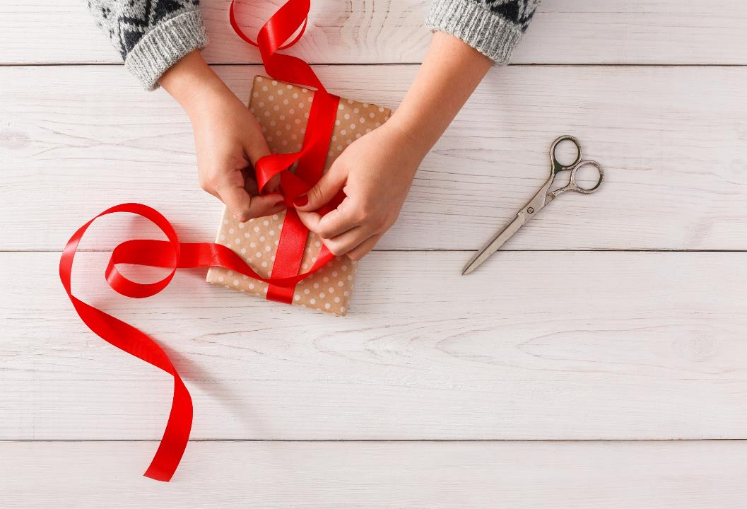
WRAP-UP

Slide 34
Unit 6. Clothes – Lesson 2.1
1. New words
dress
shirt
shorts
socks
pants
2. Structures
a. What do you want?
I want a dress.
b. What do you want?
I want some shorts.

