Slide 1
Unit 3
School
Lesson 1.1

Slide 2

WARM UP

Slide 3

Unit 3: School
Lesson 1.1
Page 38

Slide 4

New words

Slide 5

Presentation

Slide 6


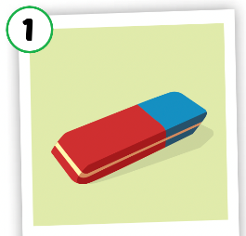
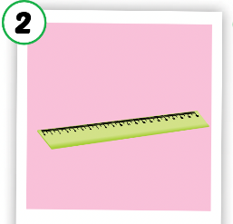
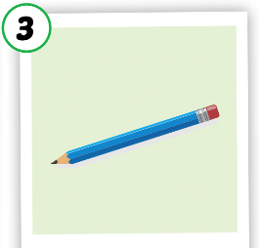

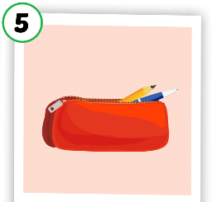
Listen and point.
Click the icon to hear the sound.

Slide 7

Listen and repeat.
Click each picture to hear the sound.
eraser
/ɪˈreɪsər/
cục tẩy

Slide 8

Listen and repeat.
Click each picture to hear the sound.
ruler
/ˈruːlər/
cái thước kẻ

Slide 9
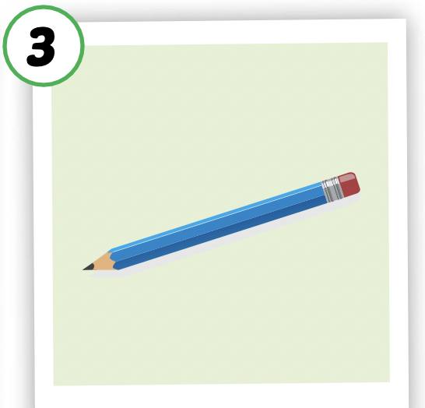
Listen and repeat.
Click each picture to hear the sound.
pencil
/ˈpensl/
cây bút chì

Slide 10

Listen and repeat.
Click each picture to hear the sound.
notebook
/ˈnəʊtbʊk/
quyển vở, quyển sổ

Slide 11
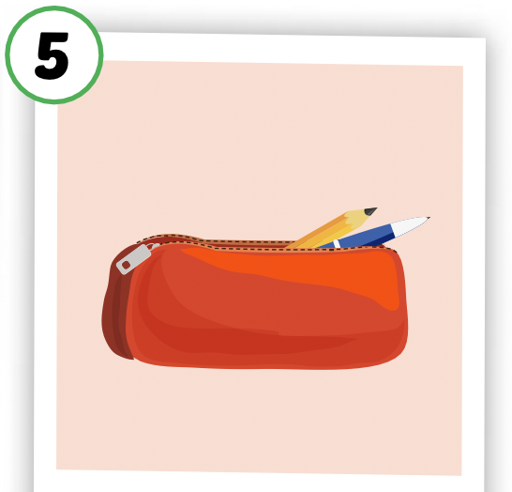
Listen and repeat.
Click each picture to hear the sound.
pencil case
/ˈpensl keɪs/
cái hộp bút

Slide 12

Practice

Slide 13

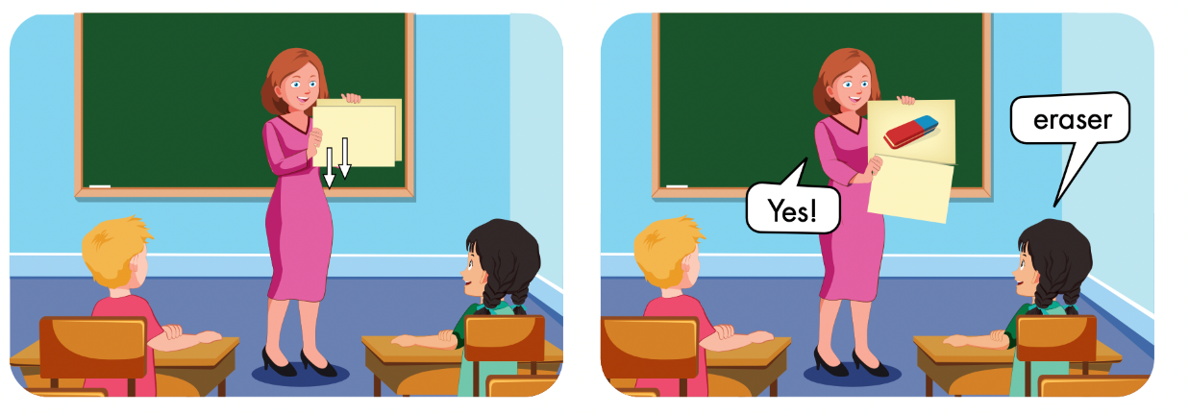

Slide 14


Structures

Slide 15
Presentation

Slide 16



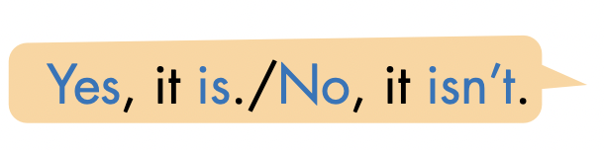




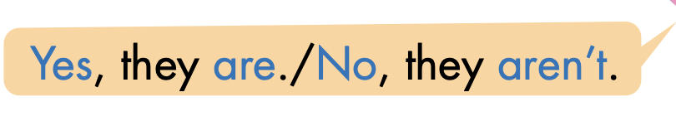
Click here to hear the sound.

Slide 17
Practice

Slide 18
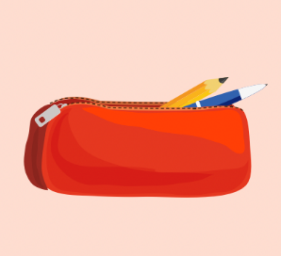


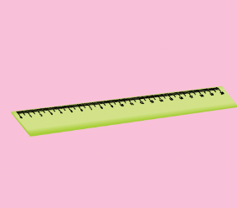

LET’S PRACTICE!
Is this your…………?
Yes, it is.
No, it isn’t.
No, it isn’t.
Yes, it is.
No, it isn’t.

Slide 19

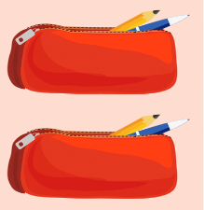
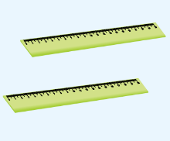
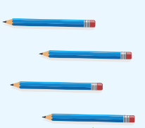
Are these your ………………?
No, they aren’t.
No, they aren’t.
Yes, they are.
Yes, they are.

Slide 20

SB:
page 38
Production

Slide 21


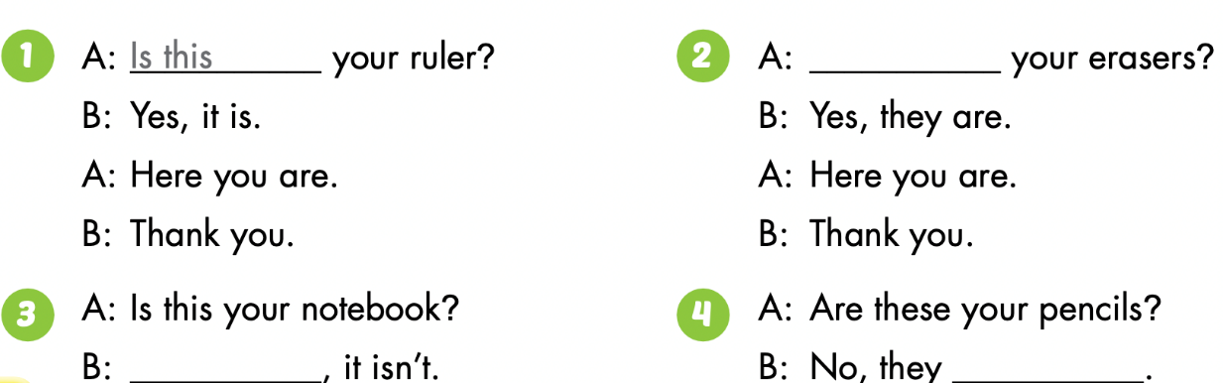

Slide 22
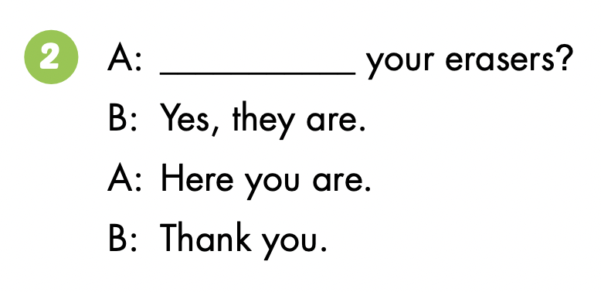
Are these

Slide 23
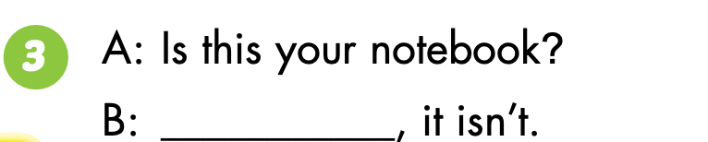
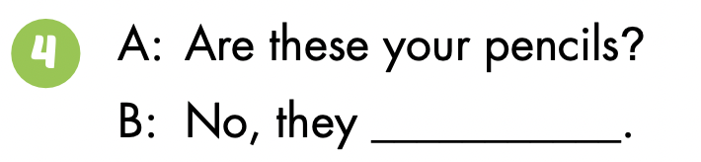
No
aren’t

Slide 24

CONSOLIDATION

Slide 25


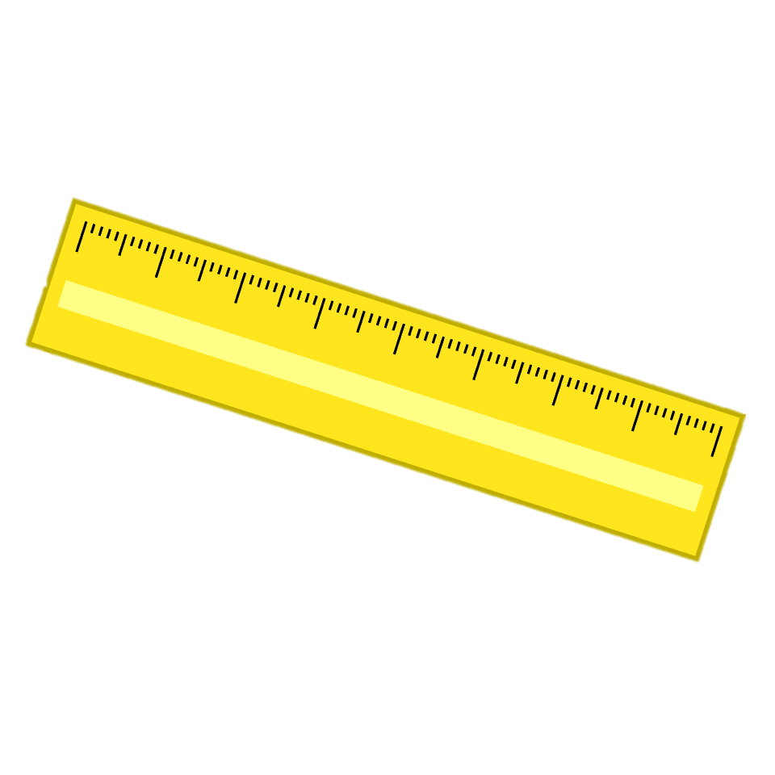
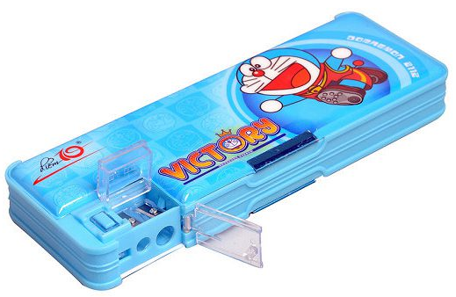


Structure
Yes, it is.
Is this your ____?
(Đây là _______ của bạn có phải không?)
No, it isn’t.
pencil case
ruler
pencil
notebook

Slide 26
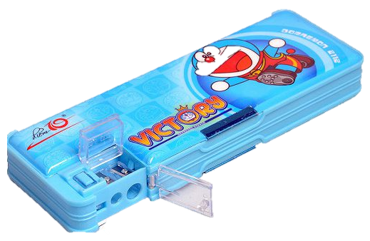
Structure
Yes, they are.
Are these your ____?
(Đây là những _______ của bạn có phải không?)
No, they aren’t.
rulers
pencil cases
notebooks
pencils

Slide 27
Tuesday, November 8th, 2022
Unit 3. School
Lesson 1
I. New words
1. eraser
2. ruler
3. pencil
4. notebook
5. pencil case
II. Structures
1. Is this your eraser?
- Yes, it is./No, it isn’t.
2. Are these your notebooks?
- Yes, they are./No, they aren't.

Slide 28

Thank you for your attention!
Have a nice day!

