Slide 1

Unit 17
What would you like to eat
Lesson 1

Slide 2
Warm-up

Slide 3
Pronunciation

Slide 4

1. Listen and repeat.
1. | What would you like to eat? ↷ I'd like a banana, ↷ please. ⤻
2. | What would you like to drink? ↷ I'd like a glass of milk, ↷ please. ⤻
3. | How much rice do you eat every day? ↷ I'd like a glass of milk, ↷ please. ⤻

Slide 5
2. Listen and circle a or b
a. an apple
b. a banana
1. What would you like to eat?
I'd like ___________, please.
2. What would you like to drink?
I'd like a glass of ___________, please.
3. How many eggs do you eat every week?
I eat ___________ a week.
4. How much water do you drink?
I drink ___________ bottles a day.
a. milk
b. orange juice
a. three
b. four
a. four
b. five

Slide 6
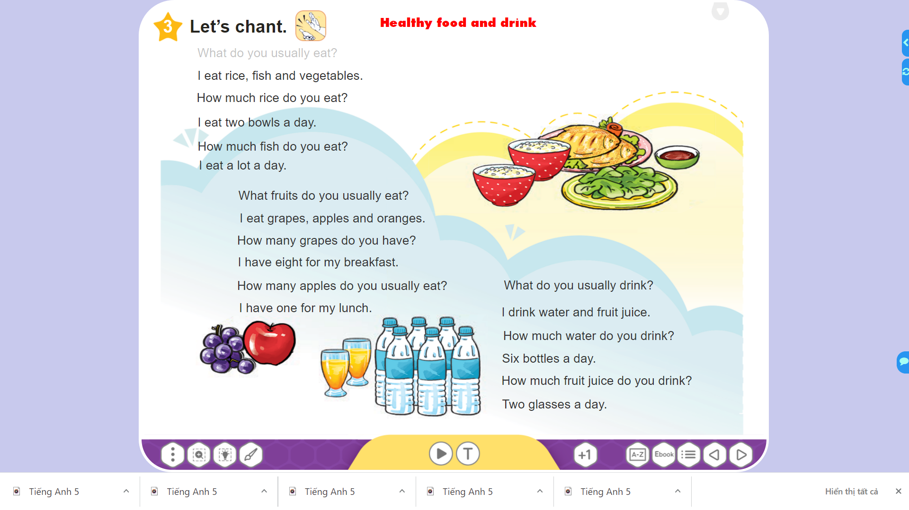


3. Let’s chant

Slide 7
Vocabulary

Slide 8

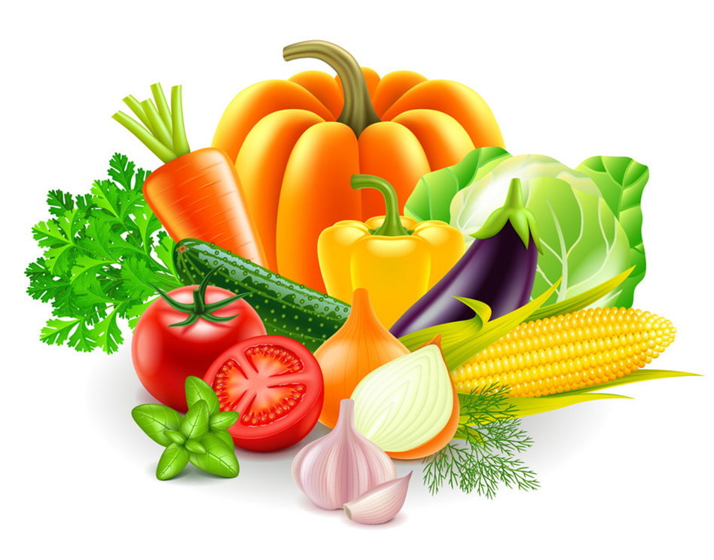

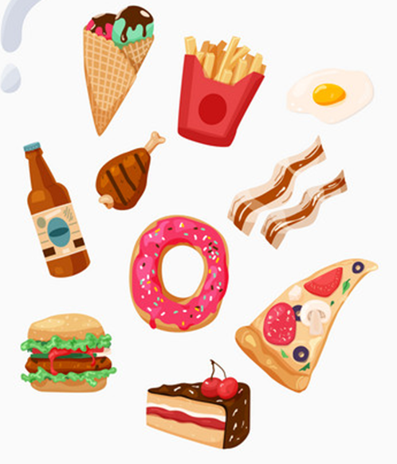

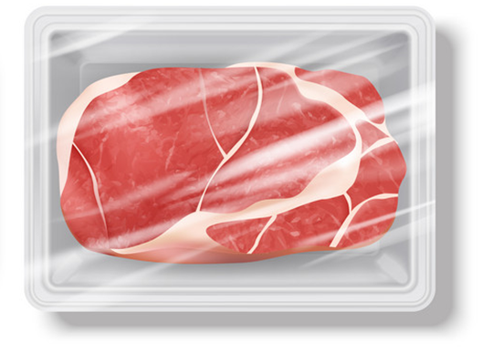
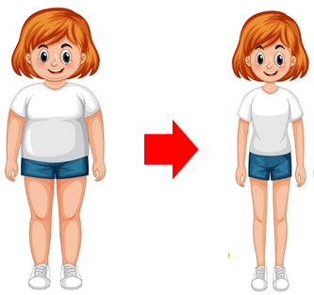
Vocabulary
Vitamin
Vegetable
Sugar
Fat
/ˈvaɪtəmɪn/
/ˈvedʒtəbl/
/ˈʃʊɡər/
/fæt/
Fruit
Meat
Diet
/fruːt/
/miːt/
/ˈdaɪət/

Slide 9
Practise

Slide 10
4.1. Match the headings with the paragraphs.
1.
A healthy diet
2.
Fruit juice is good
for you
3.
Vegetables are
good for you
a. Orange or apple juice is good for breakfast or lunch, and you should drink a lot of water between meals.
b. It's important to eat vegetables every day. You need vitamins from vegetables for a healthy body
c. Chocolate has some vitamins, but it has a lot of fat and sugar too, so don't eat too much. To be healthy, you should eat rice, bread and lots of vegetables and fruit. You also need some meat, fish or eggs.

Slide 11
4.2. Answer the questions.
What healthy drinks should you have for
breakfast or lunch?
We should have some orange or apple juice.
2. What should you drink between meals?
We should drink a lot of water between meals.
3. Why are vegetables good for you?
Because vegetables have vitamins. We need vitamins for a healthy body.

Slide 12
4.2. Answer the questions.
4. Why shouldn't you eat too much chocolate?
Because it has a lot of fat and sugar.
5. What should you eat to be healthy?
We should eat rice, bread and lots of vegetables and fruit. We also need some meat, fish or eggs.

Slide 13
5. Write about your eating habits.
1. What kinds of vegetables do you eat every day?
_____________________________________________.
2. What kinds of fruits do you eat every day?
_____________________________________________.
3. How much rice do you eat every day?
_____________________________________________.

