Slide 1









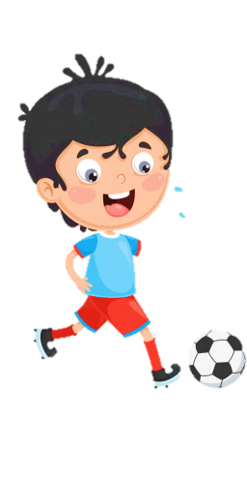
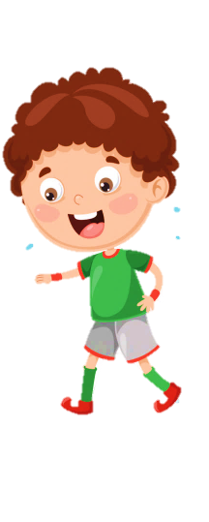





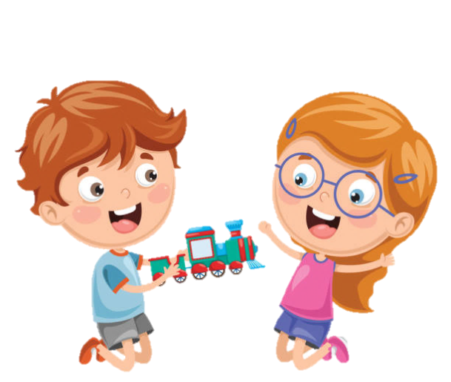




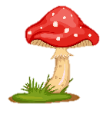

Slide 2
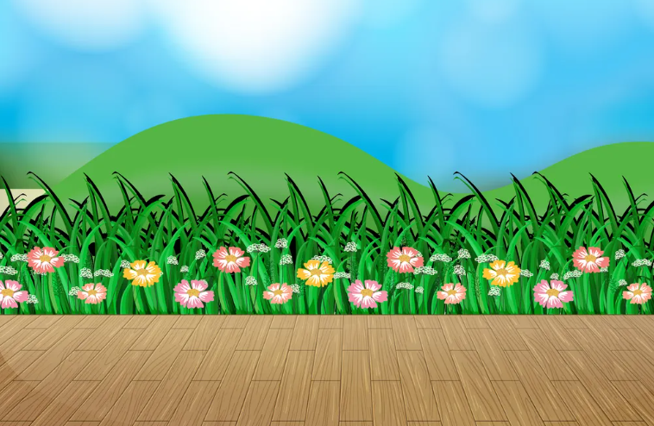
UNIT 10. OUR WORLD
LESSON 2 . Task 4 5 6

Slide 3
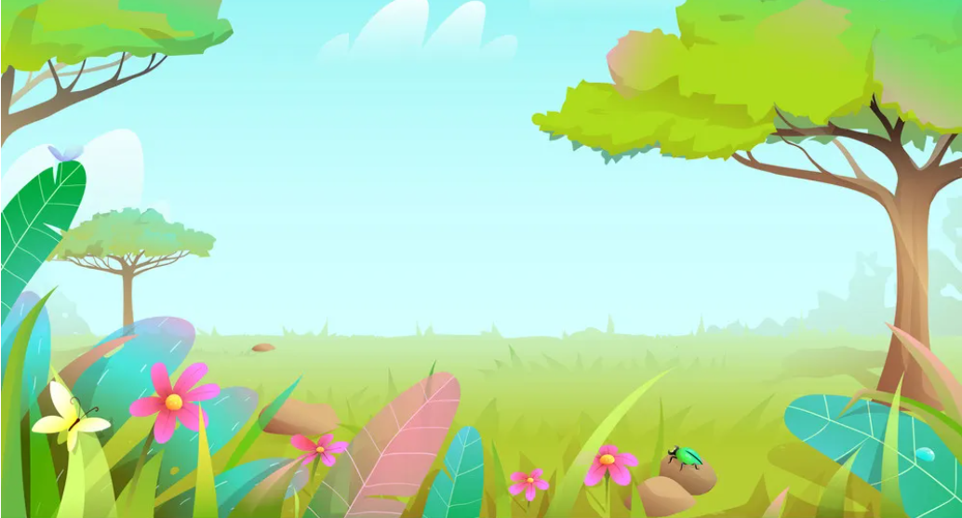
01
Warm Up
Let’s sing and do the actions

Slide 4
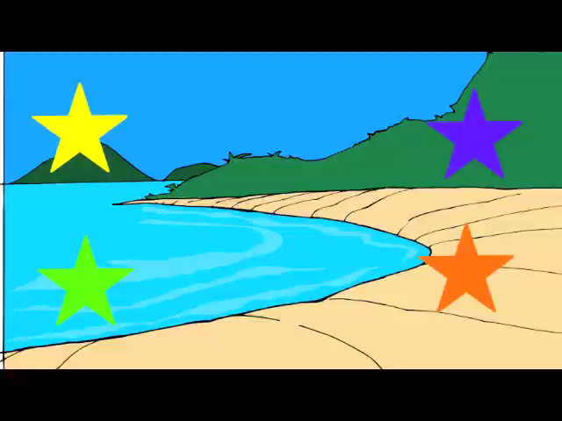
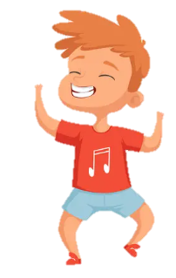
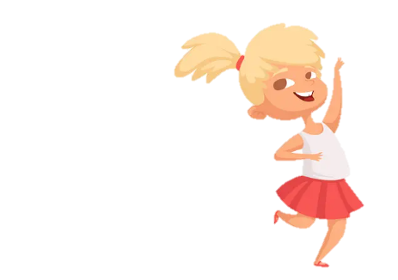

Slide 5
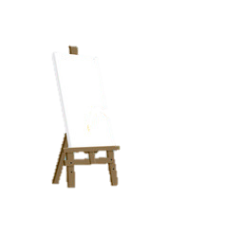
02
Presentation

Slide 6
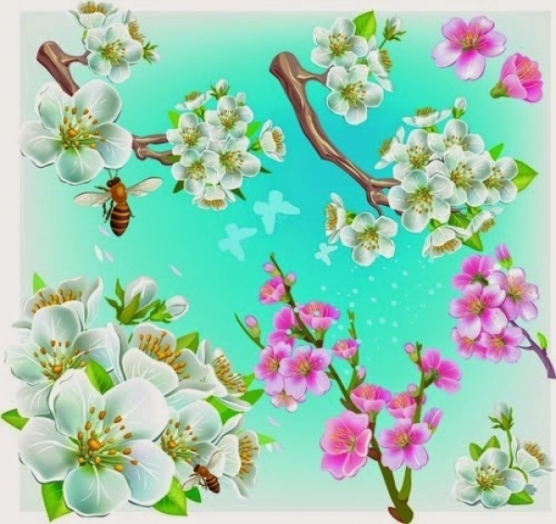
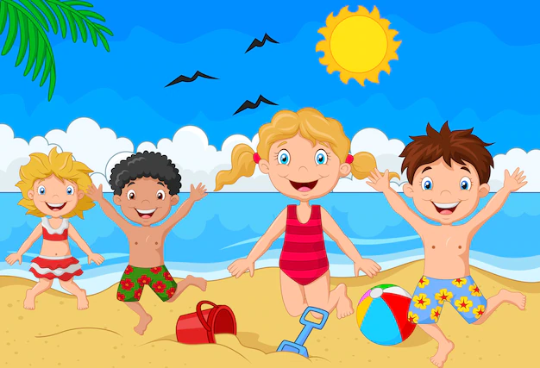
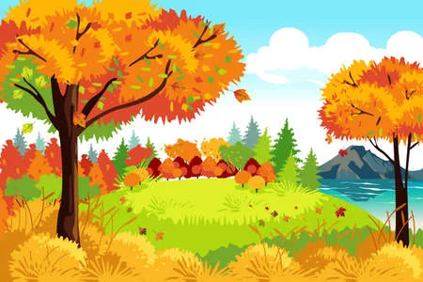
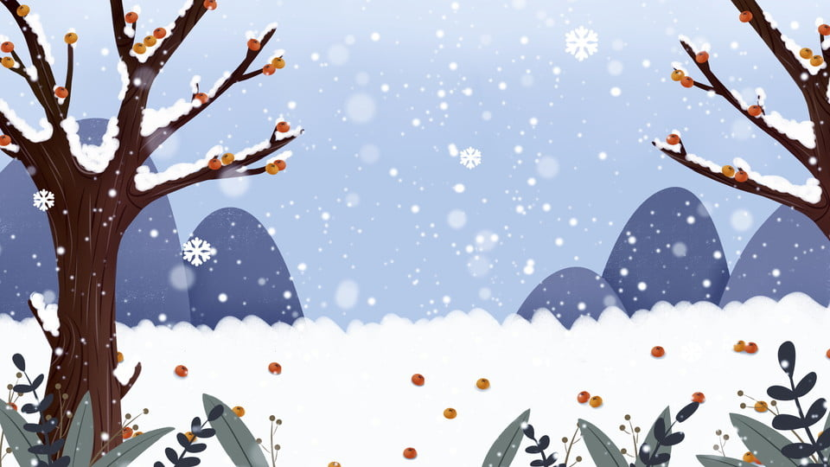
spring
summer
autumn
winter

Slide 7

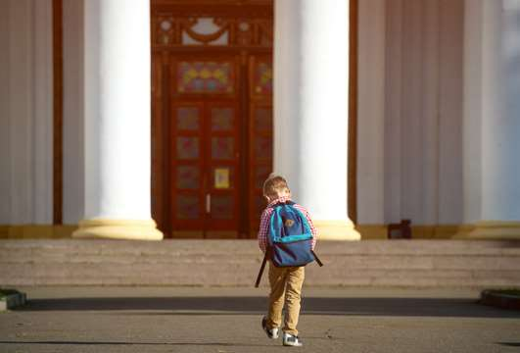
Listen and choose
A. winter
B. summer
summer
Do you go to school in ………………….?

Slide 8

Look and choose. Then listen and check .
A. Yes, I do.
B. No, I don’t.
Do you go to school in summer?

Slide 9
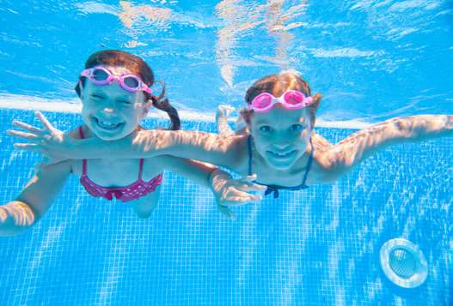

Look and choose. Then listen and check .
Do they swim in winter?
No, they don’t.
Yes, they do.

Slide 10
Task 4. Listen and repeat.
2. Do they swim in winter?
1. Do you go to school in summer?
- Yes, I do .
- No, they don’t.

Slide 11

Grammar: present tense – Yes/No questions
Daily Activities
● Do you go to school in summer? - Yes, I do. ● Do they swim in winter? - No, they don’t.

Slide 12
03
Practice

Slide 13


MAGIC PENCIL GAME
START

Slide 14

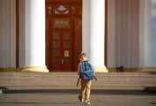

I
1.Do you go to school in summer ? No, ……don’t. .
I
You

Slide 15

They
2.____ swim in the pool in summer.
She
They

Slide 16
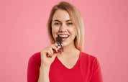
eat
3. I _______chocolate in winter.
eat
drink

Slide 17
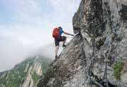
I do
4. Do you climb the rock ? Yes, ……….. .
I don’t
I do

Slide 18
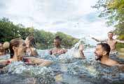
5. Do they swim in the river in winter ? - ____, they don’t.
No
Yes
No

Slide 19
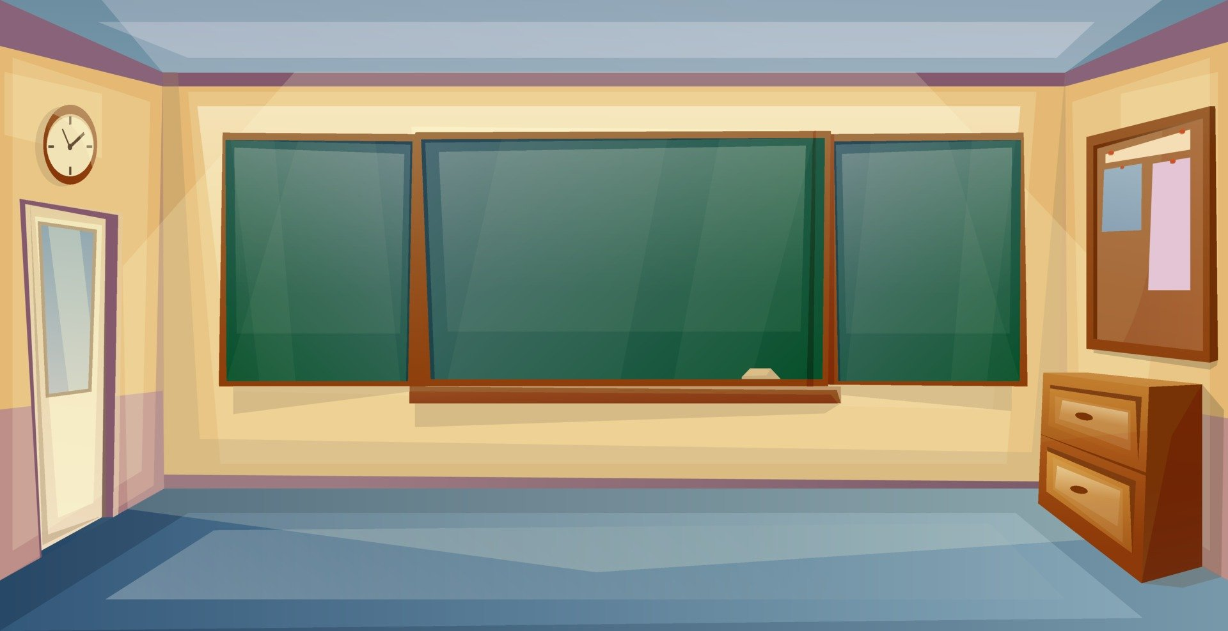
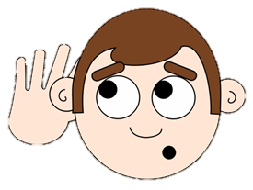

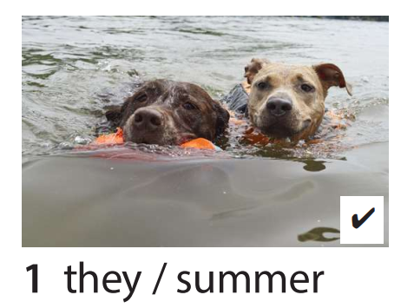
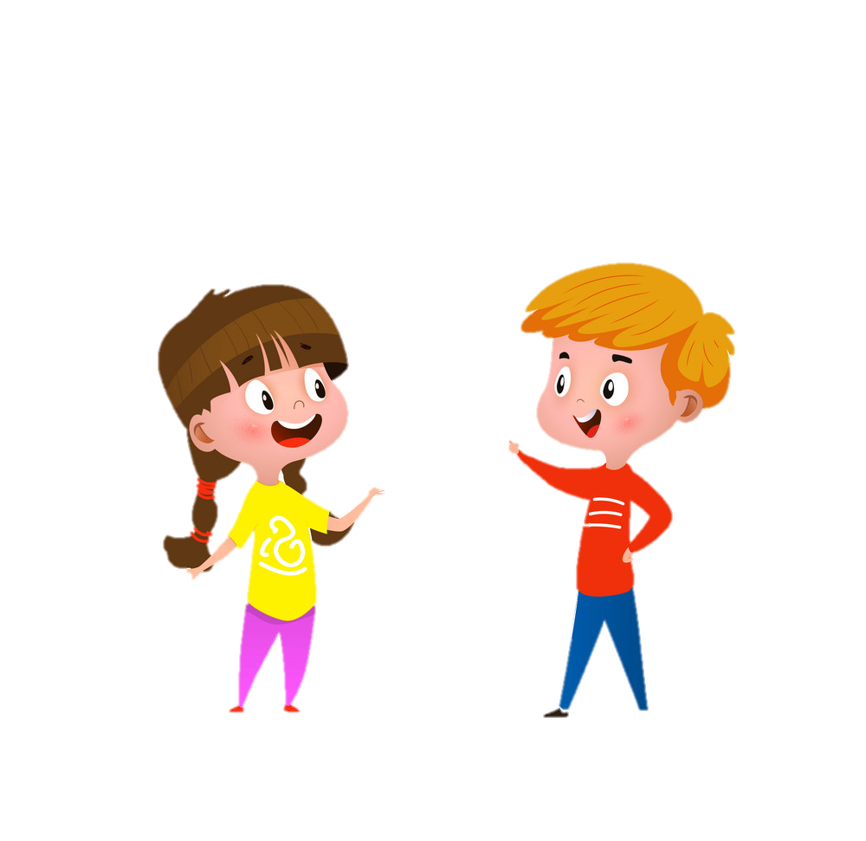

5. Look and say
Yes, they do.
Do they swim in summer?

Slide 20
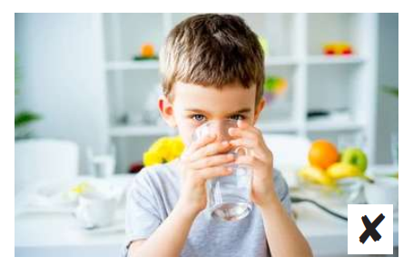
5. Look and say
No, I don’t.
Do you drink cold water in summer?

Slide 21
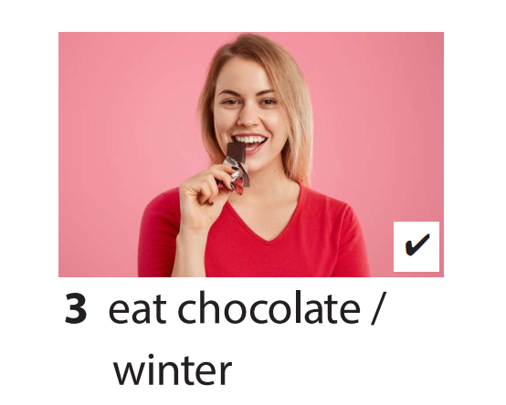
5. Look and say
Yes, they do.
Do they eat chocolate in winter ?

Slide 22
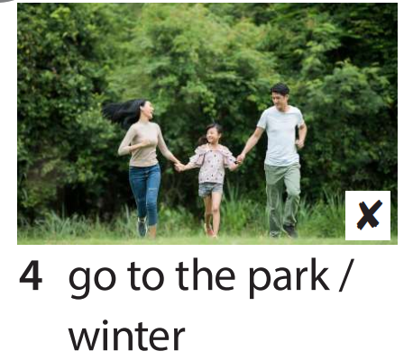
5. Look and say
No, they don’t.
Do they go to the park in winter ?

Slide 23
04
Production

Slide 24
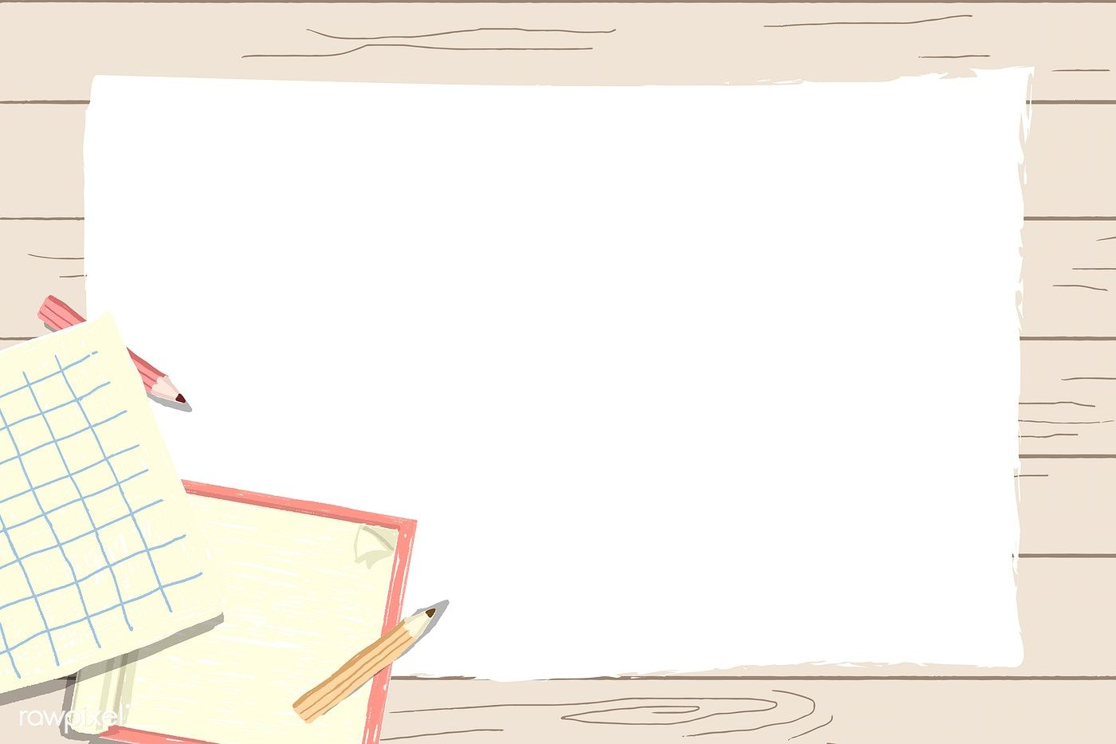
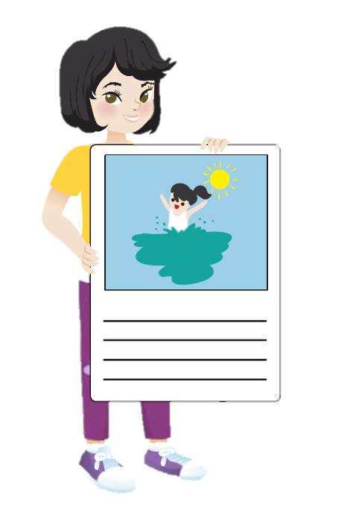
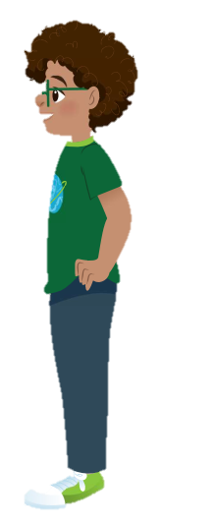
6. Draw and write. Say .
Summer is my favourite season. In summer ,I play with my friends. We go to the pool.
It’s hot. Do you swim in the pool?
Yes, I do. I swim in the pool with my friends.

Slide 25
Draw your favourite season and the activities .
My favorite season is. I…….in the …..

Slide 26
05
Assessment

Slide 27
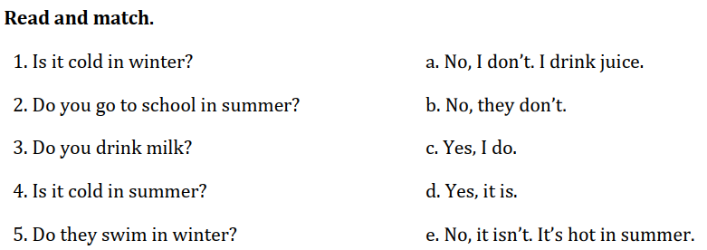
Notes:
HOẠT ĐỘNG TƯƠNG TÁC

Slide 28




Thank you & goodbye!

