Slide 1









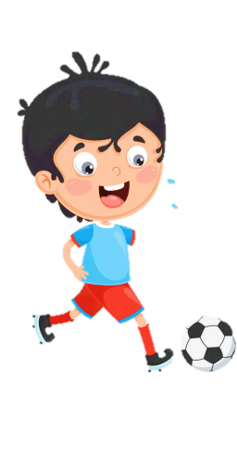
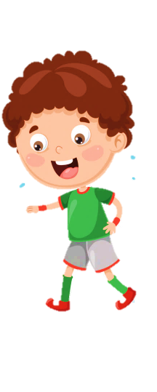












Slide 2
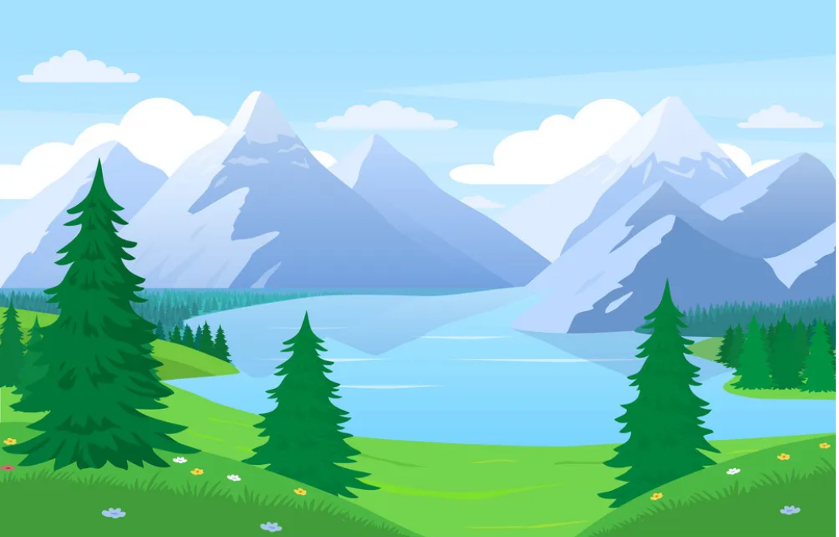
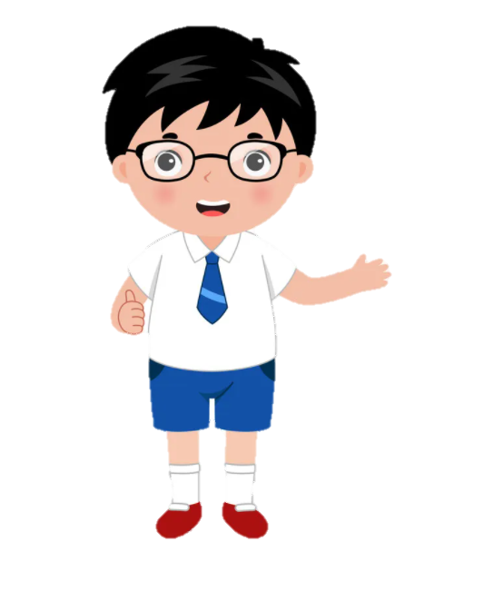
Unit 10. Our World Lesson 1- Task 4,5,6

Slide 3





1. Warm Up
Matching Game

Slide 4





a
b
1.climb
2.rock
3.river
c
d
e
4.tree
5.water

Slide 5
2. Presentation
Listen and tick

Slide 6
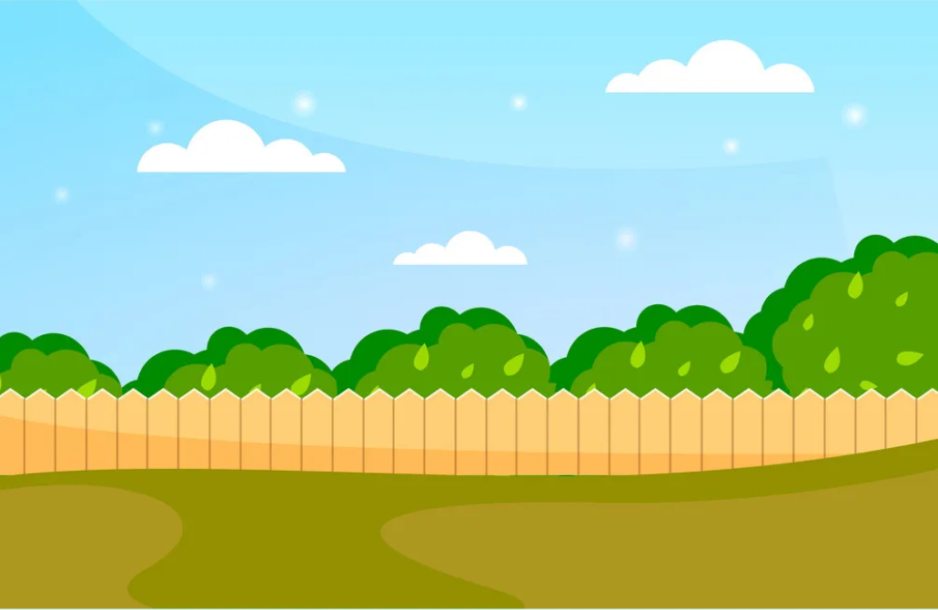

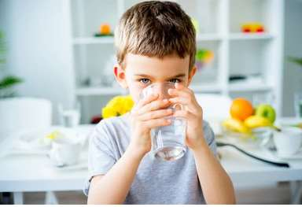
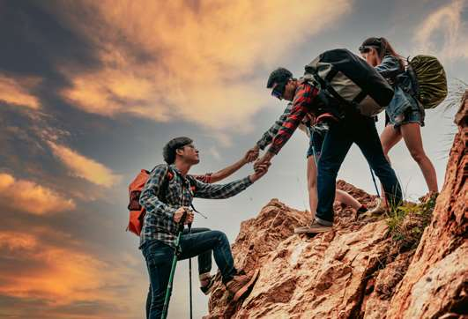
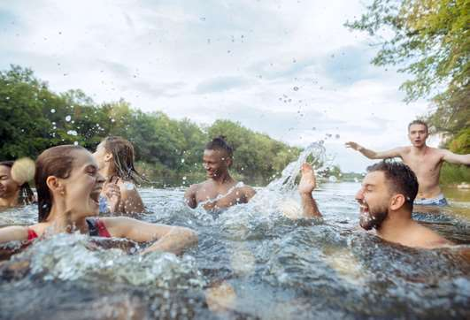
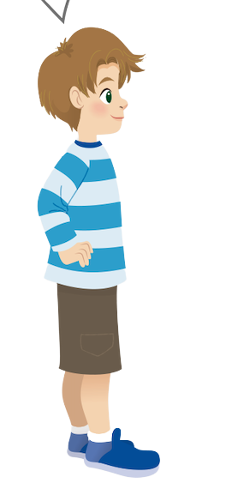
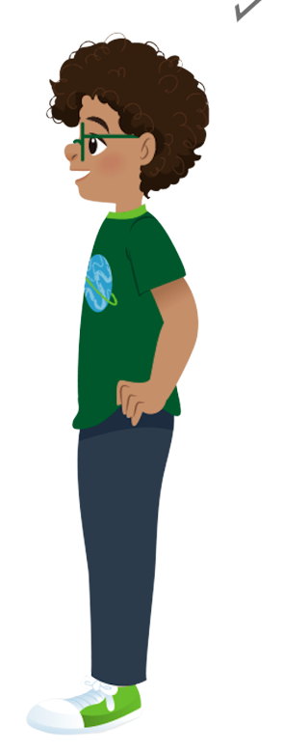
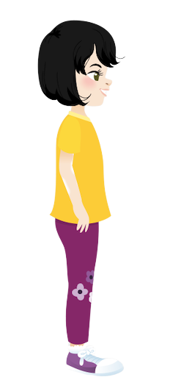
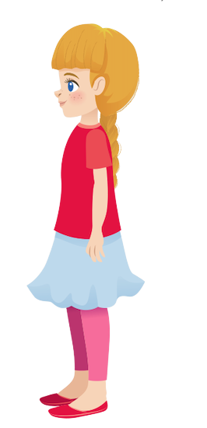
✓
Listen and tick
✓
2. I
✓
1. I.
✓
3. I
Sophie
Ana
Alex
Tomas

Slide 7
New words
drink water

Slide 8
New words
climb the rock

Slide 9
New words
swim in the river

Slide 10


Task 4. Listen and repeat.

Slide 11
4. Listen and repeat.
1. I drink water.

Slide 12

2. They climb the rock.

Slide 13
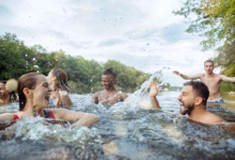
3. We swim in the river.

Slide 14
Actions
I drink water.
They climb the rock.
We swim in the river.

Slide 15
3. Practice

Slide 16


Super Hero Team
Task 5. Look and Say
Let’s go
Please, help the Police catch the thief

Slide 17


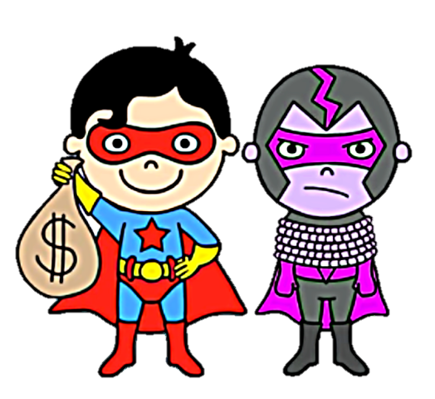

You win !
1
2
3
4
Next
Notes:
Click vào từng số để mở tranh.
Click vào hình siêu nhân để di chuyển nếu hs trả lời đúng .
Bấm next part để tới phần production.

Slide 18
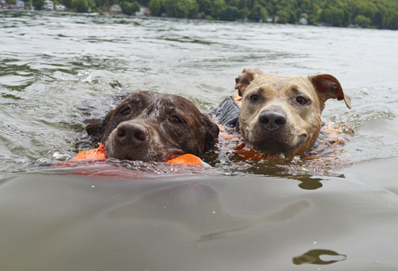
HOME
1. They / the river
1. They swim in the river.

Slide 19
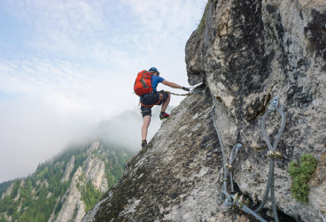
HOME
2. I/ climb the rock
2. I climb the rock.

Slide 20
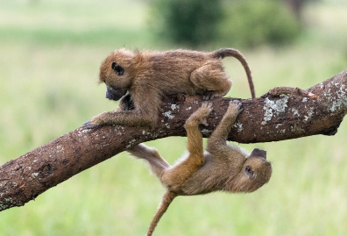
HOME
3. They/ trees
3. They climb the trees.

Slide 21
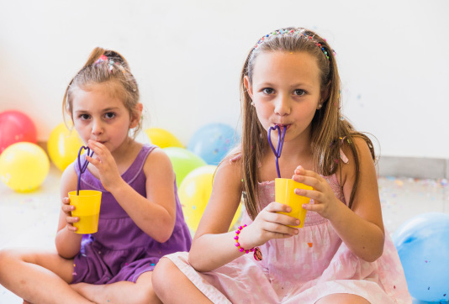
HOME
4. We/ water
4. We drink water.

Slide 22
Task 6. Let’s talk .

Slide 23
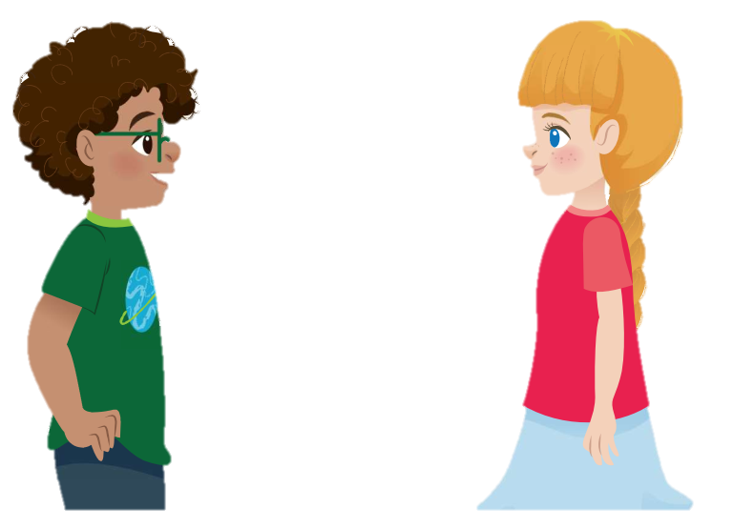
Task 6. Let’s talk .
I climb the rock. It’s fun.
I swim in the pool. It’s great.

Slide 24
4. Production
Draw and say

Slide 25




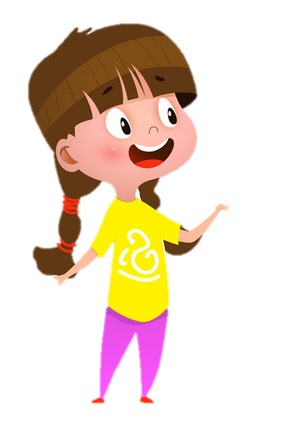
I climb the rock .

Slide 26
5. Assessment

Slide 27
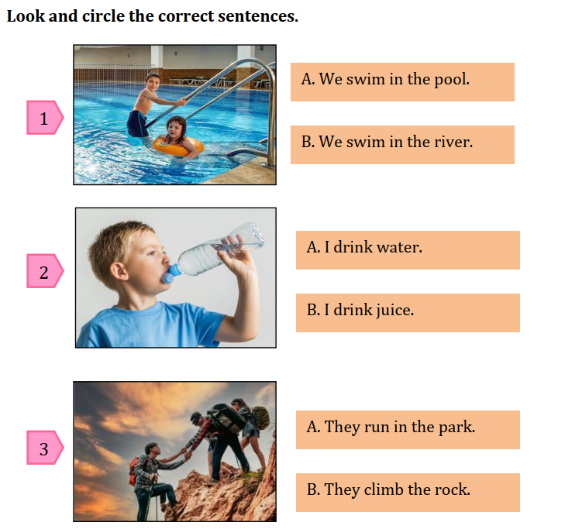
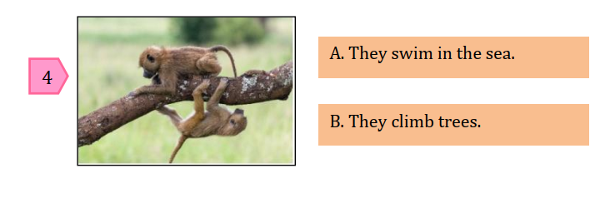
Look and circle the correct answer
Notes:
HOẠT ĐỘNG TƯƠNG TÁC

Slide 28




Thank you & goodbye!

