Slide 1





















Review 5
Part 4

Slide 2










1.Warm-up

Slide 3



Slide 4
2.Review

Slide 5

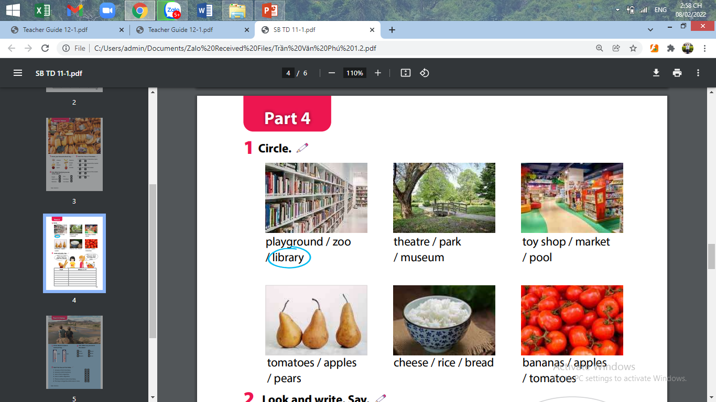

Slide 6



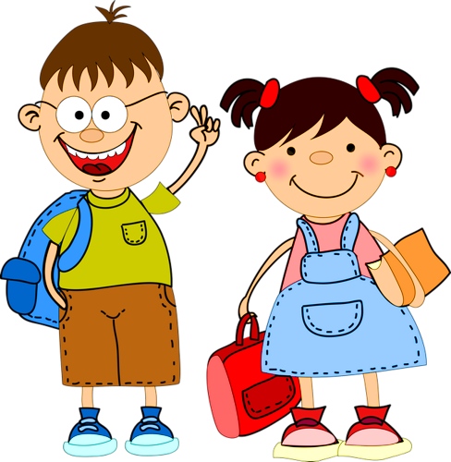
THE BIG WHEEL GAME
0
1
2
3
questions
SPIN
1
0
1
2
2
4
3
4
50
5

Slide 7




Look and choose
Where’s the red apple ?
A. The red apple is under the chair.
B. The red apple is on the chair.
C. The red apple is on the table.
back

Slide 8
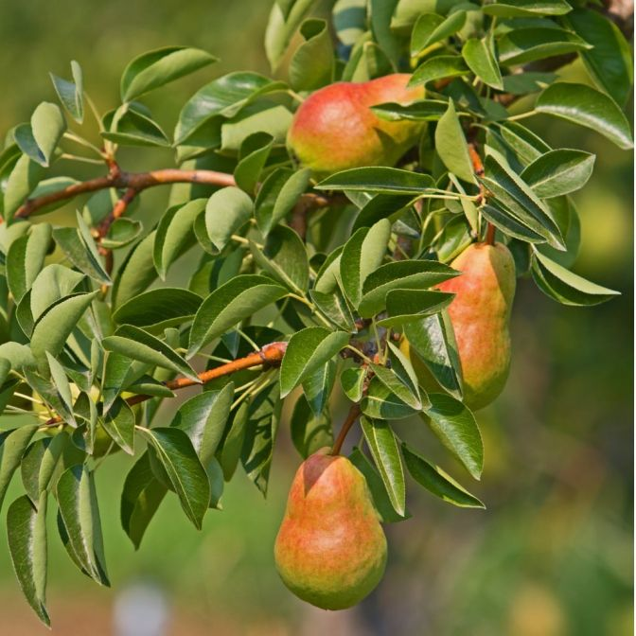
Look and choose.
Where are the pears ?
A.They’re on the shelf.
B. They’re on the tree.
C.They’re under the table.
back

Slide 9
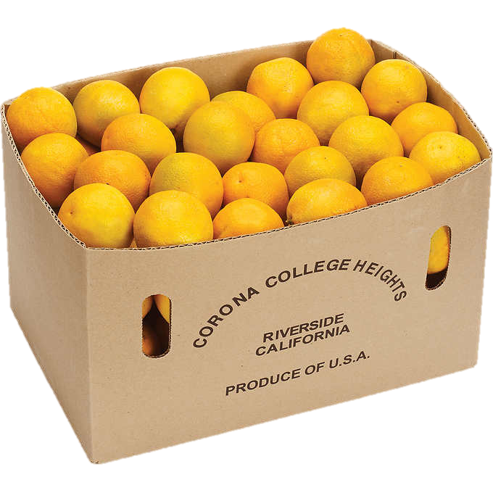
Look and choose
Where are the oranges ?
A. They’re in the box.
B. They’re under the box.
C. They’re behind the box.
back

Slide 10

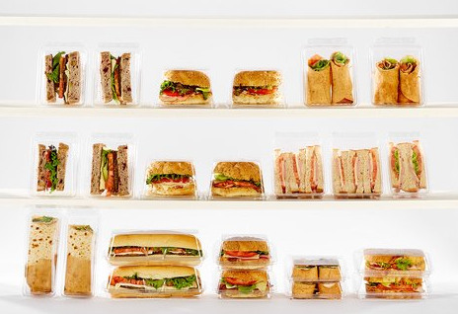
Look and choose
Where are those sandwiches?
A. They’re on the shelf.
B. They’re under the shelf.
C. They’re behind the shelf.
back

Slide 11
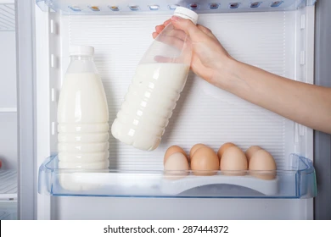
Look and choose
Where are eggs and milk ?
A.They’re in the box.
B.They’re in the fridge.
C. They’re on the table.
back

Slide 12







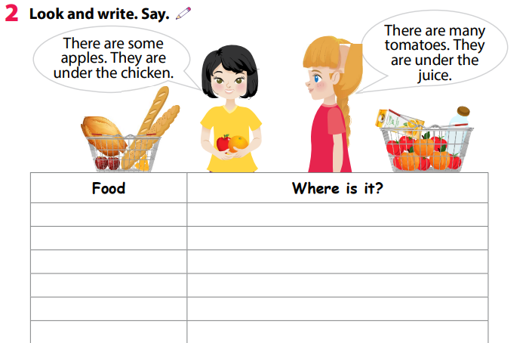





apples
They’re under the chicken.
tomatoes
They’re under the juice.

Slide 13
3.Extra activity

Slide 14

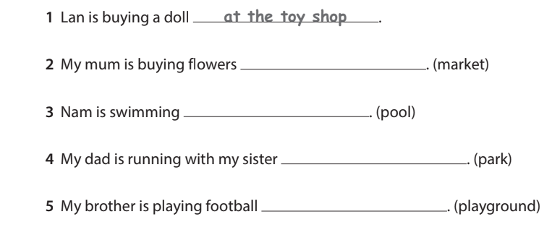

Task 1: Fill in the blank.
(toy shop)
at the market
in the pool
in the park
at the playground

Slide 15
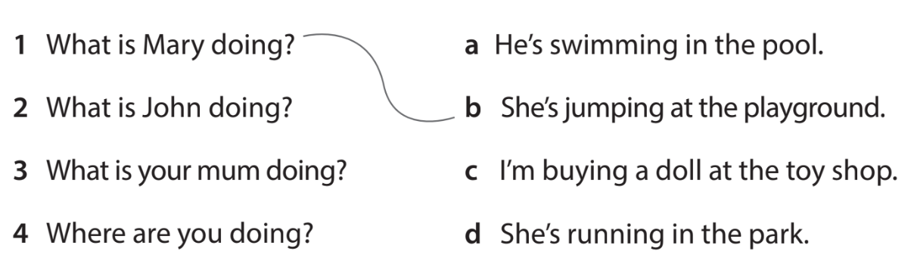
Task 2: Read and match.
What are they doing?
They're running in the park.

Slide 16
Task 3: Read and draw.
There is a glass of juice on the table.
There are two apples on the table.
There is a box of rice under the chair.
There is an ice cream in the fridge.

Slide 17




Thank you & goodbye!

