Slide 1






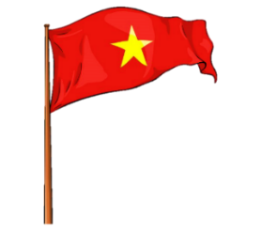














Review 5
Part 3: Video

Slide 2






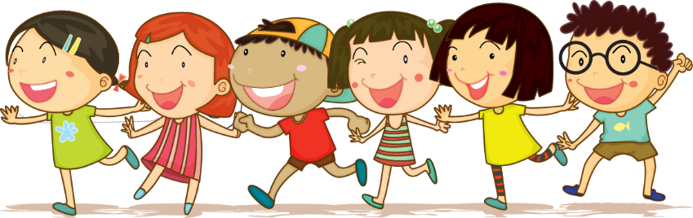



1.Warm-up

Slide 3


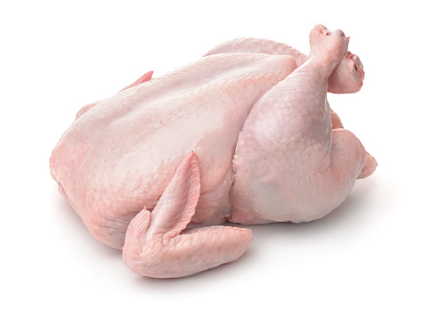


1
2
What food is it?
6 stars
3
4
It’s chicken.

Slide 4
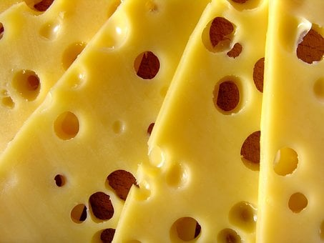
1
2
What food is it?
3 stars
3
4
It’s cheese.

Slide 5
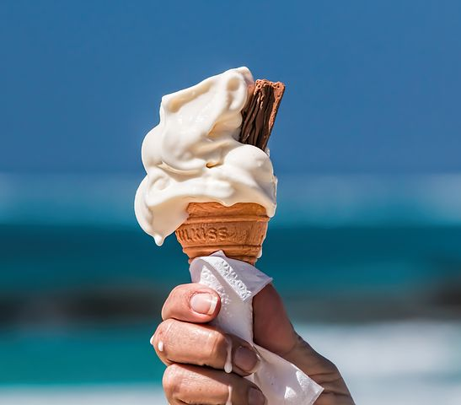

1
2
What food is it?
9 stars
3
4
It’s an ice cream.

Slide 6
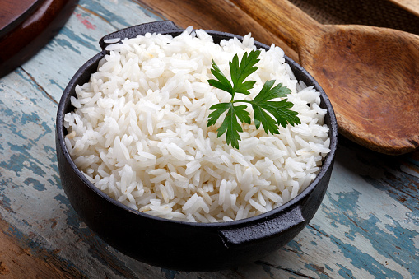
1
2
What food is it?
3 stars
3
4
It’s rice.

Slide 7
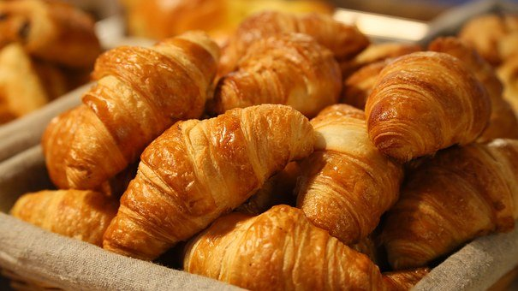
1
2
What food is it?
5
stars
3
4
It’s bread.

Slide 8
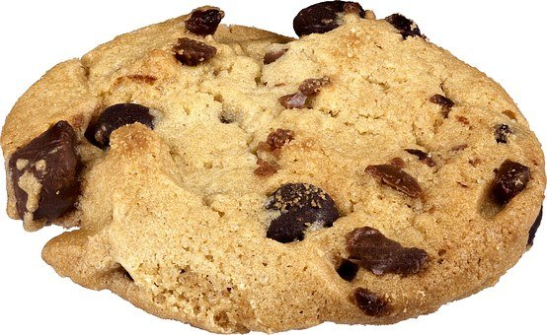
1
2
What food is it?
4 stars
3
4
It’s a biscuit.

Slide 9
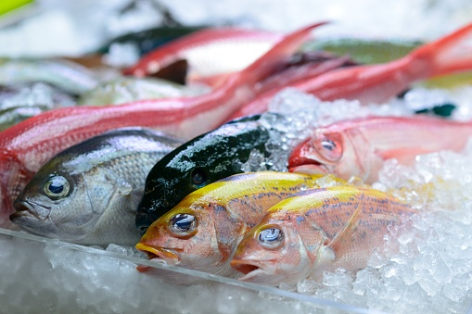
1
2
What food is it?
2 stars
3
4
It’s fish.

Slide 10
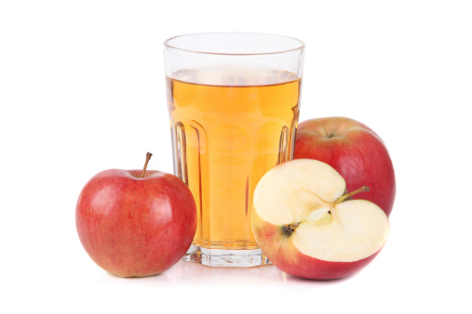
1
2
What drink is it?
5 stars
3
4
It’s apple juice.

Slide 11
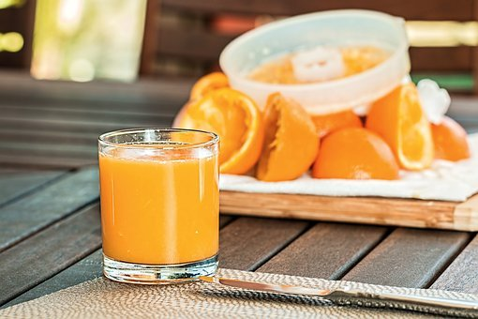
1
2
What drink is it?
8 stars
3
4
It’s orange juice.

Slide 12
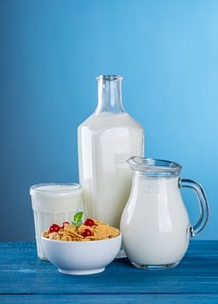
1
2
What drink is it?
4 stars
3
4
It’s milk.

Slide 13
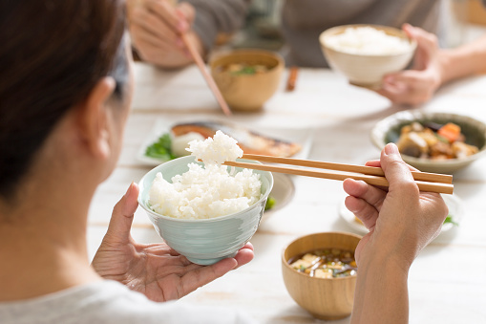
1
2
What are they doing?
7 stars
3
4
They’re eating.

Slide 14

1
2
What’s she doing?
5 stars
3
4
She’s drinking.

Slide 15
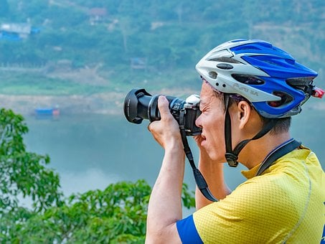
1
2
What’s he doing?
8 stars
3
4
He’s taking photos.

Slide 16
2.Review

Slide 17

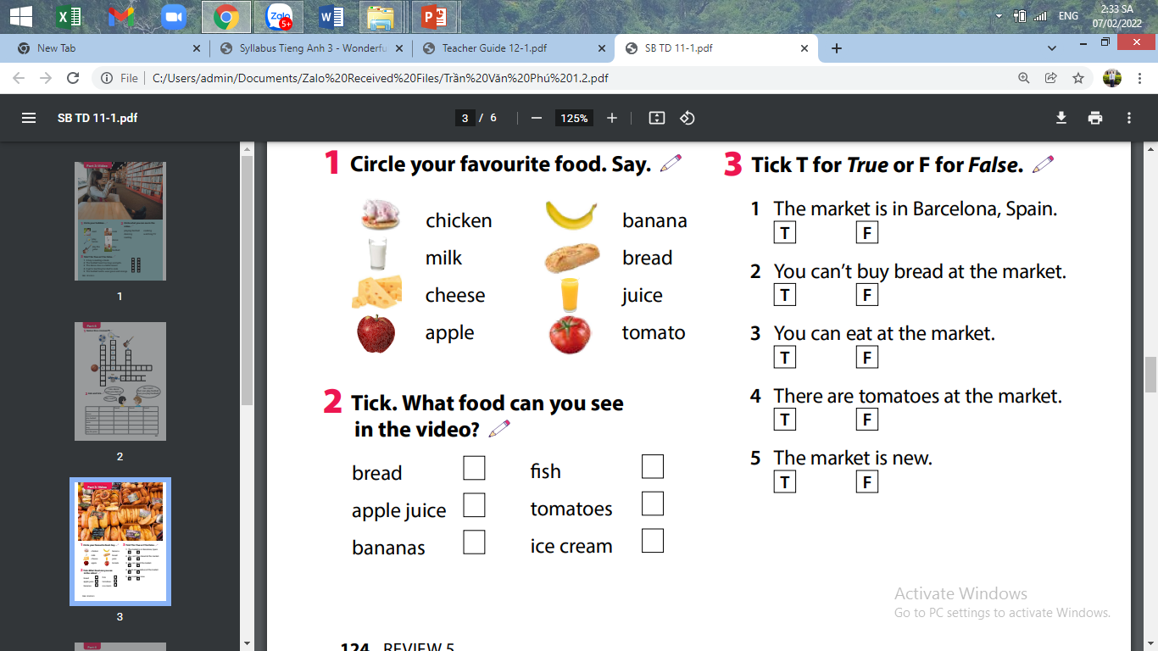




Slide 18


Slide 19


Slide 22












Hide and seek !!!
Snow White & the 7 dwarfs

Slide 23
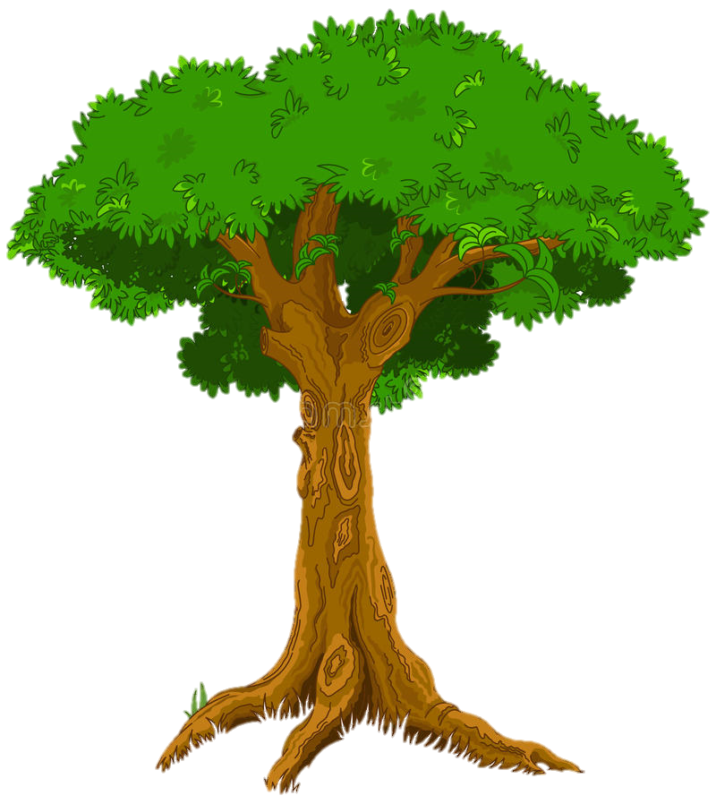

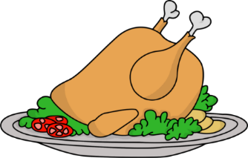


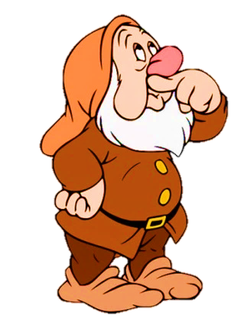
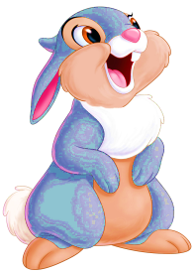
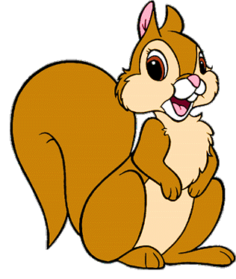
Look and answer the question
How many plates of chicken are there?
Question 1
There are 10 plates of chickens.
5 stars

Slide 24





Make the question
How many loaves of bread are there?
Question 2
There are twelve loaves of bread.
4 stars

Slide 25
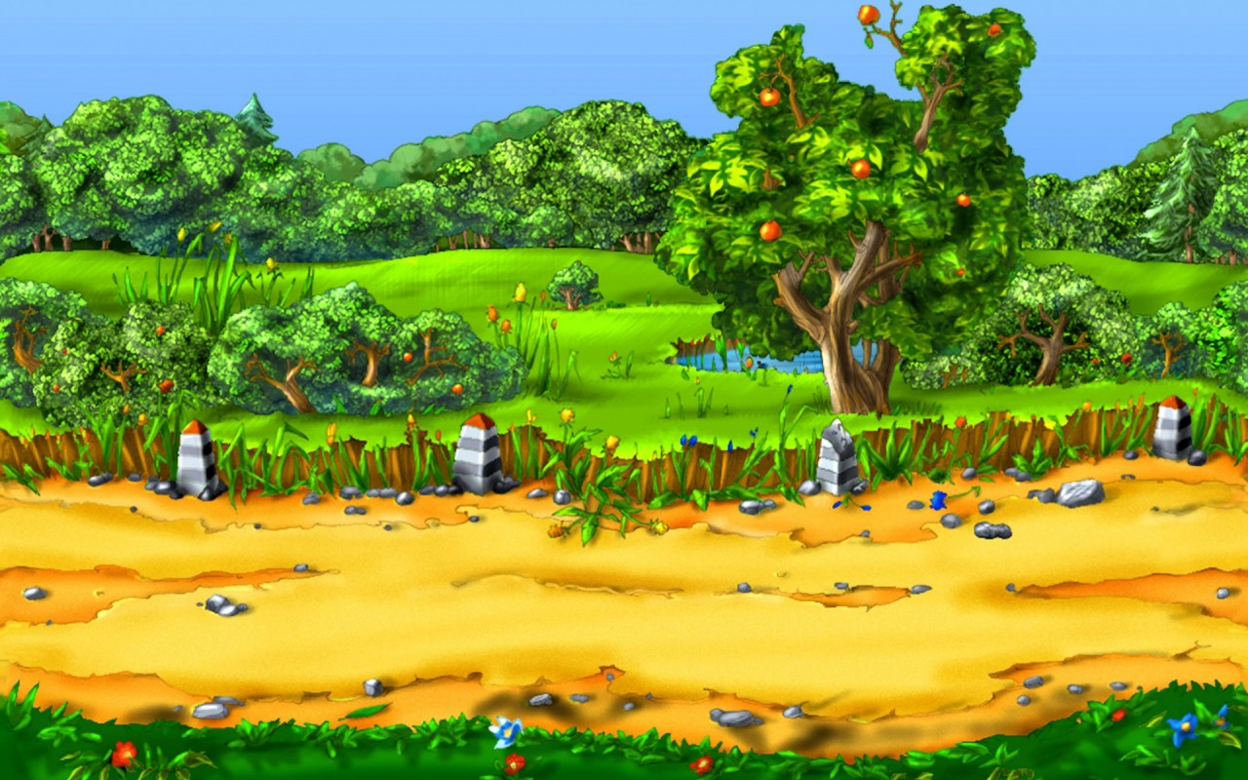

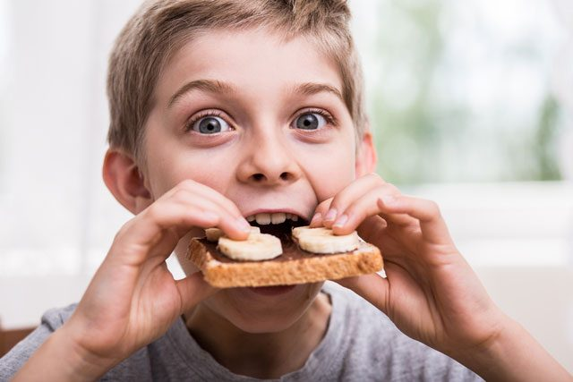

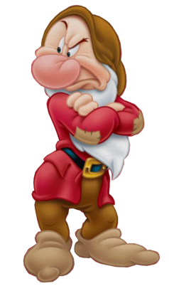
Look and fill in the blanks
What are they doing?
Question 3
drinking
eating
She’s..................and he’s.........
6 stars

Slide 26
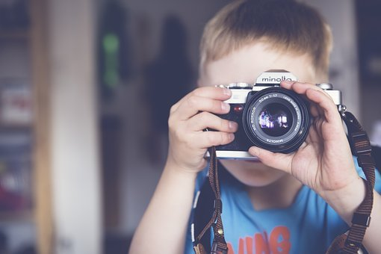
Look and fill in the blank
Question 4
What’s he doing?
taking photos
He’s.................
2 stars

Slide 27
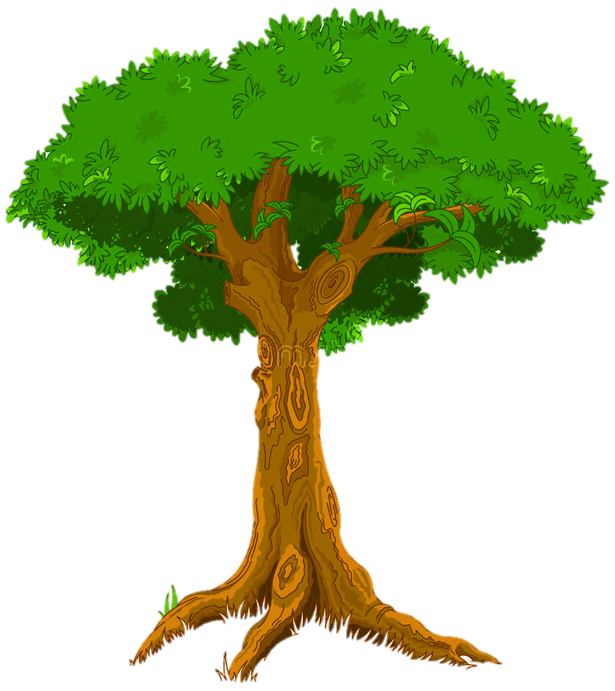
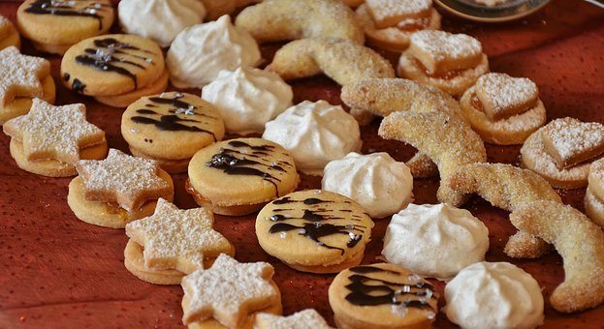
Circle the correct word
Question 5
There are some / a lot of biscuits.
3 stars

Slide 28

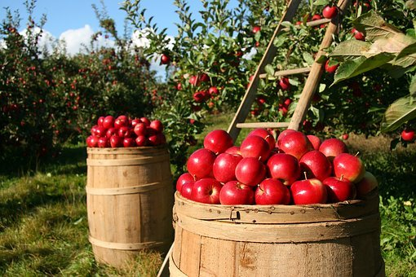

Circle the correct word
Question 6
There are many / some apples.
4 stars

Slide 29
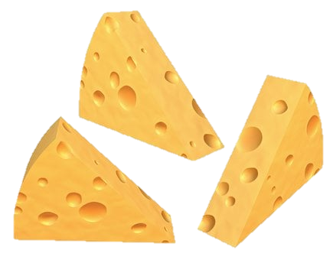

Circle the correct word
Question 7
There are some / a lot of cheese.
4 stars

Slide 30
3.Extra activity

Slide 31



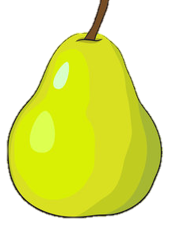
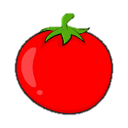
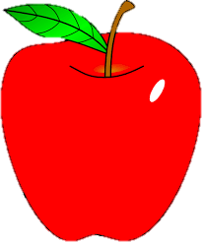
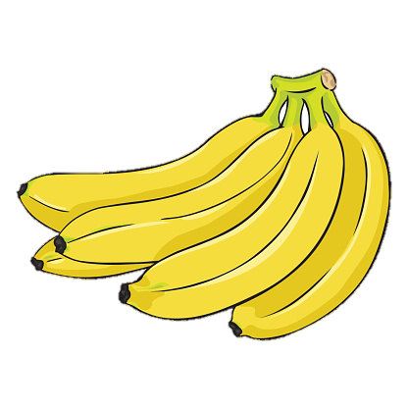

Task 1: Look and circle.
1 There are a lot of / some pears.
2 There are some / many tomatoes.
3 There are some / a lot of apples.
4 There are many / some bananas.

Slide 32
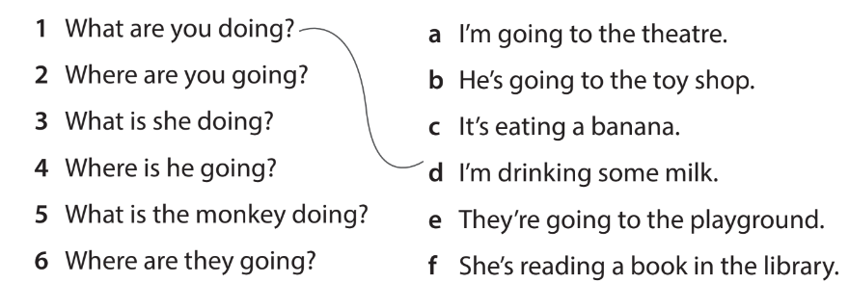
Task 2: Read and match.

Slide 33


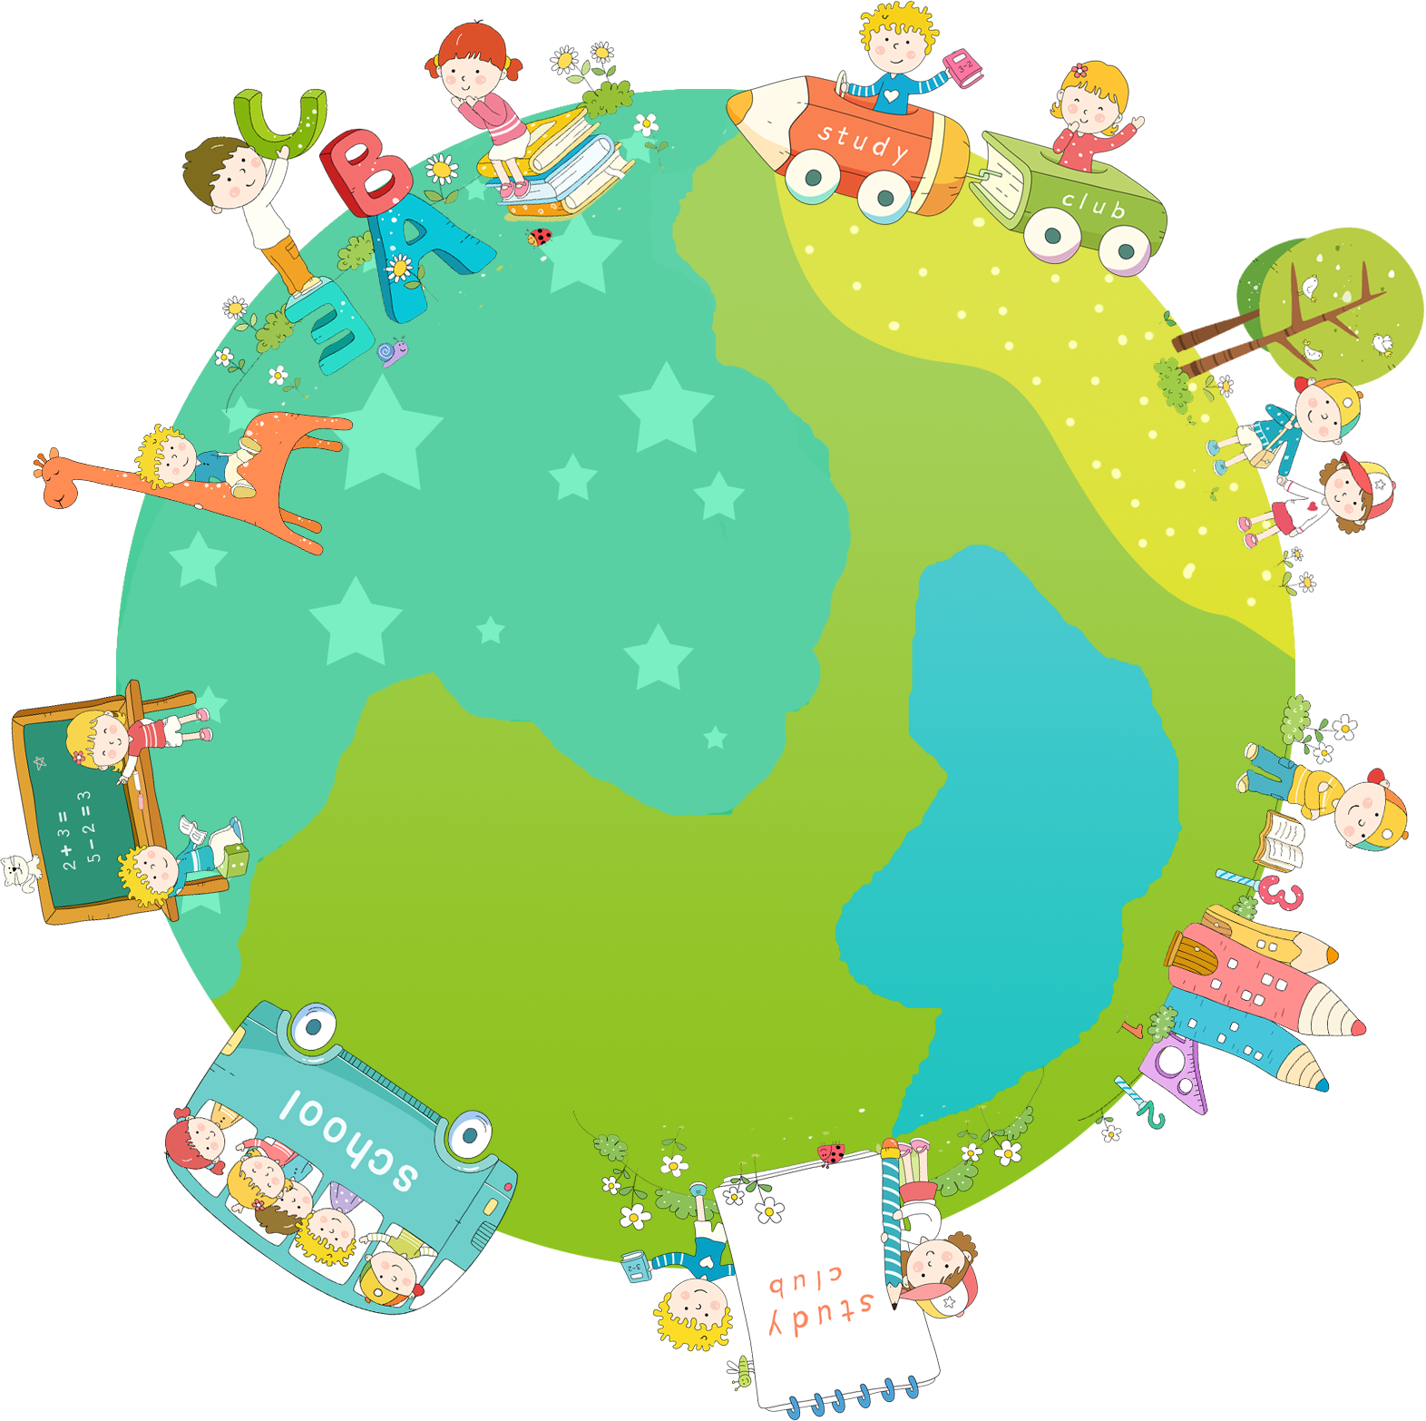
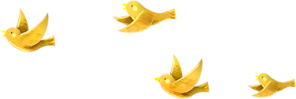
Thank you & goodbye!

