Slide 1





















Review 5
Part 2

Slide 2






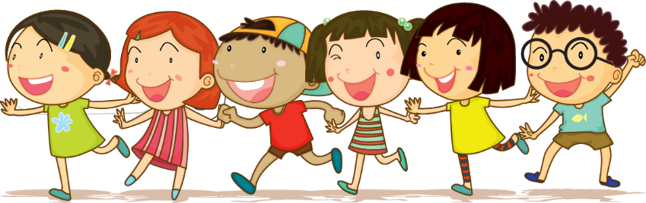



1.Warm up
Horserace

Slide 3


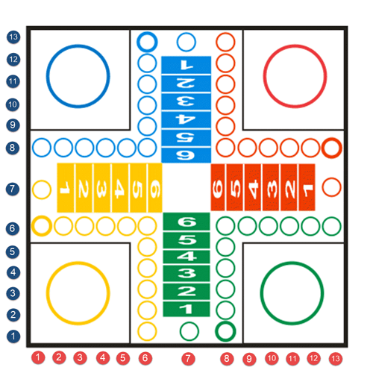




Practice
1
1
2
2
3
4
1
2
2
1
5
6
2
7
8
1

Slide 4
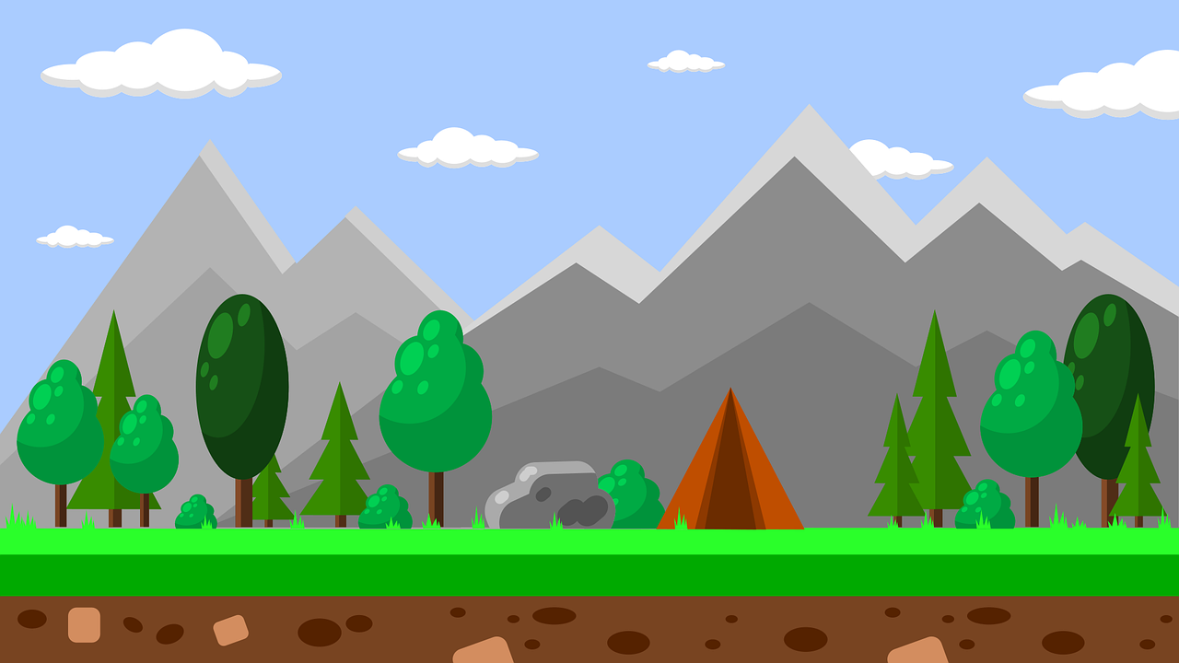
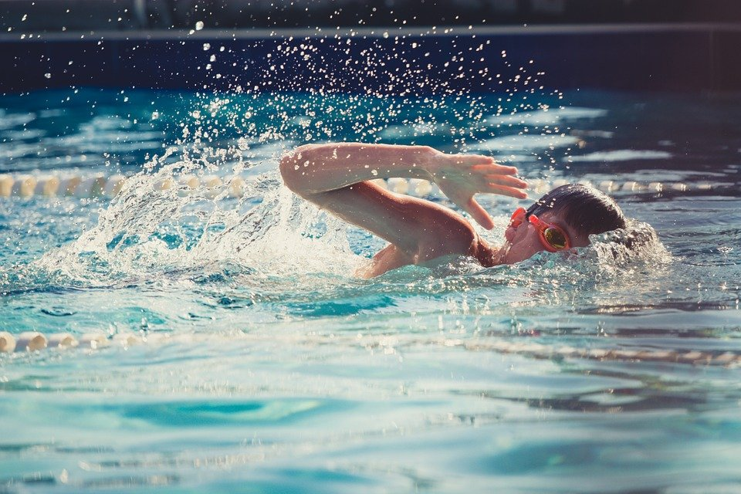
Look and write
Let’s go to the pool and _____.
swim
Back

Slide 5
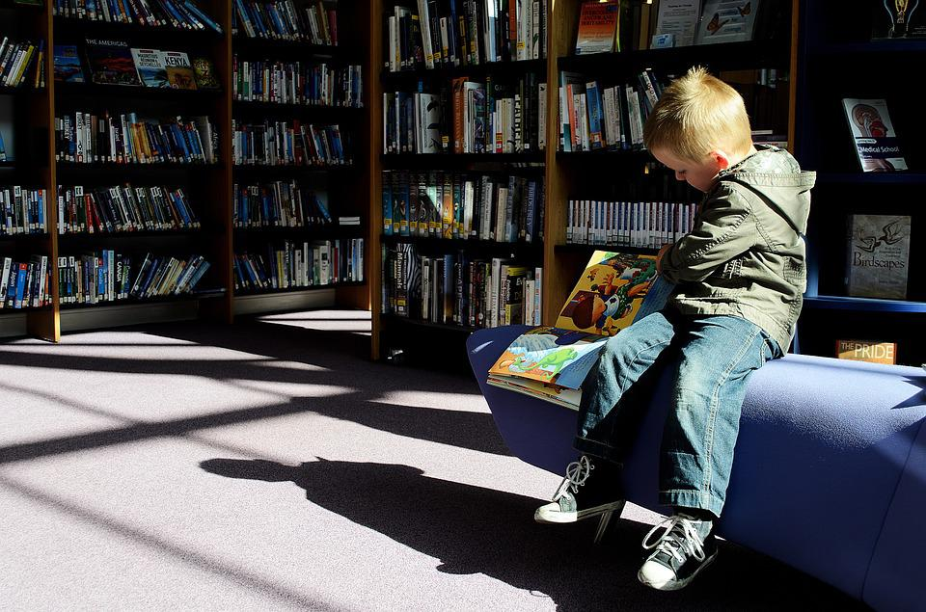
Look and write
May I _____ books in the library?
Yes, you can.
read
Back

Slide 6
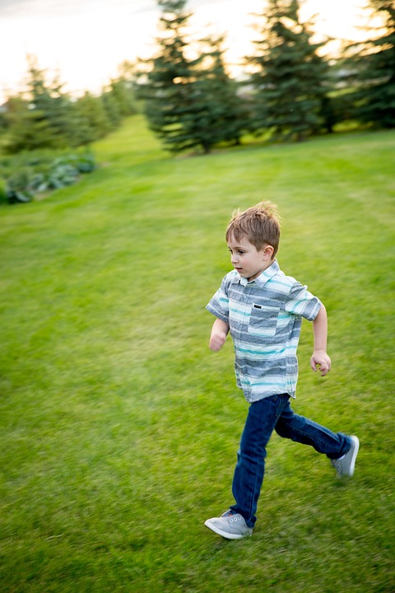
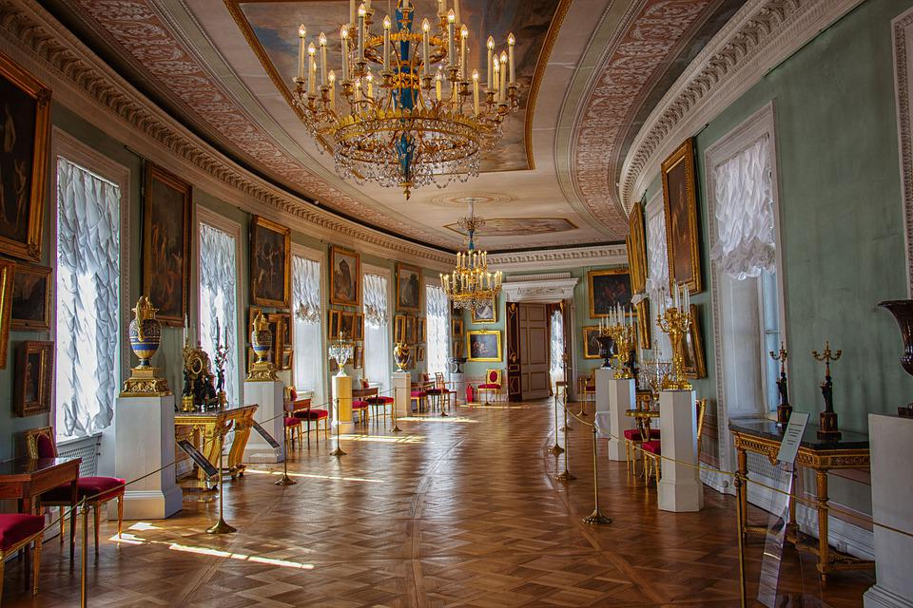
Look and write
May I _____ in the museum?
No, you can’t.
run
Back

Slide 7
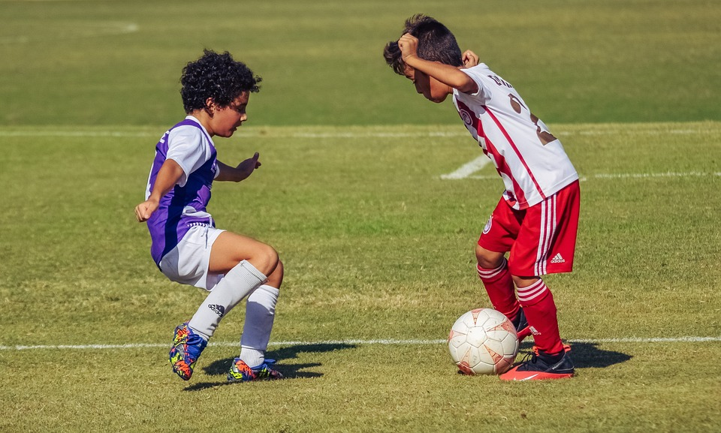
Look and write
Let’s go to the playground and _____________.
play football
Back

Slide 8

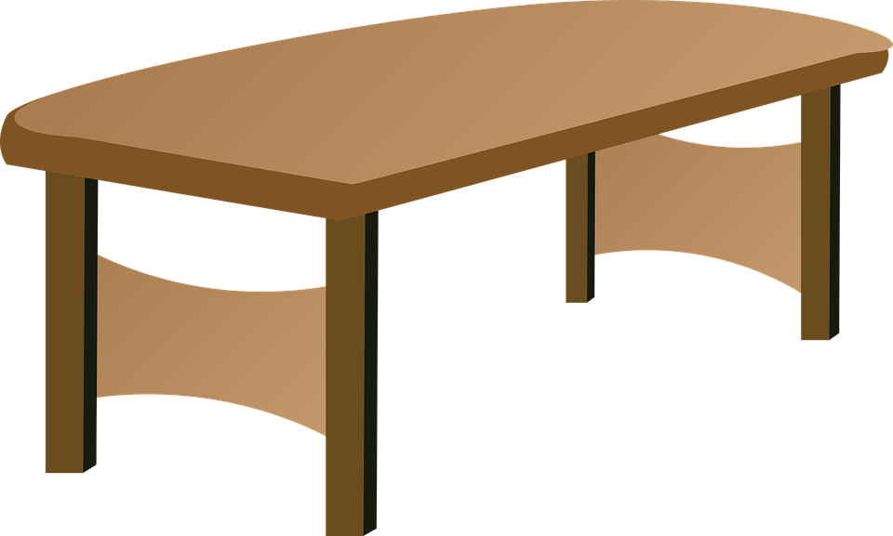
Where’s the pear?
It’s ____ the table.
on
Back

Slide 9
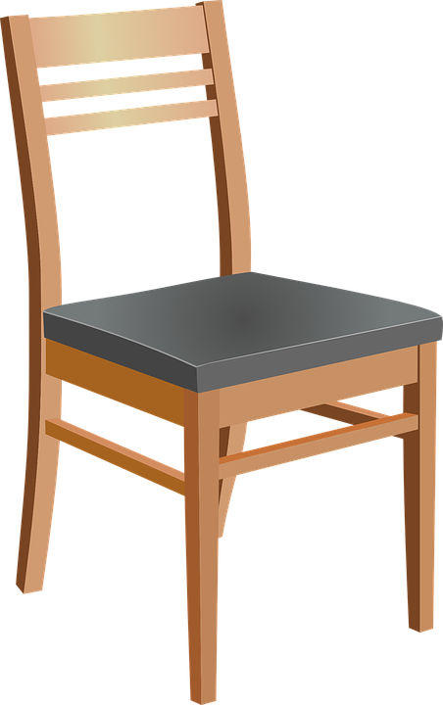

Where’s the pencil?
It’s ____ the table.
under
Back

Slide 10
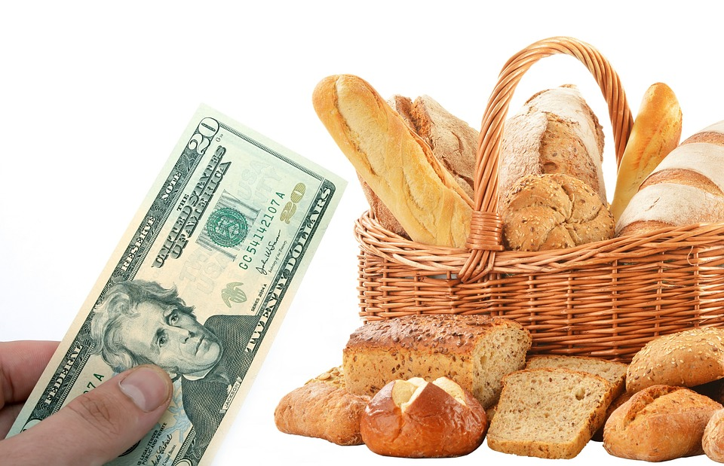
Look and write
Let’s ______ some bread.
buy
Back

Slide 11
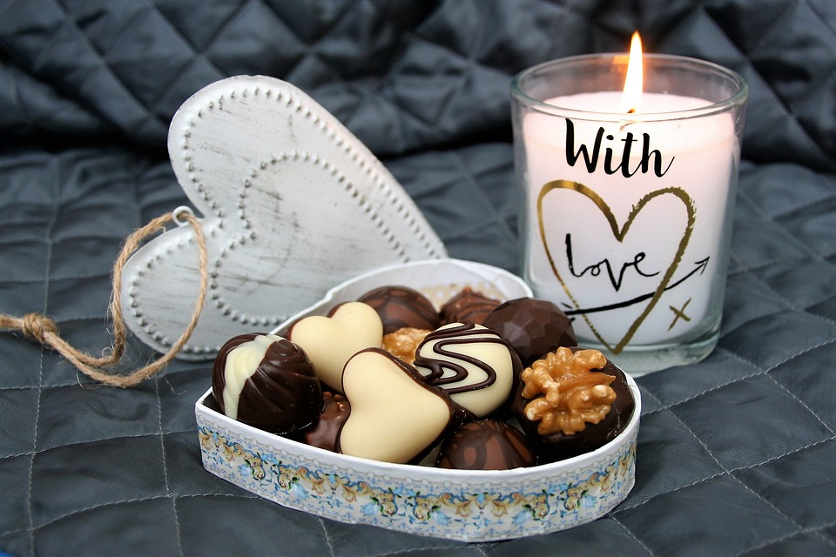
Where is the chocolate?
It’s _____ the box.
in
Back

Slide 12
2.Review

Slide 13

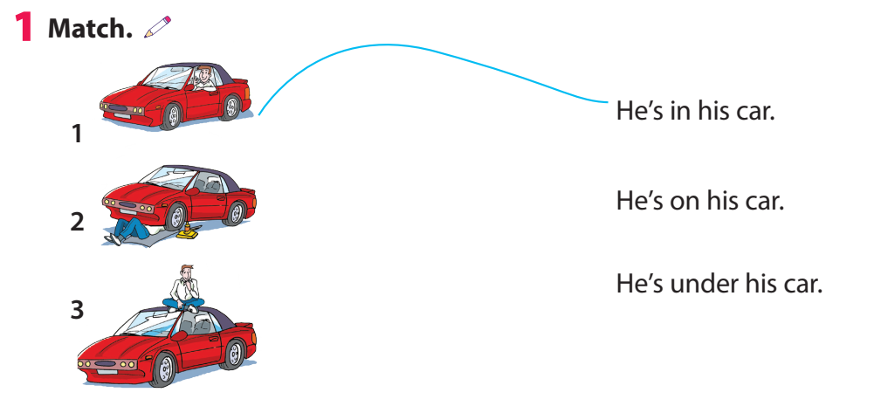



Slide 14
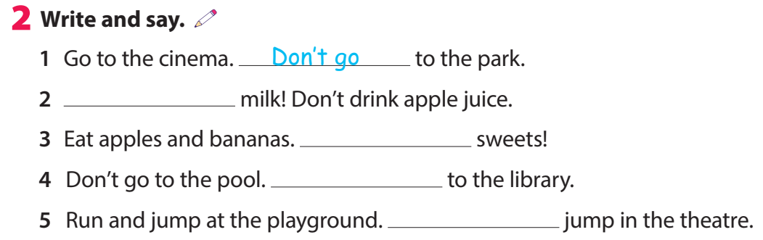
Drink
Don’t eat
Go
Don’t jump

Slide 15
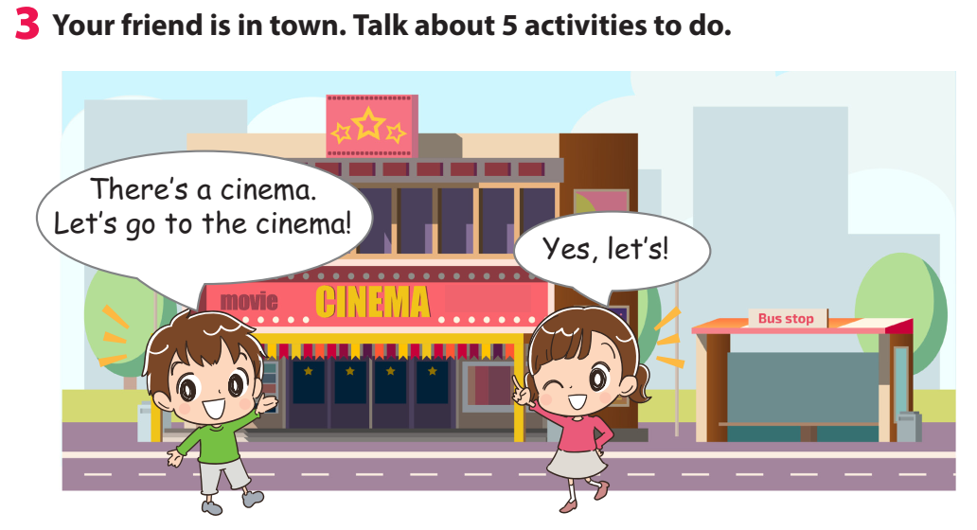

Slide 16
3.Extra activity

Slide 17

Choose the word and fill in the blank.
sleep
buy
drink
watch
swim
run
read
1 Let’s go to the toyshop and _______ toys.
2 Let’s go to the zoo and _______ lions.
3 Let’ go to the pool and ______.
4 Let’s go to the library and _________ books.
5 Let’s go to the playground and _________.

Slide 18




Thank you & goodbye!

