Slide 1
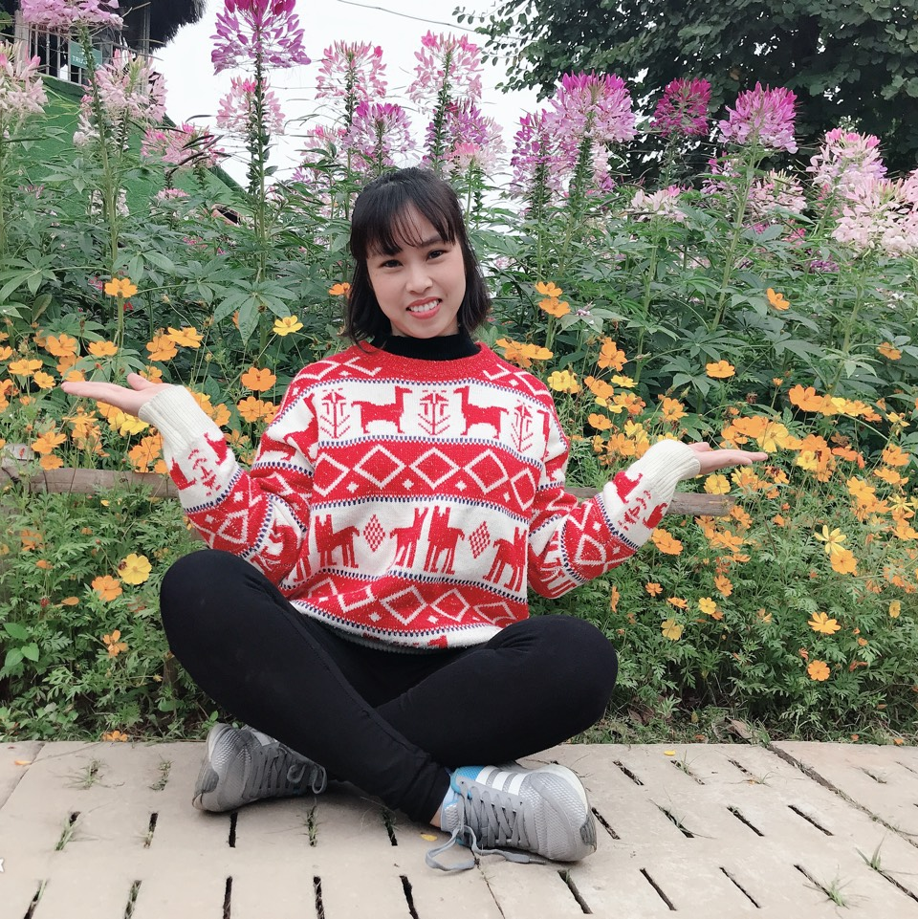
Hello!
Nice to see you again!
Have a nice week!

Slide 2
Unit 15: When’s Children’s Day?
Lesson 3
Teacher: Ngoc Khue

Slide 3
Objectives
Use the words and phrases related to the topic Popular Festivals.
Pronounce the sounds “cl” and “fl”
Mục đích bài học:
Sử dụng các từ và cụm từ liên quan đến chủ đề Các ngày lễ phổ biến.
Phát âm đúng âm “cl” and “fl”

Slide 4
Table of Contents.
Part 01
Part 02
Part 03
Part 04
01
02
Revision
Phonics
03
04
Practice
Homelink

Slide 5
Revision
01

Slide 6
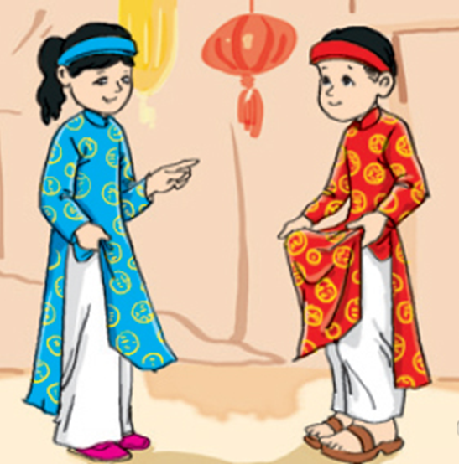
Children wear new ____ at Tet.
A. clothes
B. books
C. School bag
D. house
Next

Slide 7
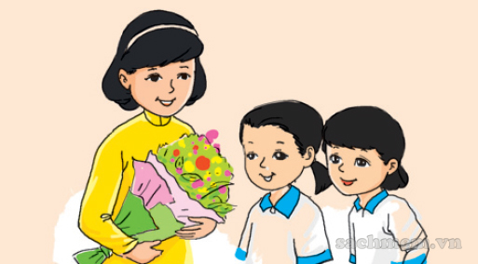
We give our teachers beautiful _______ on Teachers' Day.
A. books
B. clothes
C. Banh Chung
D. Flowers
Next

Slide 8
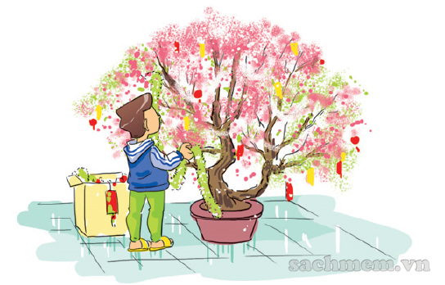
decorate ...
A. the class
B. the school
C. the house
D. the tree
Next

Slide 9
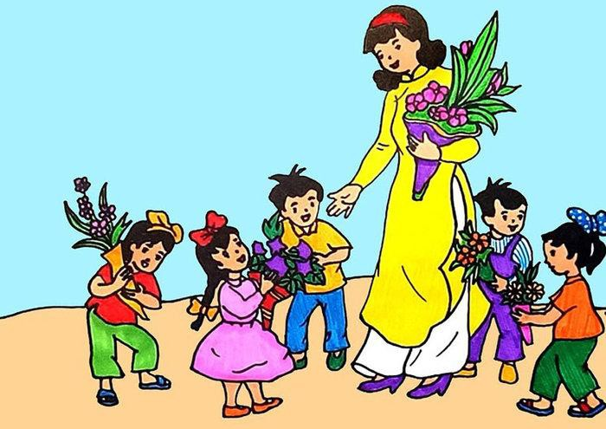
When is Teachers' Day?
A. We have a party.
B. It's on the twentieth of November.
C. I'm playing football.
D. We make Banh Chung
Next

Slide 10
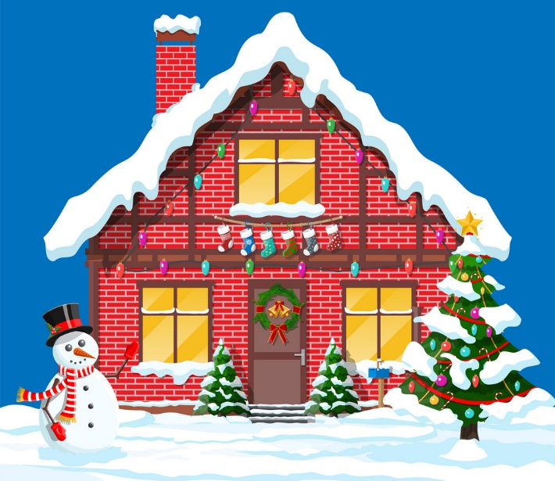
A: ______ is Christmas?
B: It's on the twenty-fifth of December.
A. Where
B. When
C. What
D. We
Next

Slide 11

What do you do on ______?
A. Children’s Day
B. Teachers’ Day
C. Women’s Day
D. Fathers’ Day
Next

Slide 12
WELL DONE!

Slide 13
Phonics
02

Slide 14

1. Listen and repeat
cl | clothes | She wears new clothes at Tet.
 | close | Close the door, please.
fl | flowers | My mother buys lots of flowers for Tet.
 | floor | I clean the floor in the afternoon.

Slide 15
2. Listen and write.
1. We give our teachers lots of ________ on Teachers' Day.
2. ________ the door, please.
3. The _________ are beautiful.
4. She's cleaning the _______ now.
flowers
Close
clothes
floor

Slide 16
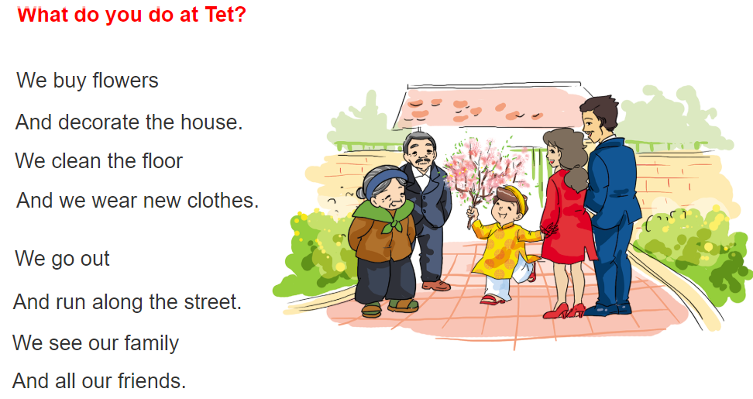

3. Let's chant

Slide 17
Practice
03

Slide 18
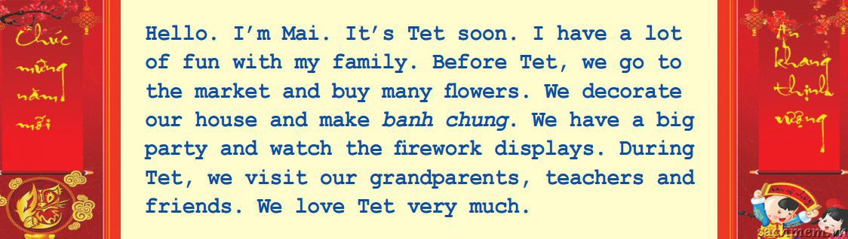
4. Read and write
1. It's ________ soon.
2. Mai's family go to the market and buy many ________.
3. They decorate ____________ and make ____________.
4. They watch _____________________.
5. They visit _________________, ________ and _______.
Tet
flowers
their house
banh chung
the firework displays
their grandparents
teachers
friends

Slide 19
5. Write about your Tet:
Before Tet, I __________________.
During Tet, I ________________.
decorate the house and go shopping
visit my grandparents and get lucky money

Slide 20
Homelink
04

Slide 21
Monday, March 6th 2023
Unit 15: When’s Children’s Day?
Lesson 3
1. Phonics:
cl | clothes | She wears new clothes at Tet.
 | close | Close the door, please.
fl | flowers | My mother buys lots of flowers for Tet.
 | floor | I clean the floor in the afternoon.
2.Homework:
- Do WB: part A- 1,2 (page 60)

Slide 22
Thank you!

