Slide 1
Unit 15 – Lesson 1
What would you like to be in the future?

Slide 2


pilot
/ˈpaɪlət/

Slide 3
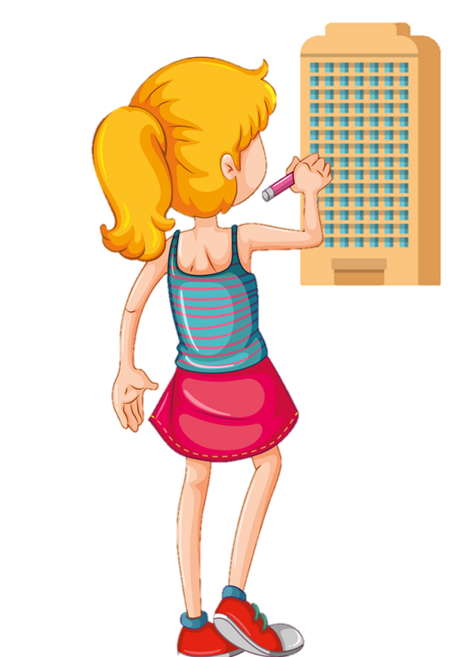
architect
/ˈɑːrkɪtekt/

Slide 4

writer
/ˈraɪtər/

Slide 5
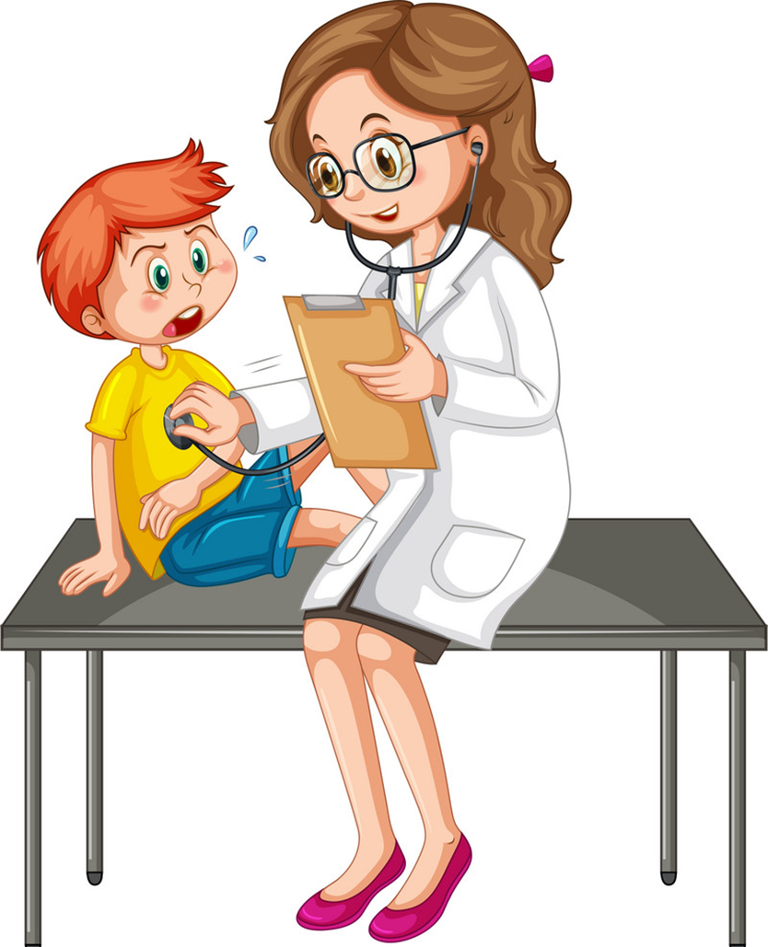
doctor
/ˈdɑːktər/

Slide 6

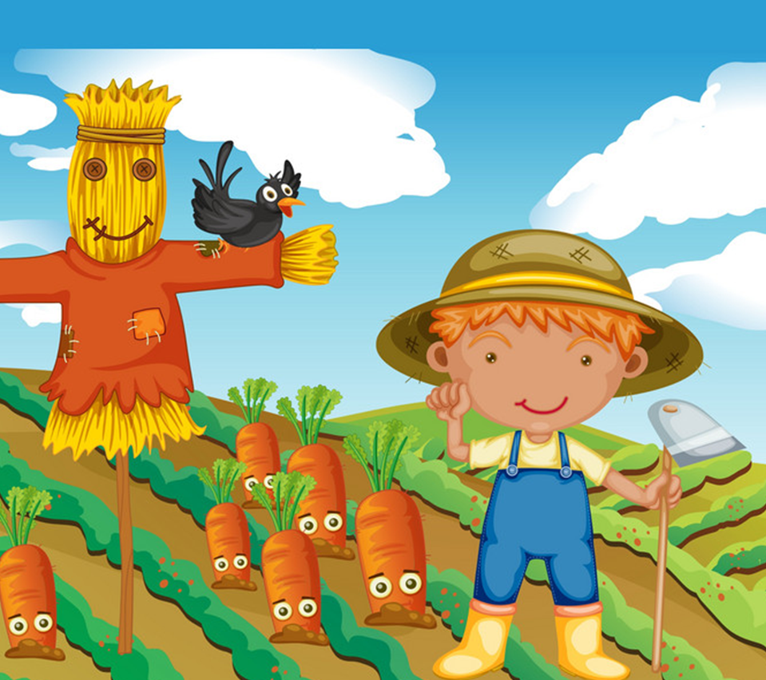


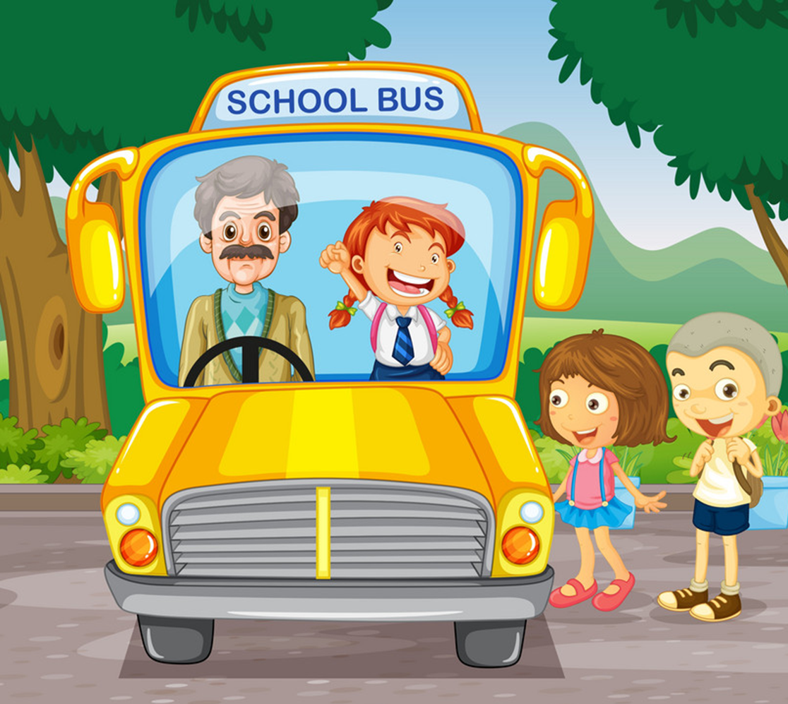
Vocabulary
architect
teacher
farmer
worker
writer
driver
doctor
nurse
pilot

Slide 7




Look and tick
pilot

Slide 8
Look and tick
driver

Slide 9
Look and tick
writer

Slide 10
Look and tick
nurse

Slide 11
Look and tick
architect

Slide 12
Look and tick
doctor

Slide 13
Look and tick
farmer

Slide 14
Look and tick
worker

Slide 15
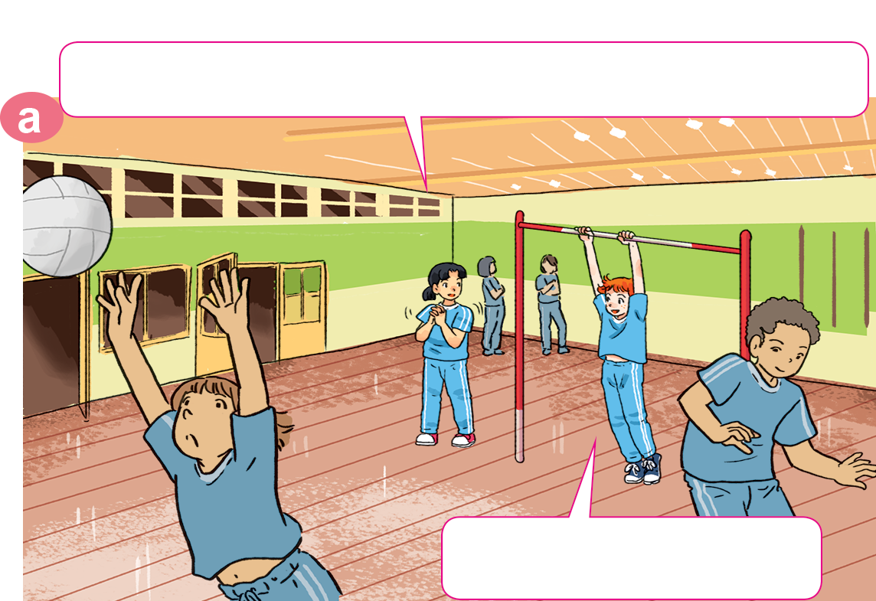
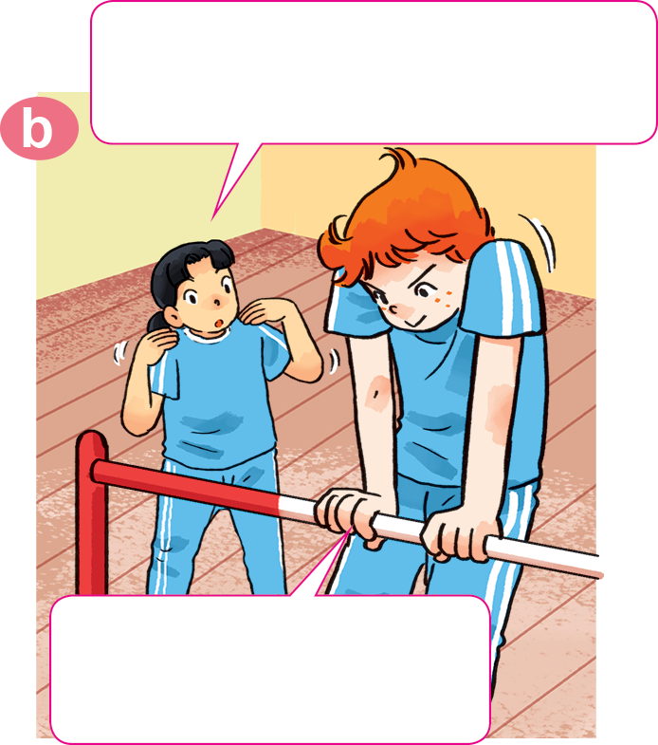
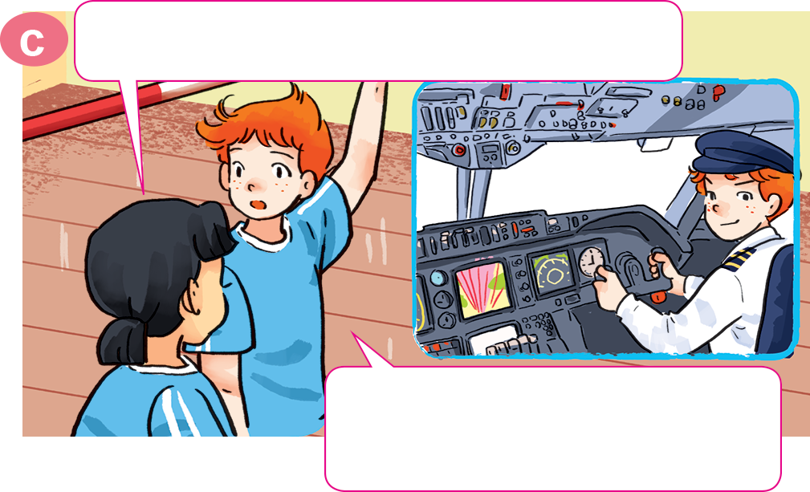
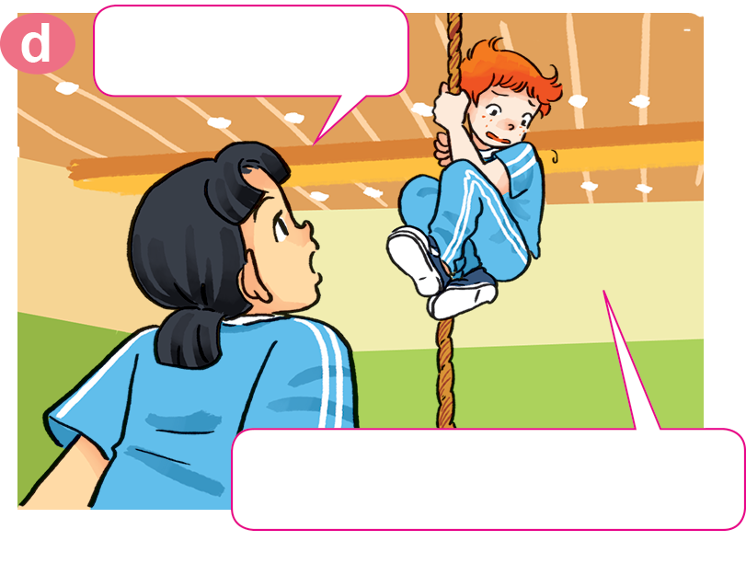
1. Look, listen and repeat
Is that why you work
out so much in the gym?
What would you like to be in the future, Tony?
Yes. Pilots have to be strong.
I'd like to be a pilot.
So would you like to fly a plane?
What's that?
Yes, of course!
There's only one problem.
I'm scared of heights!

Slide 16
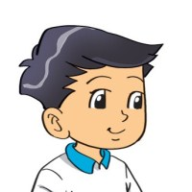
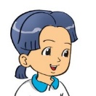
2. Point and say
What would you like to be in the future?
I'd like to be __________.
a doctor

Slide 17
2. Point and say
What would you like to be in the future?
I'd like to be __________.
a pilot

Slide 18
2. Point and say
What would you like to be in the future?
I'd like to be ____________.
an architect

Slide 19
2. Point and say
What would you like to be in the future?
I'd like to be __________.
a writer

Slide 20
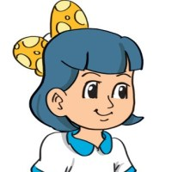



3. Let’s talk
What would you like to be in the future?
I’d like to be a/an __________.
driver
architect
teacher
farmer
writer
doctor
nurse
pilot
worker

Slide 21
3. Let’s talk
What would you like to be in the future?
I'd like to be a/an _________________.

Slide 22
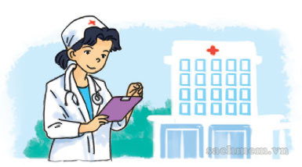

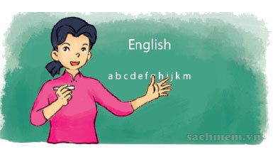
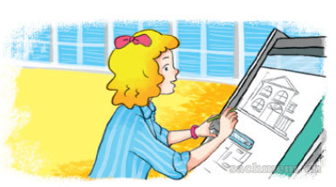
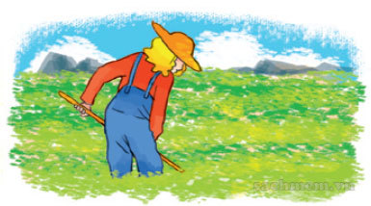
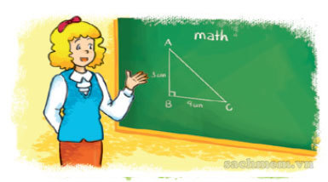
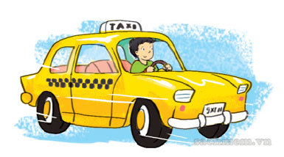
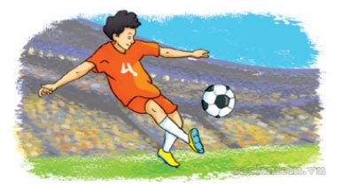
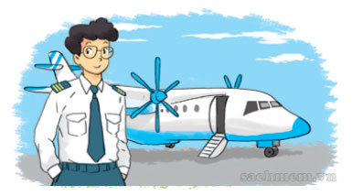
4. Listen and tick.
1
✓
a
b
c
2
✓
a
b
c
3
✓
a
b
c

Slide 23
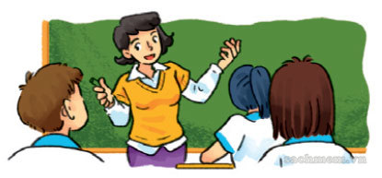
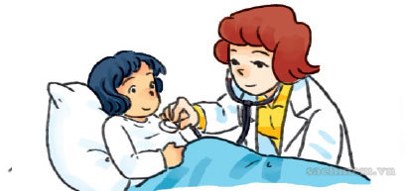
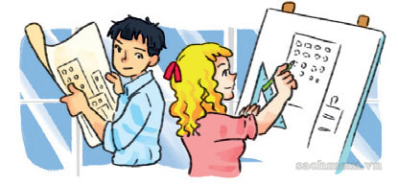
5. Look and write.
A: What would you like to be in the future, Hoa?
B: I'd ______________________.
like to be a teacher
A: What would Mary like to be when she grows up?
B: She'd ___________________.
like to be a doctor
A: What would Linda and Trung like to do when they leave school?
B: They'd ___________________.
like to be an architect

Slide 24
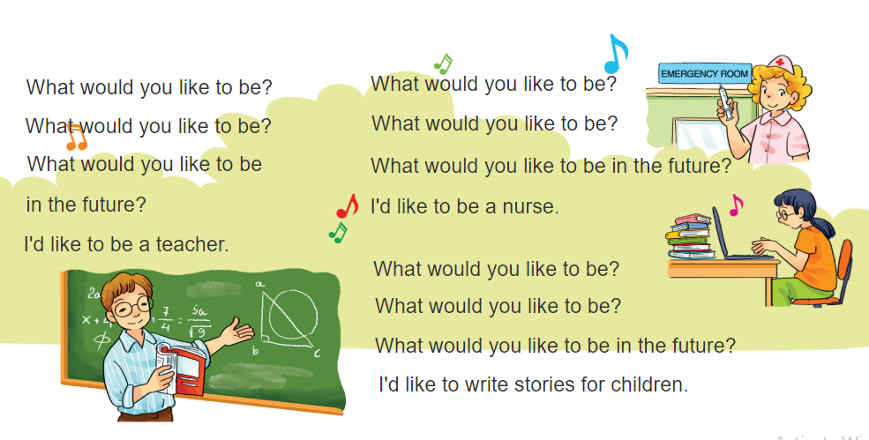

6. Let’s sing.
What would you like to be in the future?

