Slide 1









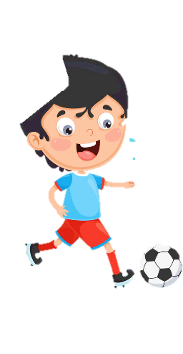











Unit 8
My Town
Lesson 2 – Task 4,5,6

Slide 2










1 Warm up

Slide 3

Puzzle word
1
w | r | i | t | e
2
j | u | m | p
3
s | w | i | m
4
d | a | n | c | e
5
r | u | n
6
r | e | a | d
Next

Slide 4
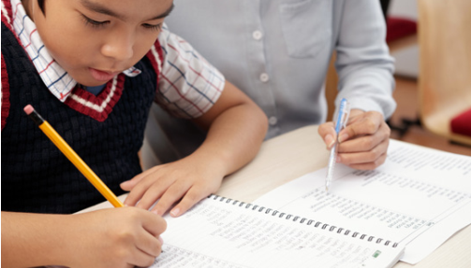
write
Back

Slide 5

jump
Back

Slide 6
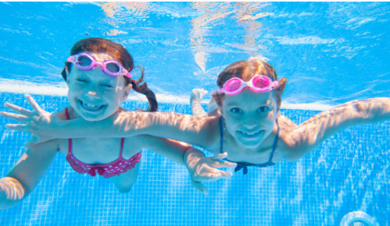
swim
Back

Slide 7
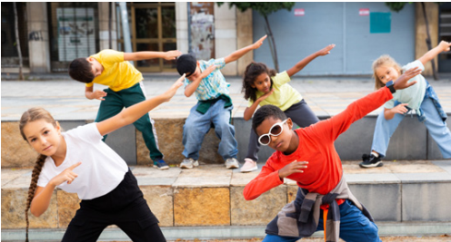
dance
Back

Slide 8
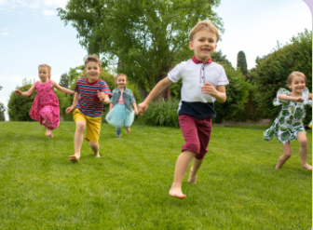
run
Back

Slide 9

read
Back

Slide 10
2 Presentation

Slide 11


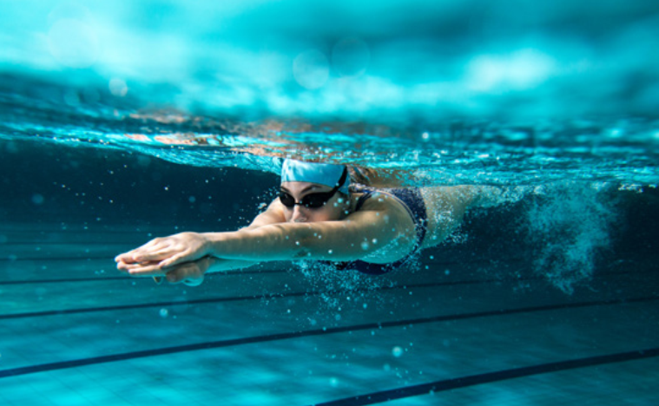
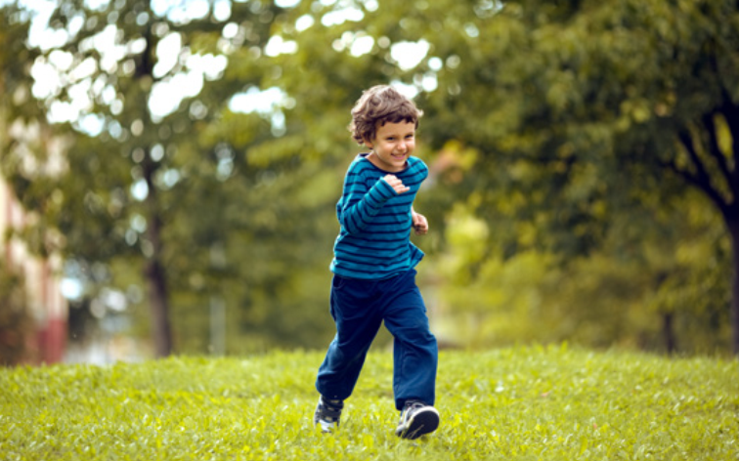
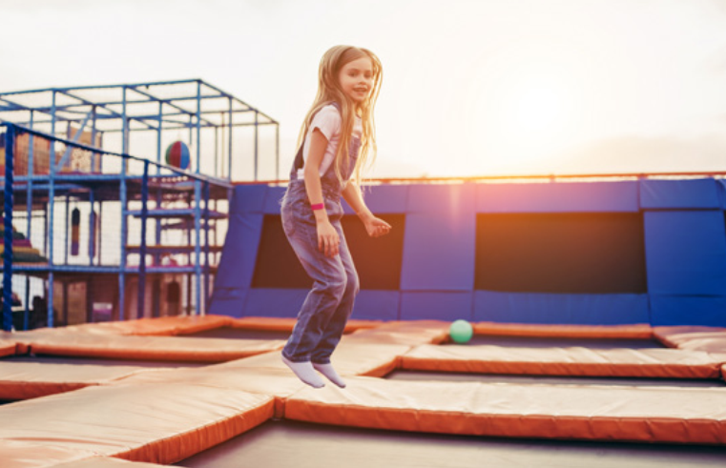

Slide 12

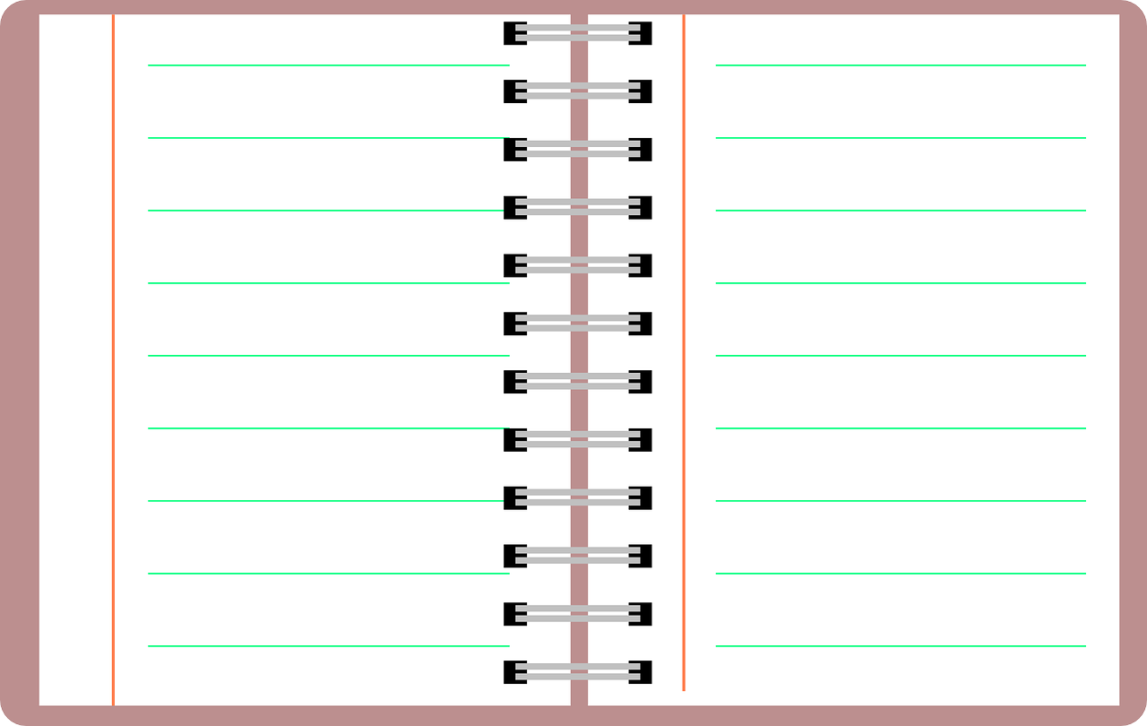
New structure
What are you doing?
I’m ____________.
What is he doing?
He’s __________.
What is she doing?
She’s __________.
What are they doing?
They’re__________.

Slide 13

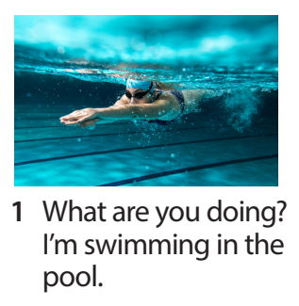
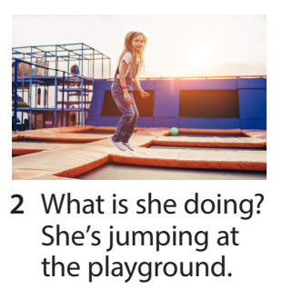
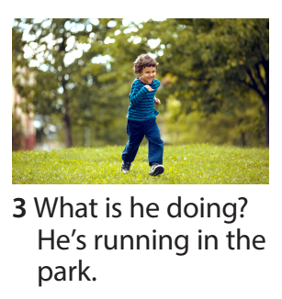
Task 4 Listen and repeat.

Slide 14

Quick eyes, quick hands
Notes:
Đổi tên thành game
Câu hỏi đâu??? Nên cho câu hỏi lên, hs xem qua, đọc qua rồi mới chơi (bên cạnh câu hỏi để trong basket…)
- Prepare 4 baskets with many small flashcash (teacher has to cut a sentence into many small pieces).
-Invite 4 Ss go to the board. When T turns on the audio, Ss listen carefully and choose words from his/her own basket to stick on the board.
-Who is fastest will be the winner.

Slide 15
3 Practice

Slide 16

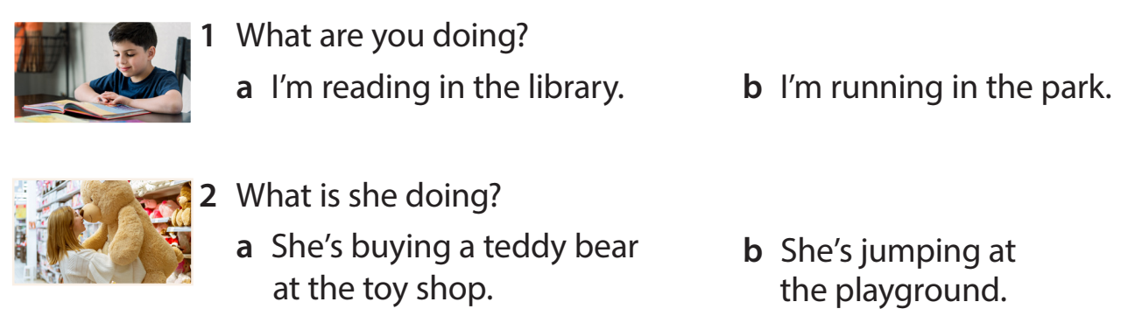
Task 5 Look and read. Circle and say.

Slide 17
4 Production

Slide 18
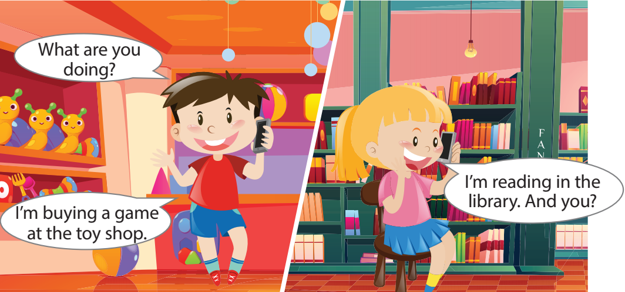
Task 6 Let’s talk.
Notes:
- Allow them enough time to make their own and practise the dialogue.
- Ask some volunteers to go to the broard to make a phone call( one is in the class, one is out of the class.)

Slide 19
5 Assessment

Slide 20
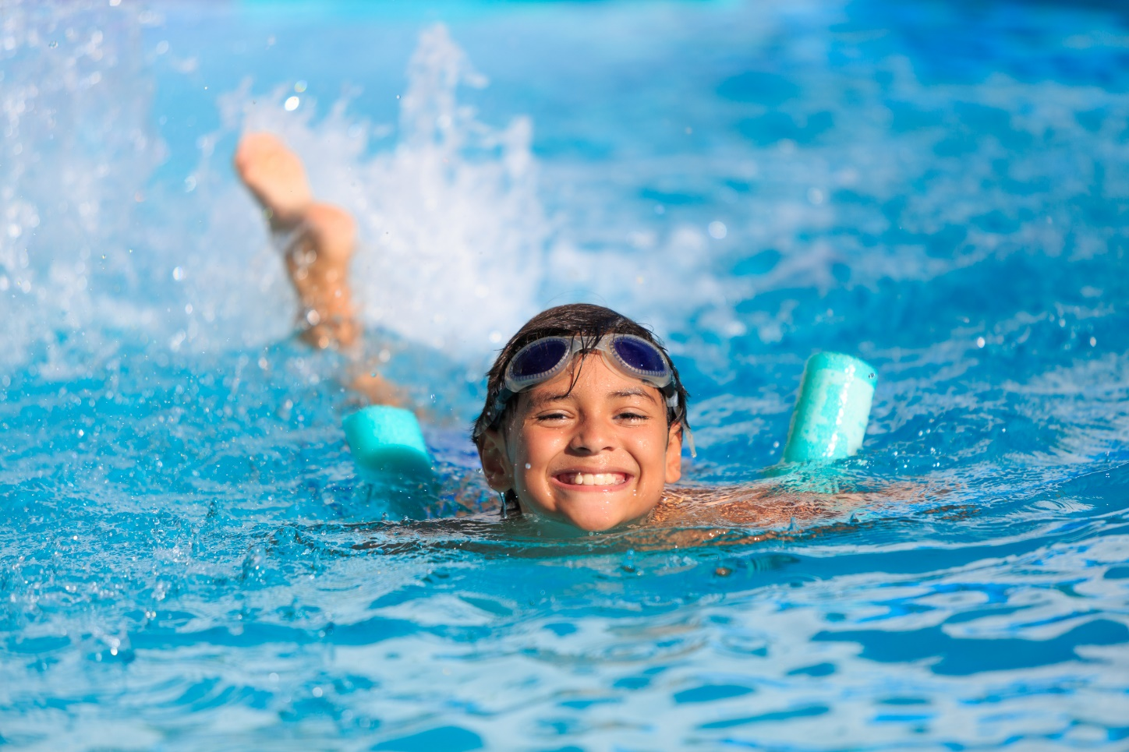
What is he doing?
A. He’s swimming in the pool.
B. He’s jumping.
C. He’s smiling.

Slide 21
What is she doing?
A. She’s singing.
B. She’s driving a car.
C. She’s jumping.

Slide 22
What is he doing?
A. He’s eating.
B. He’ running.
C. He’s run.

Slide 23
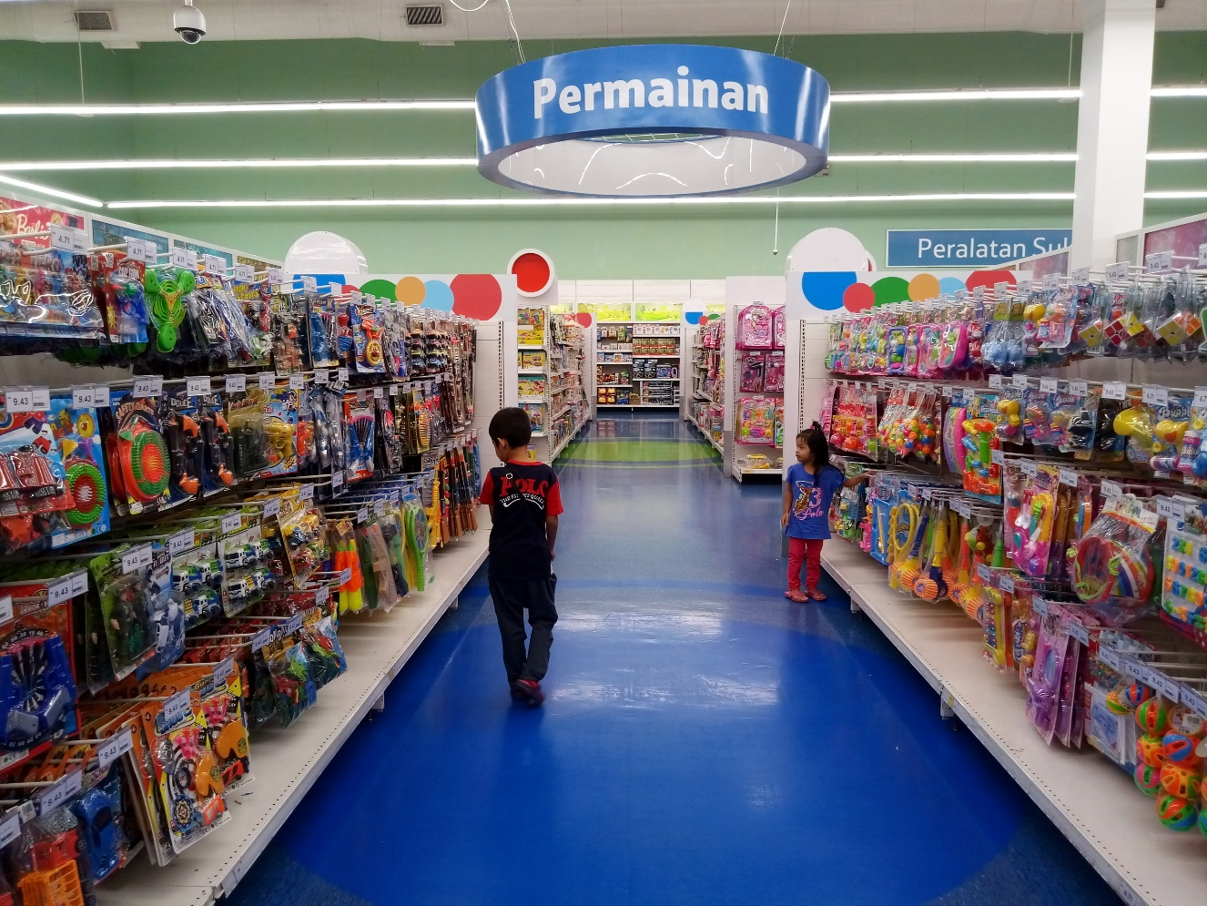
Fill in the blank.
We’re ______ balls at the toy shop now.
buying

Slide 24
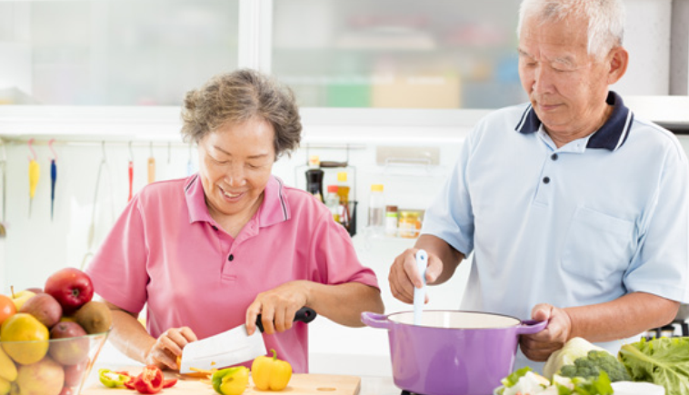
Fill in the blank.
They ’re ______ in the kitchen.
cooking

Slide 25




Thank you & goodbye!

