Slide 1









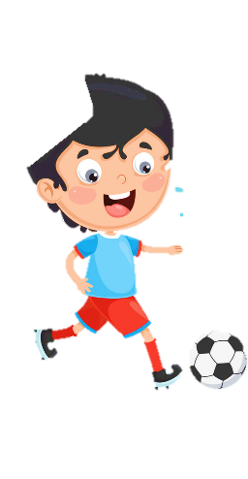











Unit 8
My Town
Lesson 1 – Task 4,5,6

Slide 2






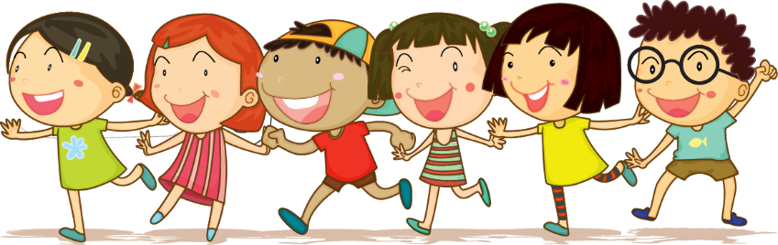



1 Warm up

Slide 3


Warm up
Simon says
Notes:
+Ss will not comply with the request if the command does not begin with the word “simon says:” Dance, play football, talk,jump, run…
+On the contrary, if the command sentence begins with “simon says” but Ss does not follow the request, they will not receive stars for their team.

Slide 4
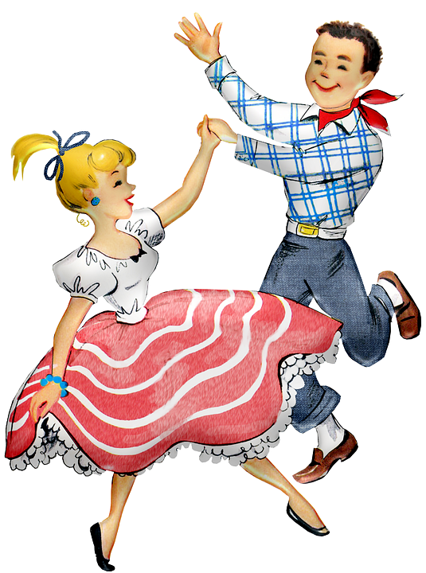

Warm up
Dance!
Notes:
+Ss will not comply with the request if the command does not begin with the word “simon says…”Dance, play football, talk, jump, run…
+On the contrary, if the command sentence begins with “simon says” but Ss does not follow the request, they will not receive stars for their team.

Slide 5
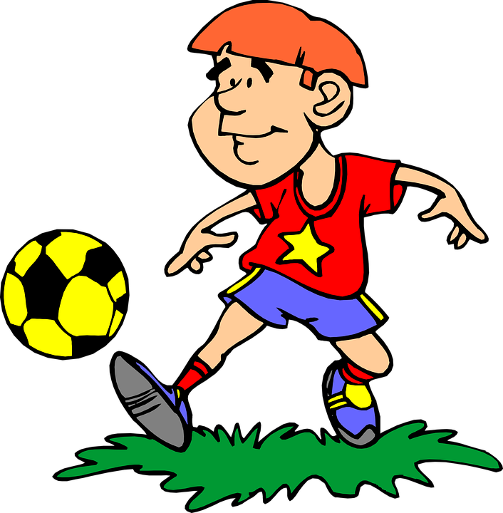
Warm up
Play football!

Slide 6

Warm up
Talk!

Slide 7
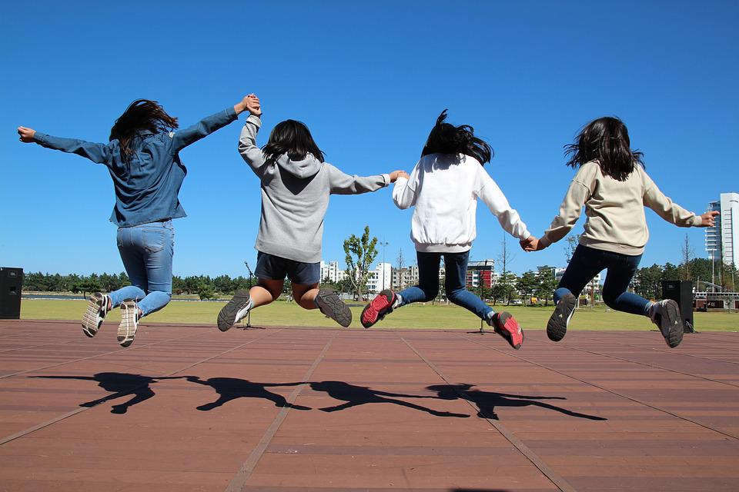
Warm up
Jump!

Slide 8
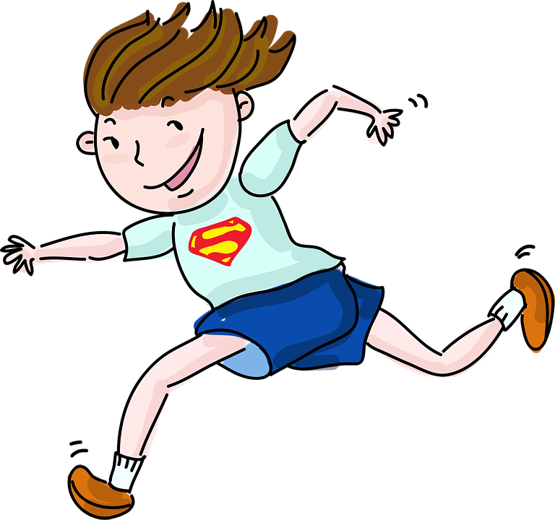
Warm up
Run!

Slide 9
2 Presentation

Slide 10




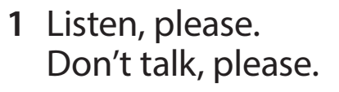
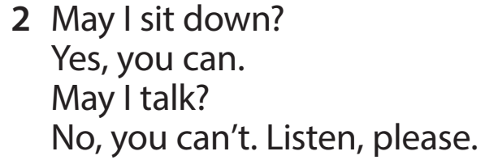
Notes:
-Let Ss look at two pictures and ask Ss a few questions?
Where are they?
How many people are there ?
What are they doing?
How are they now?

Slide 11


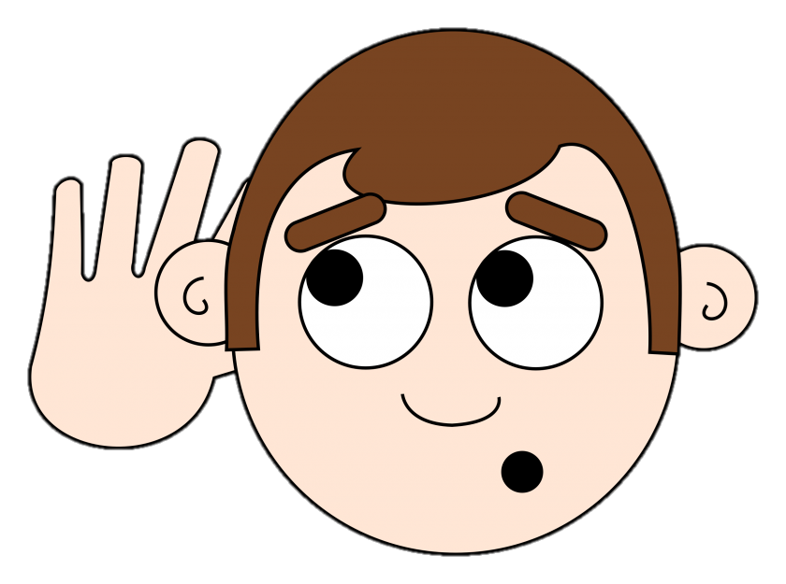

New structure
Listen, please.
Don’t talk, please.
Notes:
Nên có tranh minh họa
- Introduce new structure: Listen, please/ don’t talk ,please and asking permission May I…. Yes, you can./No, you can’t.

Slide 12



New structure
May I go out?
May I ______?
Yes, you can.
No, you can’t.
Yes, you can.
Notes:
Nên có tranh minh họa
- Introduce new structure: Listen, please/ don’t talk ,please and asking permission May I…. Yes, you can./No, you can’t.

Slide 13

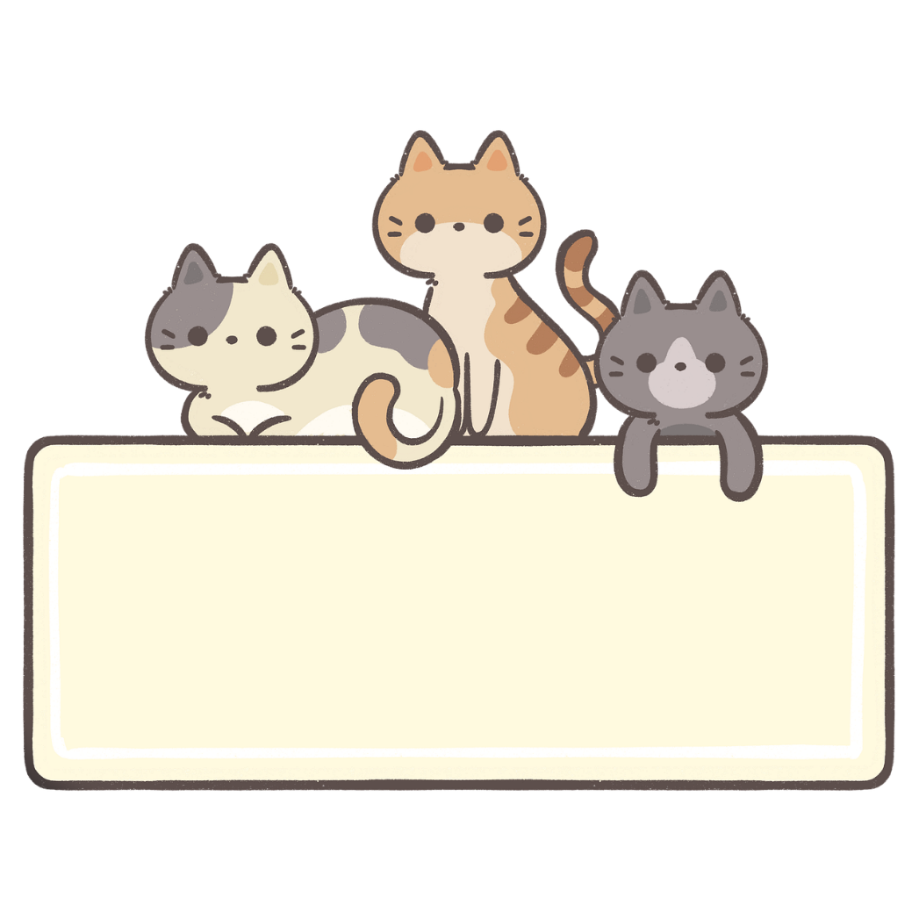


Task 4. Listen and repeat.

Slide 14


Slide 15
Whisper game

Slide 16

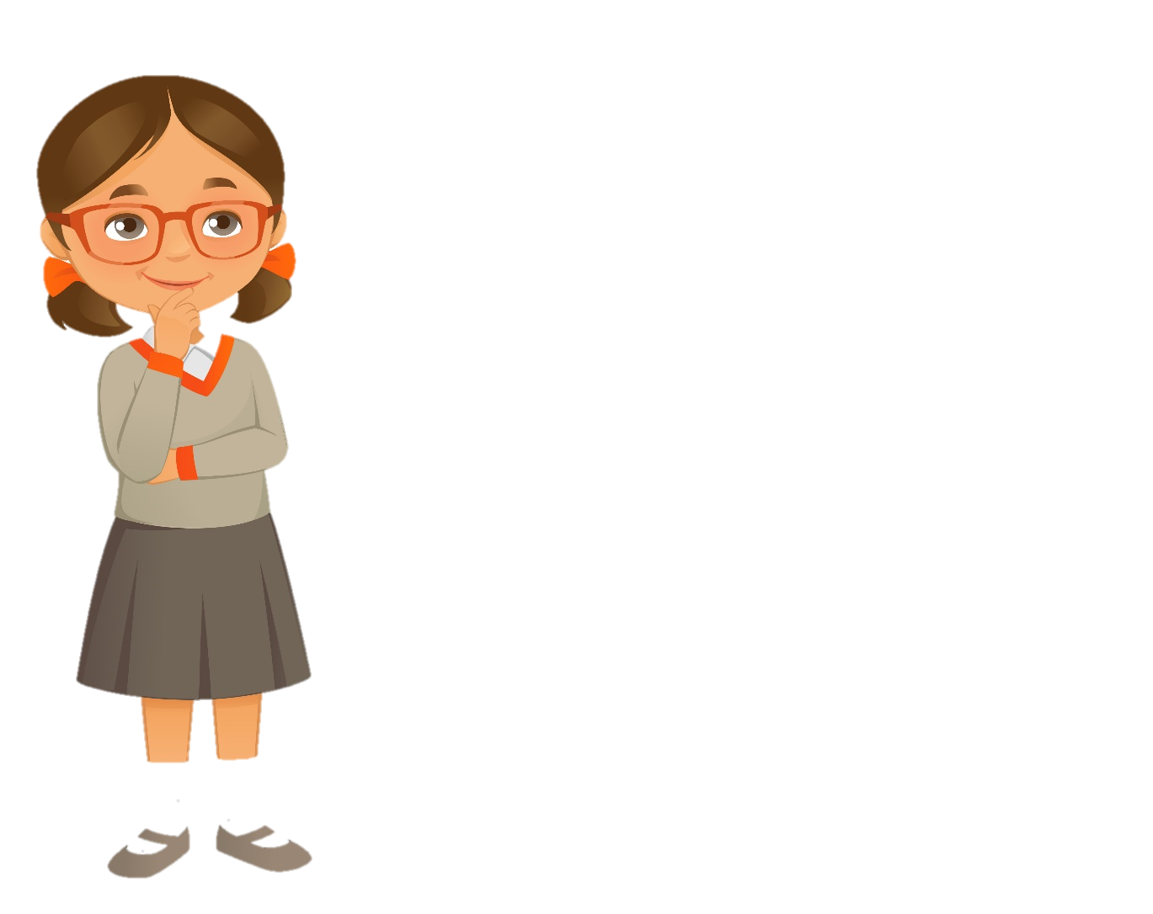
1. Listen, please.
2. Don’t talk, please.
3. May I sit?
4. May I talk?
Notes:
T invites 4 players (The first person of each team) go to the board and T whispers a message. Then each player whispers the message to the next player in his/her group successively until the last player gets the message will go to the board and slap the right command.

Slide 17
3 Practice

Slide 18
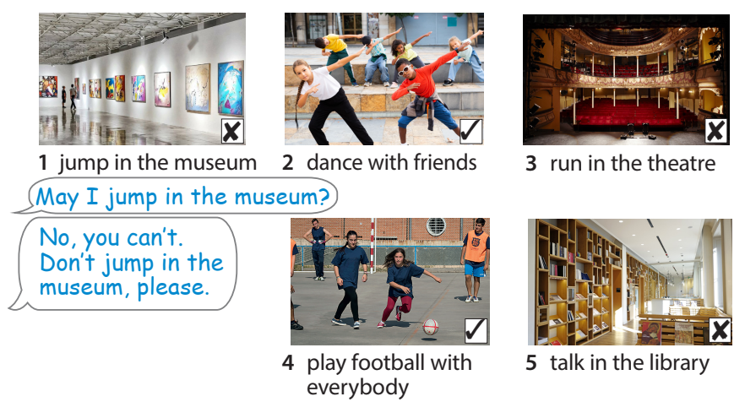

Task 5. Look and say.

Slide 19

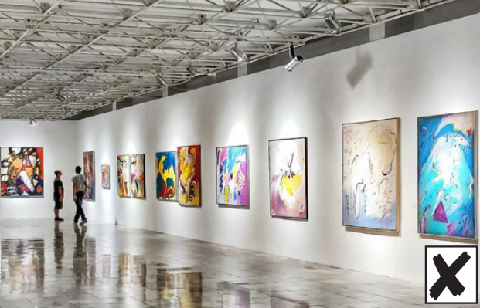

May I jump in the museum?
No, you can’t.
Don’t jump in the museum, please.

Slide 20
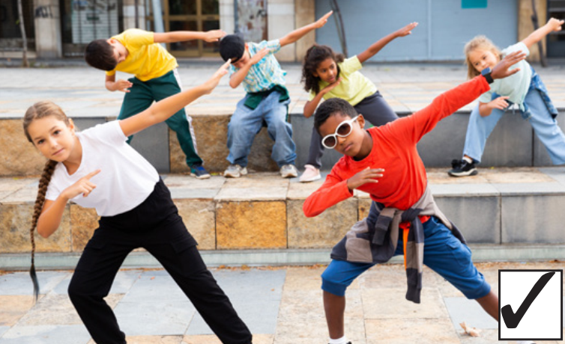

May I dance with friends?
Yes, you can.

Slide 21
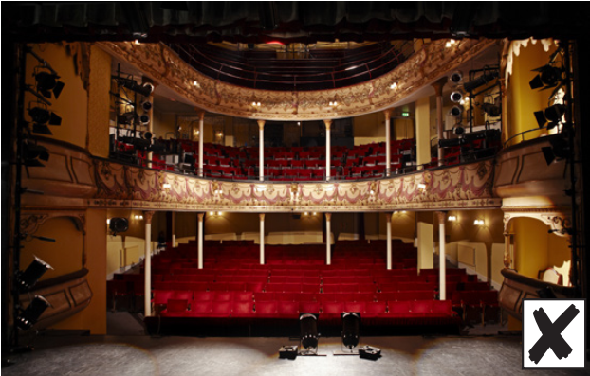

May I run in the theater?
No, you can’t.
Don’t run in the theater, please.

Slide 22
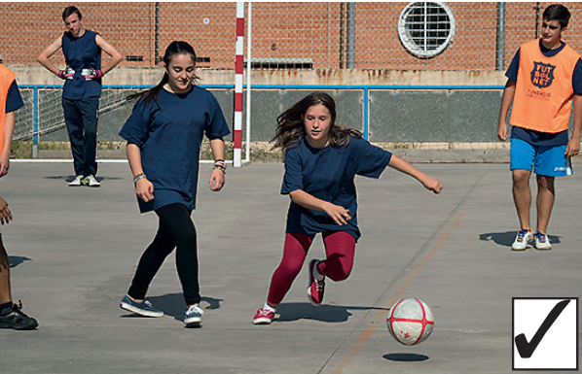
4 play football with everybody
May I play football with everybody?
Yes, you can.

Slide 23


No, you can’t.
Don’t talk in the library, please.
May I talk in the library?

Slide 24
4 Production

Slide 25
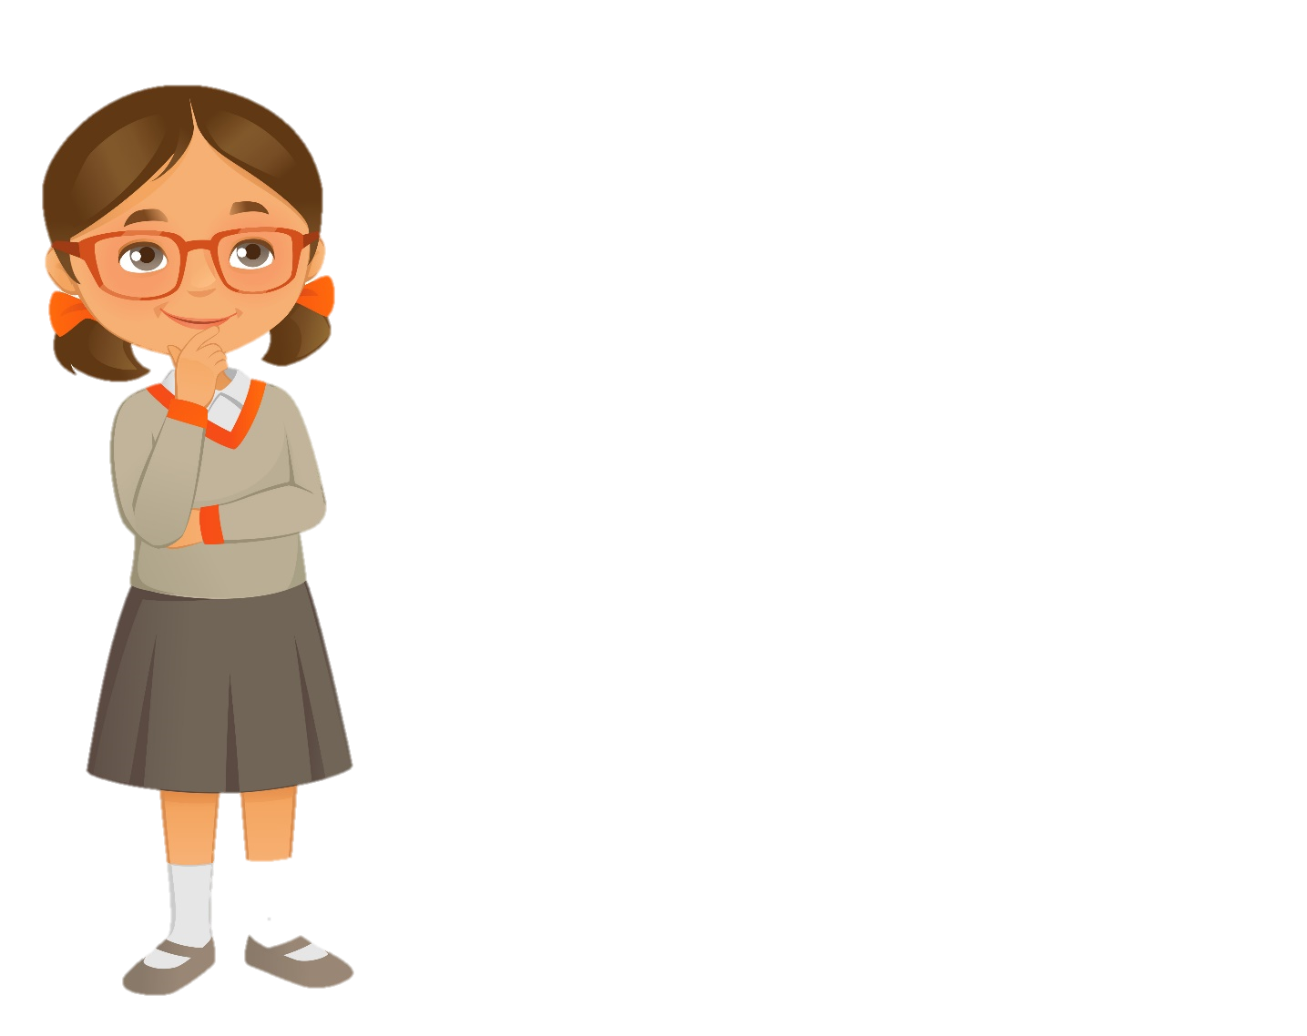
Project
Place | Do (✓) | Don’t (x)
in the library | Read book | Don’t talk
in the museum
at the zoo
at the theater …….

Slide 26
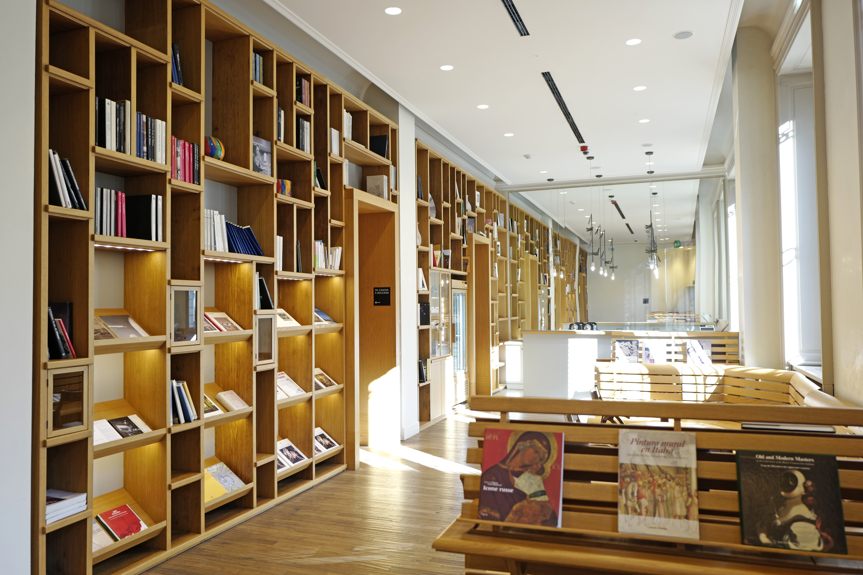


Task 6 Let’s talk.
We’re in the library.
May I talk?
No, you can’t.
Don’t talk, please.
Read books, please.

Slide 27
5 Assessment

Slide 28

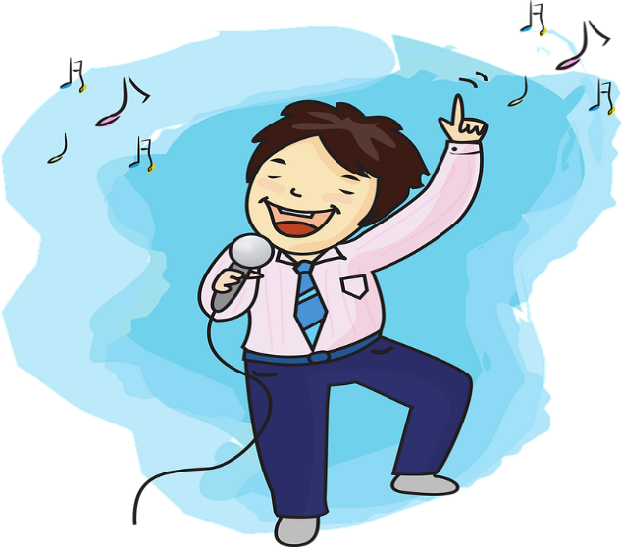
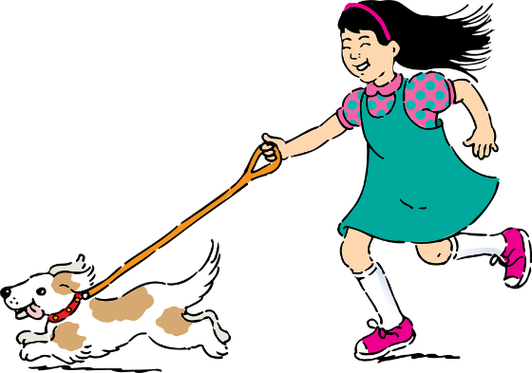
Look and choose
1
2
3
4
A. Open your book, please.
B. May I run?
Yes, you can.
C. May I sing in the library?
No, you can’t.
D. Don’t talk, please.
A
C
D
B
1 - a | 2 - C | 3 - D | 4 - C
Notes:
HOẠT ĐỘNG TƯƠNG TÁC. MATCHING

Slide 29




Thank you & goodbye!

