Slide 1






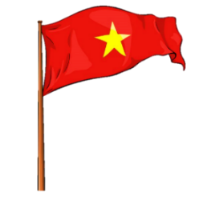


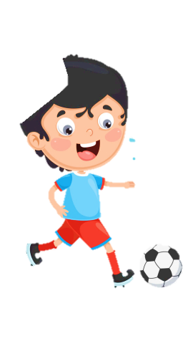
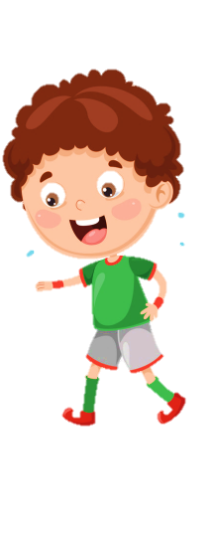

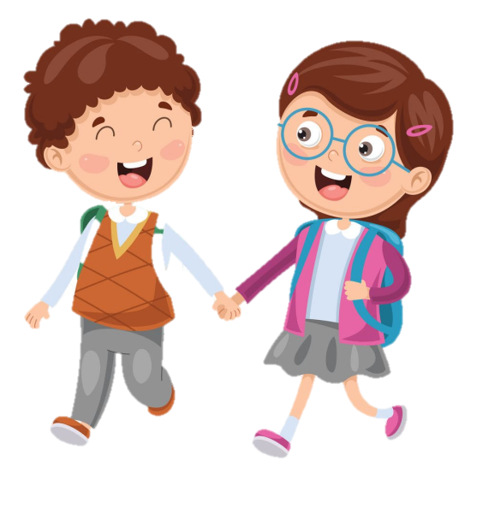
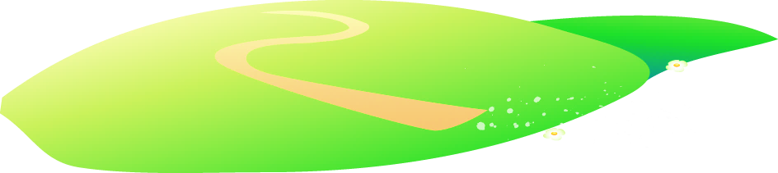

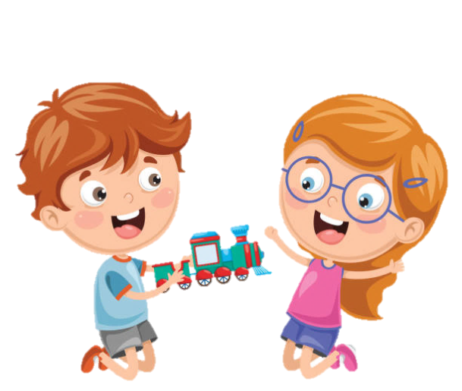






Slide 2
Unit 9:
My Favourite Food
Lesson 3 – Task 1, 2, 3

Slide 3
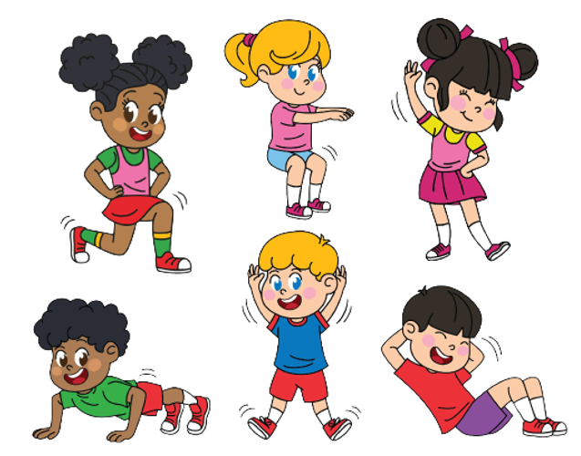
1 WARM UP
Challenge: 2 at once

Slide 4
1 WARM UP
Let’s sing.
https://www.youtube.com/watch?v=0VLxWIHRD4E

Slide 5


Slide 6
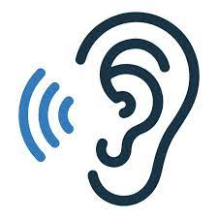

2 PRESENTATION
Task 4 Listen and repeat.

Slide 7
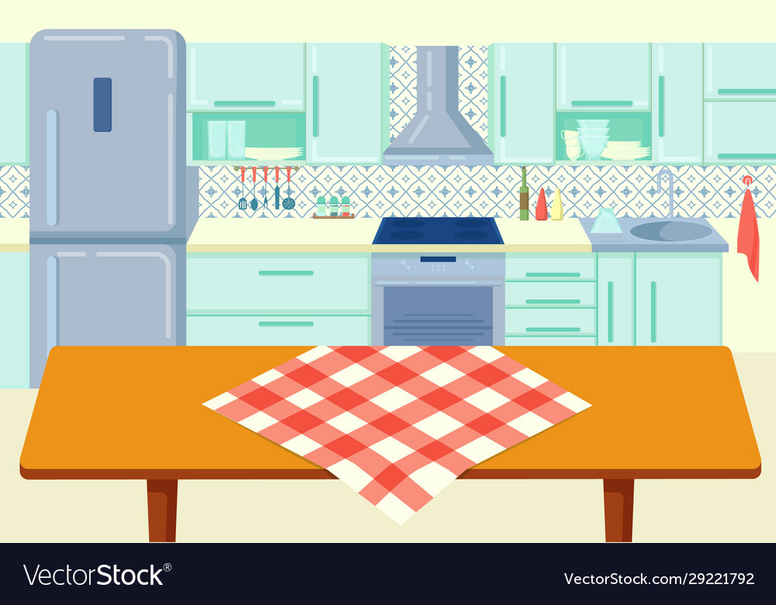
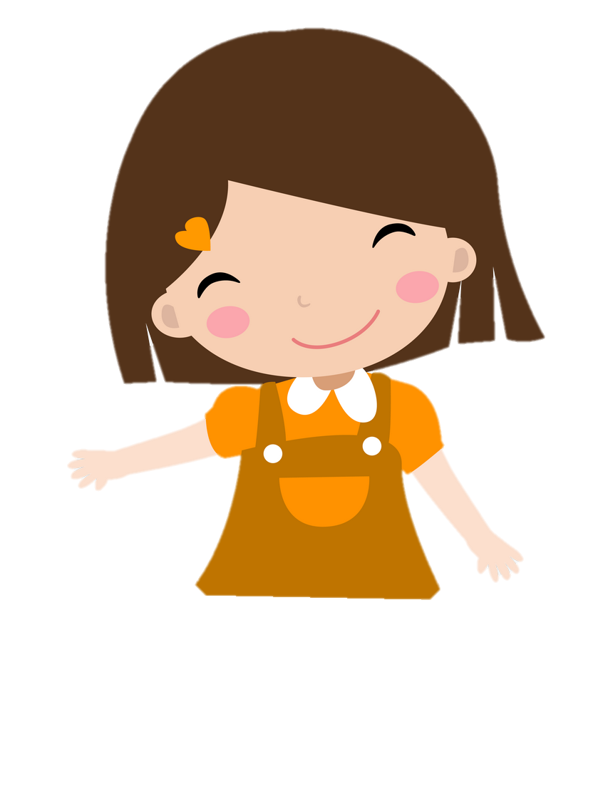
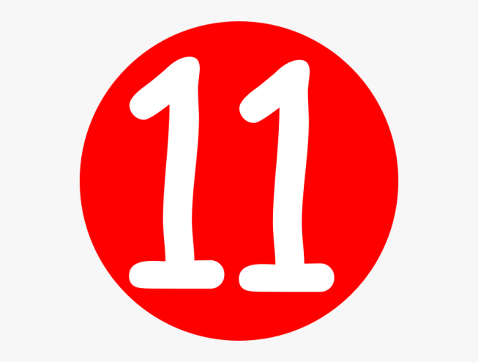
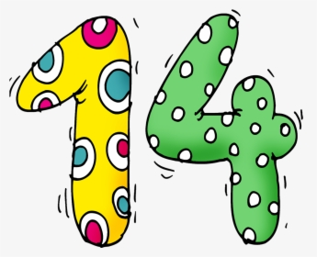
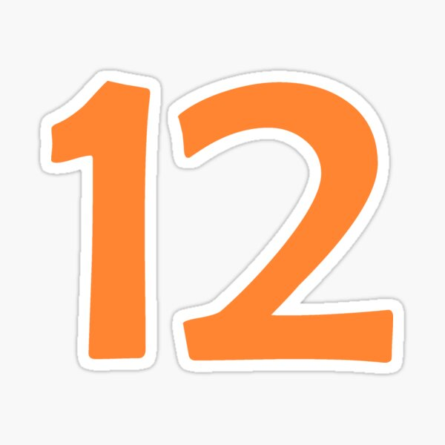
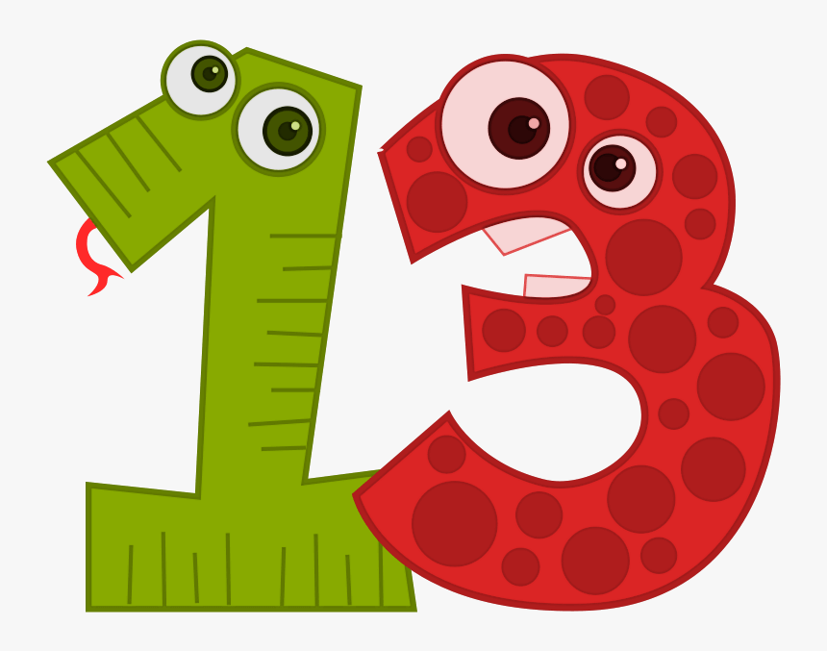
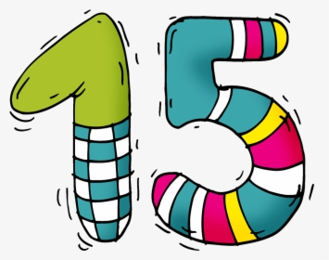
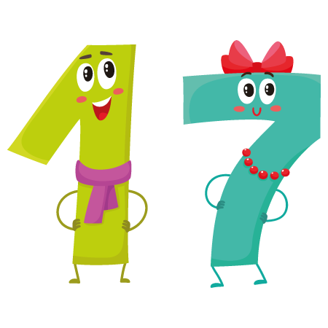
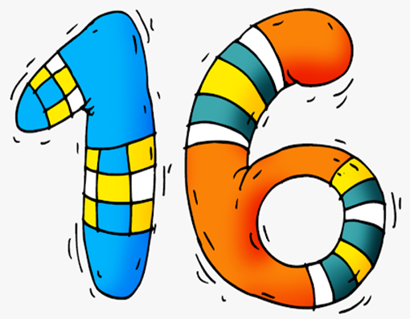
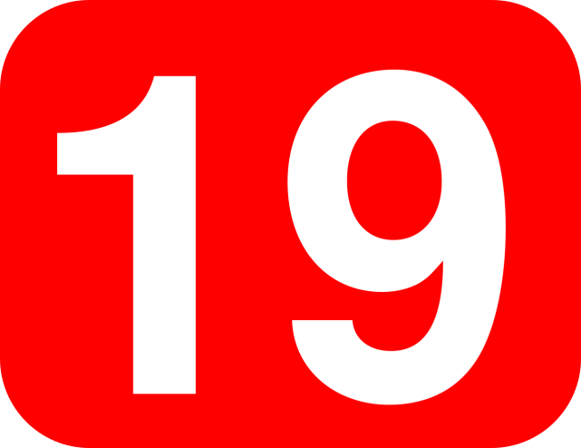
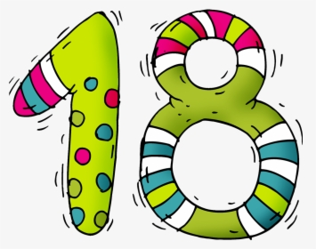
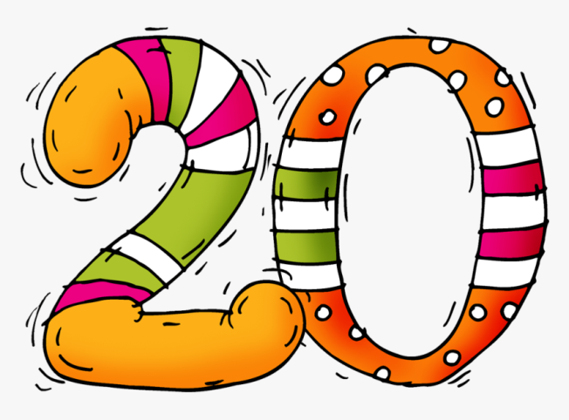
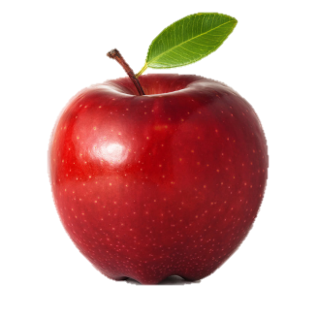

fifteen
twelve
sixteen
eleven
thirteen
seventeen
nineteen
twenty
fourteen
eighteen
QUICK CHECK

Slide 8

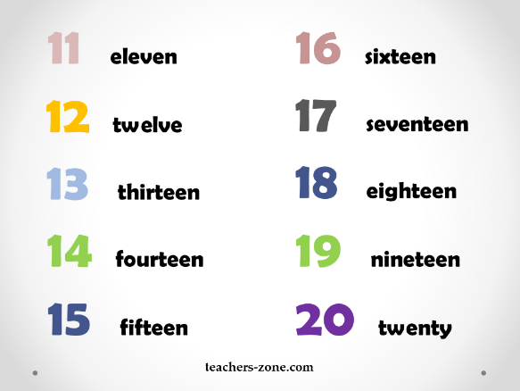
Listen and repeat.

Slide 9
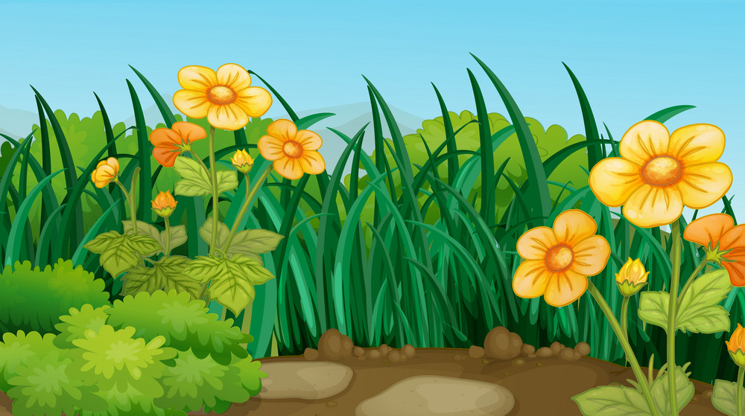



Let’s check.
11
GO
15
20
18
- How many apples are there?
- Fifteen.

Slide 10
Let’s check.
11
GO
19
12
16
- How many apples are there?
- Eleven.

Slide 11
Let’s check.
11
GO
13
12
15
- How many apples are there?
- Thirteen.

Slide 12
Let’s check.
16
GO
19
15
20
- How many apples are there?
- Sixteen.

Slide 13
Let’s check.
14
GO
18
20
11
- How many apples are there?
- Eighteen.

Slide 14

3 PRACTICE
Task 5 Look and say.

Slide 15
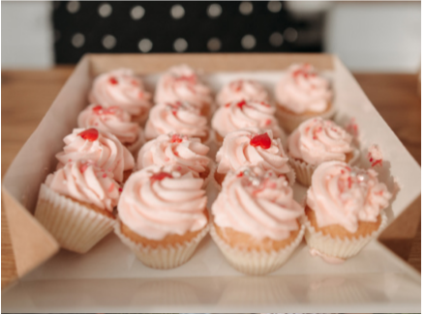
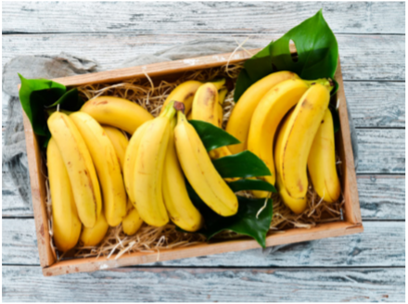
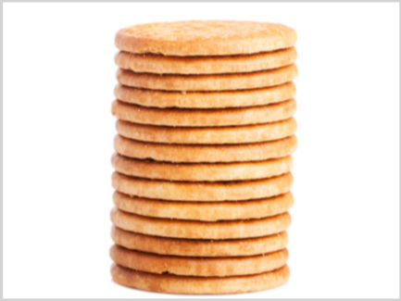
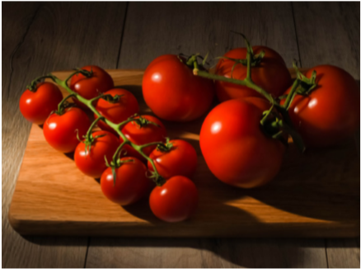
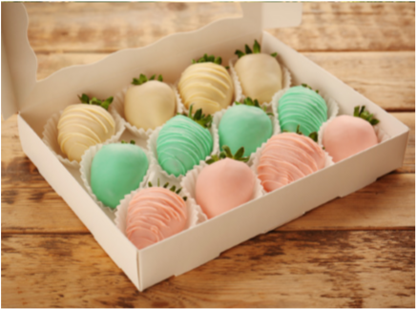
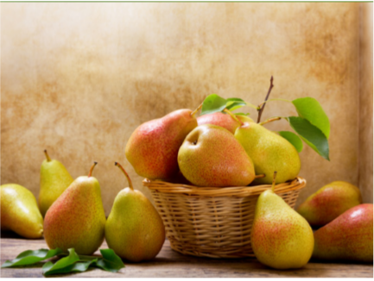
1. sweets / 15
2. bananas /16
3. biscuits /14
4. tomatoes /13
5. sweets / 12
6. pears / 11

Slide 16
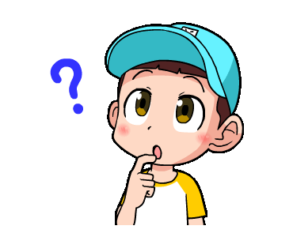
1. sweets / 15
How many sweets are there?
Fifteen.

Slide 17
2. bananas /16
How many bananas are there?
Sixteen.

Slide 18
3. biscuits /14
How many biscuits are there?
Fourteen.

Slide 19
4. tomatoes /13
How many tomatoes are there?
Thirteen.

Slide 20
5. sweets / 12
How many sweets are there?
Twelve.

Slide 21
6. pears / 11
How many pears are there?
Eleven.

Slide 22

4 PRODUCTION
Task 6 Listen and chant.

Slide 23
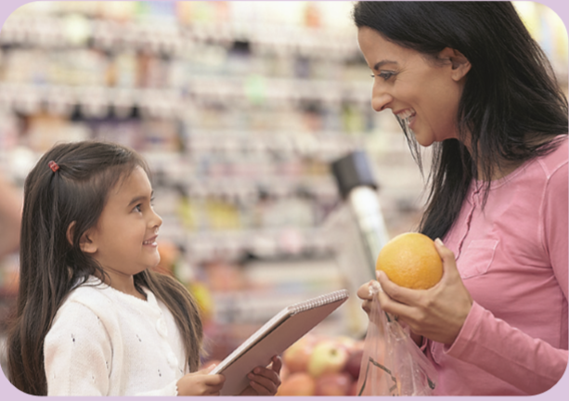
Let’s go to the market!
Let’s buy some food!
Let’s buy 12 apples and 15 pears!
How many apples?
How many pears?
Let’s buy 12 apples and 15 pears!

Slide 24

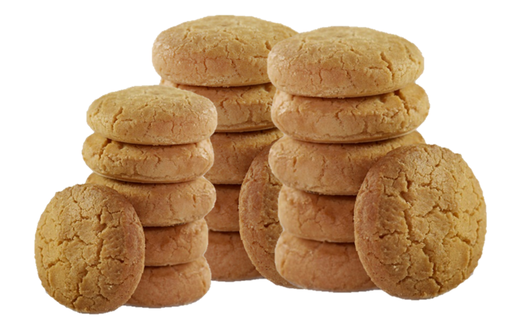
Make a new chant
Let’s go to the market!
Let’s buy some food!
Let’s buy 11 sweets and 16 biscuits!
How many sweets?
How many biscuits?
Let’s buy 11 sweets and 16 biscuits!

Slide 25
5 ASSESSMENT
Look and circle
the correct answer.

Slide 26
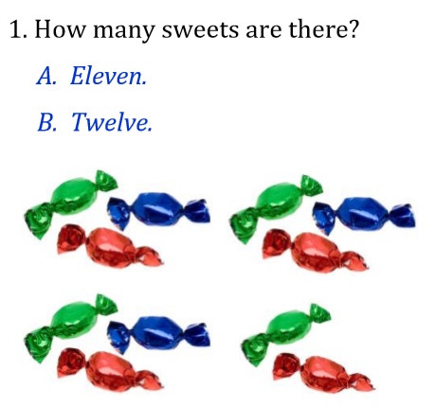
Look and circle the correct answer.

Slide 27
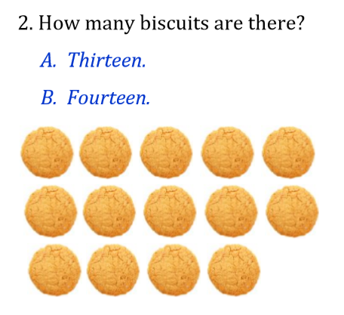
Look and circle the correct answer.

Slide 28
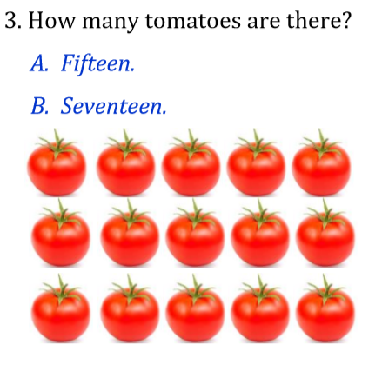
Look and circle the correct answer.

Slide 29
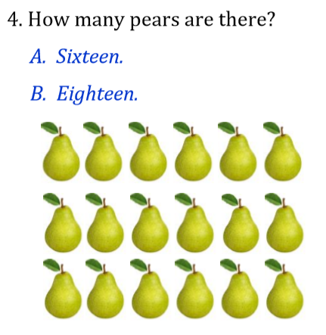
Look and circle the correct answer.

Slide 30
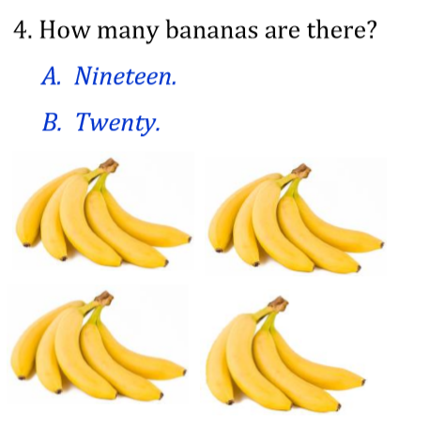
Look and circle the correct answer.
5.

Slide 31


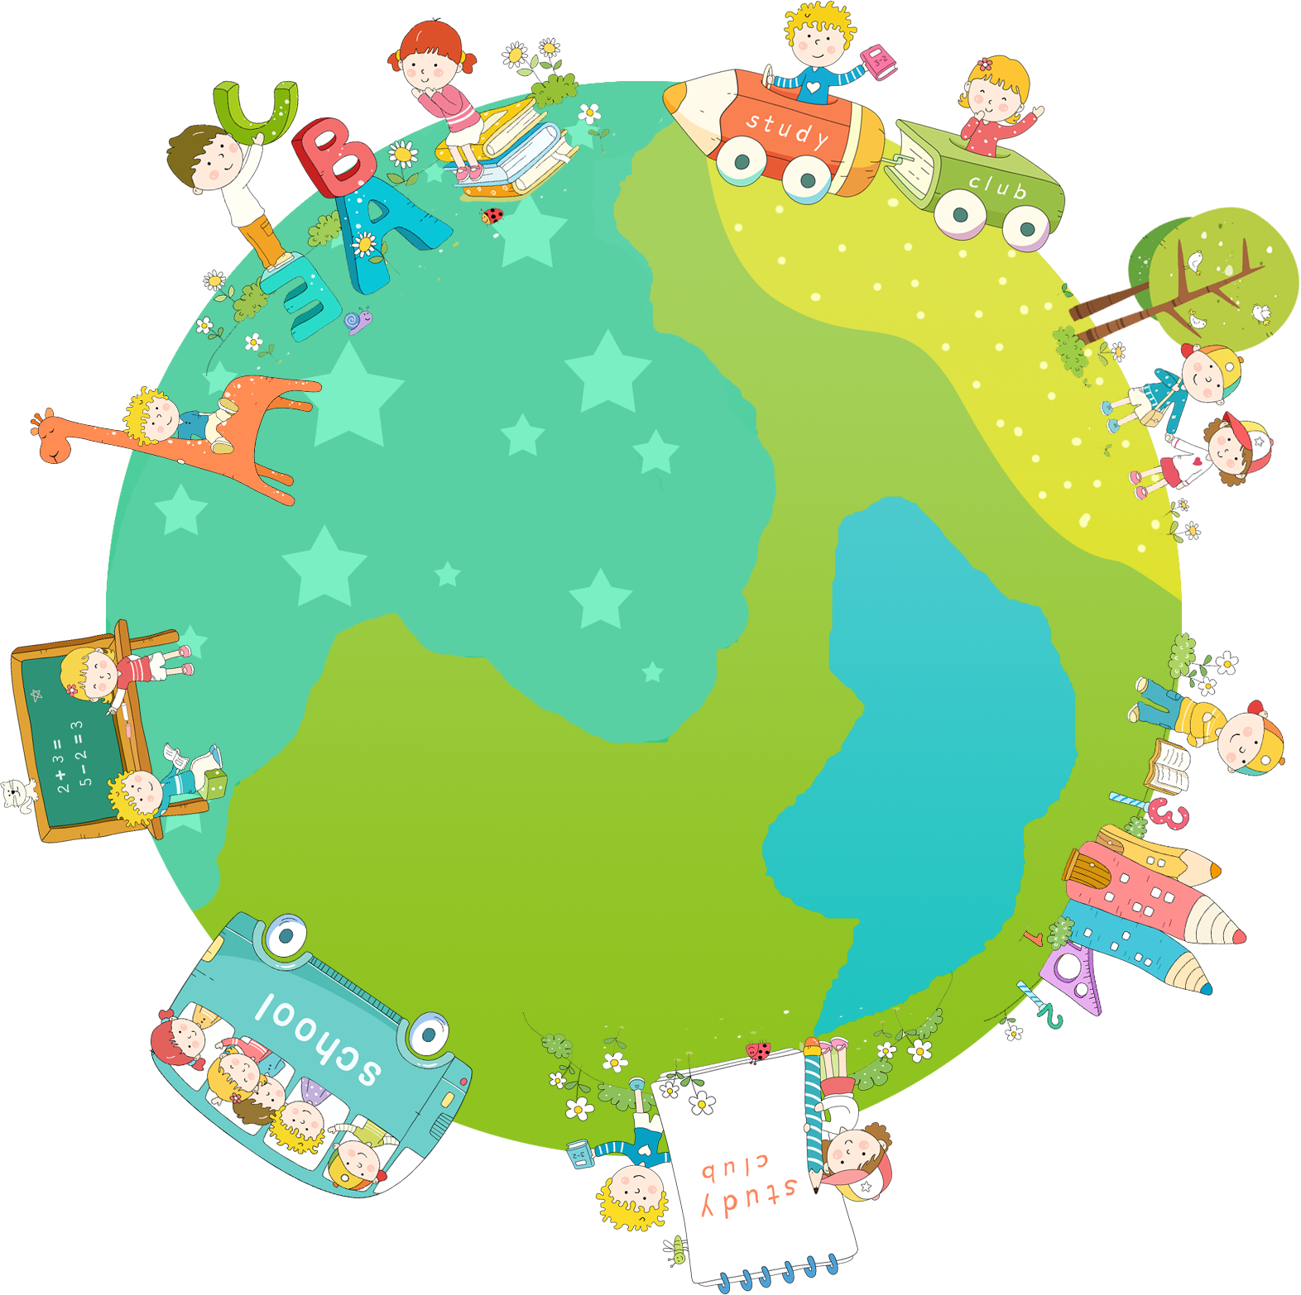

Thank you & goodbye!

