Slide 1









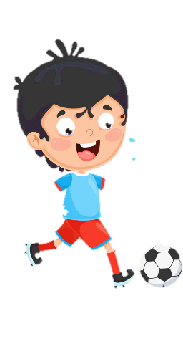













Slide 2
Unit 9:
My Favourite Food
Lesson 2 – Task 7, 8, 9

Slide 3

LUCKY PRESENT

Slide 4
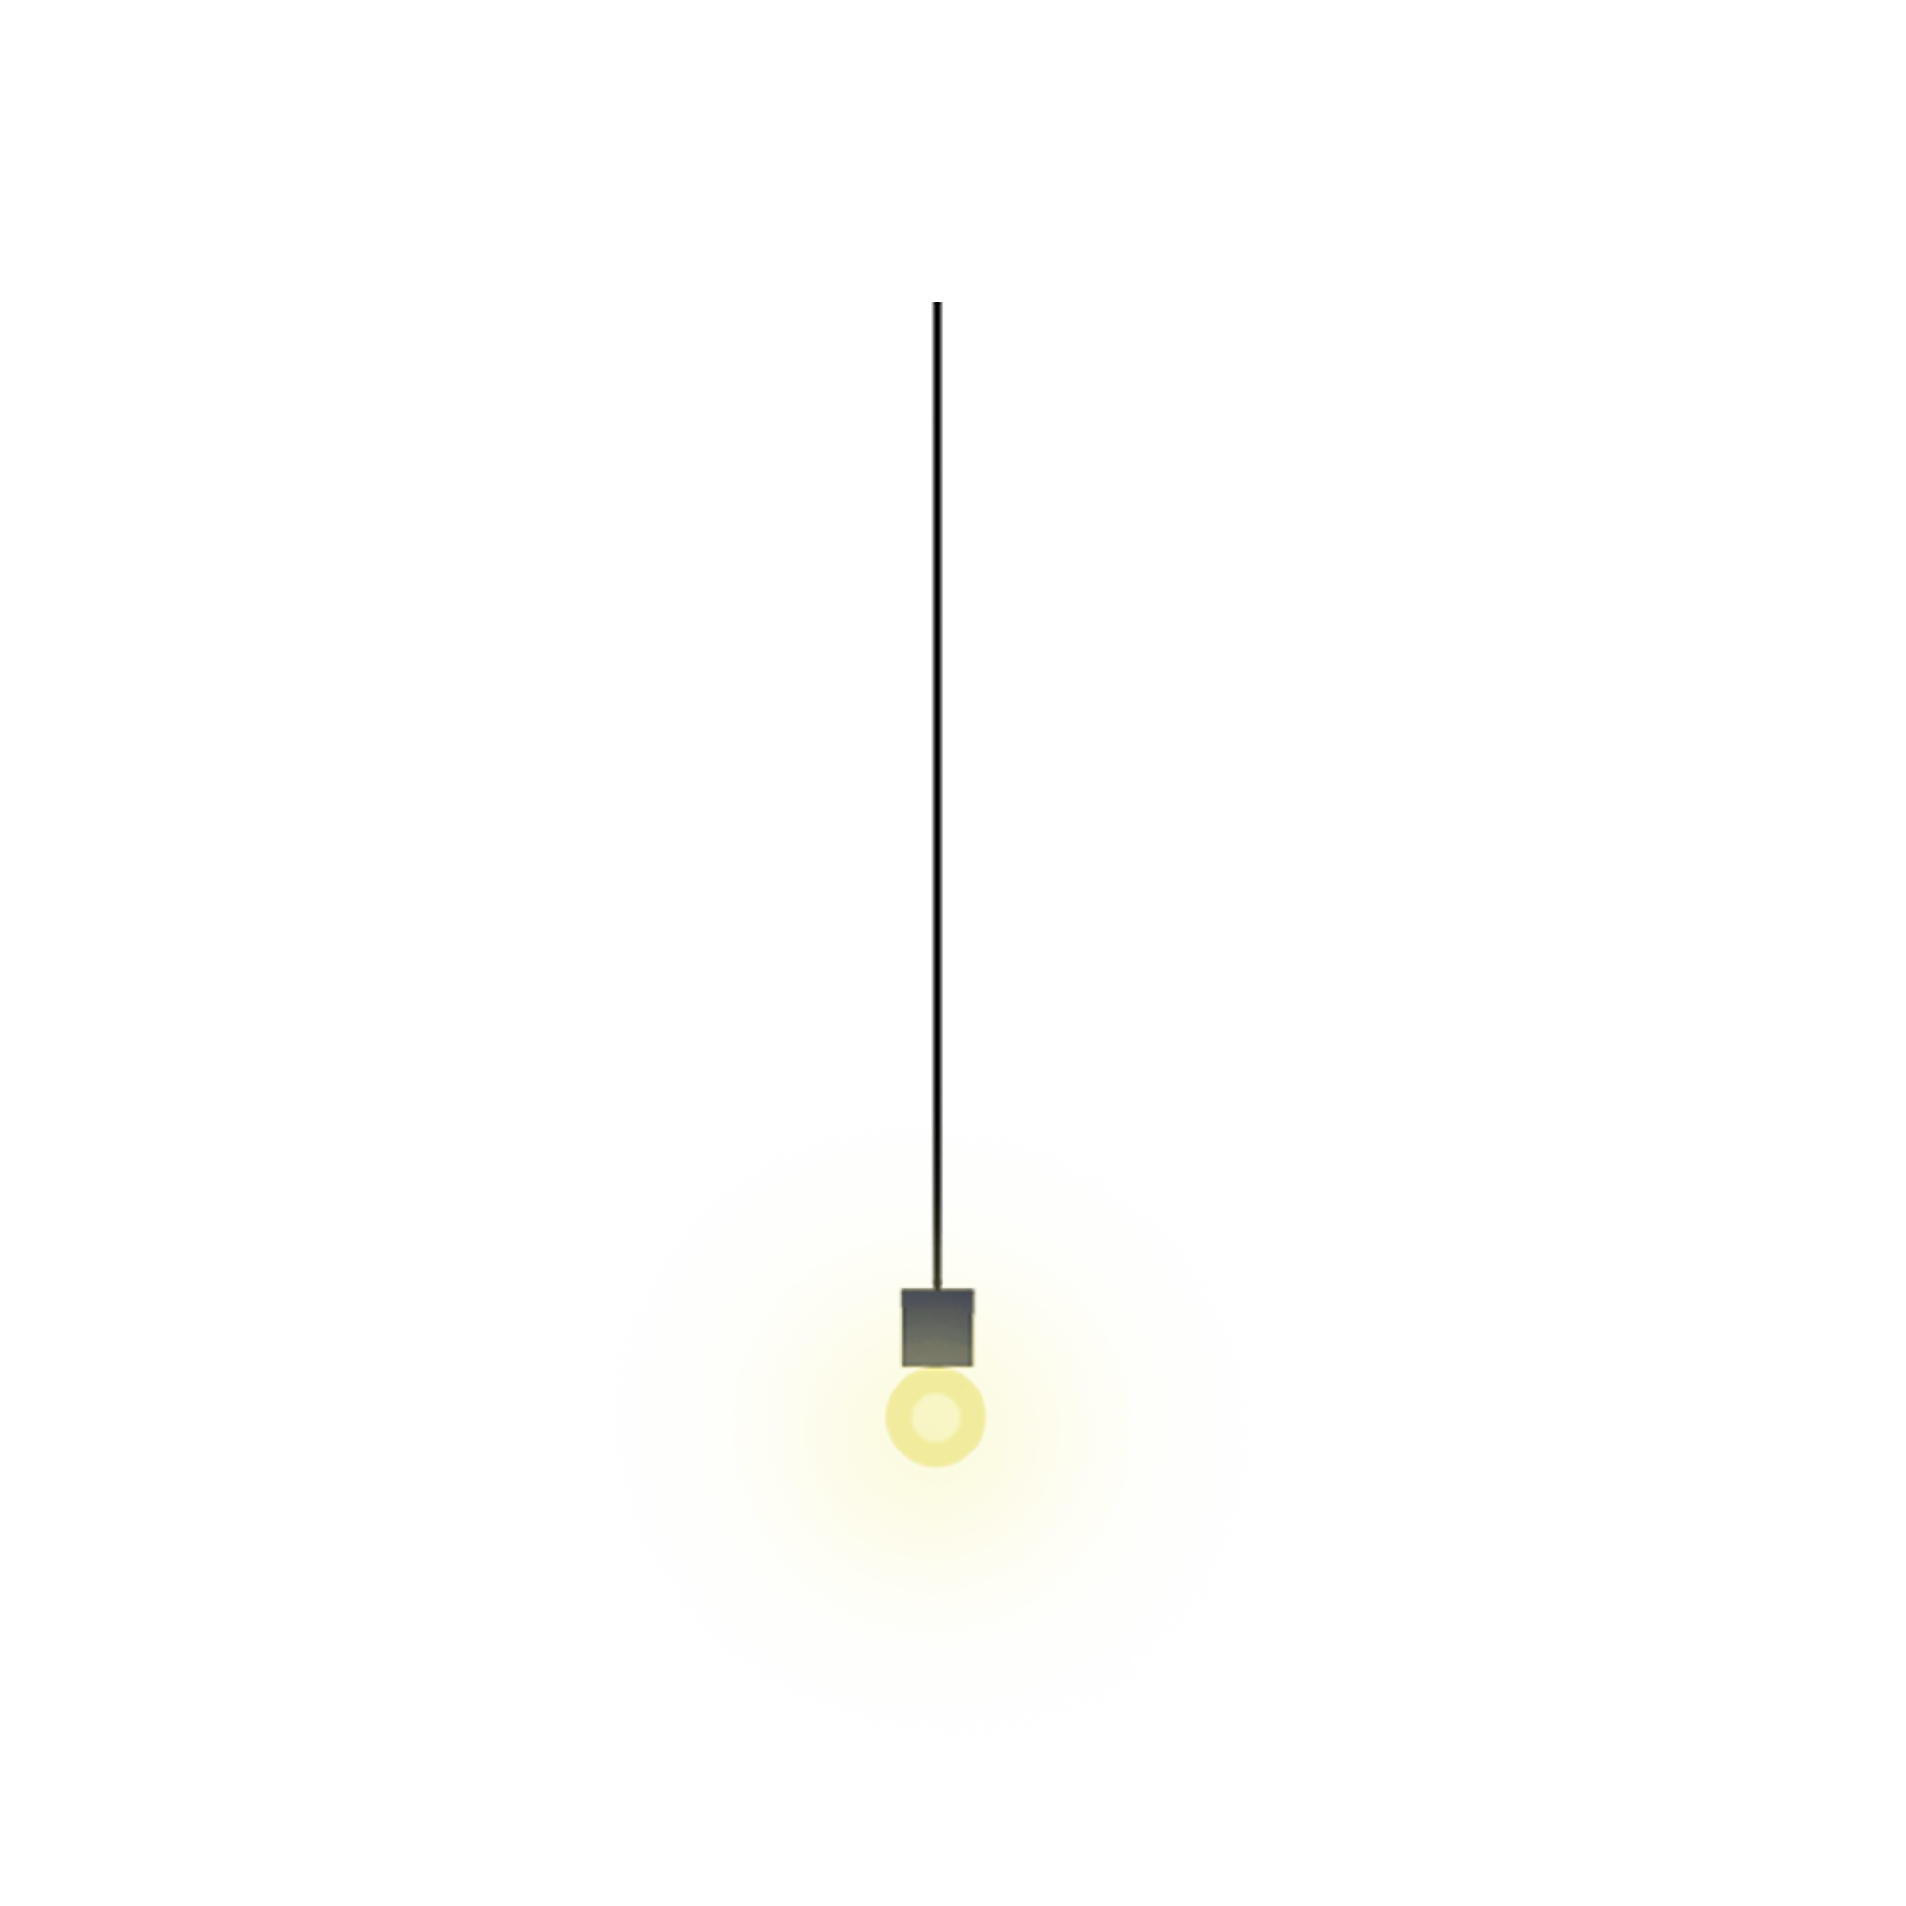

6
6
3
3
8
8
7
7
2
2
1
0
1
9
0
4
9
10
4
5
10
5

Slide 5




Slide 7
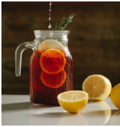
TIME ‘S UP
Where’s the juice?
It’s in the jug.

Slide 8
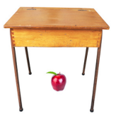
TIME’S UP
Where’s the apple?
It’s under the table.

Slide 9
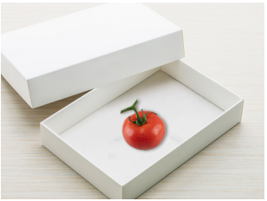
TIME’S UP
Where’s the tomato?
It’s in the box.

Slide 10
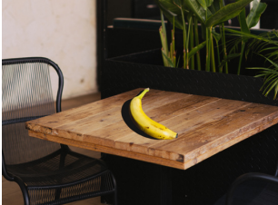
TIME’S UP
Where’s the banana?
It’s on the table.

Slide 11
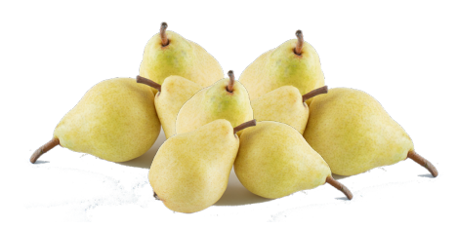
TIME’S UP
There are …. pears.
A. many B. some
There are many pears.

Slide 12
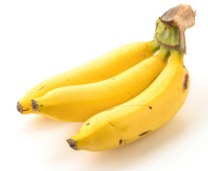
TIME’S UP
There are …..bananas.
A. a lot of B. some
There are some bananas.

Slide 13


2 PRESENTATION
Task 7 Listen and circle.

Slide 14

Listen and circle.
1 There are some / a lot of tomatoes.
2 There are many / some apples.
3 The chicken is in the jug / box.
4 The jug is under / on the table.

Slide 15

3 PRACTICE
Task 8 Look and say.

Slide 16
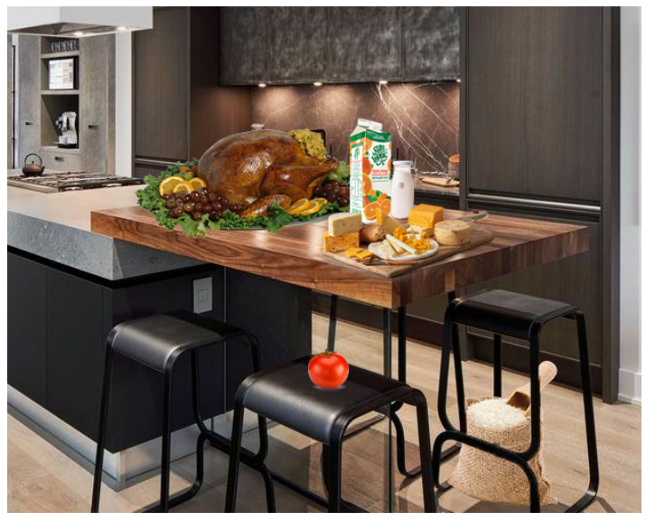
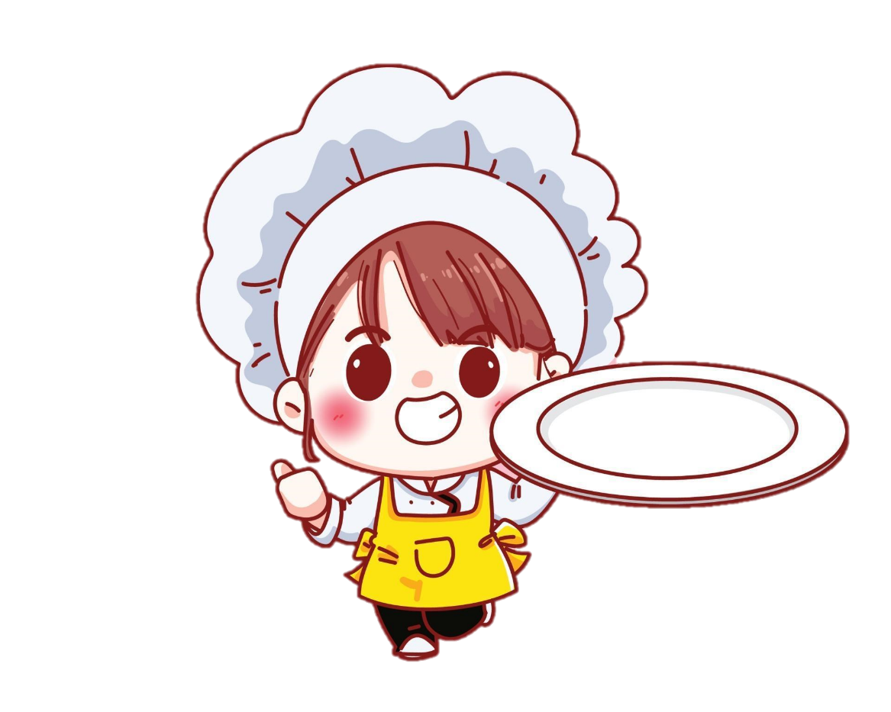
1 juice / box
2 cheese / table
3 chicken / table
4 milk / jug
5 rice / chair
6 tomato / chair

Slide 17

1 juice / box
Where’s the juice?
It’s in the box.

Slide 18
2 cheese / table
Where’s the cheese?
It’s on the table.

Slide 19
3 chicken / table
Where’s the chicken?
It’s on the table.

Slide 20
4 milk / jug
Where’s the milk?
It’s in the jug.

Slide 21
5 rice / chair
Where’s the rice?
It’s under the chair.

Slide 22
6 tomato / chair
Where’s the tomato?
It’s on the chair.

Slide 23
3 PRACTICE
Task 9 Let’s talk.

Slide 24
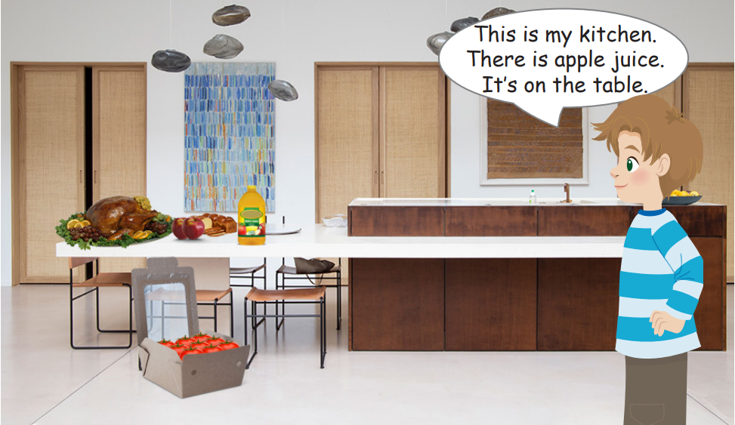
kitchen
bread
chicken
juice
apples
tomatoes

Slide 25
Where’s the bread?
Where’re the apples?
Where’s the chicken?
Where’s the juice?
Where’re the tomatoes?
They’re in the box.
They’re on the table.
It’s on the table.
It’s on the table.
It’s on the table.

Slide 27
4 PRODUCTION
.
Spot the difference.

Slide 28
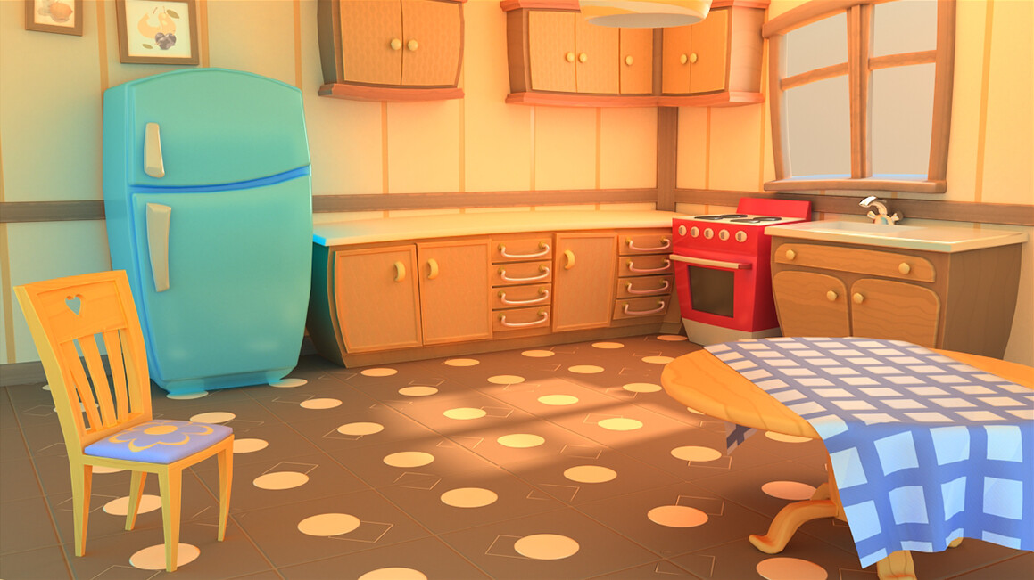
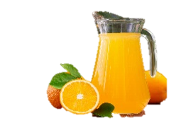
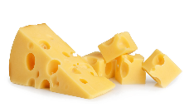
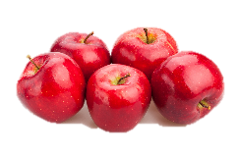
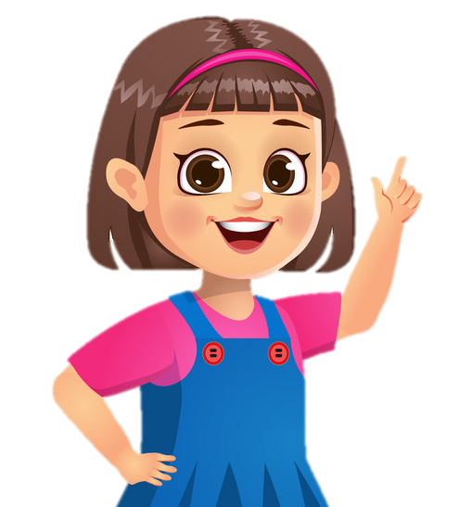
1
2
There are some apples. It’s on the table.
There are some cheeses.
It’s under the table.
There are some cheeses.
It’s on the table.
There is some rice.
It’s in the bowl.
There is some juice. It’s in the jug.
There is a tomato under the chair.
There is a tomato on the chair.

Slide 29
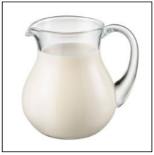
5 ASSESSMENT
Look and read. Put a tick (✓) or a cross (✗) in the box.
.
✓
1. The milk is in the jug.

Slide 30
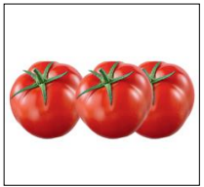
5 ASSESSMENT
Look and read. Put a tick (✓) or a cross (✗) in the box.
✗
2.There are a lot of tomatoes.

Slide 31
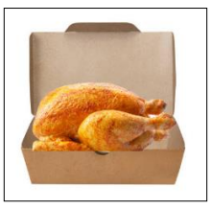
5 ASSESSMENT
Look and read. Put a tick (✓) or a cross (✗) in the box.
✗
3. The chicken is under the box.

Slide 32
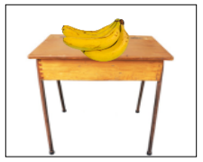
5 ASSESSMENT
Look and read. Put a tick (✓) or a cross (✗) in the box.
✓
4. There are some bananas on the table.

Slide 33
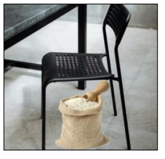
5 ASSESSMENT
Look and read. Put a tick (✓) or a cross (✗) in the box.
✗
5. The rice is on the chair.

Slide 34


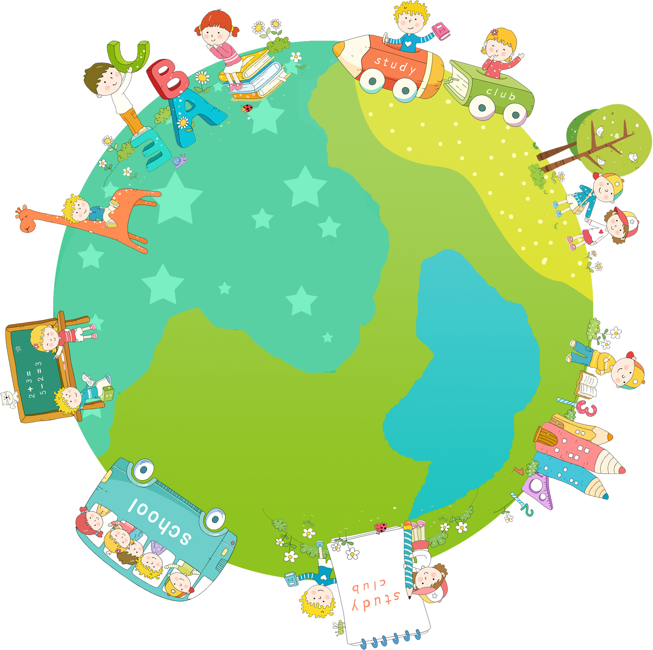

Thank you & goodbye!

