Slide 1









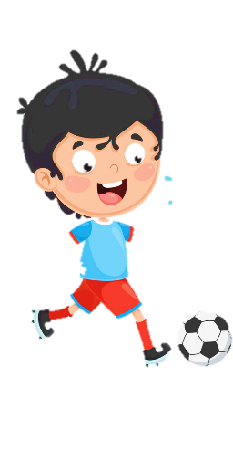













Slide 2
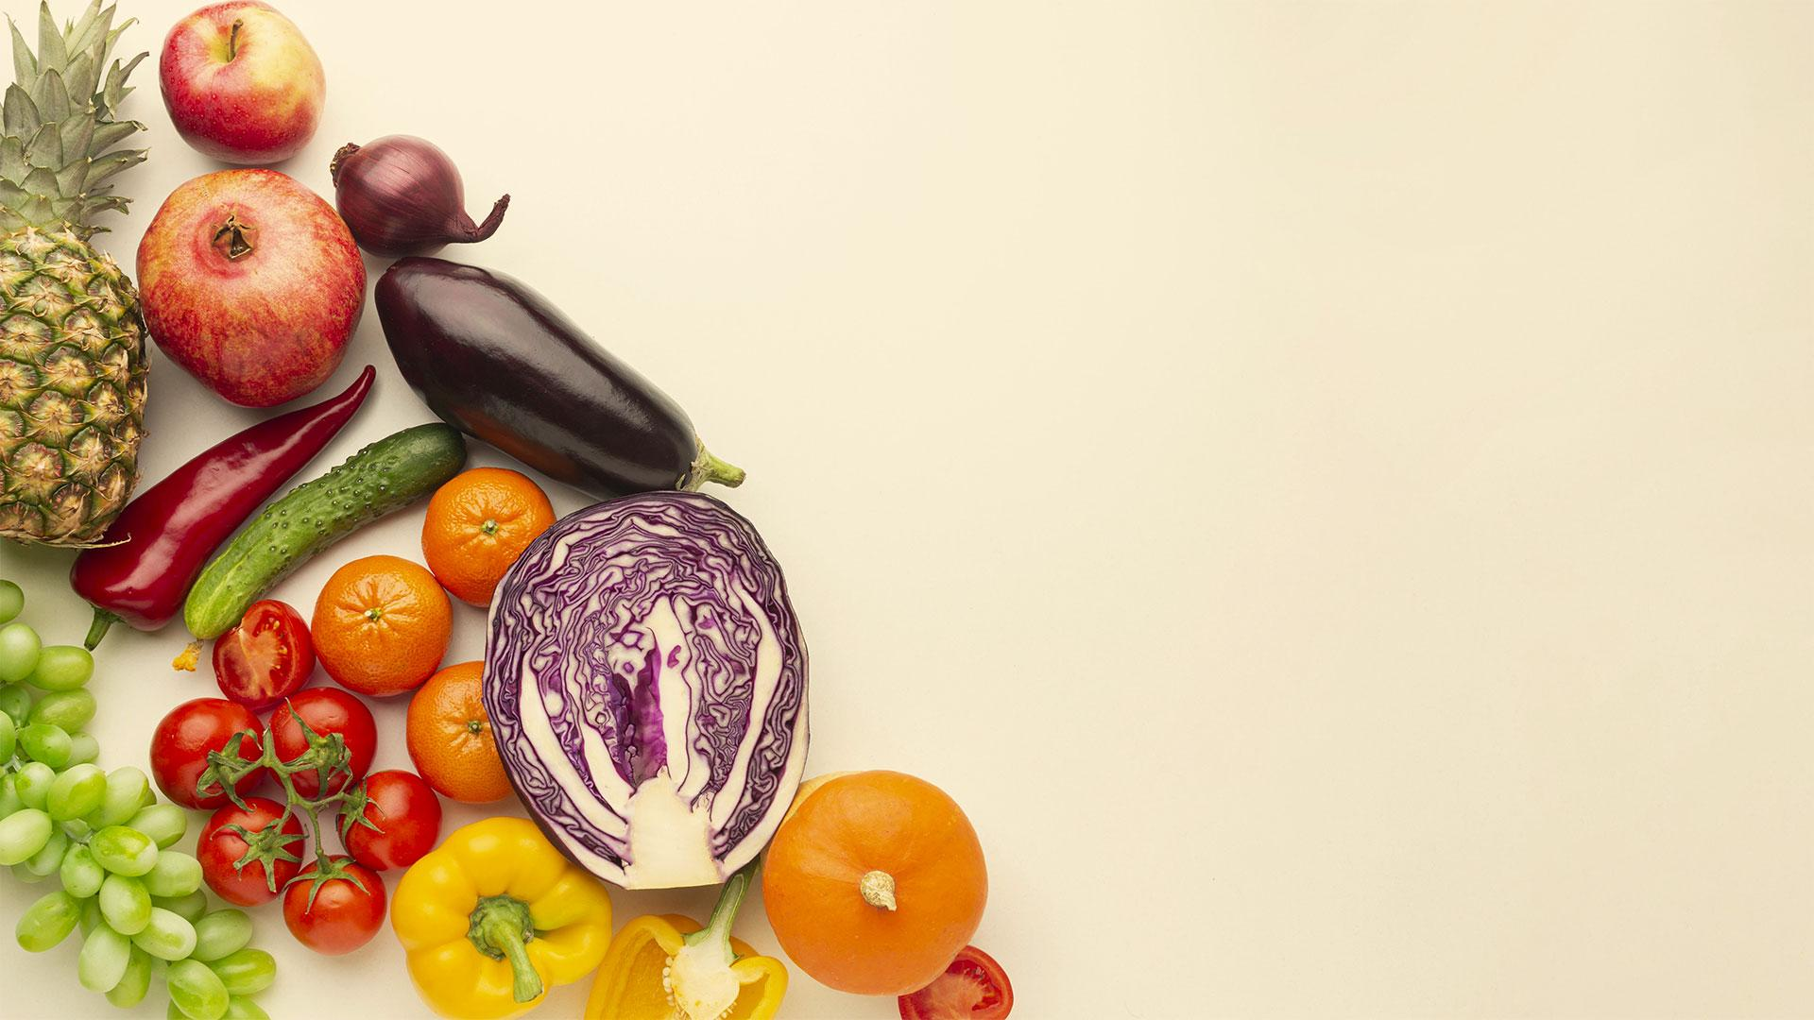
Unit 9:
My Favourite Food
Lesson 2 – Task 4, 5, 6

Slide 3
1 WARM UP
FINDING FOOD GAME.

Slide 4

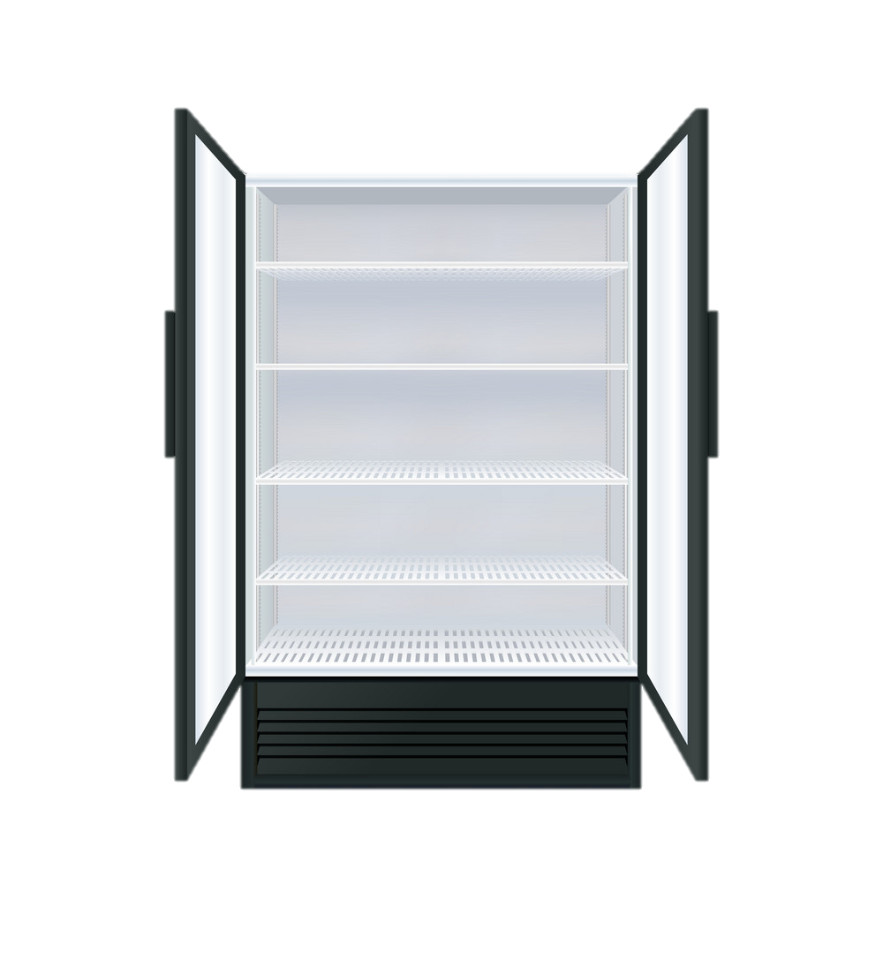
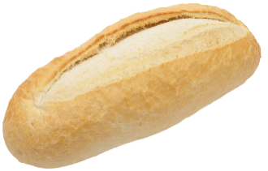

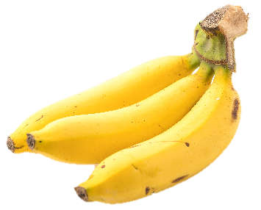
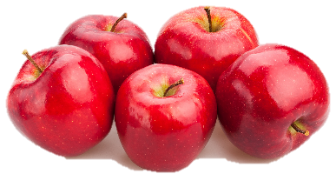

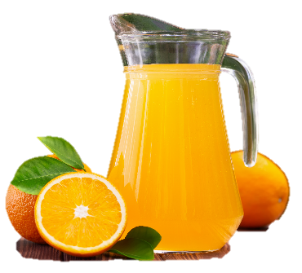
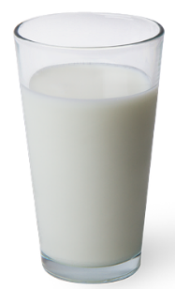
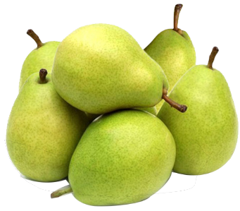
Great!
We can eat cheese with bread.
Notes:
Bấm vào đồ ăn để chọn đáp án

Slide 5
Great!
There are a lot of pears.
Notes:
Bấm vào đồ ăn để chọn đáp án

Slide 6
Great!
There is a tomato.
Notes:
Bấm vào đồ ăn để chọn đáp án

Slide 7
Great!
We can eat chicken with rice.
Notes:
Bấm vào đồ ăn để chọn đáp án

Slide 8
Great!
There are many apples.
Notes:
Bấm vào đồ ăn để chọn đáp án

Slide 9

Great!
There are some bananas.
Notes:
Bấm vào đồ ăn để chọn đáp án

Slide 10
Great!
There is great juice in the jug.
Notes:
Bấm vào đồ ăn để chọn đáp án

Slide 11


2 PRESENTATION
Task 4 Listen and repeat.

Slide 12

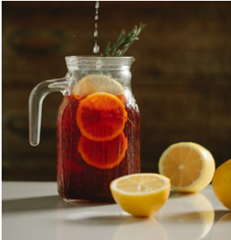
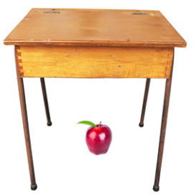
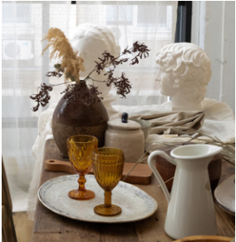
Listen and repeat.
1 Where’s the juice?
It’s in the jug.
2 Where’s the apple?
It’s under the table.
3 Where’s the jug?
It’s on the table.
Notes:
Bấm vào loa để nghe cả bài
Bấm vào câu để nghe lại từng câu

Slide 13

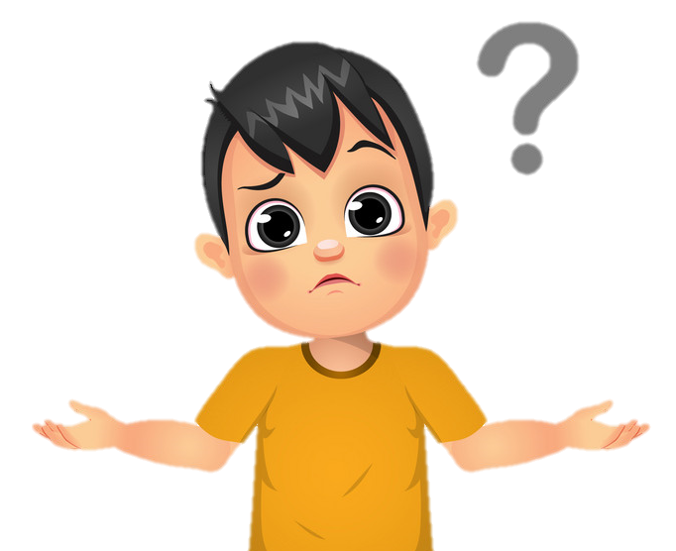

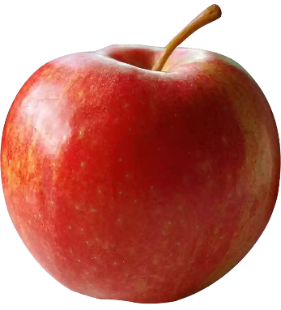


Where’s the apple?
It’s ___the box.
on
on
in
under

Slide 14
Where’s the apple?
It’s _____the box.
under
on
in
under

Slide 15


Where’s the apple?
It’s ___the box.
in
on
in
under

Slide 16

3 PRACTICE
Task 5 Look and say.

Slide 17
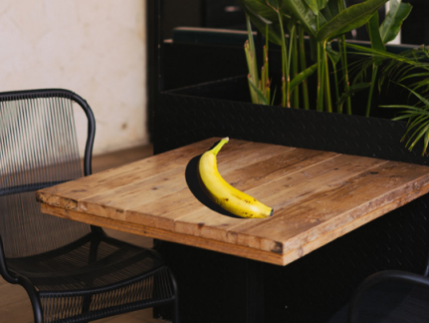
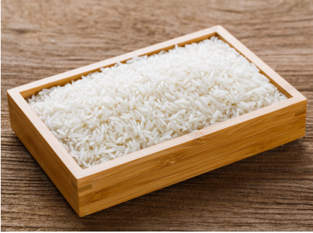
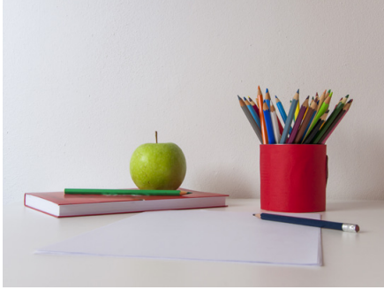
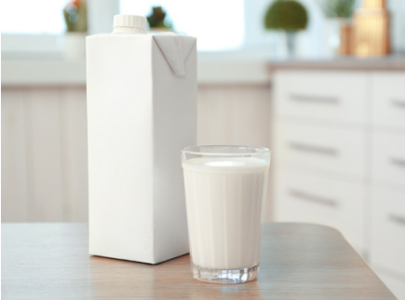
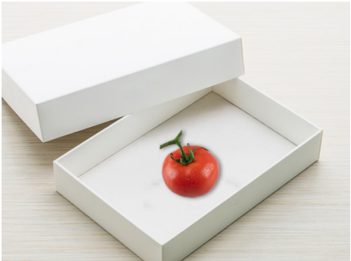
1 banana / table
2 rice / box
3 book / apple
4 milk / table
5 tomato / box

Slide 18
Where’s the banana?
Where’s the rice?
Where’s the book?
It’s on the table.
It’s in the box.
It’s under the apple.
Where’s the milk?
Where’s the tomato?
It’s on the table.
It’s in the box.

Slide 19
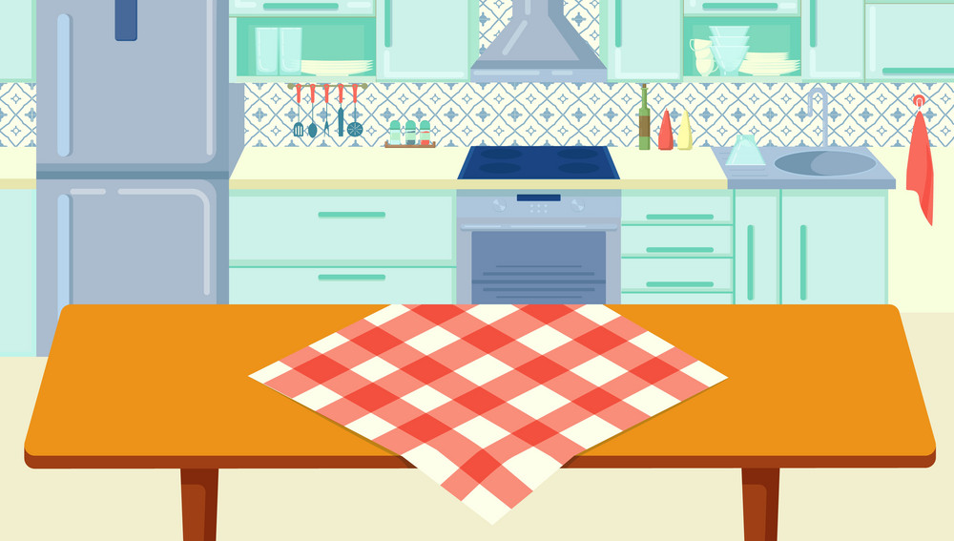
Where’s the apple?
It’s in the box.
GO
Notes:
Bấm GO để hình hiện ra nhiều lần

Slide 20

Where’s the banana?
It’s under the table.
GO
Notes:
Bấm GO để hình hiện ra nhiều lần

Slide 21
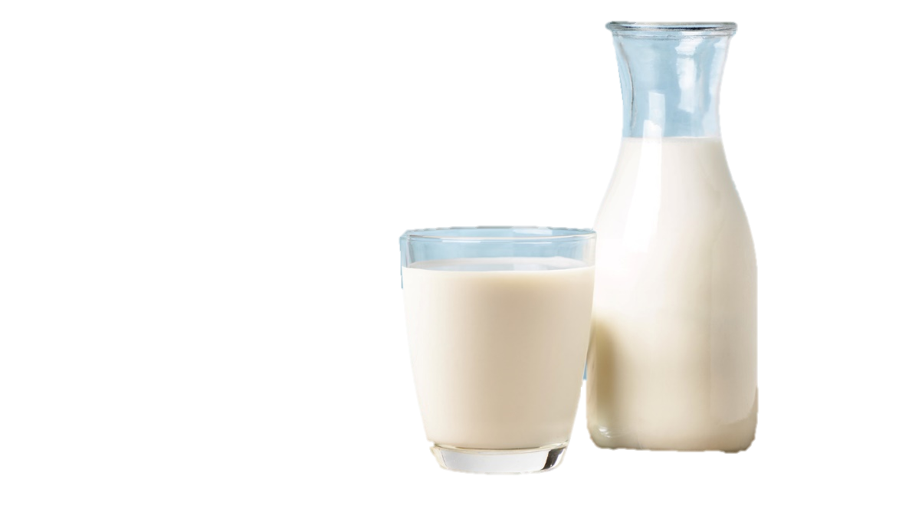
Where’s the milk?
It’s on the table.
GO
Notes:
Bấm GO để hình hiện ra nhiều lần

Slide 22
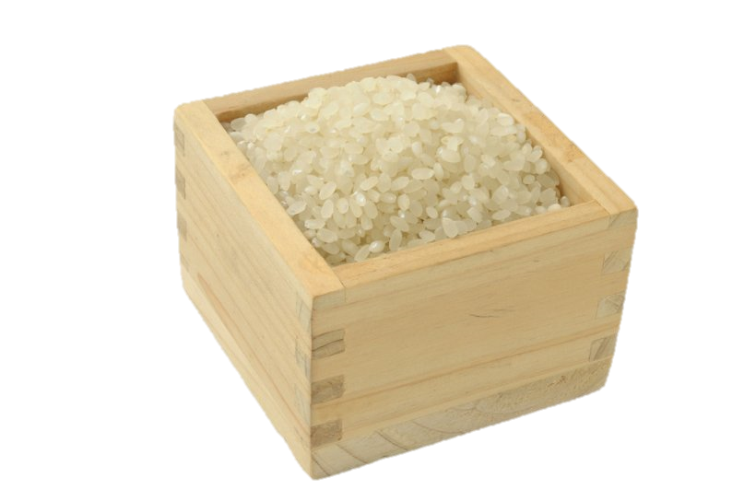
Where’s the rice?
It’s in the box.
GO
Notes:
Bấm GO để hình hiện ra nhiều lần

Slide 23
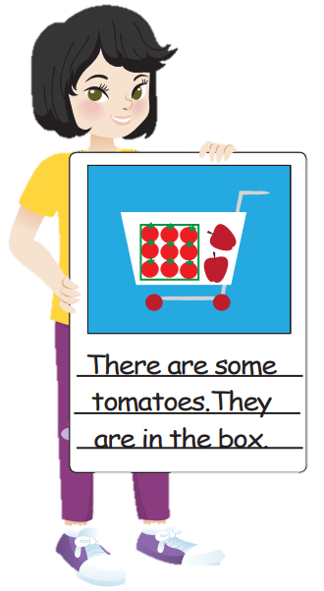

4 PRODUCTION
Task 6 Draw and write. Say.
I am buying food. Look! There are some tomatoes. They are in the box.

Slide 24
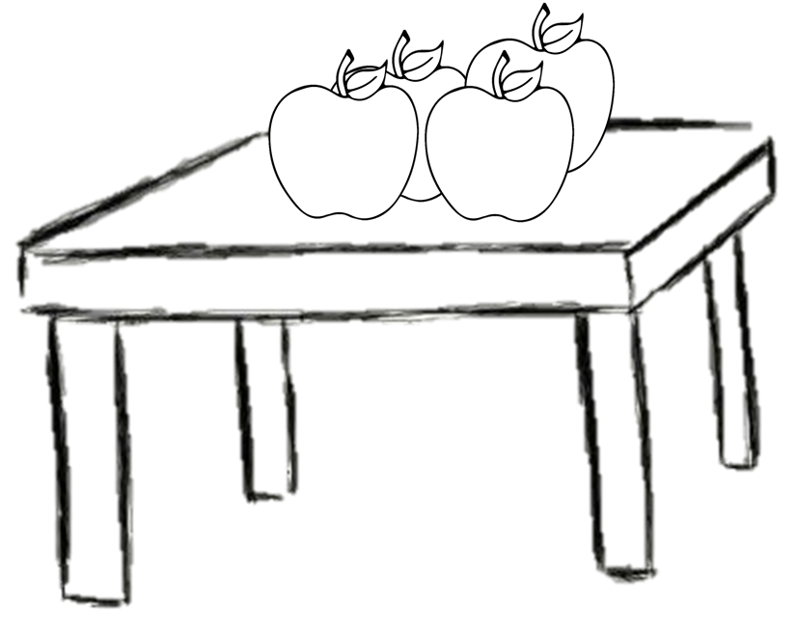

Let’s draw!

Slide 25
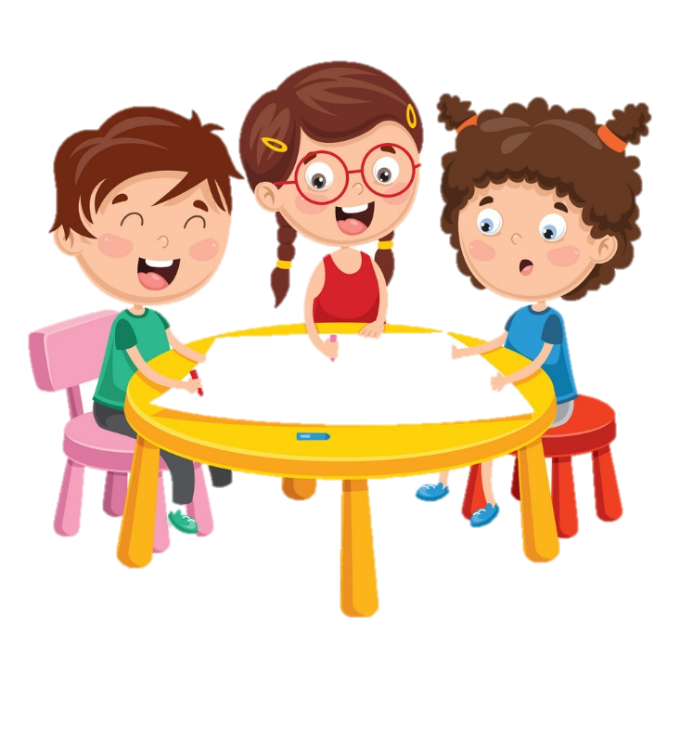
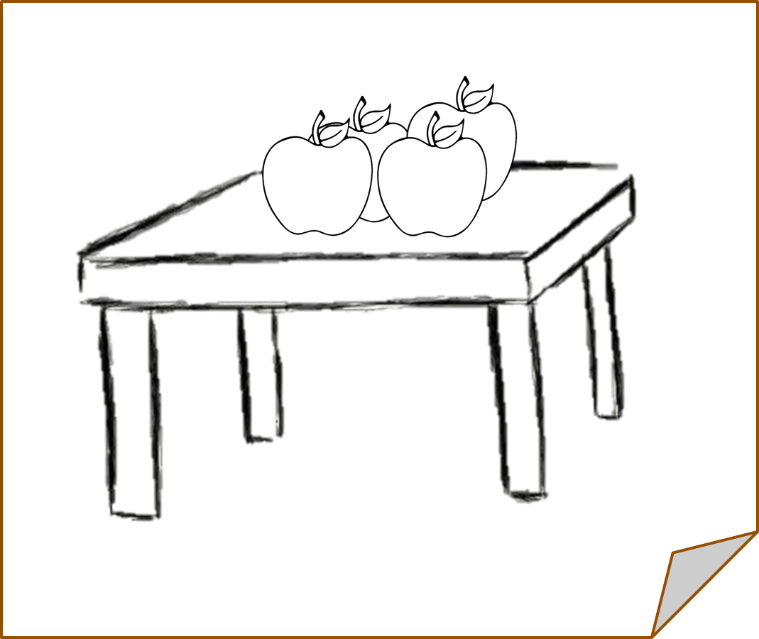
I am buying food. Look! There are some apples. They are on the table.

Slide 26
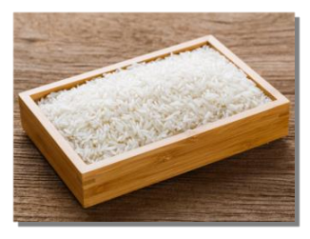
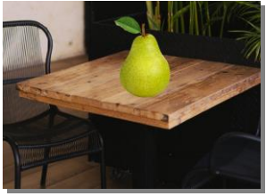
5 ASSESSMENT
Look at the pictures and write under / in/ on in each blank.
1. Where’s the rice?
- It’s ____ the box.
2. Where’s the pear?
- It’s ____ the table.
in
on

Slide 27

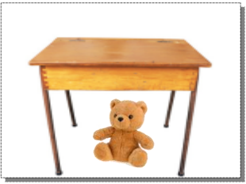
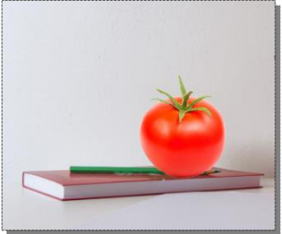
5 ASSESSMENT
Look at the pictures and write under / in/ on in each blank.
3. Where’s the juice?
- It’s _____ the jug.
5. Where’s the tomato?
- It’s ______ the book.
in
on
4. Where’s the teddy bear?
- It’s ______ the table.
under

Slide 28




Thank you & goodbye!

