Slide 1
Unit 14: What does he look like?
Lesson 2
Teacher: Ngoc Khue

Slide 2
Objectives
- Use the words and phrases related to the Physical Appearance.
- Ask and answer the questions about comparing physical appearance’s someone to another, using “Who is adj+er? – It’s.......”..
Mục đích bài học:
Sử dụng các từ và cụm từ liên quan đến chủ đề Ngoại hình.
Hỏi và trả lời về việc so sánh ngoại hình của ai đó với nhau bằng mẫu câu “Who is adj+er? – It’s.......”.

Slide 3
Here is what you are going to learn in this lesson:
01.New words
02. Model sentence
03. Practice
04. Homelink

Slide 4
Warm up!

Slide 5
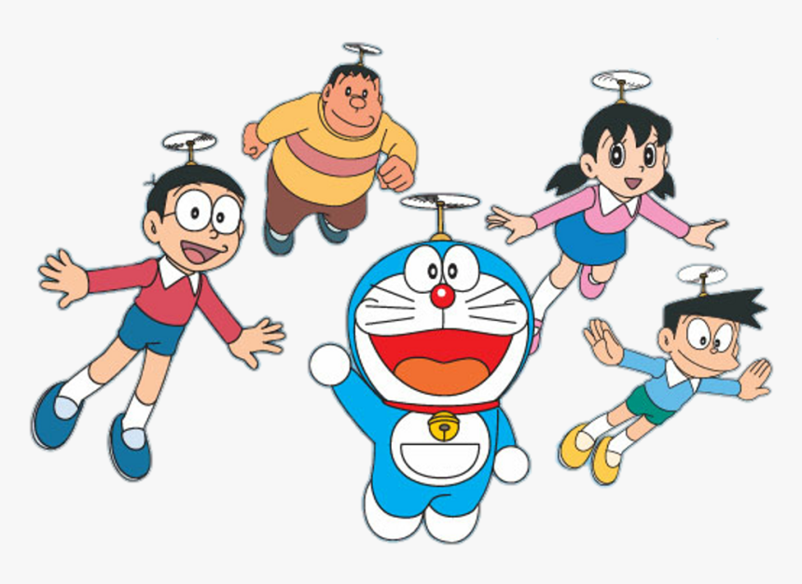
He’s tall and fat.
3
4
She’s beautiful and thin.
He’s slim.
5
2
He’s short.
1
He’s short and fat.
What does he/ she look like?
He’s/ She’s..........

Slide 6
01
New words

Slide 7
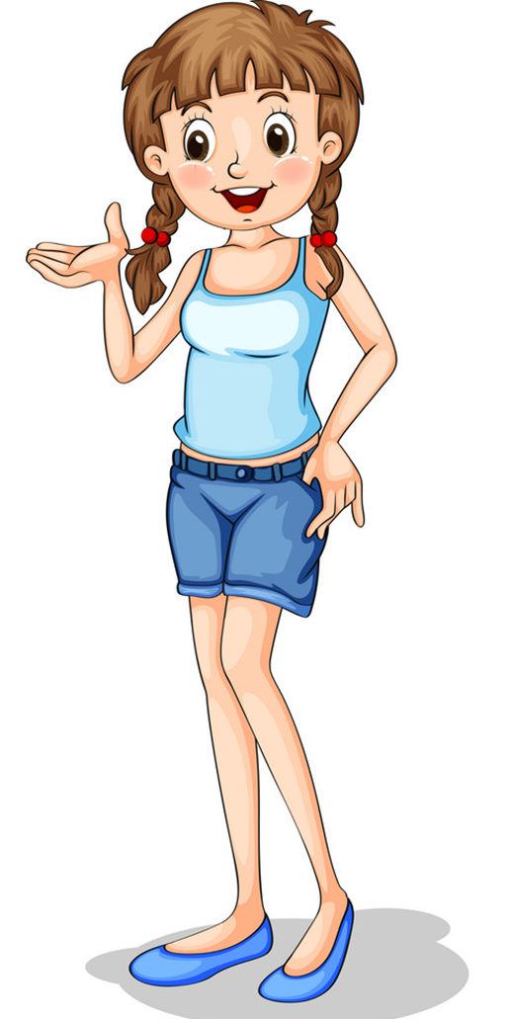
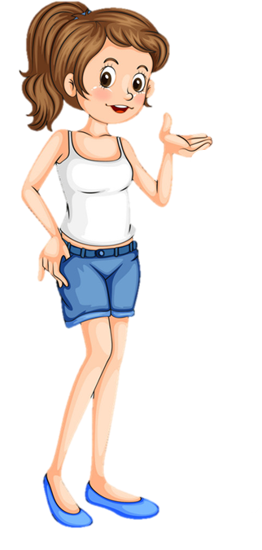
Vocabulary
tall
taller
/tɔːl/
/tɔːlər/

Slide 8
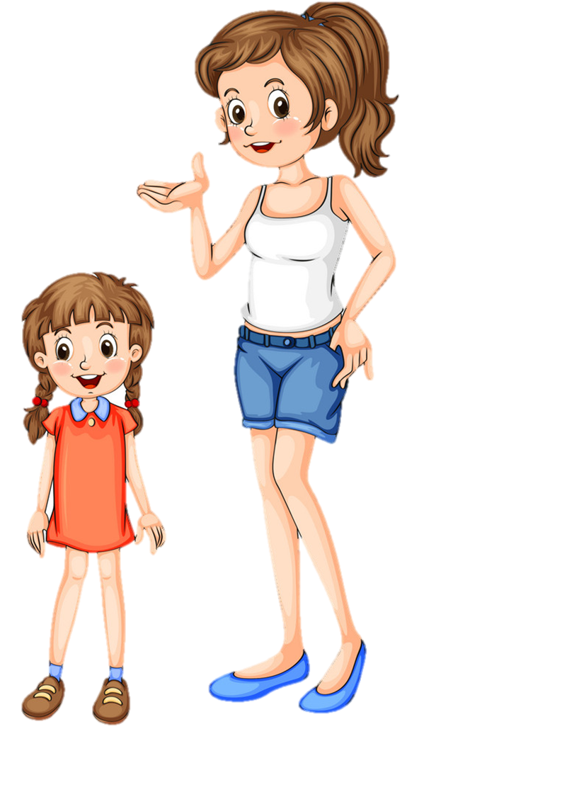
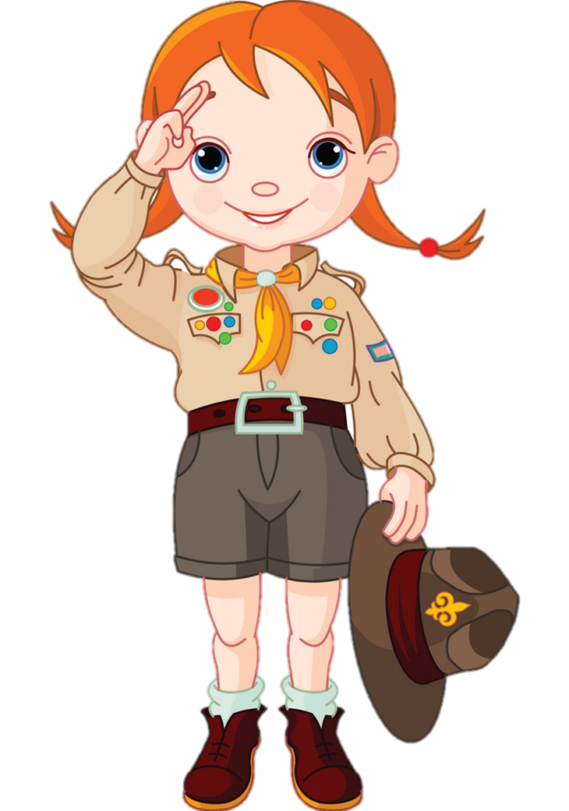
Vocabulary
short
shorter
/ʃɔːrt/
/ʃɔːrtər/

Slide 9

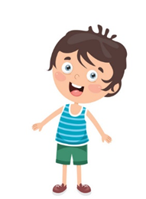
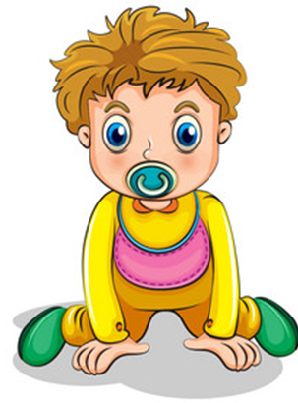

Vocabulary
young
younger
/jʌŋ/
/jʌŋər/

Slide 10
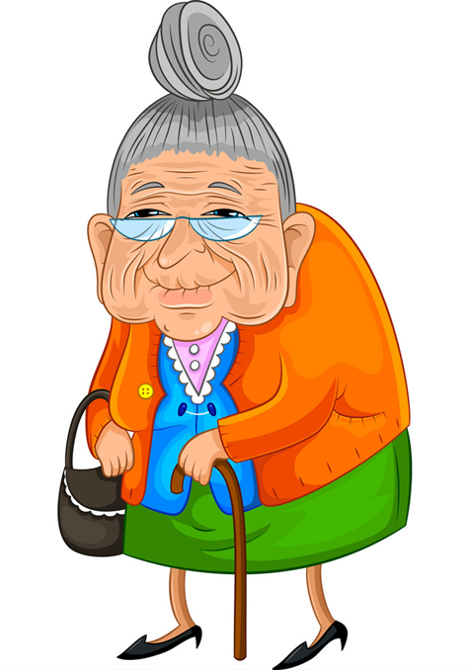
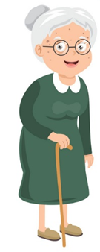
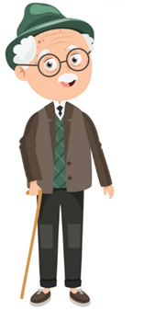
Vocabulary
old
older
/əʊld/
/əʊldər/

Slide 11
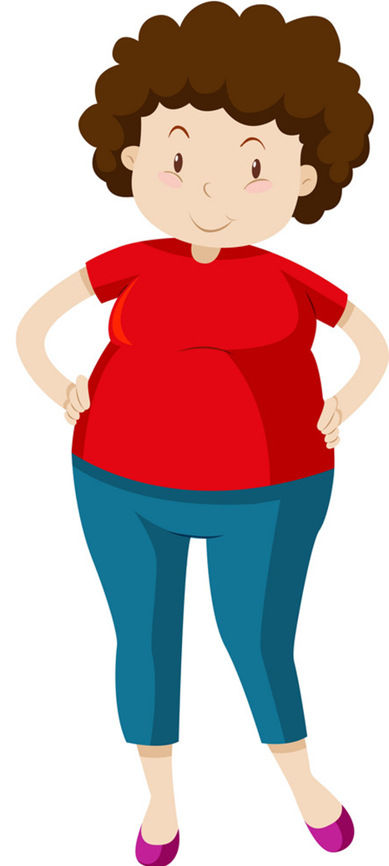
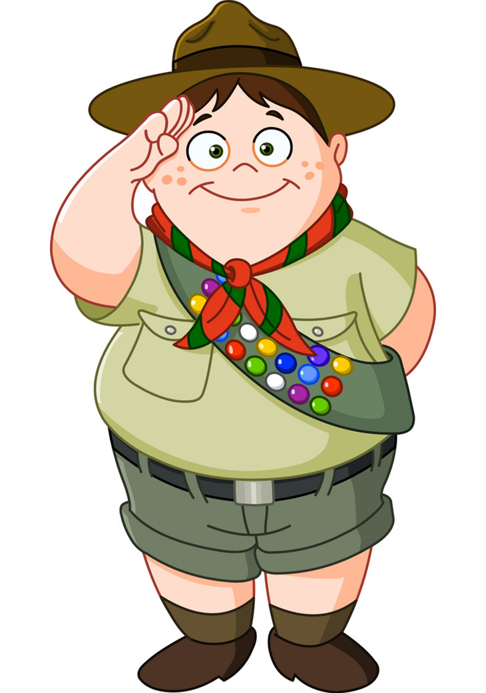
Vocabulary
big
bigger
/big/
/bigər/

Slide 12
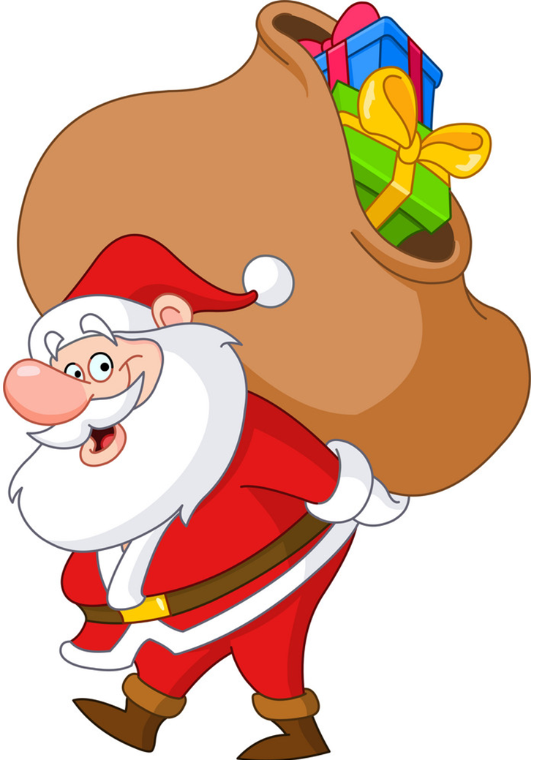
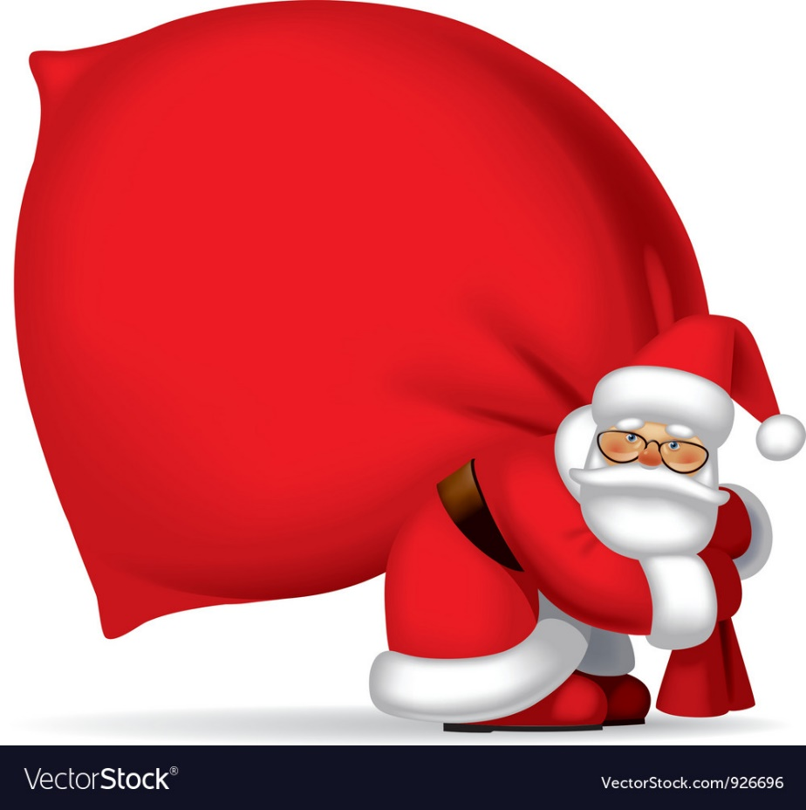
Vocabulary
strong
stronger
/strɔːŋ/
/strɔːŋər/

Slide 13
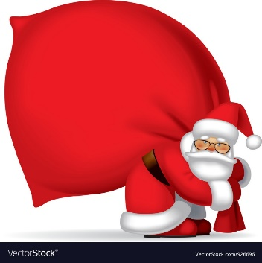
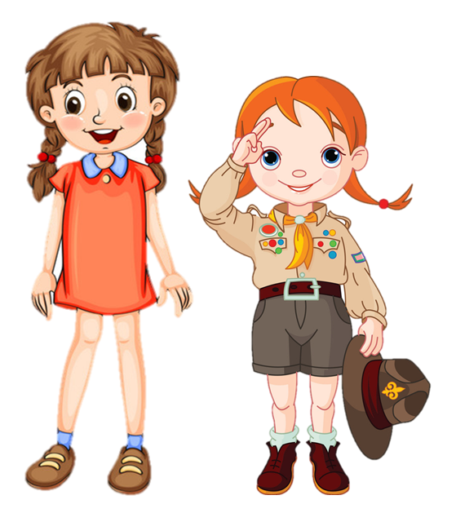
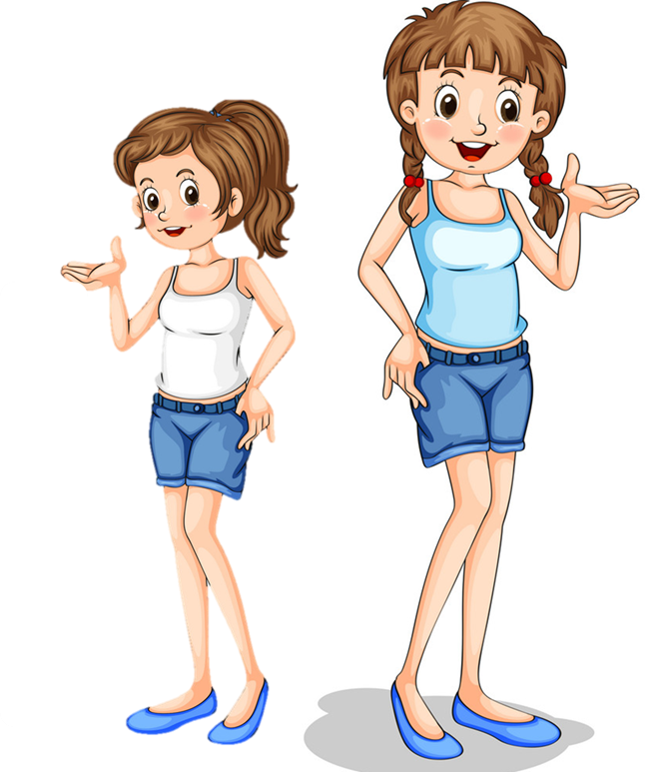
Vocabulary
stronger
bigger
older
younger
shorter
taller

Slide 14



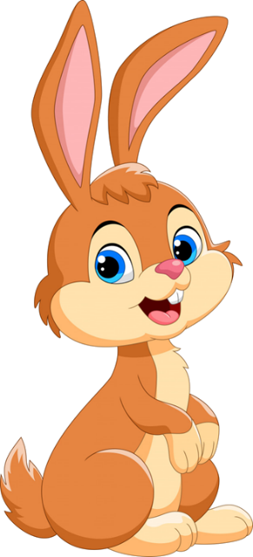

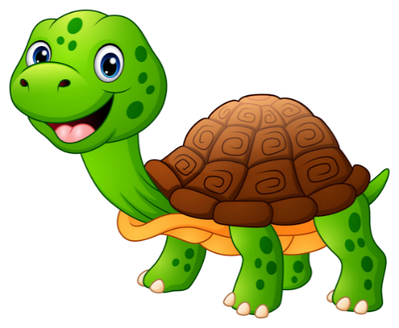
Click hình chú Thỏ hoặc chú Rùa khi chọn đáp án.

Slide 15


taller
stronger

Slide 16
younger
older

Slide 17
taller
tall

Slide 18
younger
older

Slide 19
short
shorter

Slide 20
bigger
big

Slide 21
old
older

Slide 22
taller
shorter

Slide 23


Slide 24
02
MODEL SENTENCE

Slide 25
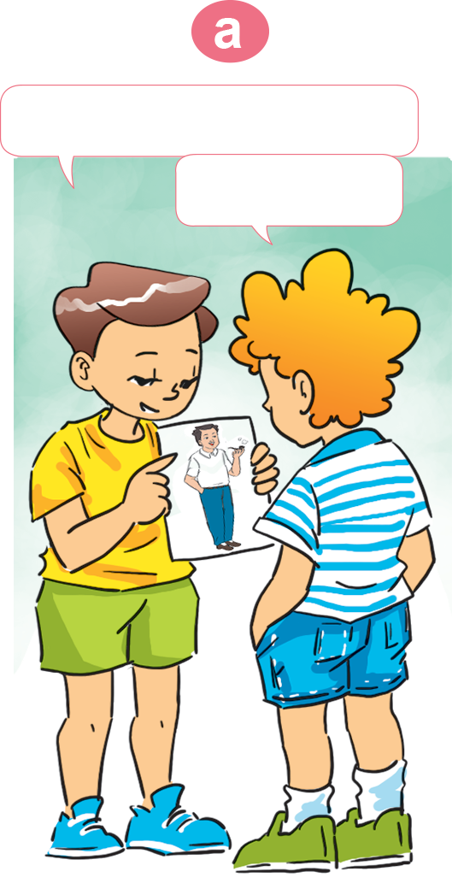

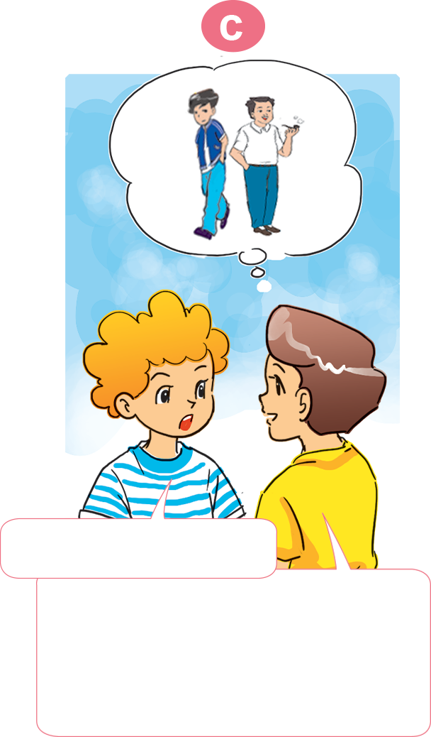
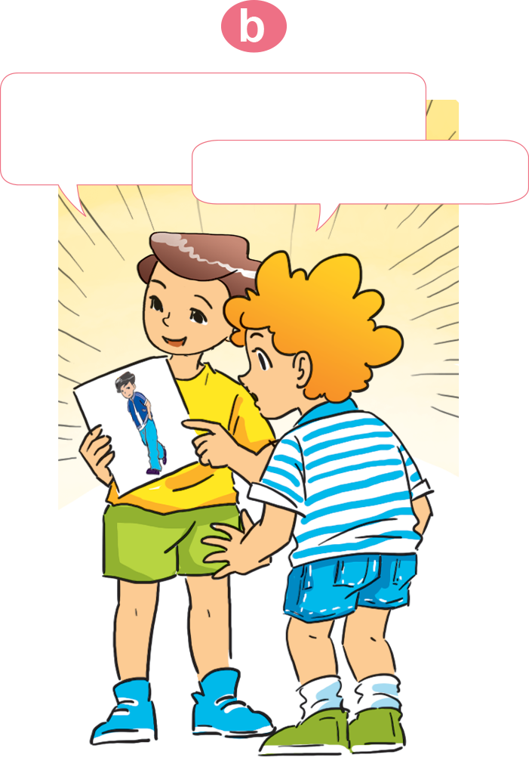
1. Look, listen and repeat.
This is my father.
And this is my elder brother.
He's tall.
Oh, he's tall, too.
Who's taller?
My brother is. My brother's taller than my father.

Slide 26
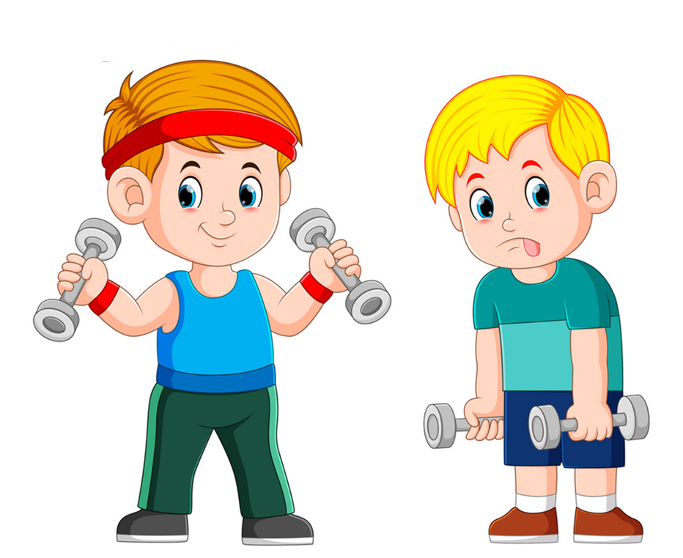
Who is ________?
_______ is _____ than ______.
younger
stronger
older
taller
bigger
shorter

Slide 27
Quy tắc thêm đuôi “-er” sau tính từ ngắn.
Tính từ kết thúc bởi 1 phụ âm ta chỉ việc thêm er.
Ex : tall - taller
short - shorter
Tính từ kết thúc bởi chữ cái “e” ta chỉ việc thêm “ r”
Ex: large - larger
Tính từ kết thúc bởi 1 nguyên âm + 1 phụ âm ta gấp đôi phụ âm rồi thêm đuôi “ er”.
Ex: big – bigger
thin – thinner
Các tính từ tận cùng bằng “y” ta phải chuyển “y-ier”
Ex: happy – happier
pretty _ prettier
- Những từ có hai âm tiết kết thúc bằng –y, –le,–ow, –er, et.
Examples: sweet- sweeter
clever-cleverer
narrow- narrower

Slide 28

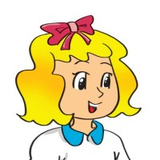
2. Point and say
Who's ____________?
__________ is ____________________.
shorter
The boy
shorter than
the girl

Slide 29
2. Point and say
Who's ____________?
__________ is ____________________.
taller
The girl
taller than
the boy

Slide 30
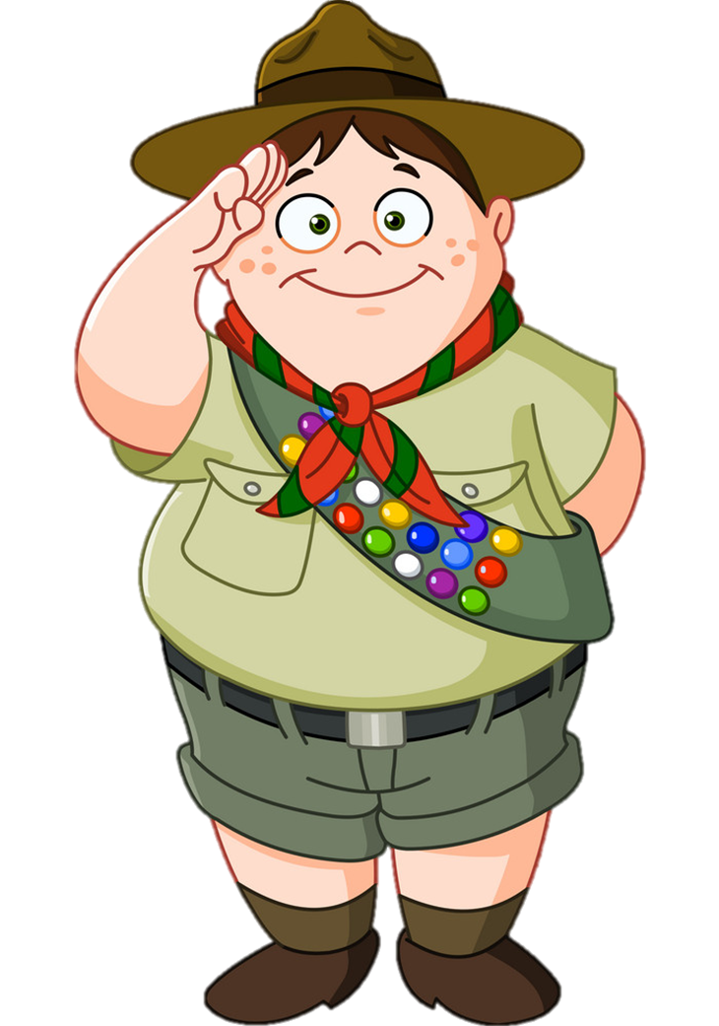
2. Point and say
Who's ____________?
__________ is ____________________.
bigger
The boy
bigger than
the girl

Slide 31
2. Point and say
Who's ____________?
__________ is ____________________.
smaller
The girl
smaller than
the boy

Slide 32
2. Point and say
Who's ____________?
__________ is ____________________.
older
The man
older than
the boy

Slide 33
2. Point and say
Who's ____________?
__________ is ______________________.
younger
The boy
younger than
the man

Slide 34
Who's ________?
_______ is _____ than ______.
younger
stronger
older
taller
bigger
shorter

Slide 35
03
Practice

Slide 36
4. Listen and circle.
1. Nam is ___________ than his sister.
a. taller b. slimmer
2. His sister is ___________ than his mother.
a. slimmer b. smaller
3. His mother is ___________ than his father.
a. shorter b. younger
4. His father is ___________ than his mother.
a. older b. taller

Slide 37

English 4 – Unit 14
Quy tắc thêm đuôi “-er” sau tính từ ngắn.
Tính từ kết thúc bởi 1 phụ âm ta chỉ việc thêm er.
Ex : tall - taller
short - shorter
Tính từ kết thúc bởi chữ cái “e” ta chỉ việc thêm “ r”
Ex: large - larger
Tính từ kết thúc bởi 1 nguyên âm + 1 phụ âm ta gấp đôi phụ âm rồi thêm đuôi “ er”.
Ex: big – bigger
thin – thinner
Các tính từ tận cùng bằng “y” ta phải chuyển “y-ier”
Ex: happy – happier
pretty _ prettier
- Những từ có hai âm tiết kết thúc bằng –y, –le,–ow, –er, et.
Examples: sweet- sweeter
clever-cleverer
narrow- narrower

Slide 38
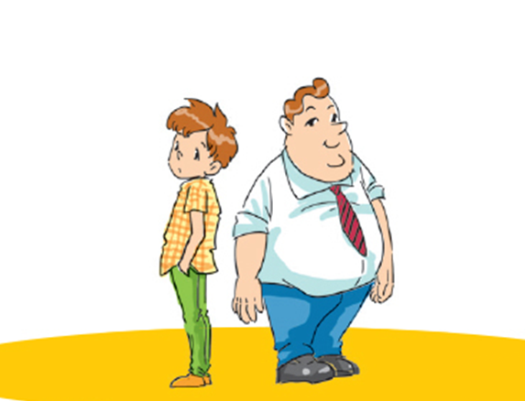
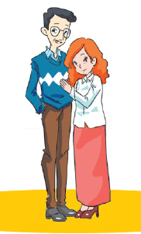
5. Look and write
A: Who's slimmer, the father or the brother?
B: _________________ than ___________.
The brother is slimmer
the father
A: Who's shorter, the father or the mother? B: _________________ than _________.
The mother is shorter
the father

Slide 39
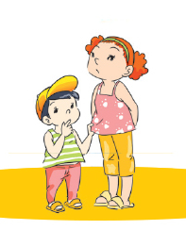
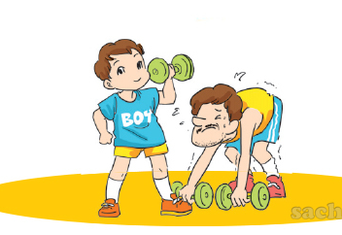
5. Look and write
A: Who's older, the brother or the sister?
B: _________________ than ___________.
The sister is older
the brother
A: Who's stronger, the father or the brother? B: _________________ than _________.
The brother is stronger
the father

Slide 40

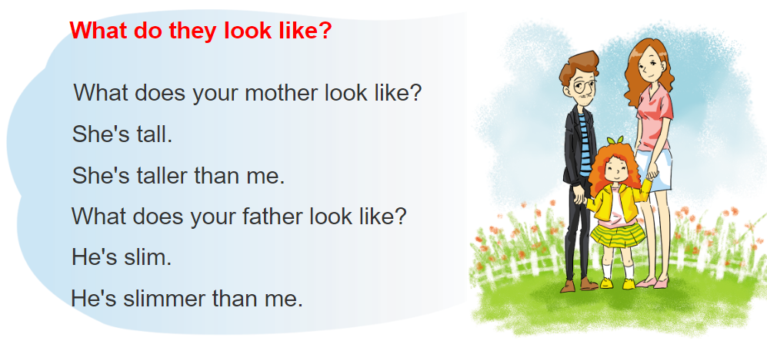
6. Let's sing

Slide 41
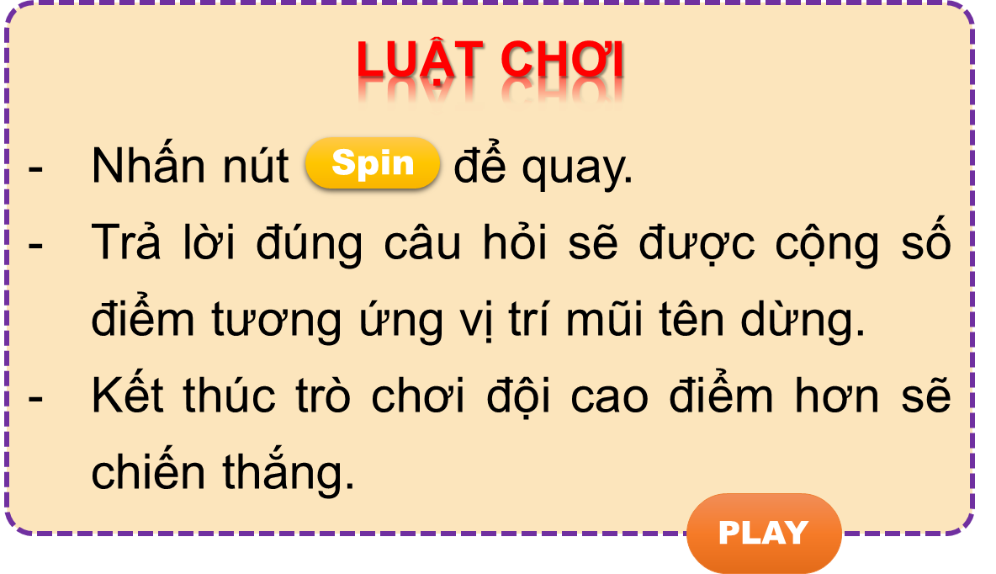

Vòng quay kì diệu
50
10
20
30
10
20
30
40
Spin
PLAY
LUẬT CHƠI
Nhấn nút để quay.
Trả lời đúng câu hỏi sẽ được cộng số điểm tương ứng vị trí mũi tên dừng.
Kết thúc trò chơi đội cao điểm hơn sẽ chiến thắng.
Spin

Slide 42
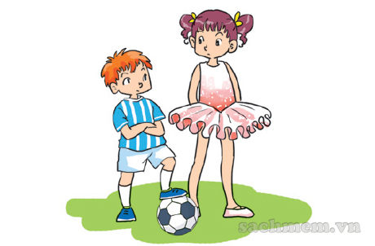
The girl is ______
than the boy
50
10
20
30
10
20
30
40
taller
Xem đáp án
Spin

Slide 43
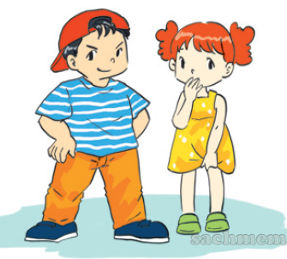
The brother is ______
than the sister.
50
10
20
30
10
20
30
04
bigger
Xem đáp án
Spin

Slide 44
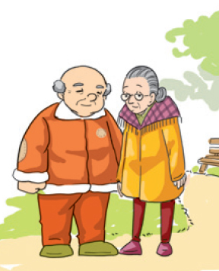
50
Who is smaller, the grandmother or the grandfather?
10
20
30
10
20
30
04
The grandmother is smaller than the grandfather.
Xem đáp án
Spin

Slide 45
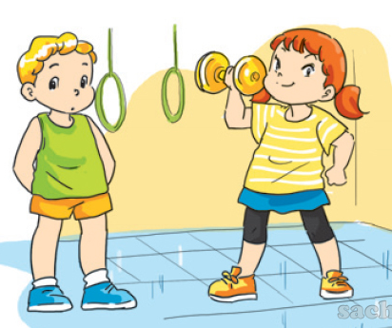

50
Who is stronger, the boy or the girl?
10
20
30
10
20
30
40
The girl is stronger than the boy.
Xem đáp án
Spin

Slide 46
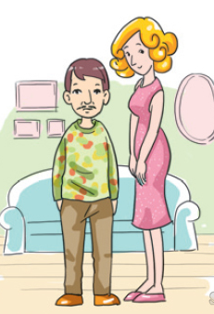
Who is taller, the man
or the woman?
50
10
20
30
10
20
30
40
The woman is taller than the man.
Xem đáp án
Spin

Slide 47
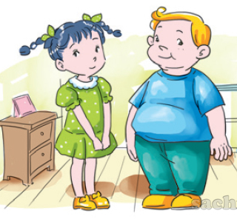
50
Who is slimmer, the sister
or the brother?
10
20
30
10
20
30
40
The sister is slimmer than the brother.
Xem đáp án
Spin

Slide 48
50
10
Who is shorter?
A. The boy is shorter than the girl.
B. The boy is shorter the girl.
20
30
10
20
30
40
A
Xem đáp án
Spin

Slide 49



50
10
20
30
10
20
30
40
EXIT

Slide 50
04. Homelink

Slide 51
Monday, February 20th 2023 Unit 14: What does he look like? Lesson 2
1. New words:
2. Model sentence:
- Tall- taller: cao- cao hơn
- Short- shorter: thấp- thấp hơn
- Young- younger: trẻ- trẻ hơn
- Old- older/ elder: già- già hơn
- Strong- stronger: khỏe- khỏe hơn
- Small- smaller: nhỏ- nhỏ hơn
- Big- bigger: to- to hơn
- Slim- slimmer: gầy- gầy hơn
- Fat- fatter: béo- béo hơn
Who’s taller?
My sister is taller than my mother.
3. Homework:
-Write NW x 2 lines and learn by heart.
-Do WB: part B-1,2 (page 56,57)
part F- 1,2 (page 59)

Slide 52

Thanks!

