Slide 1
The Online Classroom Rules
Be on time.
Mute yourself.
Turn on Camera.
Raise your hand to talk.
Prepare your supplies.

Slide 2
Unit 13: Would you like some milk?
Lesson 3
Teacher: Ngoc Khue

Slide 3
Objectives
- Use the words and phrases related to the topic Food and Drink.
- Pronounce the sounds of the letters “f” and “sh”.
Mục đích bài học:
Sử dụng các từ liên quan đến chủ đề Đồ ăn/ uống.
Phát âm đúng các âm sau: “f” và “sh”.

Slide 4
TABLE OF CONTENTS
01
02
Revision
Phonics
03
04
Practice
Homelink

Slide 5
01
REVISION

Slide 6




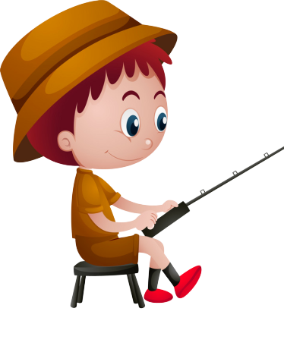

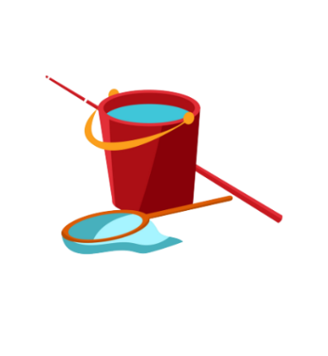
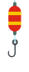

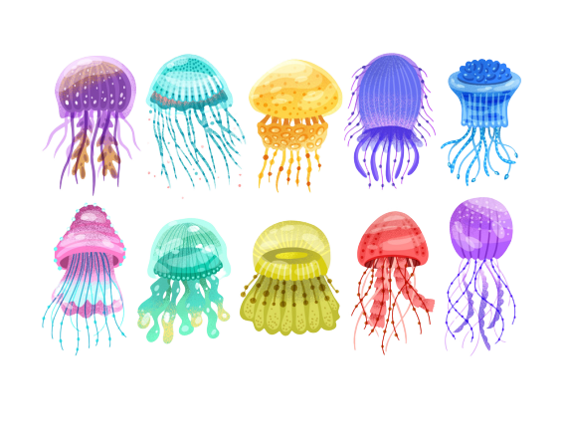

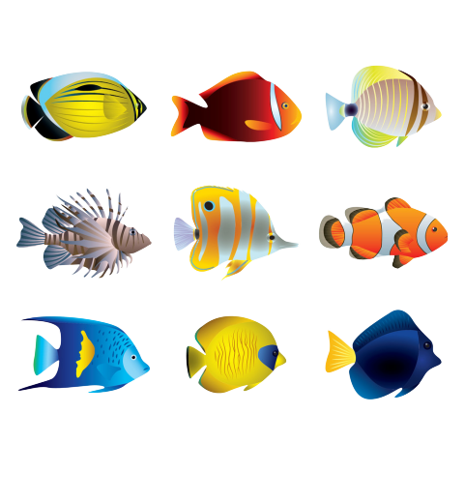

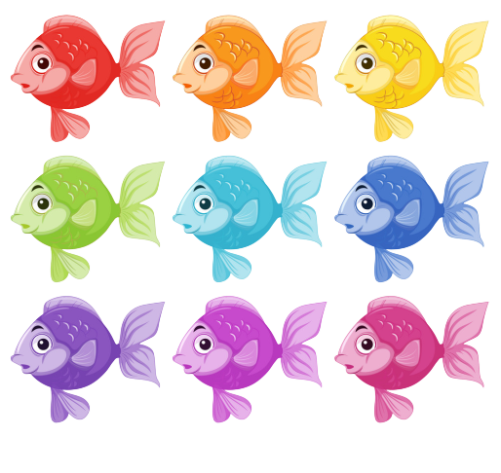
GO FISHING
Game
PLAY
EXIT

Slide 7










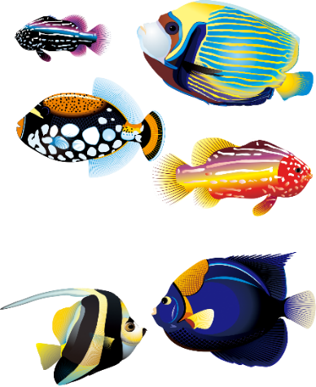
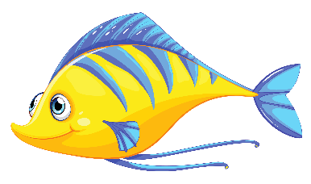
0
Score:
EXIT
8
13
6
12
1
2
7
11
14
5
3
9
4
10
15

Slide 8

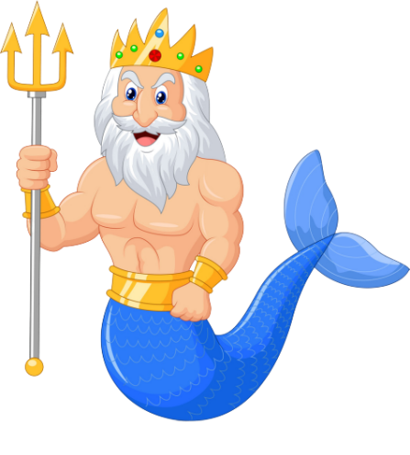


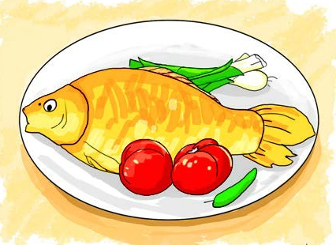
A
FISH
Her favourite food is ____.
B
BEEF
C
PORK
D
VEGETABLES

Slide 9
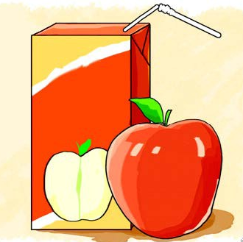
A
It's orange juice.
A: What's your favourite drink?
B: _________.
B
It's apple juice.
C
Yes, please.
D
No, thank you.

Slide 10
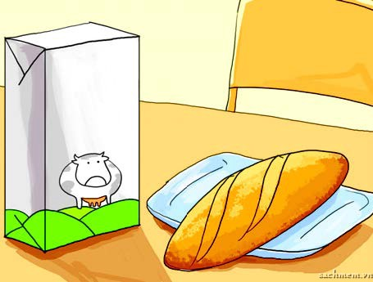
A
bread and milk
I'd like some _______.
B
bread and water
C
rice and lemonade
D
bread and juice

Slide 11
A
No, thanks. I'd like some milk.
What's your favourite food?
B
It's chicken.
C
It's orange juice.
D
Yes, please. I love noodles.

Slide 12
A
It's orange juice.
What's your favourite drink?
B
No, thanks.
C
It's fish.
D
Yes, please.

Slide 13
A
It's vegetable.
Would you like some milk?
B
No, thanks. I'd like
some bread.
C
It's orange juice.
D
Yes, please. I love milk.

Slide 14
A
What's your
favourite drink?
____________?
It's chicken.
B
What's your
favourite food?
C
Would you like
some milk?
D
Would you like
some vegetable?

Slide 15
A
What's your
favourite drink?
_____________?
No, thanks. I'd like some milk.
B
Would you like
some chicken?
C
Would you like
some water?
D
What's your
favourite food?

Slide 16
A
Would you like
some lemonade
___________?
Yes, please. I love lemonade.
B
What's your
favourite food?
C
What's your
favourite drink?
D
Would you like
some water?

Slide 17
A
Do
Mai: __________ you like some beef?
Linda: Yes, please. I love beef.
B
Would
C
Are
D
What

Slide 18
A
Would
__________ is your favourite food?
B
where
C
what
D
When

Slide 19
A
the
What's _____ favourite food?
B
my
C
you
D
your

Slide 20
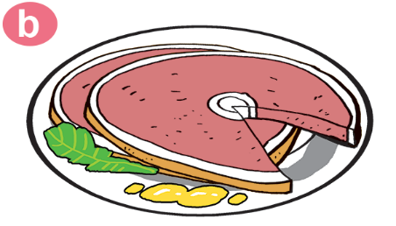
A
beef
Would you like some_____?
Yes,please
B
rice
C
pork
D
bread

Slide 21
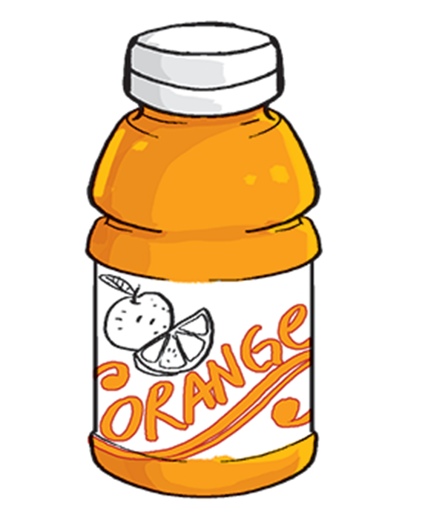
A
It’s lemonade.
What's your favourite drink?
B
It’s water.
C
It’s orange.
D
It’s orange juice.

Slide 22
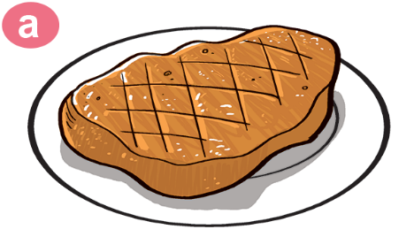
A
I love water.
What's your favourite food?
B
No, I love beef.
C
Yes, I love beef.
D
It’s beef.

Slide 23
02
PHONICS

Slide 24

1. Listen and repeat
f | beef | My favourite food is beef.
 | leaf | The leaf is yellow.
sh | fish | Would you like some fish?
 | dish | That's a big dish of fish.

Slide 25
2. Listen and circle. Then write and say aloud.
1. My favourite food is ______.
a. fish b. beef
2. Would you like some ______?
a. fish b. beef
3. What colour is this ______, Mummy?
a. leaf b. dish
4. She likes this ______ very much.
a. leaf b. dish

Slide 26
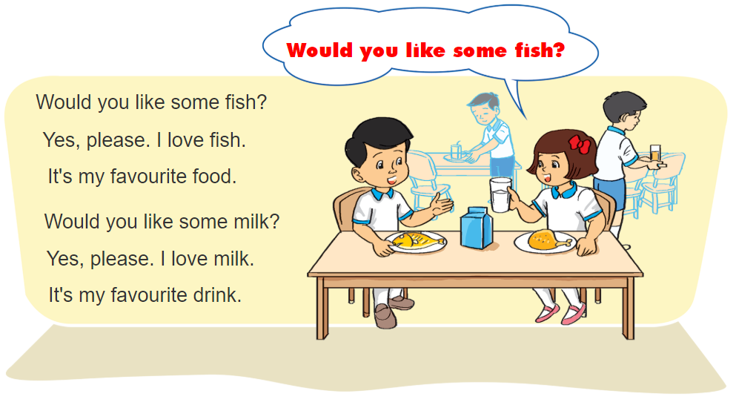

3. Let’s chant

Slide 27
03
PRACTICE

Slide 28
4. Read and complete.
Hi. My name is Linda. I like beef. It is my favourite food. My favourite drink is orange juice. I don't like vegetables. My younger brother Peter doesn't like beef. He loves chicken. It is his favourite food. He loves lemonade too. Lemonade is his favourite drink. He drinks it every day.
Person | Favorite food | Favorite drink
Linda
Peter
beef
orange juice
chicken
lemonade

Slide 29
5. Write about your favourite food and drink
My name is ________________.
I love ________________. It's ________________ food.
I like ________________. It's ________________ drink.
Linda
pizza
my favourite
orange juice
my favourite

Slide 30
04
HOMELINK

Slide 31
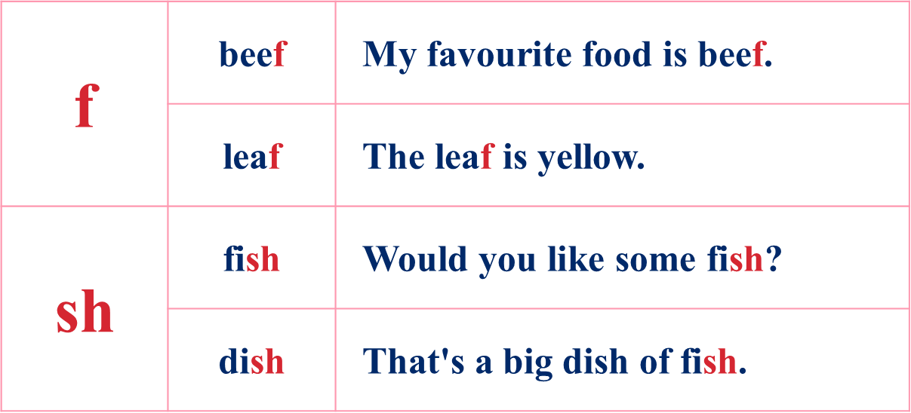
Thursday, February 16th 2023
Unit 13: Would you like some milk?
Lesson 3
1.Phonics:
2. Homework:
- Do WB part A- 1,2 (page 52 )

Slide 32
thanks!
Please keep this slide for attribution

