Slide 1




Unit 7:
My Favorite sport
Lesson 1- Task 4,5,6

Slide 2


1. Warm up
HOT SEAT
Rule : The student in the hot seat looks at the classmate doing the actions and tries to guess
Notes:
The student in the hot seat looks at the classmate doing the actions and tries to guess the word: baseball, basketball, football, hockey, tennis

Slide 3
2.Presentation

Slide 4

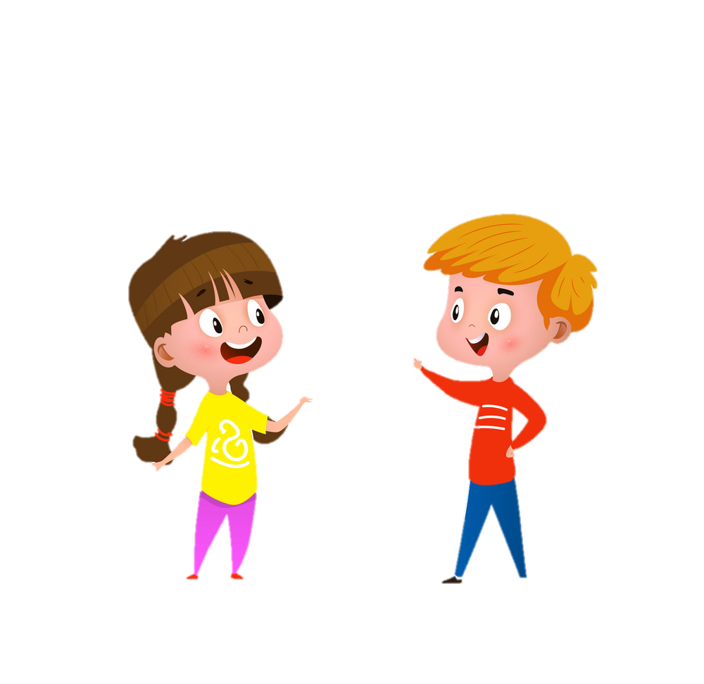
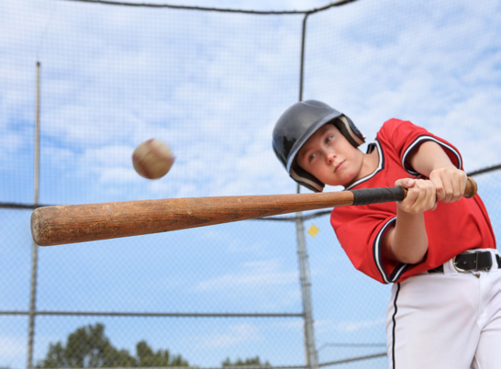
He’s playing baseball.
Notes:
Click the box of sentences to listen .

Slide 5
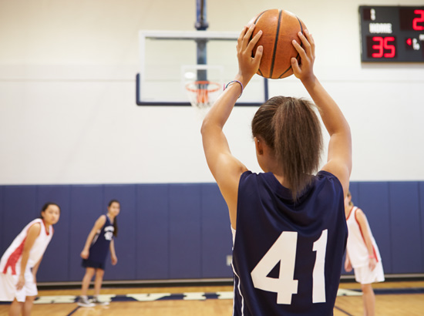
She’s playing basketball.

Slide 6
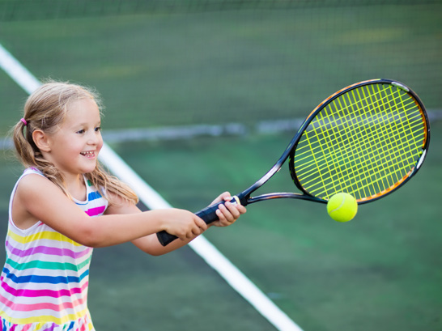
I’m playing tennis.

Slide 7



STRUCTURES CHECKING
Listen, then choose the picture described
Notes:
Listen, then choose the picture described

Slide 8

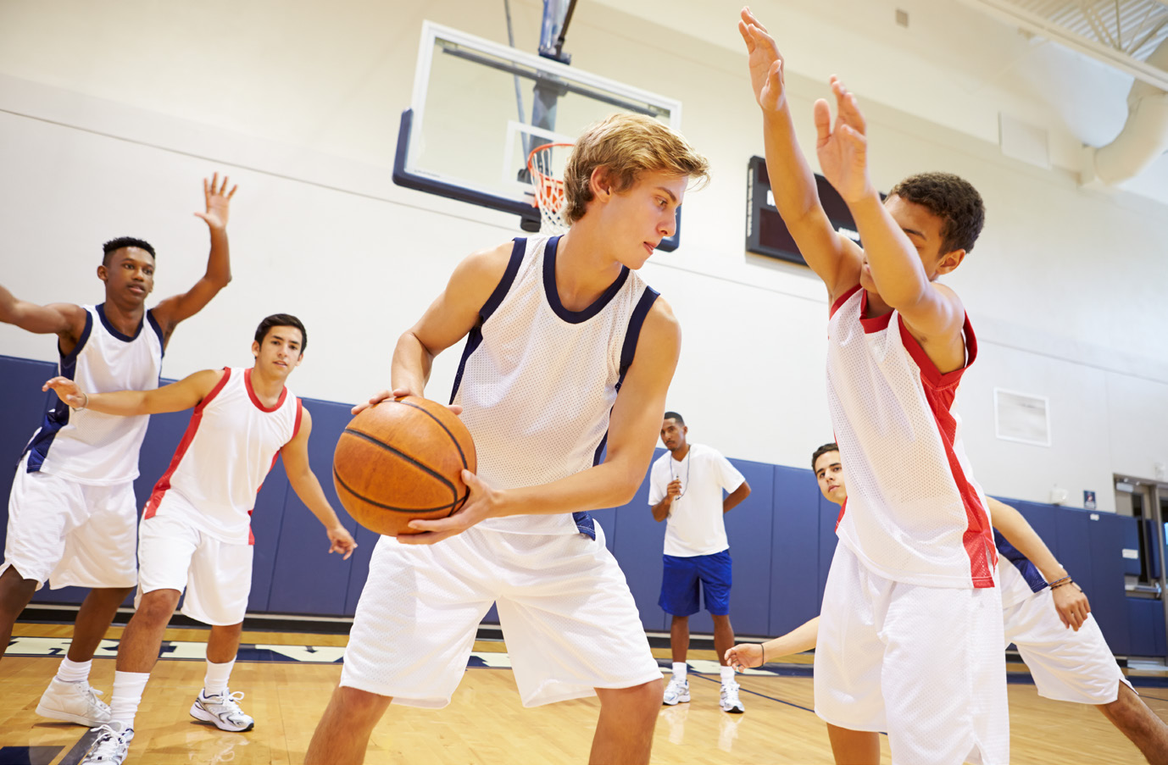

Listen, then choose the picture described
a
b
Notes:
Tap at the sound to listen .
Tap at the picture to choose.

Slide 9
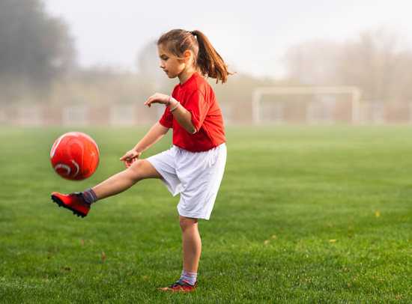
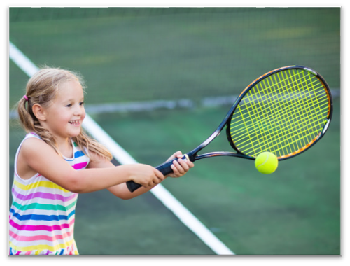

Listen, then choose the picture described
c
b
a
Notes:
Tap at the sound to listen .
Tap at the picture to choose.

Slide 10
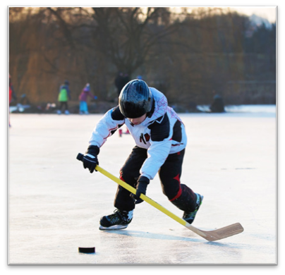
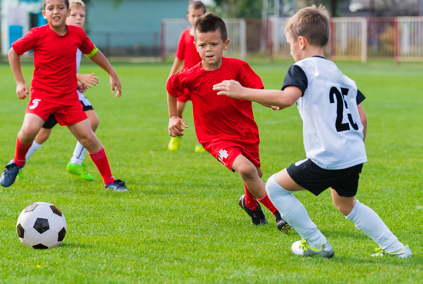
Listen, then choose the picture described
c
a
b
Notes:
Tap at the sound to listen .
Tap at the picture to choose.

Slide 11




Task 4. Listen and repeat

Slide 12

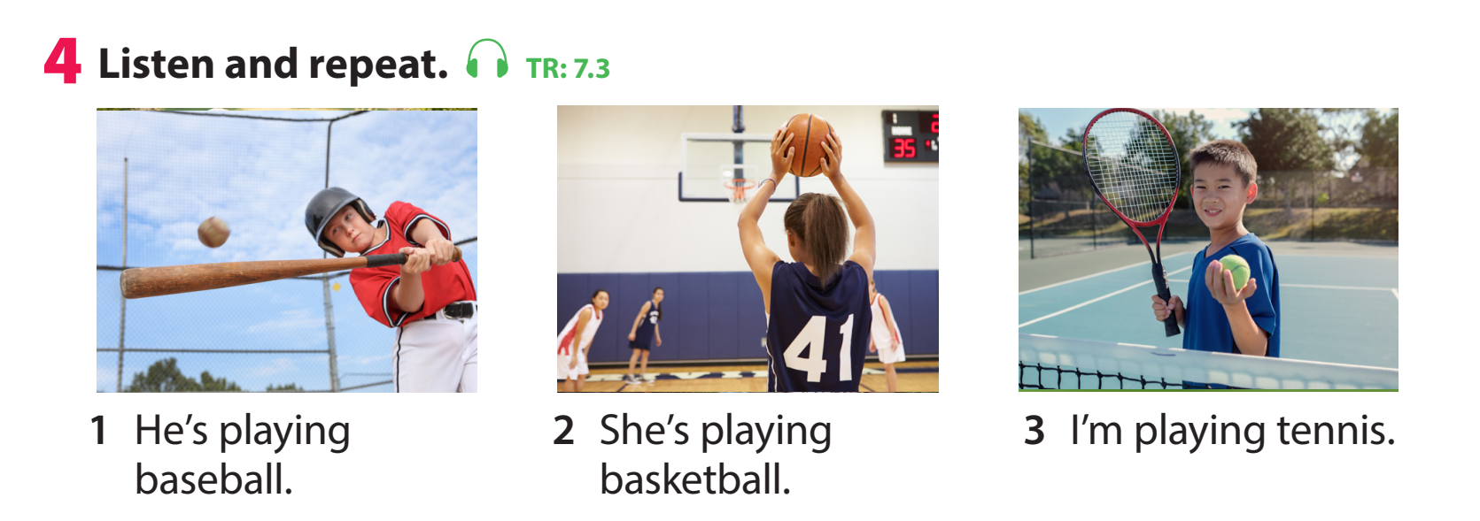


Slide 13
3. Practice

Slide 14

Task 5. Look and say
Look at the pictures and words using the structure He / She’s playing.... to say .

Slide 15



1 She/ tennis
She’s playing tennis.
Notes:
Click at the blue box to appear the answer .

Slide 16
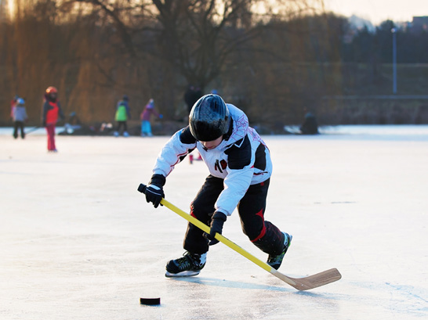
2 I / hockey
I’m playing hockey.
Notes:
Click at the blue box to appear the answer .

Slide 17
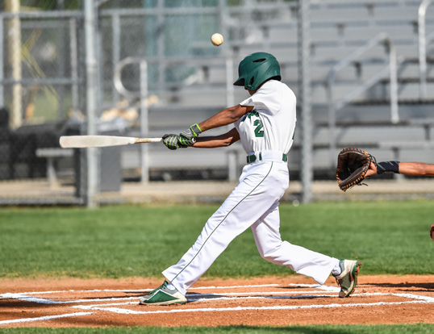
3 He / baseball
He’s playing baseball.
Notes:
Click at the blue box to appear the answer .

Slide 18
4 She / football
She’s playing football.
Notes:
Click at the blue box to appear the answer .

Slide 19
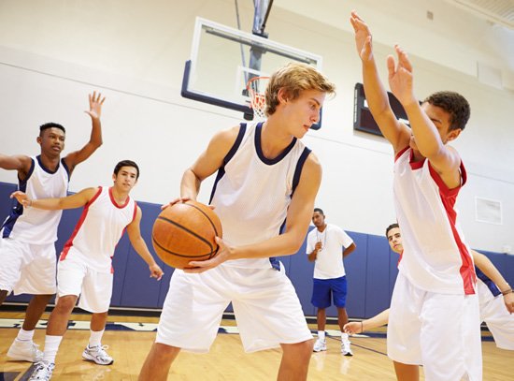
4 I / basketball
I’m playing basketball.
Notes:
Click at the blue box to appear the answer .

Slide 20
4. Production

Slide 21

Task 6 Let’s talk
One student mimes the actions, the other says what their friend is doing by using the structure He / She’s playing....

Slide 22

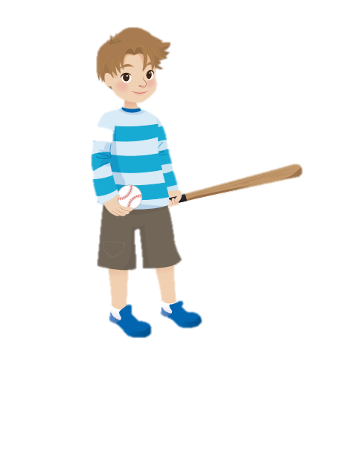

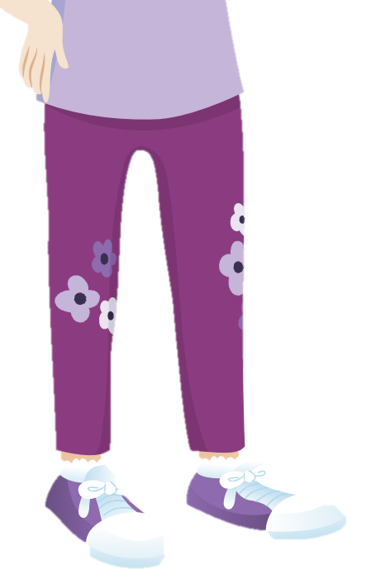
He’s playing baseball.
Notes:
One student mimes the actions, the other says what their friend is doing by using the structure He / She’s playing....

Slide 23
5. Assessment
Look and match

Slide 24

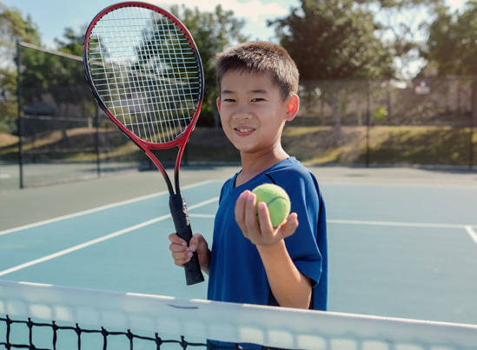
Look and match
1
2
a. He’s playing tennis.
b. He’s playing baseball.
c. She’s playing basketball.
3
4
d. He’s playing hockey .

Slide 25





Thank you & goodbye!

