Slide 1
Unit 11: What time is it?
Lesson 3
Teacher: Ngoc Khue

Slide 2
Objectives
- Review the words of topic Daily Routines and the Time.
- Pronounce the sounds of /oo/.
Mục đích bài học:
- Ôn tập lại các từ về chủ đề các hoạt động thường ngày và chủ đề thời gian.
- Phát âm chính xác âm /oo/.

Slide 3
Table of contents
01
02
Revision
Phonics
03
04
Practice
Homelink

Slide 4
01
Revision
About the Time and Daily Routines

Slide 5

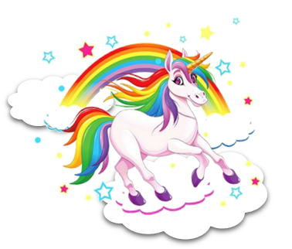
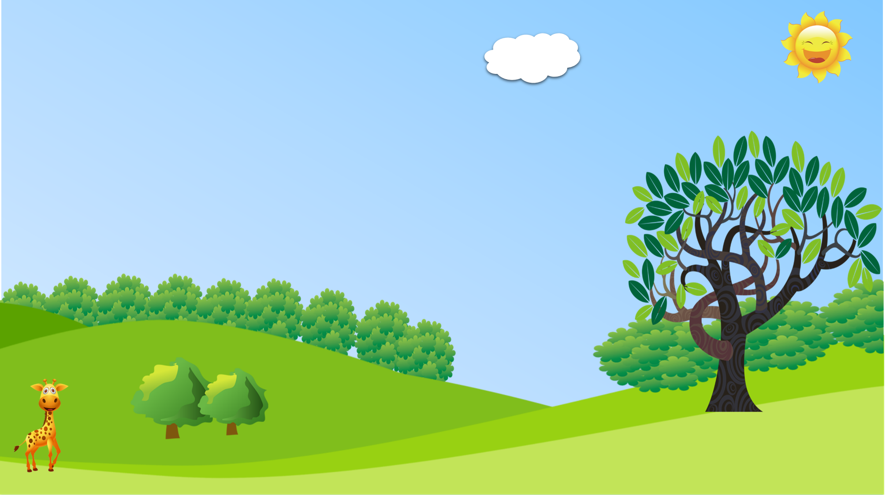



PRERENT WHEEL
10
50
30
30
20
Good job!
SPIN/STOP
SPIN/STOP
SPIN/STOP
SPIN/STOP
SPIN/STOP
SPIN/STOP
SPIN/STOP
SPIN/STOP
SPIN/STOP
SPIN/STOP
SPIN/STOP
SPIN/STOP
SPIN/STOP
SPIN/STOP
SPIN/STOP
40
SPIN/STOP
60
60
40
20
30
10
50

Slide 6
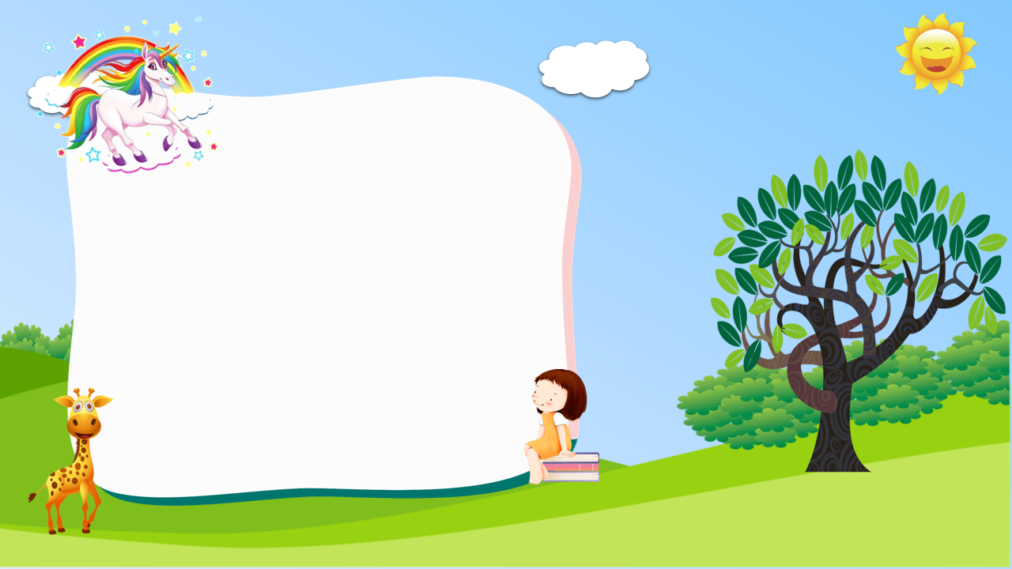
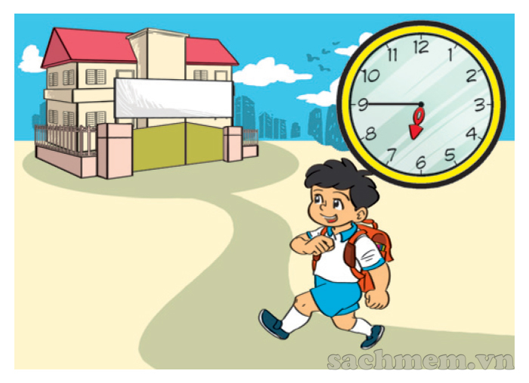

What time do you go to school?
I go to school at
six forty-five.
He goes to school at
six forty-five.

Slide 7
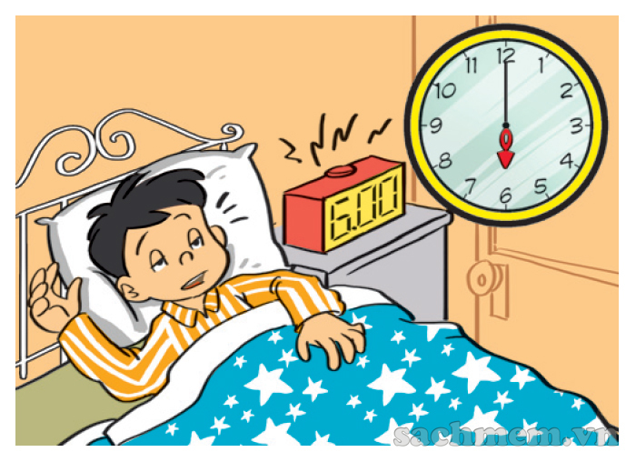
What time does he go to bed?
I go to bed at
six o’clock.
He goes to bed at
six o’clock.

Slide 8
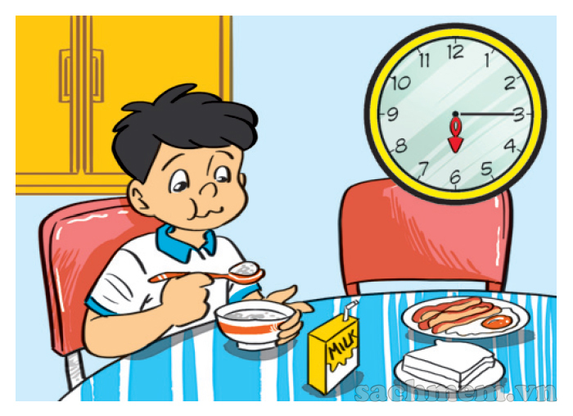
have breakfast
What time does he _______?
He has breakfast at six fifteen.
has breakfast
haves breakfast

Slide 9
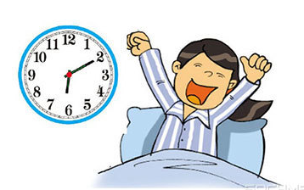
six twenty
I get up at ___________.
six ten
six forty

Slide 10
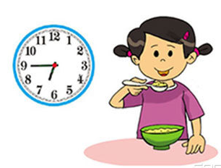
six fifteen
I have breakfast at _________.
six thirty
six forty-five

Slide 11
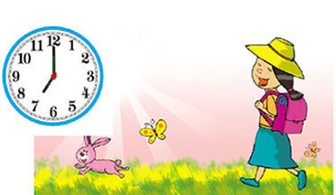
get up
I __________at
seven o'clock.
have breakfast
go to school

Slide 12
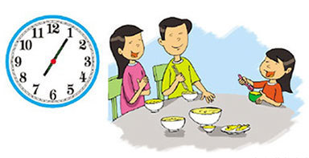
get home
I ___________ at seven five.
have dinner
watch TV

Slide 13
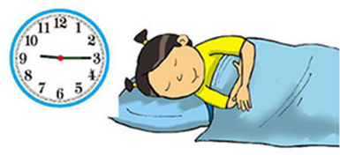
I go to bed at nine fiveteen.
True
False

Slide 14
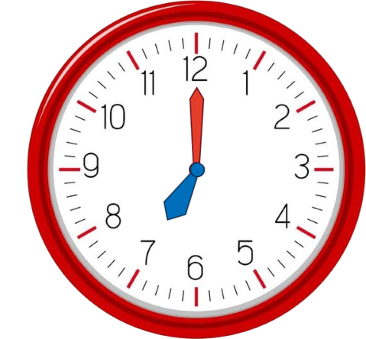
What time it is?
True
Flase

Slide 15
Answer
What time does she go home?
___________________?
She goes home at four o’clock?

Slide 16
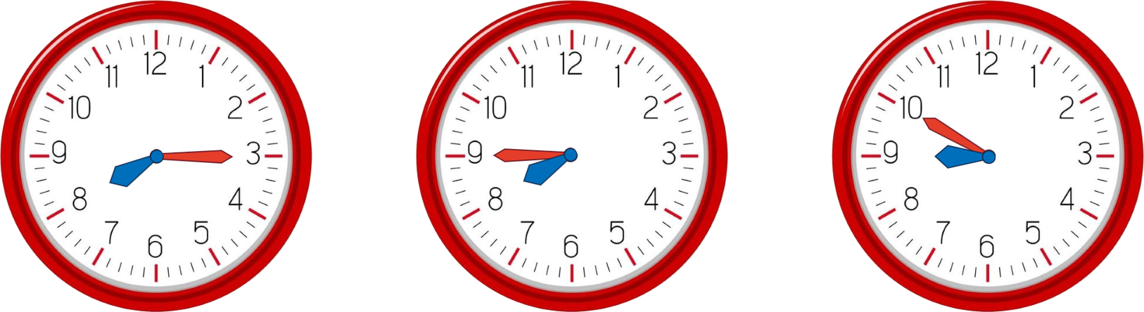
Answer
What time does your father watch TV?
He watches TV at eight fifteen
Notes:
Ms Huyền Phạm - 0936.082.789 – YOUTUBE: MsPham. Facebook: Dạy và học cùng công nghệ.

Slide 17
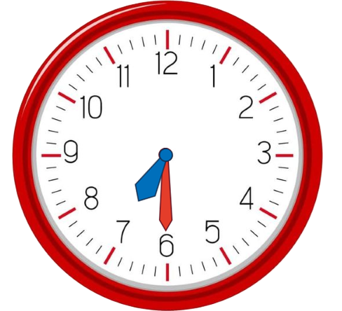
Answer
What time do you have dinner?
I have dinner at seven thirty.

Slide 18
Answer
What time is it?
It’s eight fifty.

Slide 19
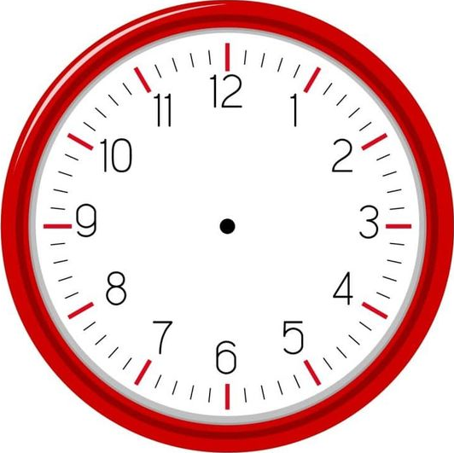

Answer
What time is it?
It’s twelve forty.

Slide 20
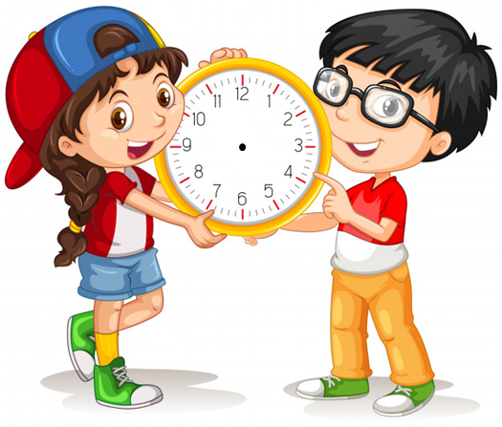
Answer
What time is it?
It’s ten twenty.

Slide 21
Phonics
02
About the Time and Daily Routines

Slide 22

1. Listen and repeat.
oo
cook | My mother cooks at six o'clock.
book | Your book is on the table.
noon | I play football at noon.
school | They have lunch at school.
oo

Slide 23
2. Listen and write. Then say aloud.
1. Look! The _______ is red.
2. They usually read books at _________.
3. My big brother can _______.
4. The children usually play football at ________.
book
school
cook
noon

Slide 24
Practice
03
Sound /oo/

Slide 25
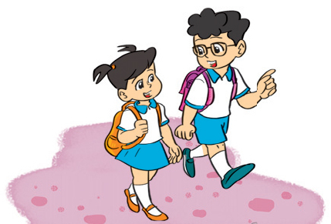
4. Read and complete.
Phong studies at Nguyen Du Primary School. Every day he gets up at 6.30. He goes to school at 7 a.m. School starts at 7.30 a.m. and finishes at 4.30 p.m. He goes home at 5 o'clock. He has dinner at 7.15 in the evening. Then he does his homework or listens to music. He goes to bed at 9.45.
1. Phong goes to school at _________.
2. He goes home at __________.
3. He ____________ at 7.15.
4. He _____________ at 9.45.
7 a.m
5 o'clock
has dinner
goes to bed

Slide 26
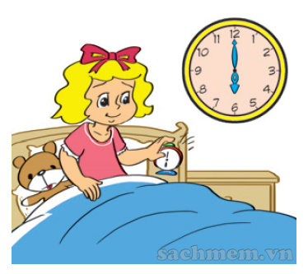
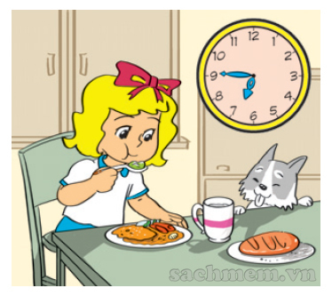
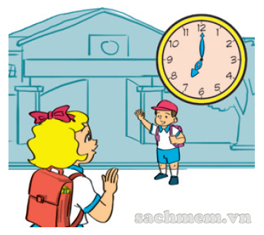
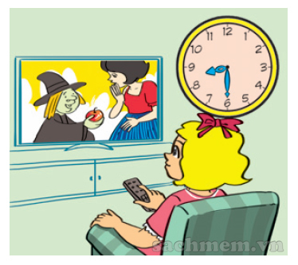
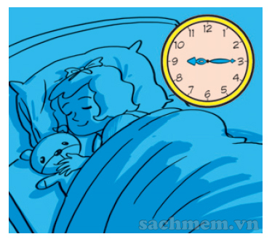
5. Let's write.
Linda gets up at six o'clock. She _____________ _______________. She ______________ _________. She ___________ ____________. And she ____________ ____________ .
has breakfast
at six forty-five
goes to school
at seven
watches TV
at eight thirty
goes to bed
at nine fifteen

Slide 27
6. Project
Write about you.
Hi, my name is _________ . I am from _______.
Every day I get up at _______. I go to school at _____________ and get home at __________.
In the evening, I _____________. I go to bed at ____________.

Slide 28
04
Homelink

Slide 29
Monday, January 16th 2023
Unit 11: What time is it?
Lesson 3
1. Pronunciation:
cook | My mother cooks at six o'clock.
book | Your book is on the table.
noon | I play football at noon.
school | They have lunch at school.
2. Homework:
Do WB: part A- 1,2 (page 44)

