Slide 1







Unit 11:
What time is it?
Lesson 1
Teacher: Ngoc Khue

Slide 2
Objectives
Use the words and phrases related to the topics The Time.
Ask and answer questions about time, using What time is it? It’s ...
Mục đích bài học:
Sử dụng các từ liên quan đến chủ đề Thời gian.
Hỏi và trả lời xem bây giờ là mấy giờ với mẫu câu: What time is it? It’s ...

Slide 3


Table of contents
01
New words
02
Model sentence
03
Practice
04
Homelink

Slide 4


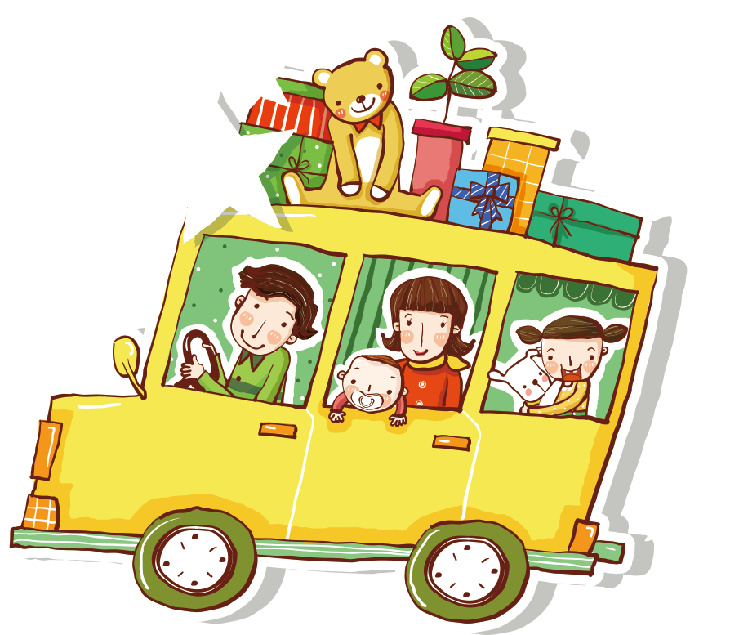
PART 01
New words

Slide 5

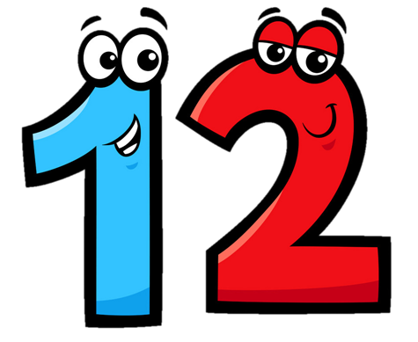

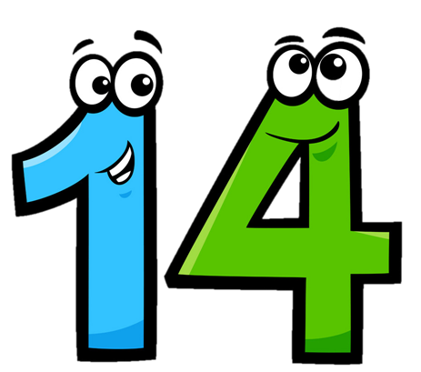

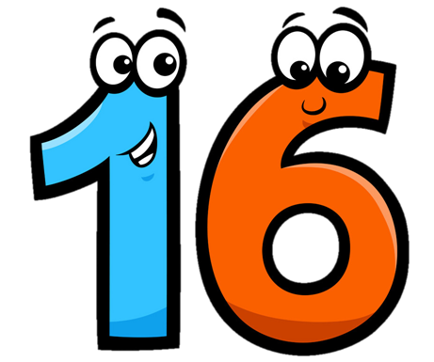

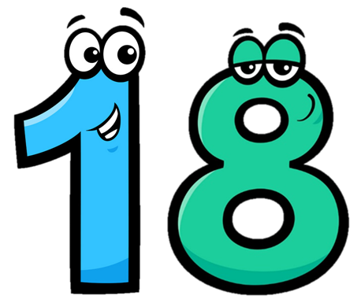
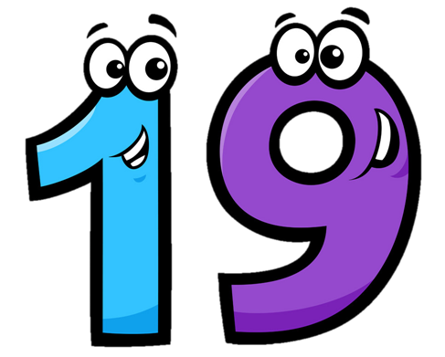
Eleven
/ɪˈlevn/
Twelve
/twelv/
Thirteen
/ˌθɜːˈtiːn/
Fourteen
/ˌfɔːˈtiːn/
Fifteen
/ˌfɪfˈtiːn/
Sixteen
/ˌsɪksˈtiːn/
Seventeen
/ˌsevnˈtiːn/
Eighteen
/ˌeɪˈtiːn/
Nineteen
/ˌnaɪnˈtiːn/

Slide 6



Choose the correct number
a
b
c
Twelve

Slide 7
Choose the correct number
a
b
c
Eleven

Slide 8
Choose the correct number
a
b
c
Fifteen

Slide 9
Choose the correct number
a
b
c
fourteen

Slide 10
Choose the correct number
a
b
c
Thirteen

Slide 11
Choose the correct number
a
b
c
Seventeen

Slide 12
Choose the correct number
a
b
c
Nineteen

Slide 13
Choose the correct number
a
b
c
Eighteen

Slide 14
Choose the correct number
a
b
c
Sixteen

Slide 15
Look read and circle
Fifteen
Sixteen
Seventeen
Eleven
Thirteen
Twelve
Eighteen
Nineteen
Sixteen

Slide 16
Look read and circle
Fifteen
Thirteen
Eighteen
Eleven
Sixteen
Twelve
Fourteen
Fifteen
Sixteen

Slide 17
Look read and circle
Eleven
Nineteen
Eighteen
Twelve
Eleven
Thirteen
Fifteen
Fourteen
Twelve

Slide 18






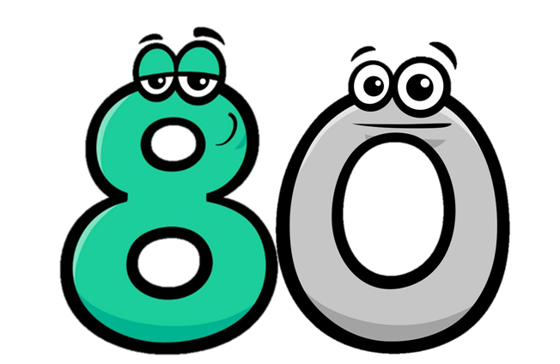

Twenty
/ˈtwenti/
Thirty
/ˈθɜːti/
Forty
/ˈfɔːti/
Fifty
/ˈfɪfti/
Seventy
/ˈsevnti/
Eighty
/ˈeɪti/
Ninety
/ˈnaɪnti/
Sixty
/ˈsɪksti/

Slide 19
Match
Forty
Thirty
Fifty
Twenty

Slide 20
Match
ninety
seventy
eighty
sixty

Slide 21
21
=
20
+
1
twenty-one
twenty
one
22
=
20
+
2
twenty-two
twenty
two

Slide 22
34
=
30
+
4
thirty-four
thirty
four
43
=
40
+
3
forty-three
forty
three

Slide 23
Look and say
15
fifteen
40
forty
20
twenty
45
forty-five
25
twenty-five
50
fifty
30
thirty
55
fifty-five
35
thirty-five

Slide 24

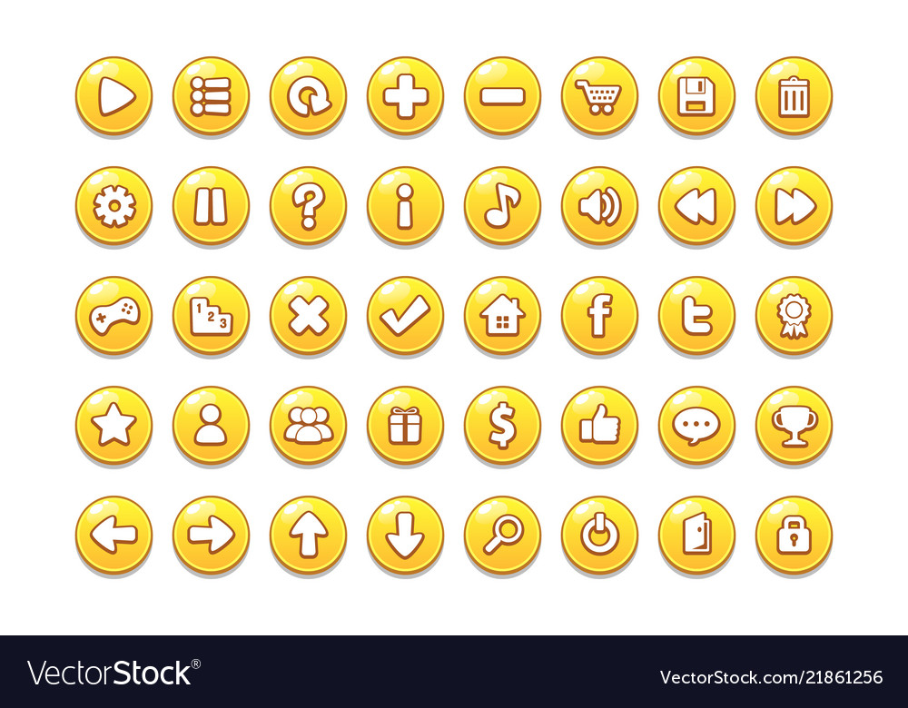


Slide 25
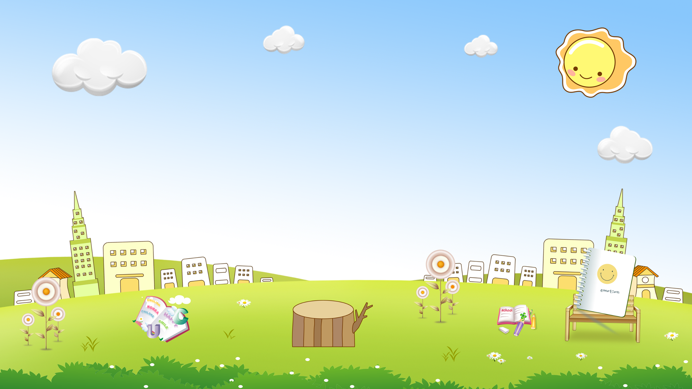










are
a. Thirteen b. Twelve
c. Eleven
a
b
c

Slide 26
old
a. Twoteen b. twelve
c. Twenty
a
b
c

Slide 27
you
a. Fifteen b. Fourteen
c. Fiveteen
a
b
c

Slide 28
old
a. Threeteen b. Thirteen
c. Thirty
a
b
c

Slide 29
are
a. Thirteen b. Twelve
c. Thirty
a
b
c

Slide 30
you
a. Fourteen b. Forteen
c. Fourty
a
b
c

Slide 31
are
a. Twelve b. Twenteen
c. Twenty
a
b
c

Slide 32
old
a. Fourty b. Forty
c. Fourteen
a
b
c

Slide 33
you
a. Fifty b. Fivety
c. Fifteen
a
b
c

Slide 34


are
a. Nine-two b. Nineteen-two
c. Ninety-two
a
b
c

Slide 35

old
a. Fifty b. Fifty-five
c. Fifteen
a
b
c

Slide 36


you
a. Eighty-six b. Sixteen
c. Eight-six
a
b
c

Slide 37


are
a. Seventeen b. Seventy
c. Seventy-three
a
b
c

Slide 38

old
a. Four-two b. Forty-two
c. Fourty-two
a
b
c

Slide 39

you
a. Thirty-one b. Eleven
c. Three-one
a
b
c

Slide 40


GOOD JOB!
STOP

Slide 41
PART 02
Model sentence

Slide 42
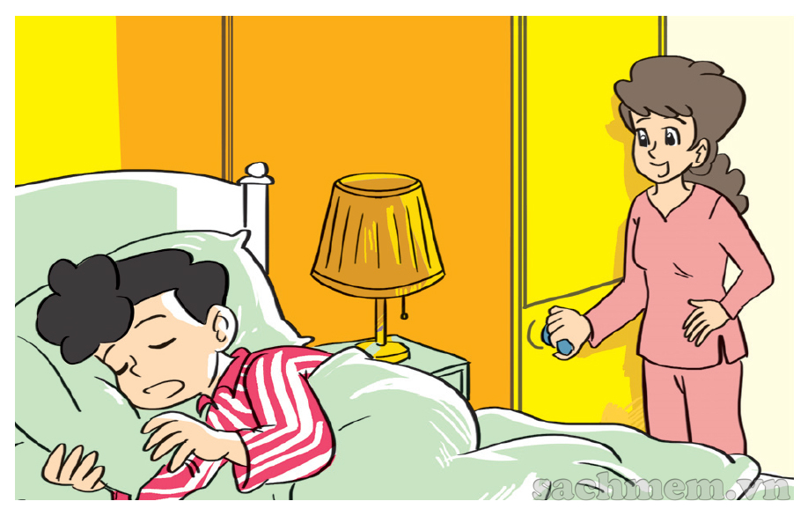
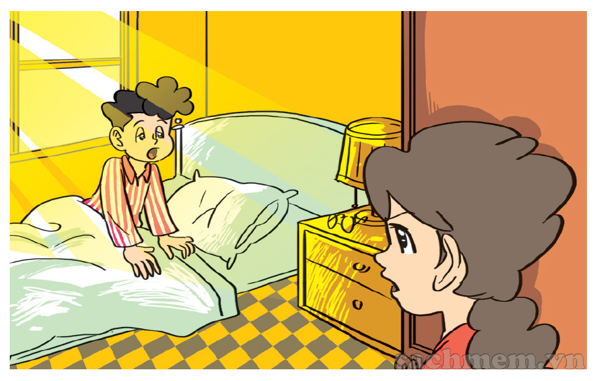
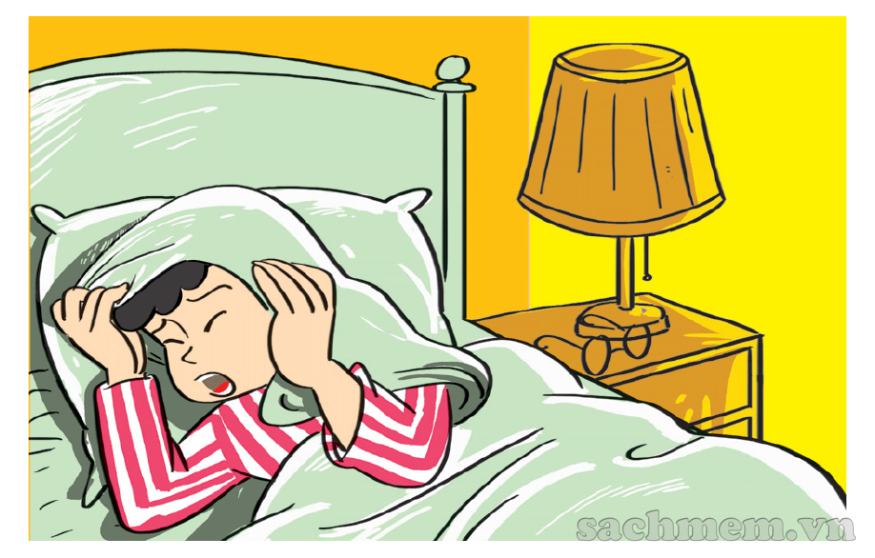
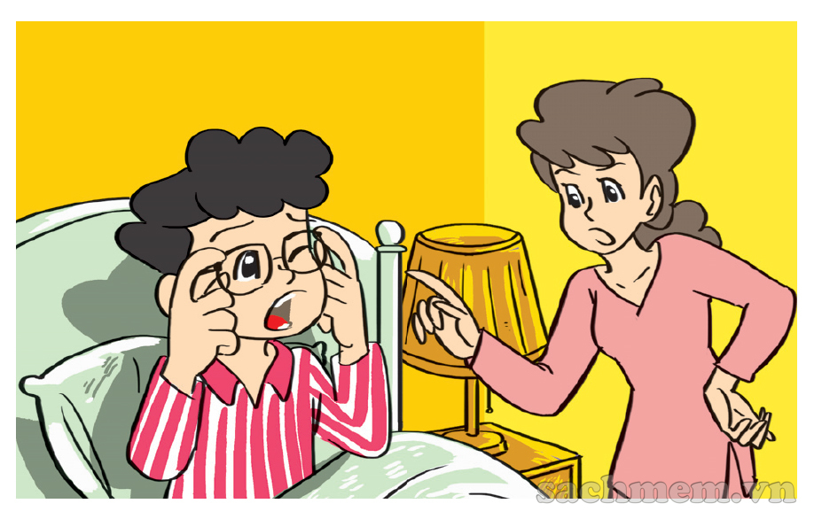


1. Look, listen and repeat.
What time is it, Mum?
It's time to get up, Phong.
It's seven o'clock
Today's Sunday and I
don't have to go to school.
But it's time
for breakfast.
Oh, yes, Mum.

Slide 43
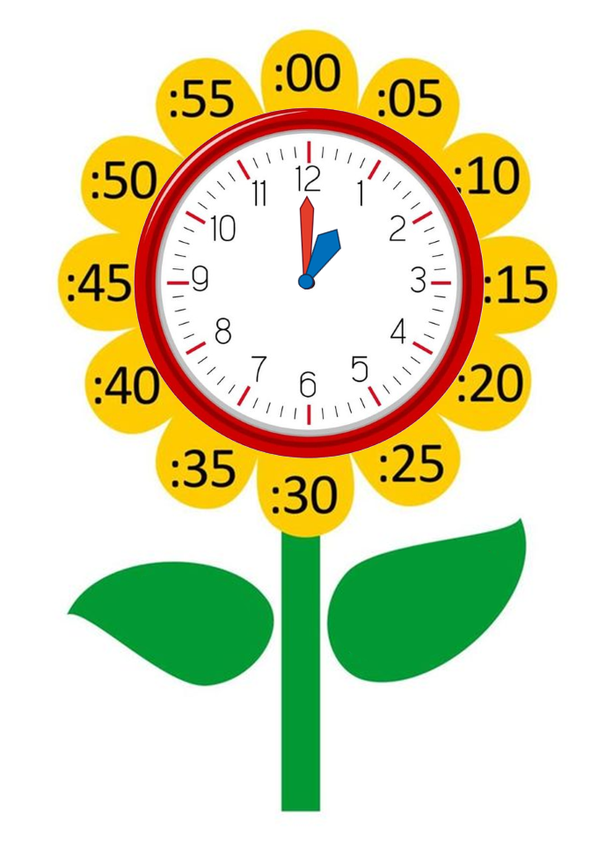
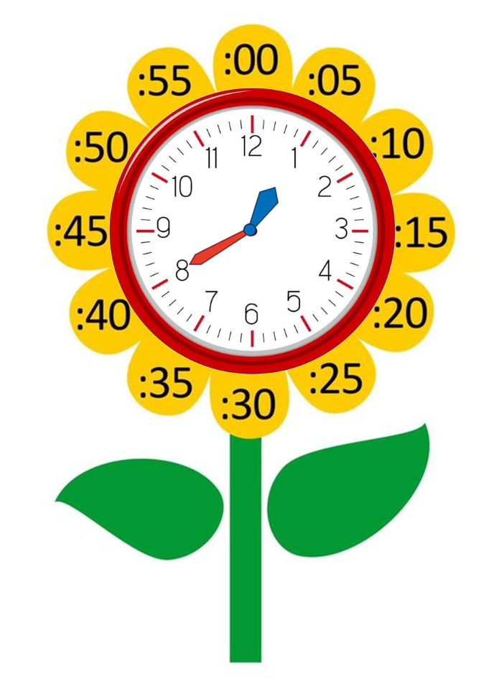
Model sentence
What time is it?
It's + số giờ + o’clock.
It's one o’clock.
It's + số giờ + số phút.
It's one forty.

Slide 44
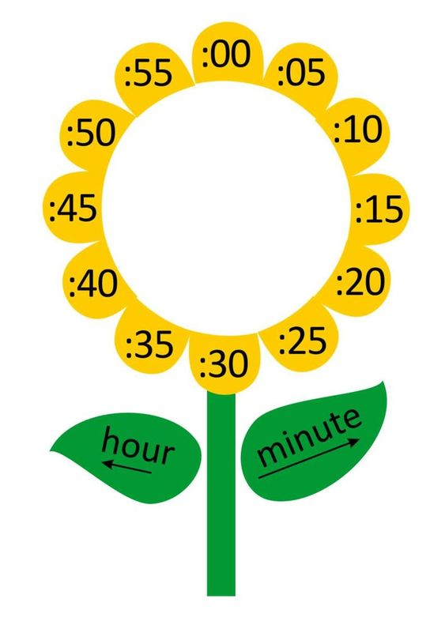
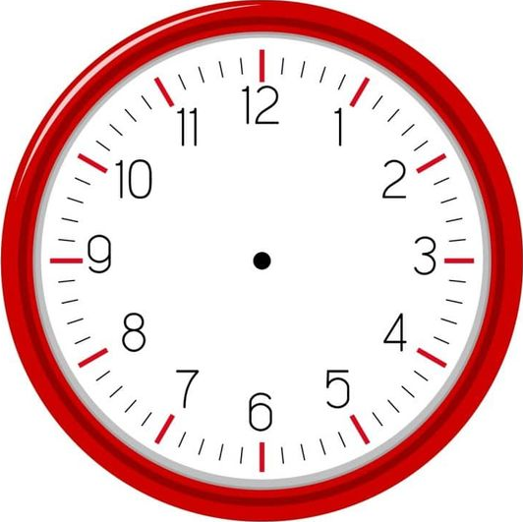

What time is it?
one
It's __________ o’clock.

Slide 45
What time is it?
three
It's __________ o’clock.

Slide 46
What time is it?
six
It's __________ o’clock.

Slide 47
What time is it?
one
fifteen
It's _________________.

Slide 48
What time is it?
one
thirty
It's _________________.

Slide 49
What time is it?
one
forty
It's _________________.

Slide 50
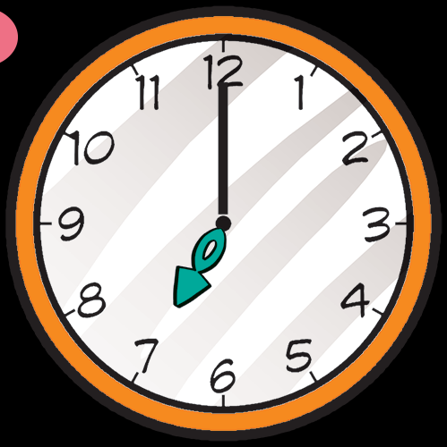
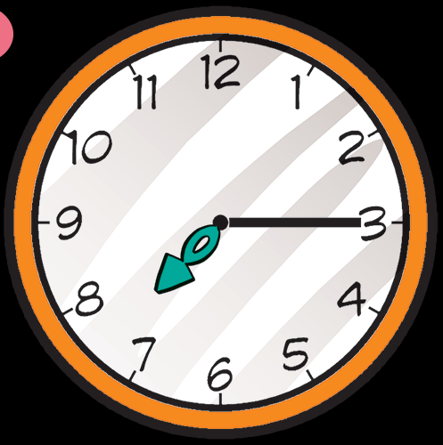
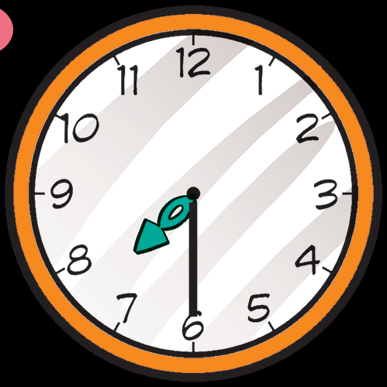
2. Point and say.
What time is it?
It's __________
It's __________
It's __________
seven o’clock.
seven fifteen.
seven thirty.

Slide 51
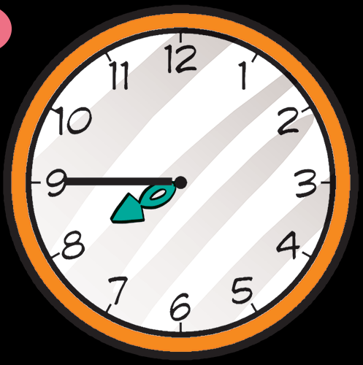
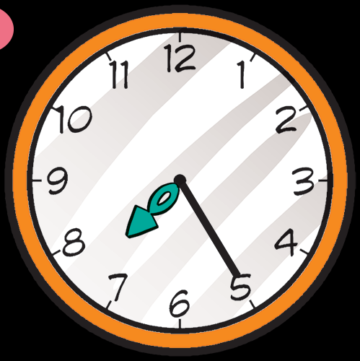
2. Point and say.
What time is it?
It's ____________.
It's ______________.
seven forty-five
seven twenty-five

Slide 52




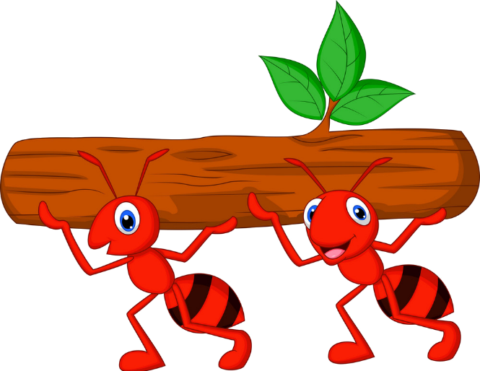



Kiến chăm chỉ
PLAY

Slide 53

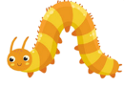


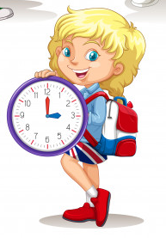



____________?
It’s three o’clock.
What time is it?
Next
Notes:
Ms Huyền Phạm - 0936.082.789 – YOUTUBE: MsPham. Facebook: Dạy và học cùng công nghệ.

Slide 54
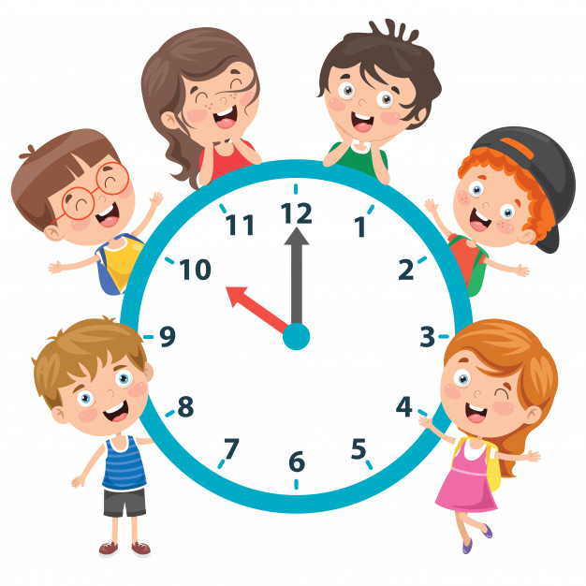
What time is it?
It’s _________.
ten o’clock.
Next
Notes:
Ms Huyền Phạm - 0936.082.789 – YOUTUBE: MsPham. Facebook: Dạy và học cùng công nghệ.

Slide 55
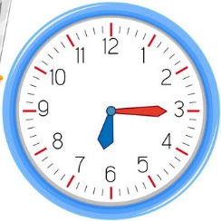
What time is it?
It’s _________.
Six fifteen
Next
Notes:
Ms Huyền Phạm - 0936.082.789 – YOUTUBE: MsPham. Facebook: Dạy và học cùng công nghệ.

Slide 56
_________ is it?
It’s six fifteen.
What time
Next
Notes:
Ms Huyền Phạm - 0936.082.789 – YOUTUBE: MsPham. Facebook: Dạy và học cùng công nghệ.

Slide 57
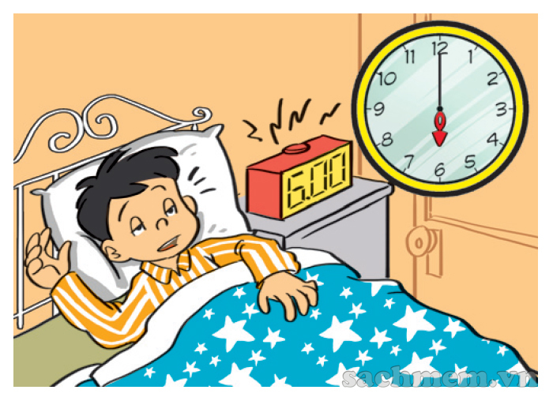
What time is it?
It’s six o’clock.
It’s twelve thirty.
It’s six o’clock.
Next
Notes:
Ms Huyền Phạm - 0936.082.789 – YOUTUBE: MsPham. Facebook: Dạy và học cùng công nghệ.

Slide 58
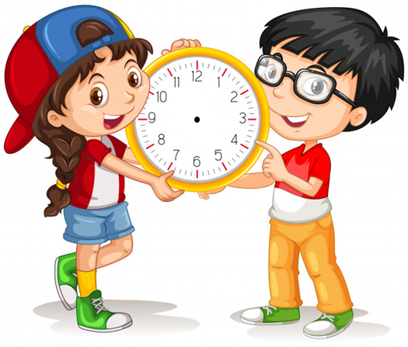
What time is it?
It’s ten thirty.
True
False
True
Next
Notes:
Ms Huyền Phạm - 0936.082.789 – YOUTUBE: MsPham. Facebook: Dạy và học cùng công nghệ.

Slide 59
What time is it?
It’s ten o’clock.
True
False
False
Next
Notes:
Ms Huyền Phạm - 0936.082.789 – YOUTUBE: MsPham. Facebook: Dạy và học cùng công nghệ.

Slide 60
WELL DONE!
EXIT
Notes:
Ms Huyền Phạm - 0936.082.789 – YOUTUBE: MsPham. Facebook: Dạy và học cùng công nghệ.

Slide 61
PART 03
Practice

Slide 62

3. Listen and tick.
a
b
c
1

Slide 63
3. Listen and tick.
a
b
c
2

Slide 64
3. Listen and tick.
a
b
c
3

Slide 65
4. Look and write
What time is it?
What time is it?
It's four o’clock.
It's ten twenty.

Slide 66
4. Look and write
What time is it?
What time is it?
It's ten thirty.
It's eleven fifty.

Slide 67
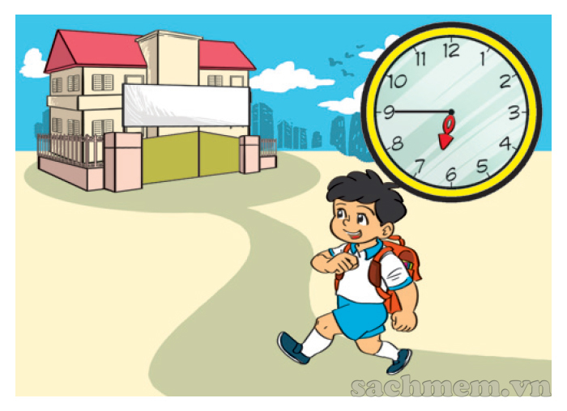
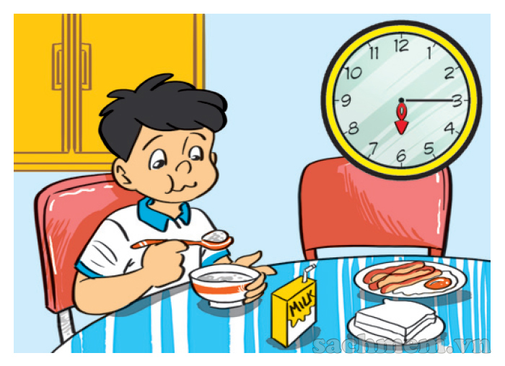
5. Let’s sing
1
2
3
a
b
c
What time is it?
It's six o'clock.
It's time to get up.
What time is it?
It's six fifteen.
It's time for breakfast.
What time is it?
It's six forty-five.
It's time for school.

Slide 68
PART 04
Homelink

Slide 69
Tuesday, January 10th 2023
Unit 11: What time is it?
Lesson 1
1. New words:
2. Model sentences:
Eleven: số 11
Twelve: số 12
Thirteen: số 13
Fourteen: số 14
Fifteen: số 15
Sixteen: số 16
Seventeen: số 17
Eighteen: số 18
Nineteen: số 19
Twenty: số 20
Twenty- one: số 21
Thirty: số 30
Forty: số 40
Fifty:số 50
Sixty: số 60
Seventy: số 70
Eighty: số 80
Ninety: số 90
One hundred: số 100
What time is it?
It’s six o’clock./ It’s six fifteen.
3. Homelink
Nw x 2lines and learn by heart.
Do WB: part B- 1,2 (page 44,45)
part C-1,2 (page 45)

Slide 70
Saturday, January 8th 2022
Unit 11: What time is it?
Lesson 1
1. New words:
2. Model sentences:
Eleven: số 11
Twelve: số 12
Thirteen: số 13
Fourteen: số 14
Fifteen: số 15
Sixteen: số 16
Seventeen: số 17
Eighteen: số 18
Nineteen: số 19
Twenty: số 20
Twenty- one: số 21
Thirty: số 30
Forty: số 40
Fifty:số 50
Sixty: số 60
Seventy: số 70
Eighty: số 80
Ninety: số 90
One hundred: số 100
What time is it?
It’s six o’clock.
It’s six fifteen.
3. Homelink
- Quizziz + Wordwall game.

Slide 71
Thank you!

