Slide 1
Unit 3
Where did you go
on holiday?
Lesson 3

Slide 2
Warm-up

Slide 3
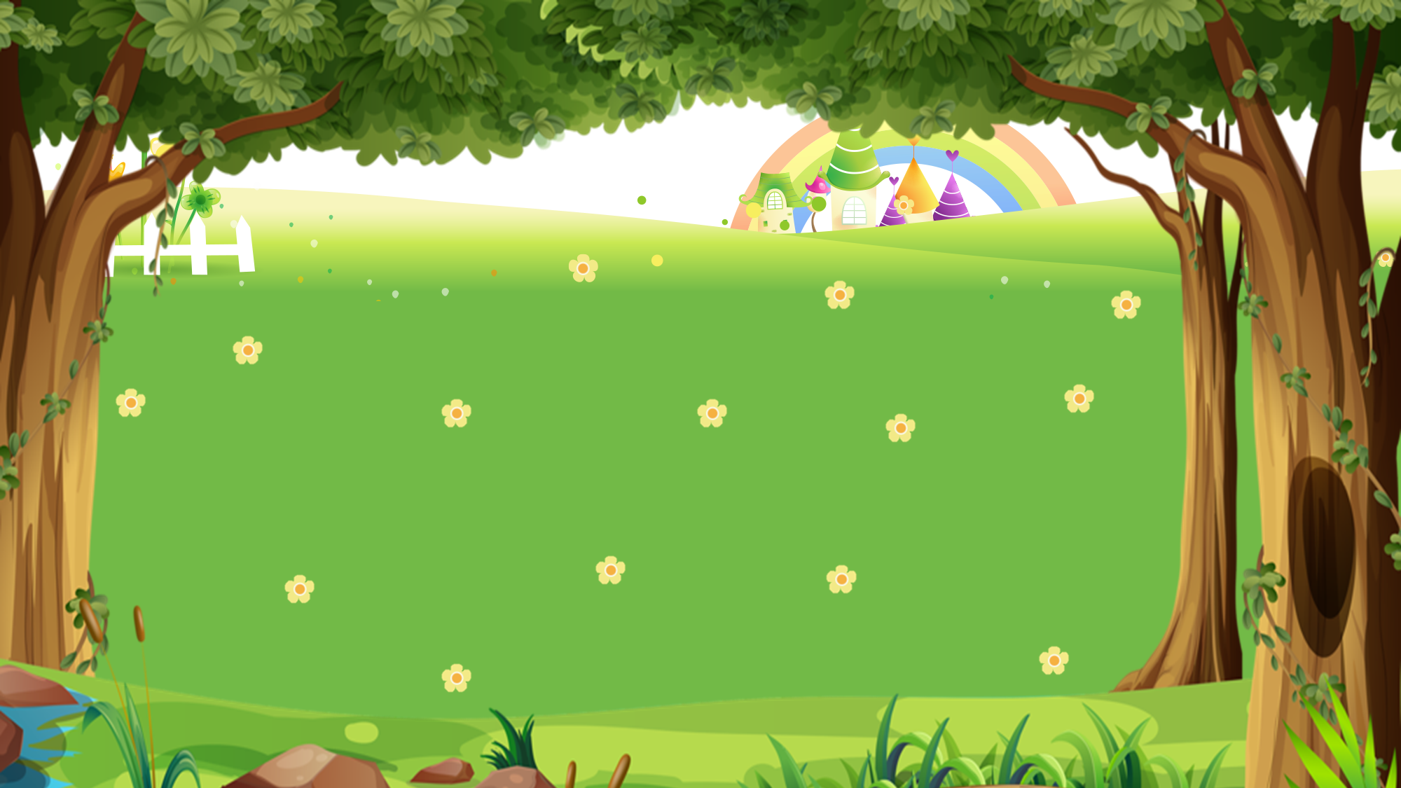

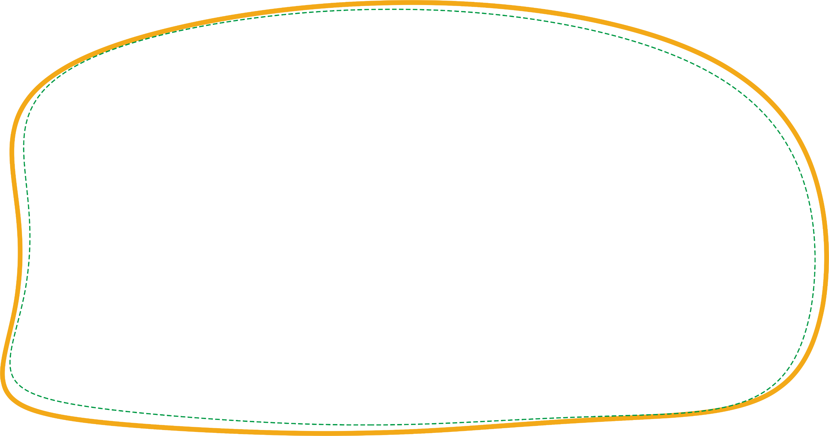
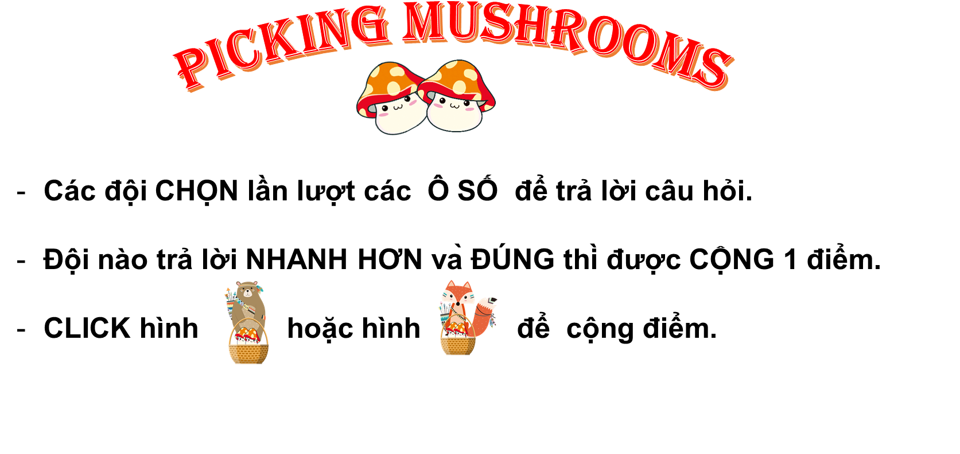


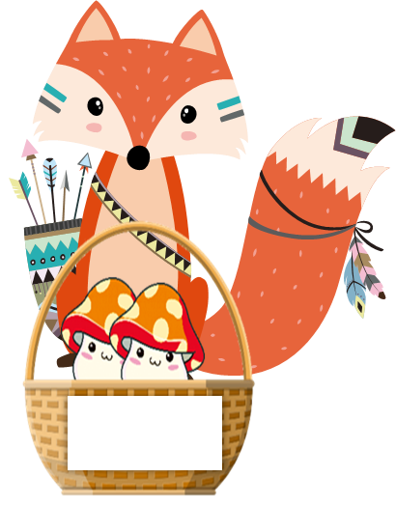




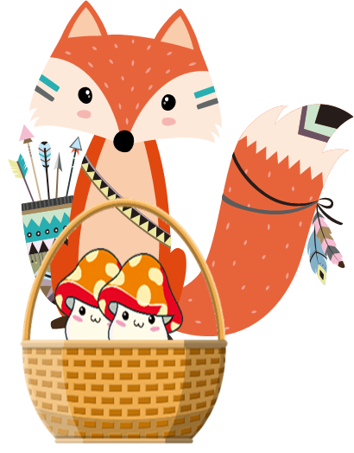

PICKING MUSHROOMS
1
2
3
Các đội CHỌN lần lượt các Ô SỐ để trả lời câu hỏi.
Đội nào trả lời NHANH HƠN và ĐÚNG thì được CỘNG 1 điểm.
CLICK hình hoặc hình để cộng điểm.
4
5
6
7
8
9
10
1
2
3
4
5
6
7
8
9
1
10
2
3
4
5
6
7
8
9
10

Slide 4







Time’s up
1
2
3
4
5
6
7
8
9
10
How did you get there?
A. I went by motorbike.
B. I went to Ha Long Bay.
C. I went swimming.
Back
A.

Slide 5
Time’s up
1
2
3
4
5
6
7
8
9
10
I went by bus.
A. Where did you go on holiday?
B. How did you get there?
C. Where did you do?
Back
A.

Slide 6
Time’s up
1
2
3
4
5
6
7
8
9
10
How did you get there?
_____ coach.
A. I went
B. I went to
C. I went by
Back
A.

Slide 7
Time’s up
1
2
3
4
5
6
7
8
9
10
____ was the trip ___?
It was great.
A. How / like
B. Where / like
C. What / like
Back
A.

Slide 8
Time’s up
1
2
3
4
5
6
7
8
9
10
Where did you go on holiday?
A. I went by bus.
B. I went to Hue Imperial City.
C. I go to Hue Imperial City.
Back
A.

Slide 9
Time’s up
1
2
3
4
5
6
7
8
9
10
Where ____ you go on holiday?
A. do
B. did
C. are
Back
A.

Slide 10
Time’s up
1
2
3
4
5
6
7
8
9
10
How did you get there?
A. I went bike train
B. I went to train
C. I went by train.
Back
A.

Slide 11
Time’s up
1
2
3
4
5
6
7
8
9
10
How did you get there?
A. To taxi
B. By taxi
C. Go taxi
Back
A.

Slide 12
Time’s up
1
2
3
4
5
6
7
8
9
10
______ did you do on holiday?
I went to Ho Chi Minh City.
A. What
B. Where
C. How
Back
A.

Slide 13
Time’s up
1
2
3
4
5
6
7
8
9
10
It was really wonderful.
A. Where di you go?
B. How did you get there?
C. What was the trip like?
Back
A.

Slide 14
PRONUNCIATION

Slide 15
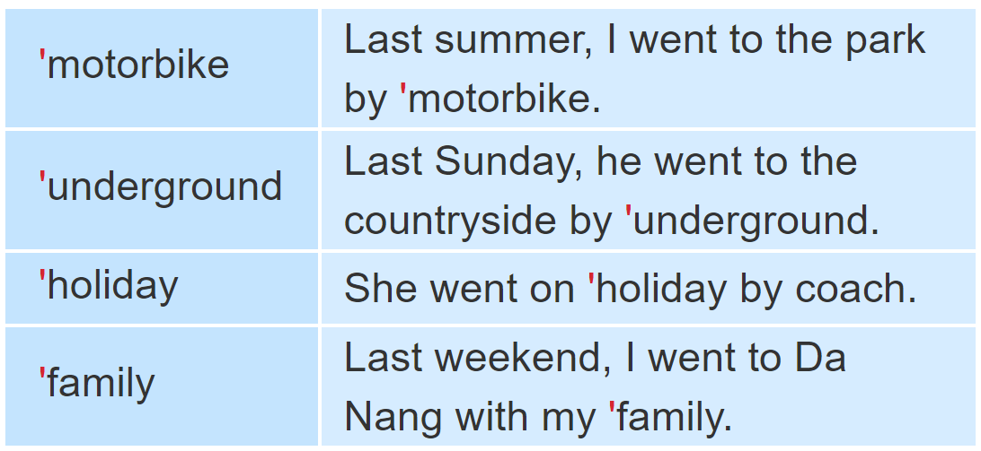
1. Listen and repeat

Slide 16
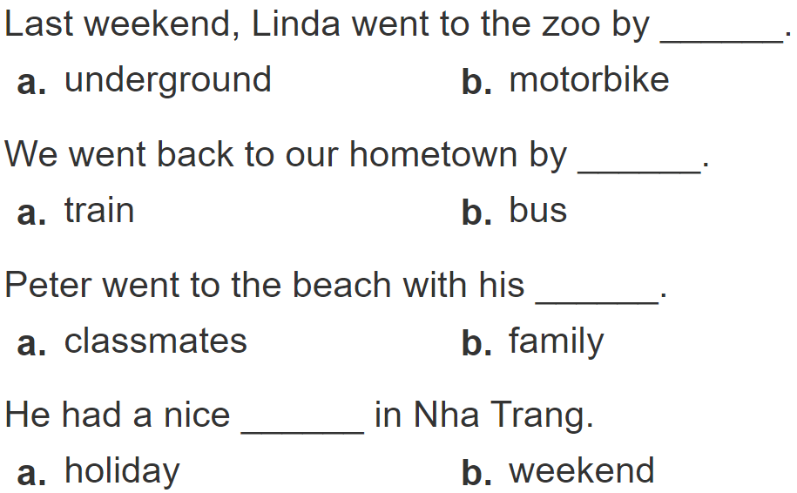
2.
Listen and circle a or b. Then say the sentences aloud.
1
2
3
4

Slide 17
PRACTISE

Slide 18
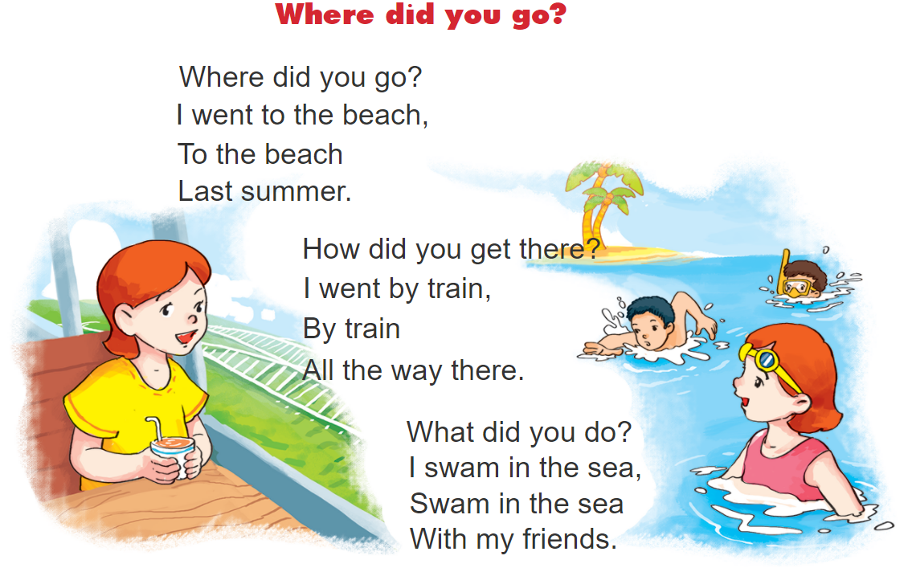


3. Let’s chant.

Slide 19
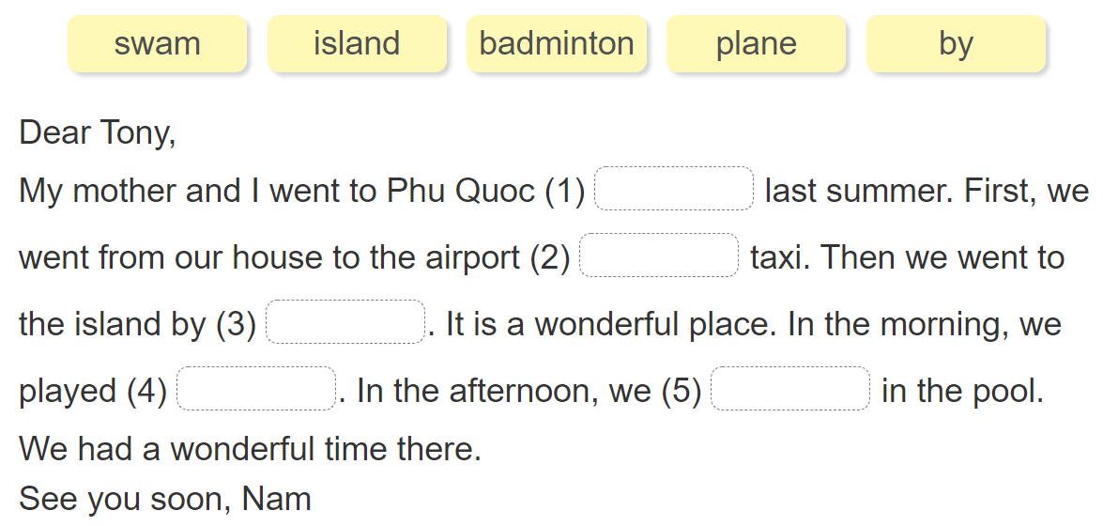
4. Read and complete.

Slide 20
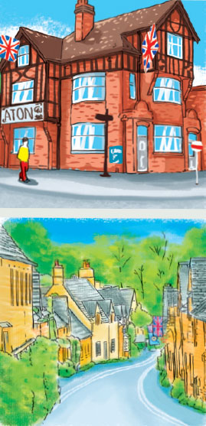
5. Write about your day.
Dear Mai, I went back to my hometown to visit my grandparents last weekend. They live in the north of England. I went to King's Cross railway station by underground. Then I took a train to my hometown. I like going by train because I can enjoy the beautiful views on the way. I walked from the train station to my grandparents' house. I had a wonderful time in my hometown. Love, Linda
1.Where's Linda's hometown?
______________________.
2.How did she get to King's Cross railway station?
______________________.
3.How did she get to her hometown?
______________________.
4.Why does she like going by train?
______________________.
5.Did she have a good time in her hometown?
______________________.
It's in the north of England.
She got there by underground.
She got there by train.
Because she can enjoy the beautiful views on the way.
Yes, she did.

Slide 21









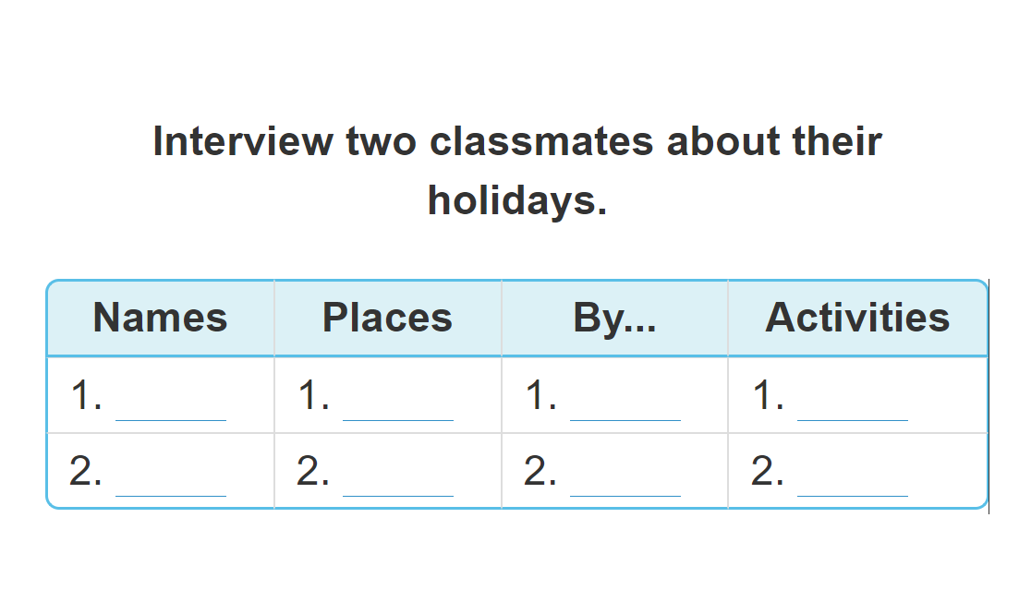
6. Project.

Slide 22
7. Colour the stars.
Now I can...
• ask and answer questions about past holidays and means of transport.
• listen to and understand texts about past holidays and means of transport.
• read and understand texts about past holidays and means of transport.
• write about someone's past holiday.

Slide 23



THANK YOU!
Welcome to join with me!
MsPham Powerpoint
Mspham

